Slide 1

APRIL 2024
Joint Lab
Meeting
Christina Surace and Johanyx Rodriguez

Slide 2
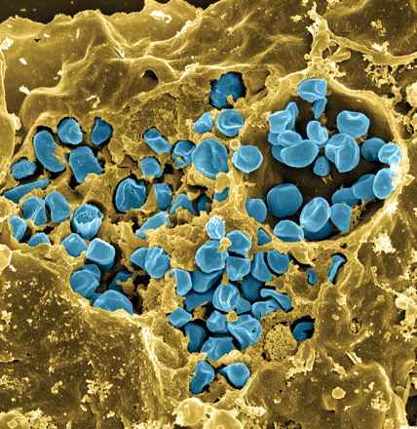
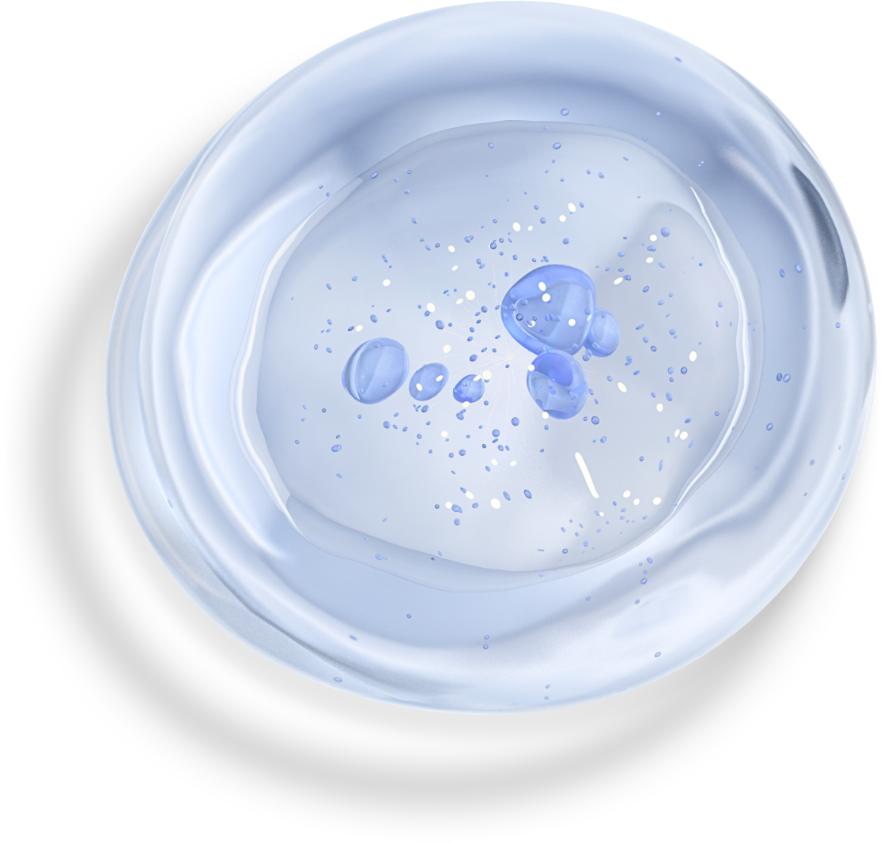
Introduction
Francisella tularensis
  Tularemia
  Potential bioweapon
  Live Vaccine Strain (LVS)
Fischer, PNAS cover 2006

Slide 3
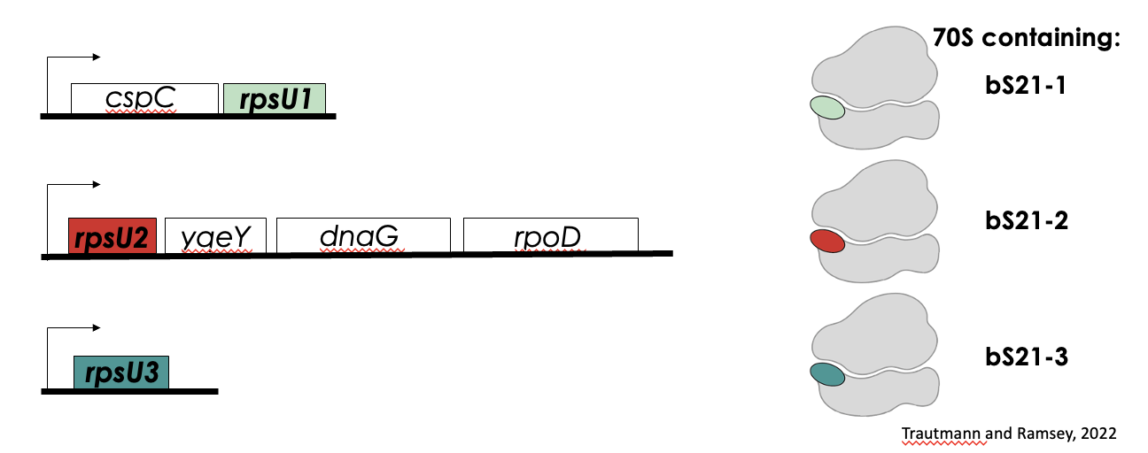
Heterogeneous ribosomes in F. tularensis

Slide 4
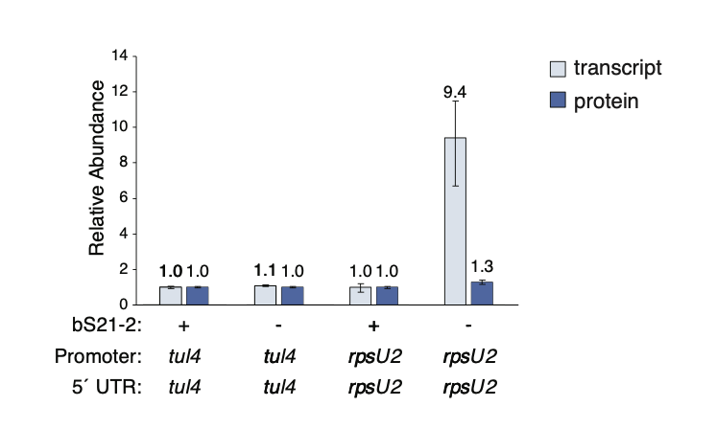
bS21-2 represses rpsU2 transcript abundance
Why don’t changes in transcript level correspond to changes in protein abundance?

Slide 5
Making a mutant to investigate bS21-2 regulation
Hypothesis: There is a factor limiting translation of transcripts with the rpsU2 5’ UTR.
Goal: Find mutants with more translation of these transcripts.
Plan: Make a strain of LVS where rpsU2 is replaced with gfp
  Cells lack bS21-2
  High transcription of gfp
  Protein should be relatively low – corresponding to low fluorescence
Mutagenize the strain to find cells with high fluorescence
  Removal of translation inhibitors

Slide 6
Introduction
Francisella tularensis
  Tularemia
  Potential bioweapon
  Live Vaccine Strain (LVS)
Fischer, PNAS cover 2006

Slide 7
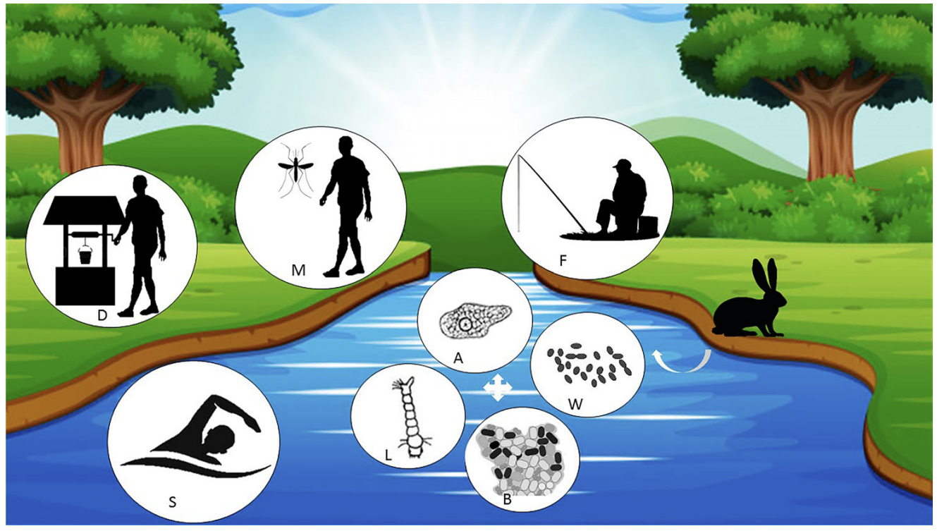
F. Tularensis in Freshwater

Slide 8
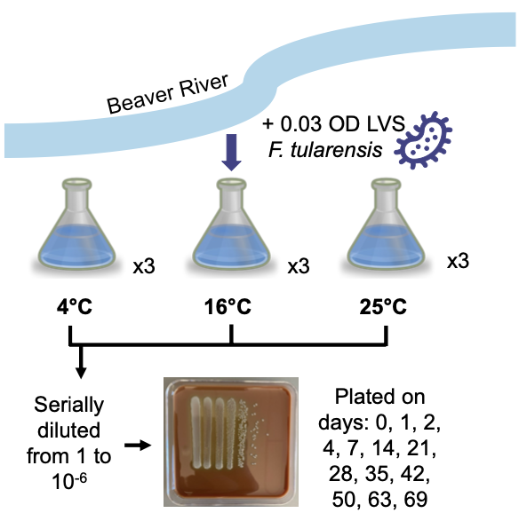
  What are genetic requirements for survival of F. tularensis in freshwater?
Macaraeg, Spring 2023
Macaraeg, Spring 2023

Slide 9
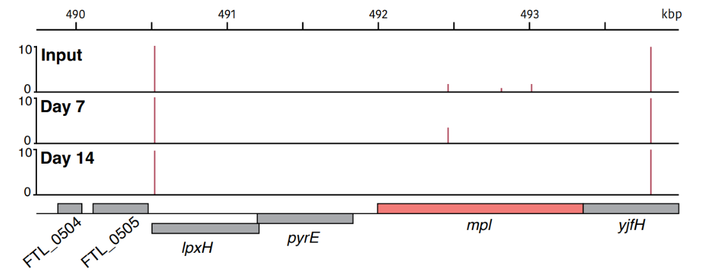
Gene mpl is important for F. tularensis to survive in model system
Macaraeg, Spring 2023

Slide 10
Johanyx’s Question
  Can we validate that the gene mpl is necessary for the survival of F. tularensis in freshwater?
  Make a strain of LVS that lacks the gene mpl

Slide 11
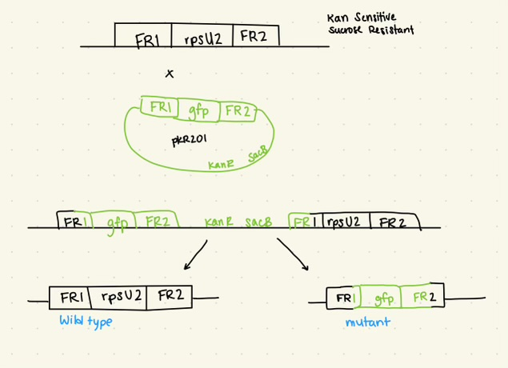
Allelic Exchange (Christina)
Select for secondary recombination event

Slide 12
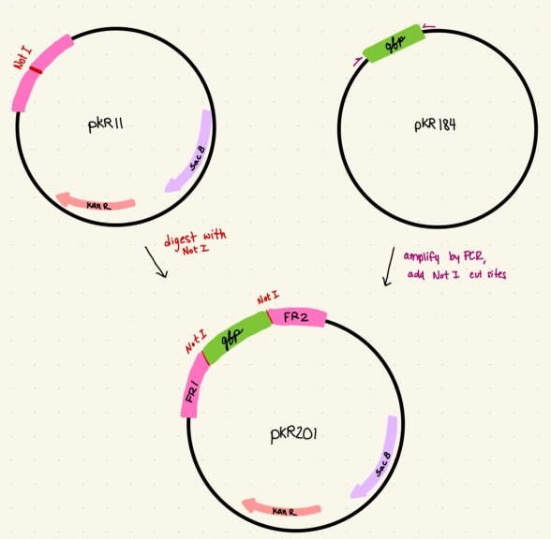
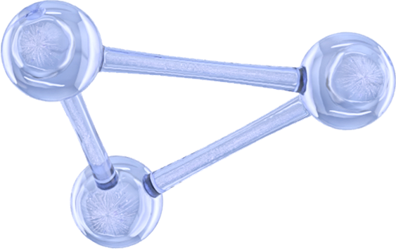
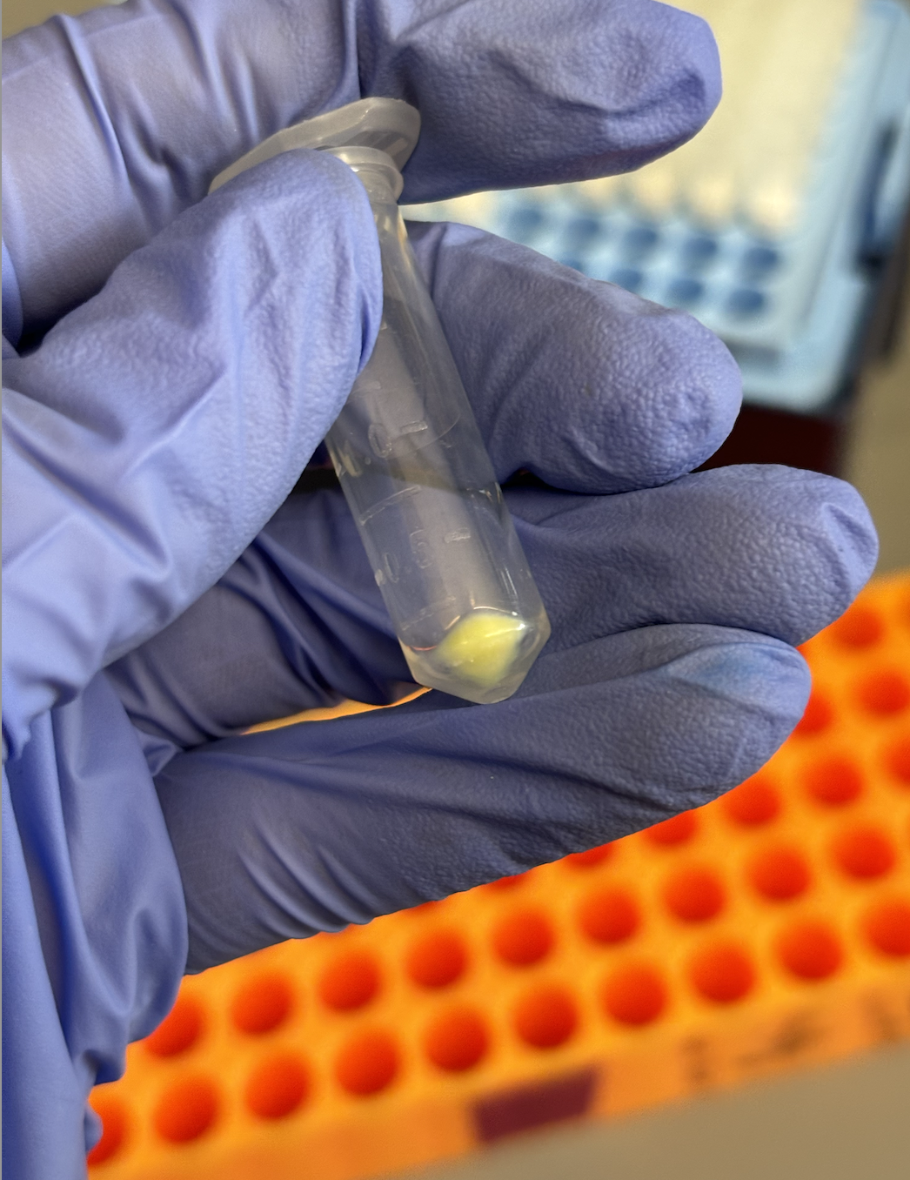
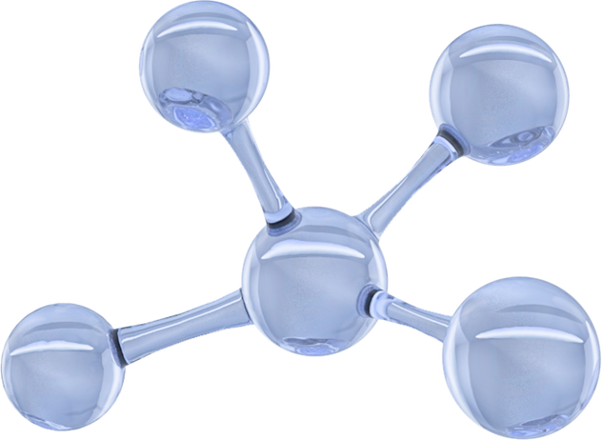
Christina’s Plasmid

Slide 13
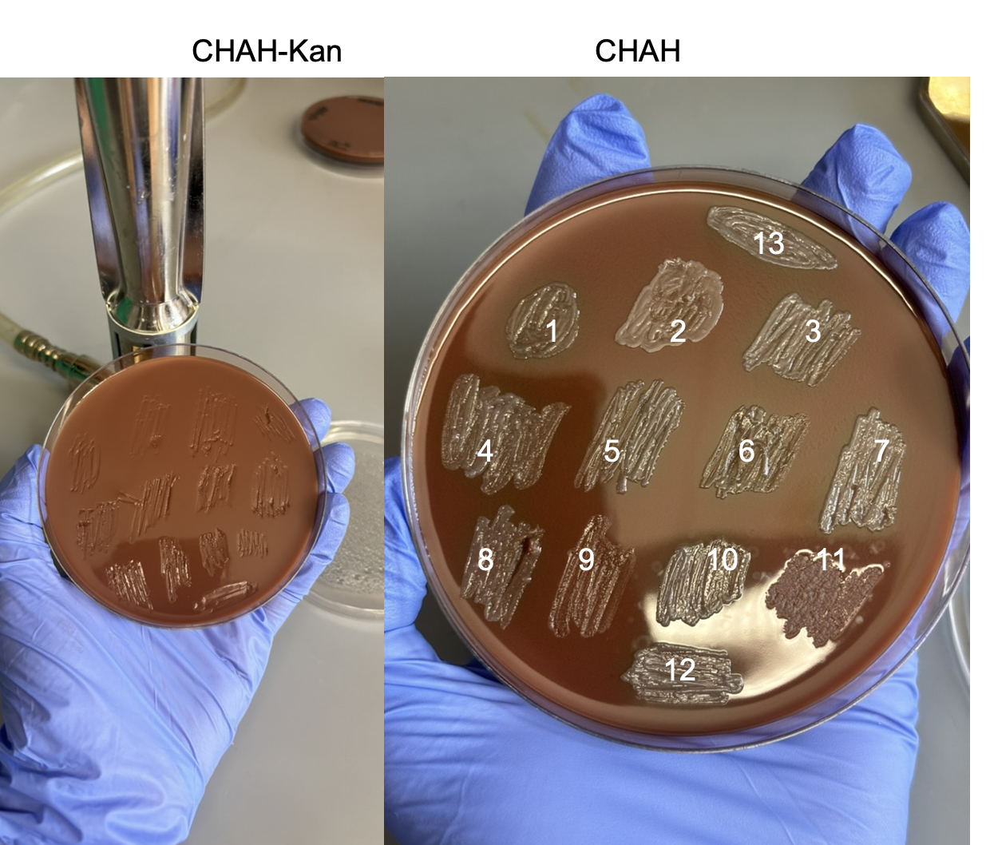
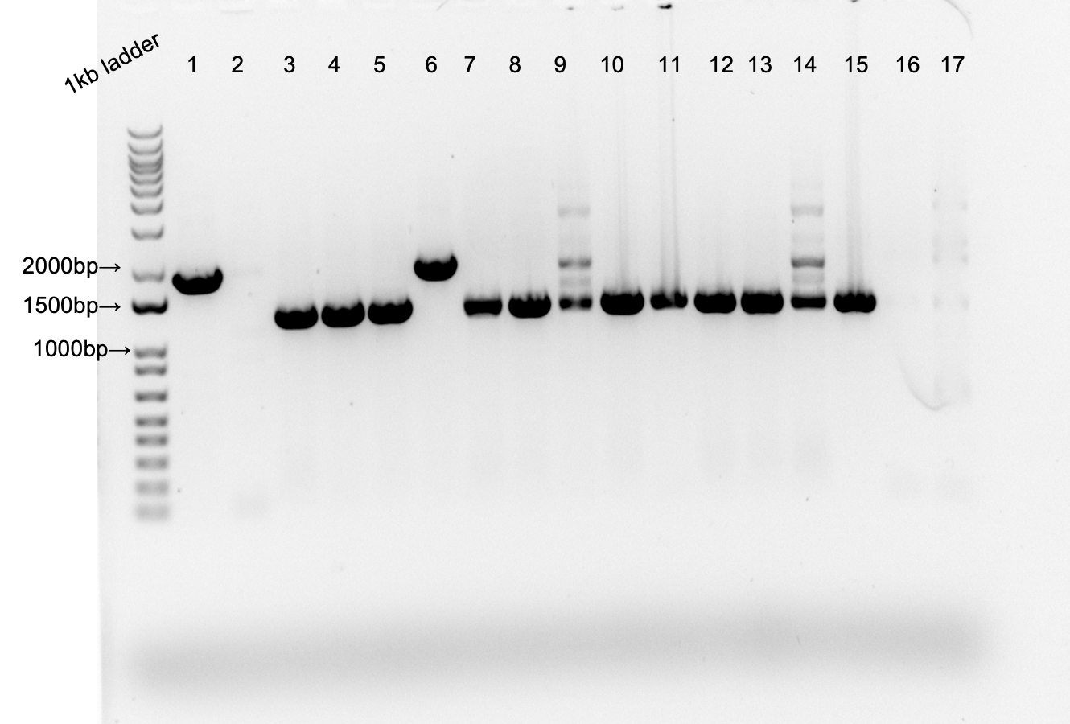
Allelic Exchange (Christina)

Slide 14
Christina’s Next Steps
Transposon mutagenesis
  Select for cells that are more green
  Sequence and identify factors inhibiting translation of rpsU2 operon

Slide 15
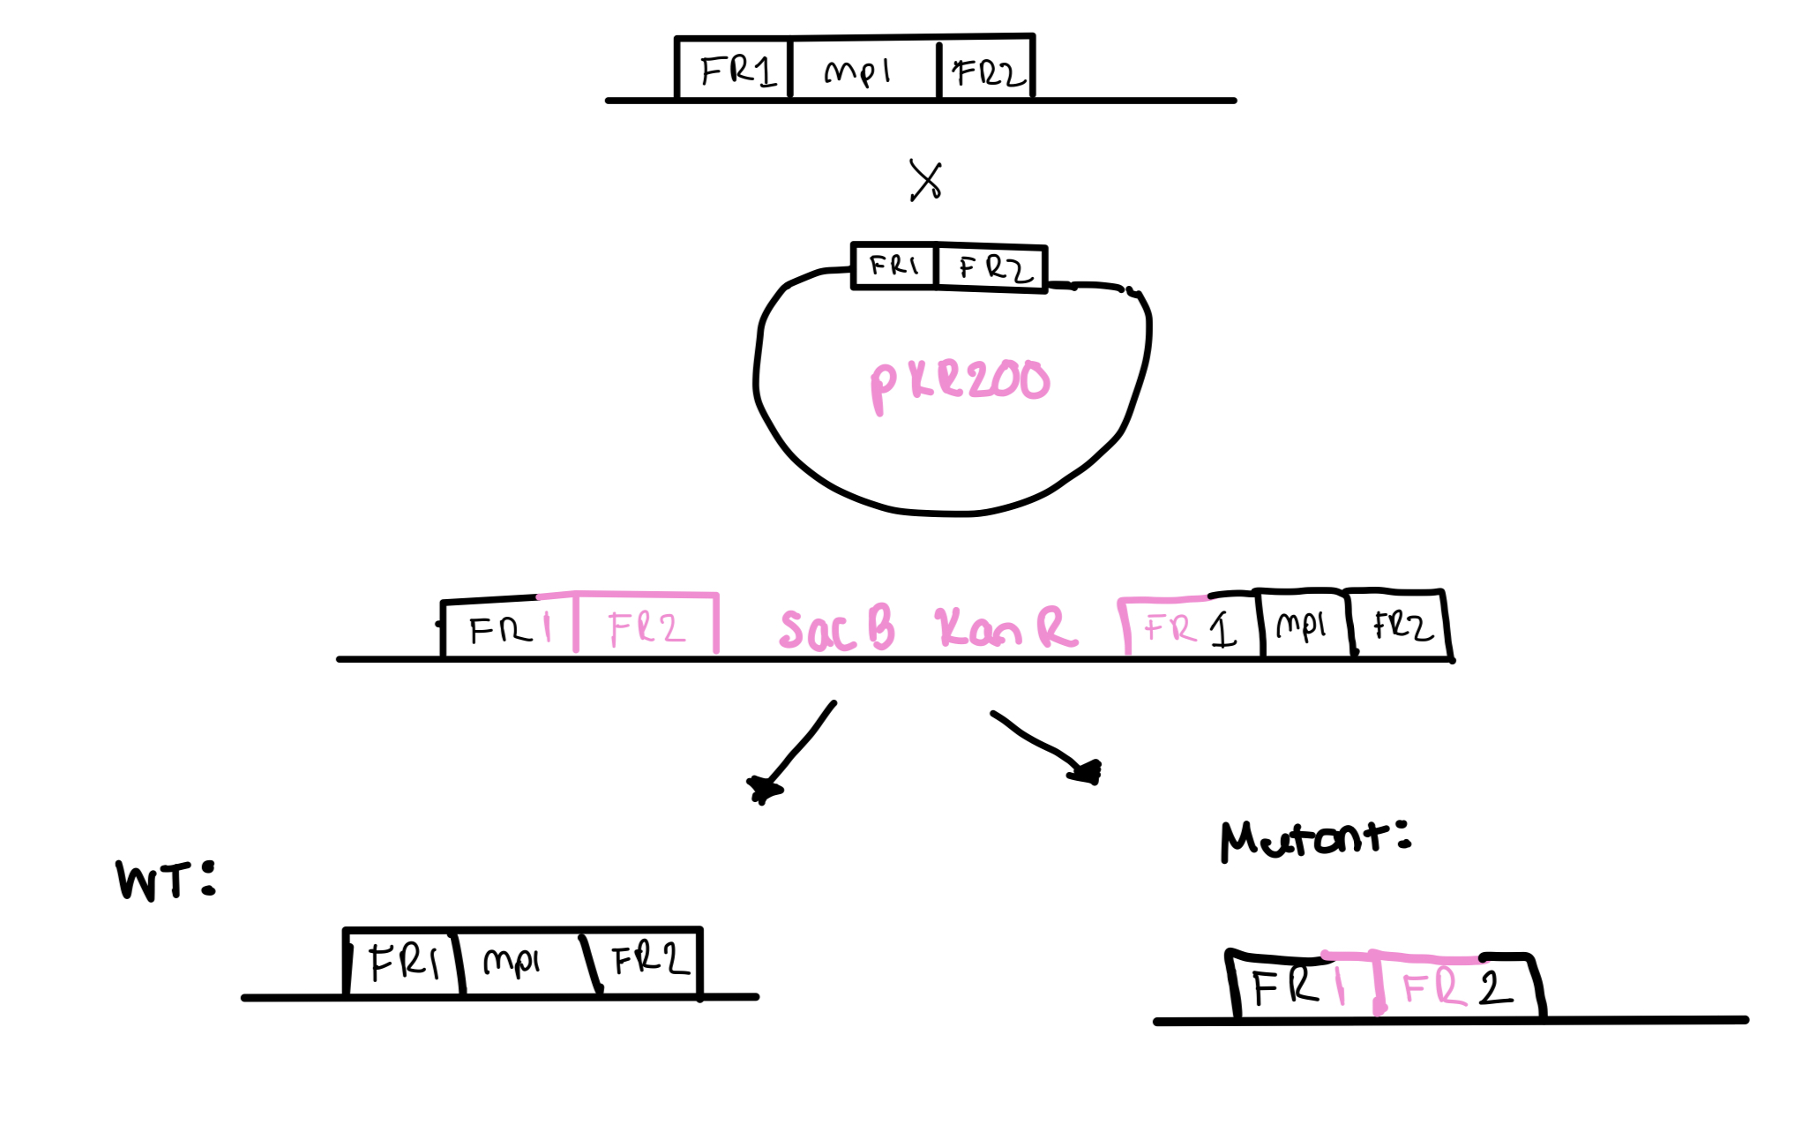
Allelic Exchange

Slide 16
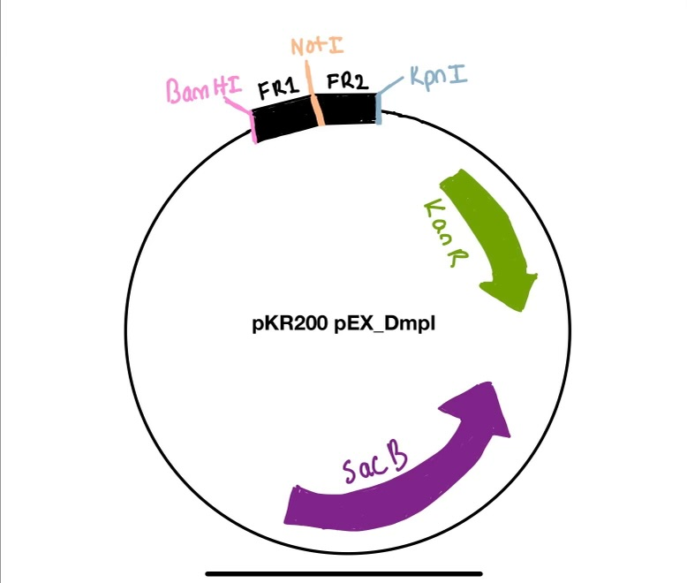
Johanyx’s Plasmid

Slide 17
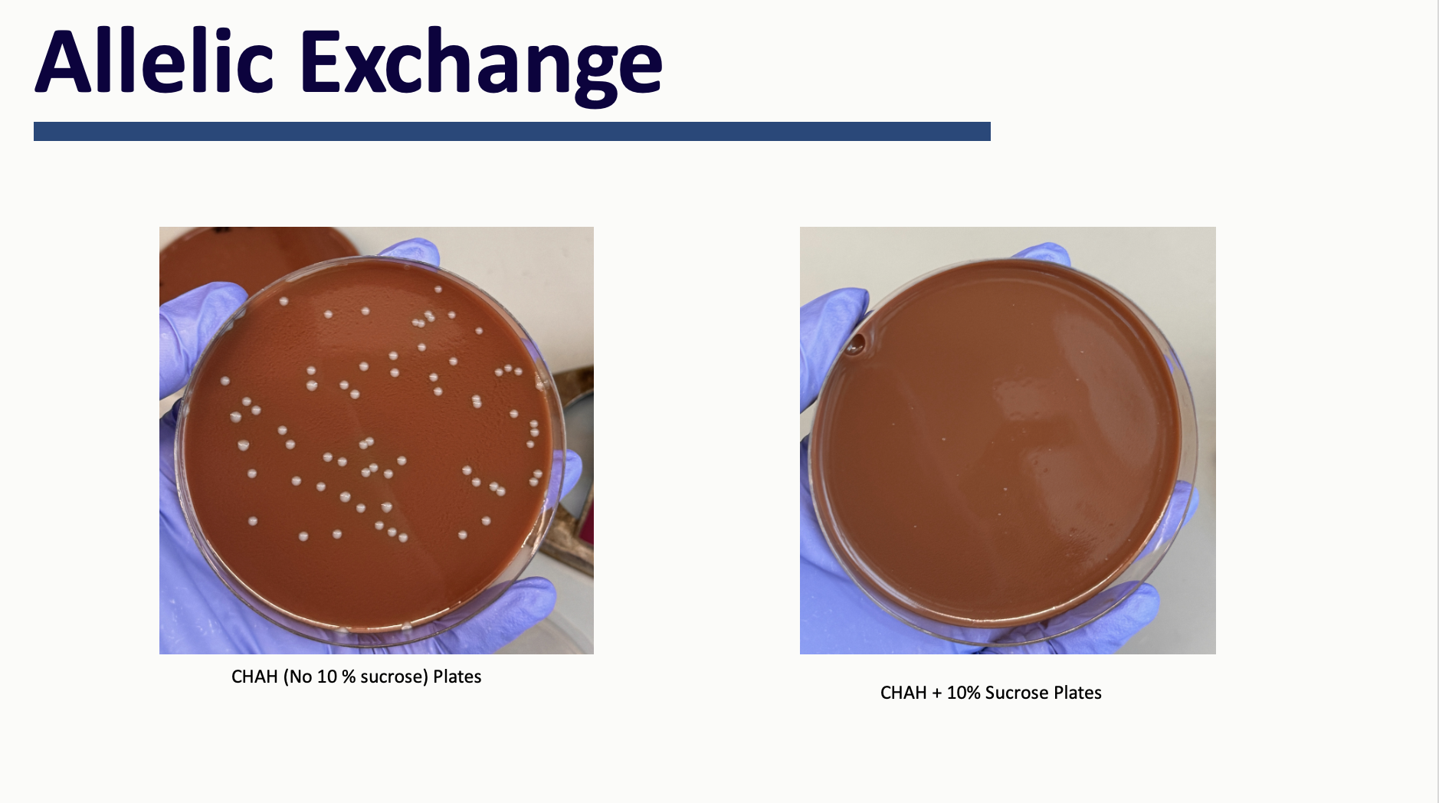

Slide 18
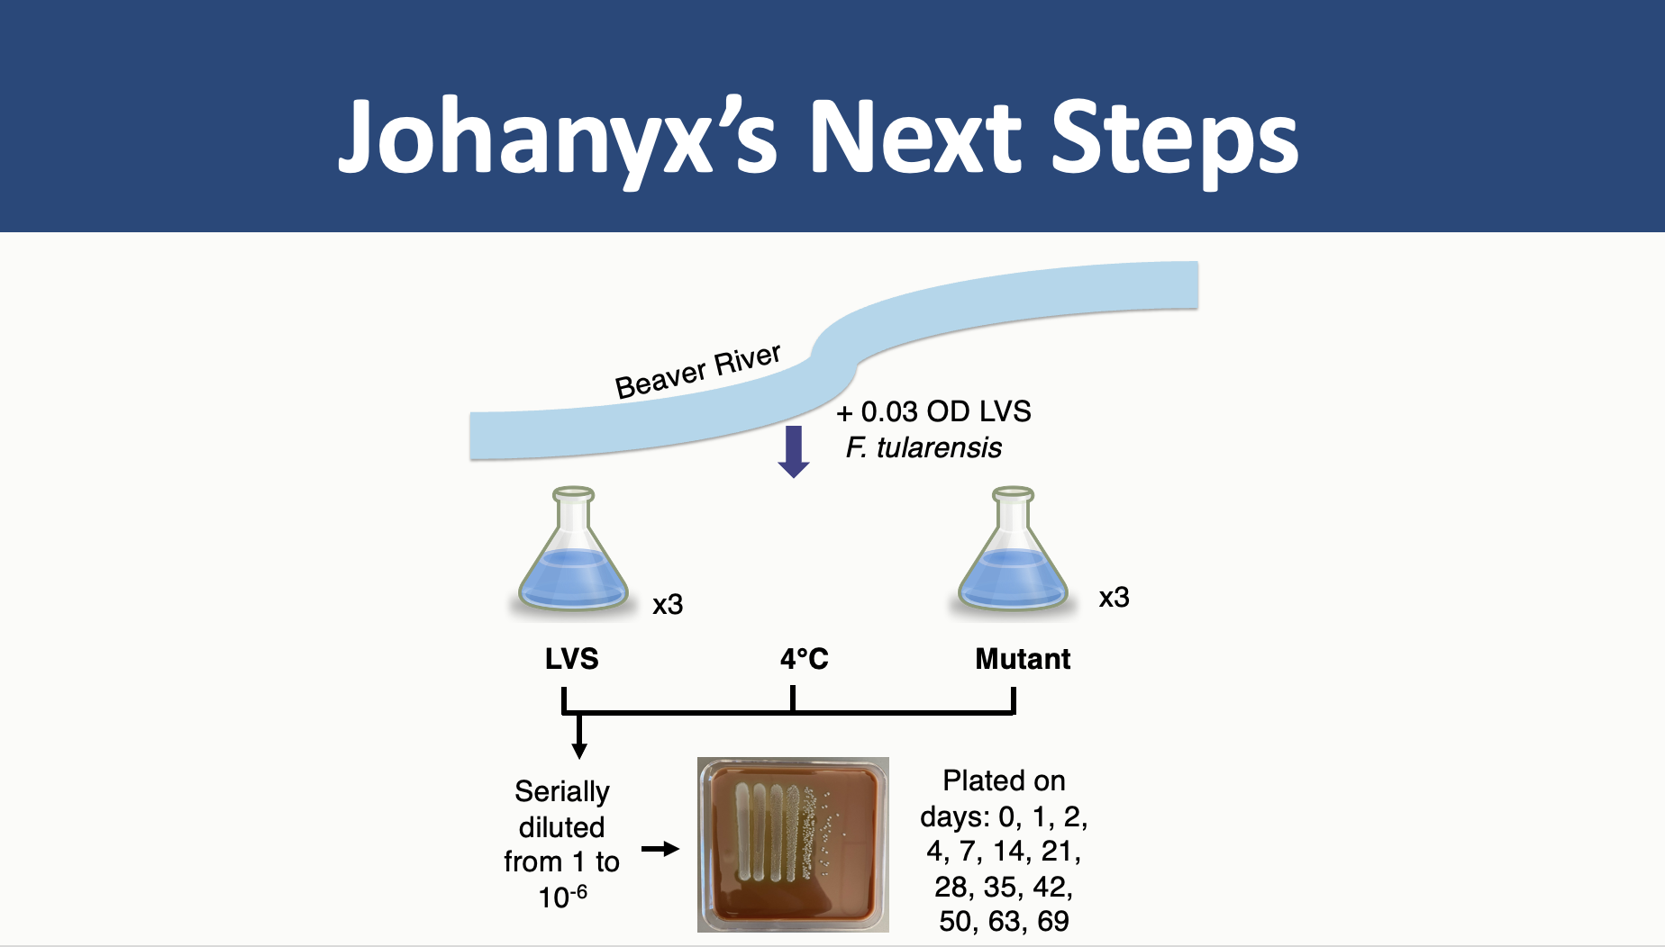
Macaraeg, Spring 2023

Slide 19
Johanyx’s Next Steps
∆mpl
?
Macaraeg, Spring 2023

Slide 20



Acknowledgements
The Ramsey Lab
  Dr. Kathryn Ramsey
  Kira Bernabe
  Ben Moore
  Alex Farah
  Aisling Macreg

