Slide 1


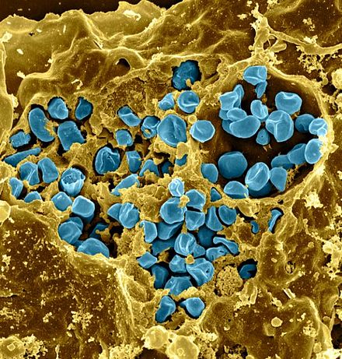
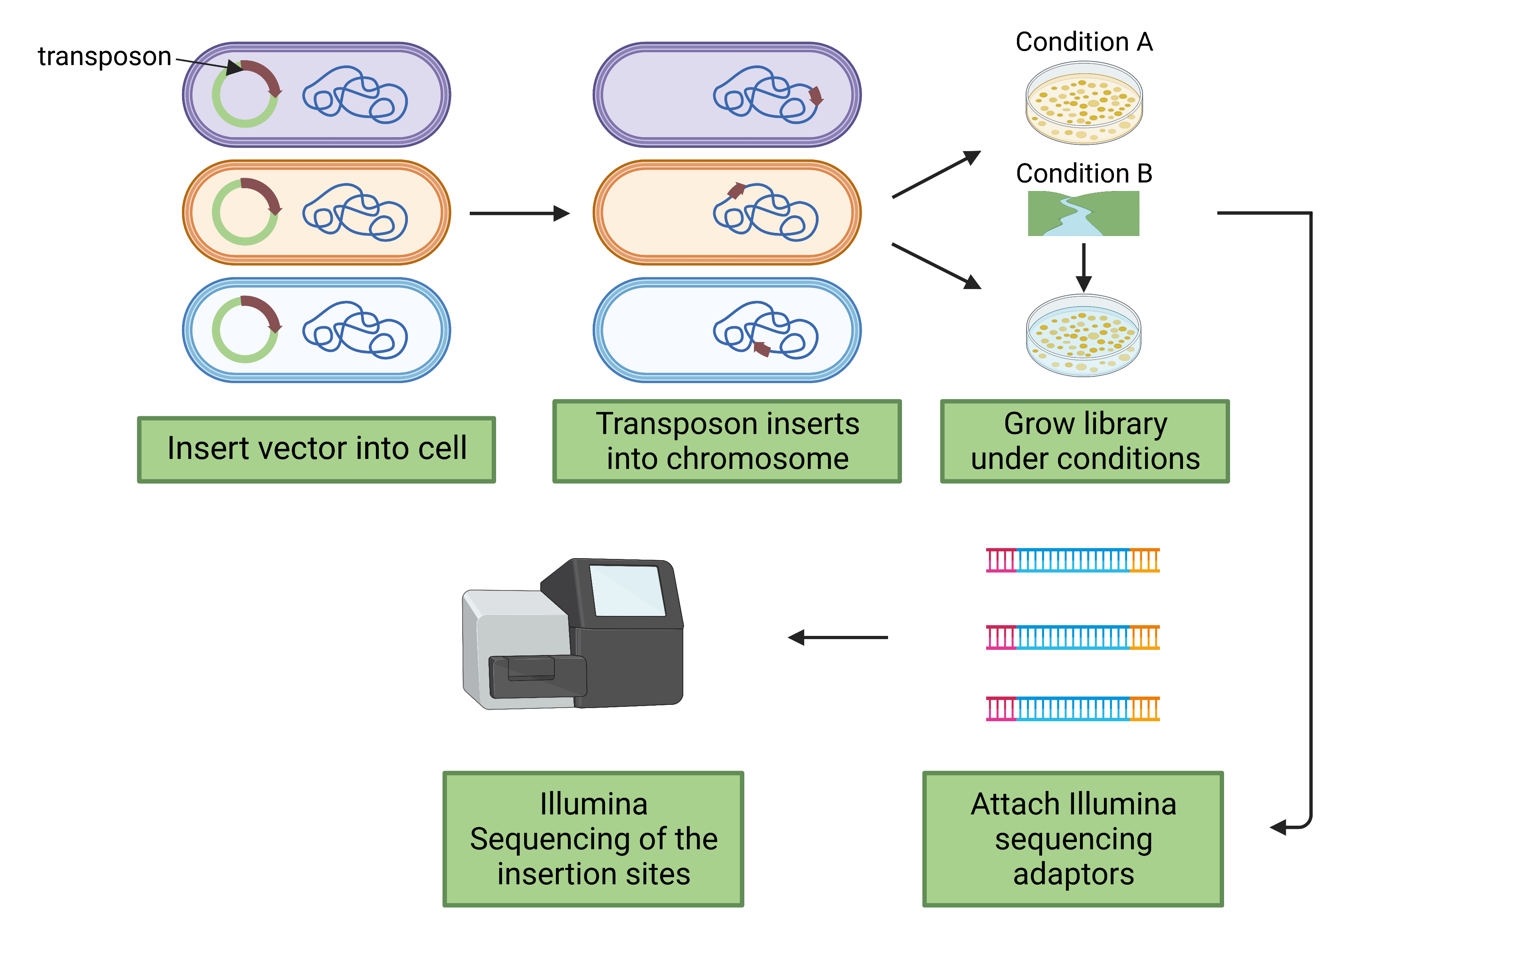


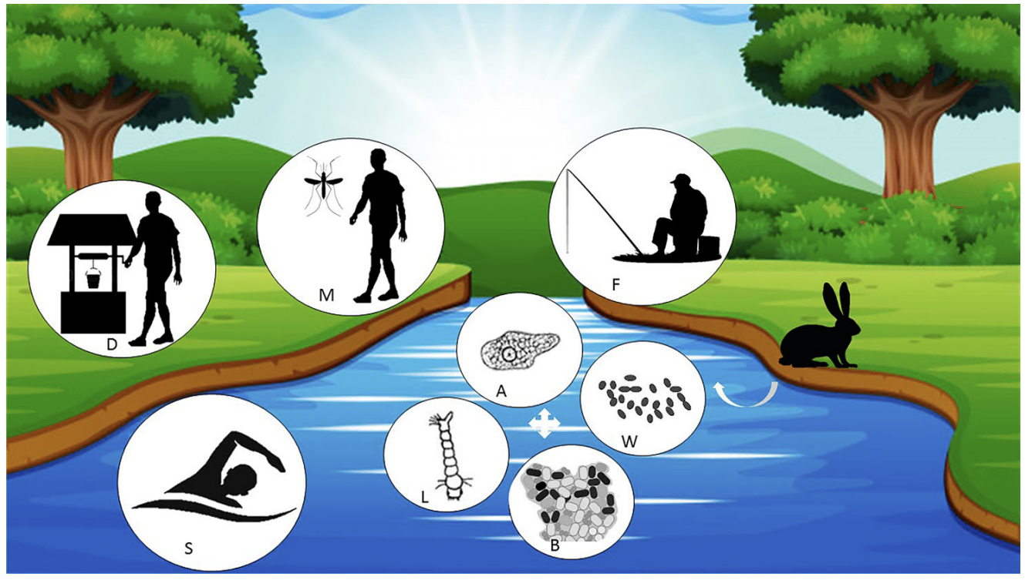
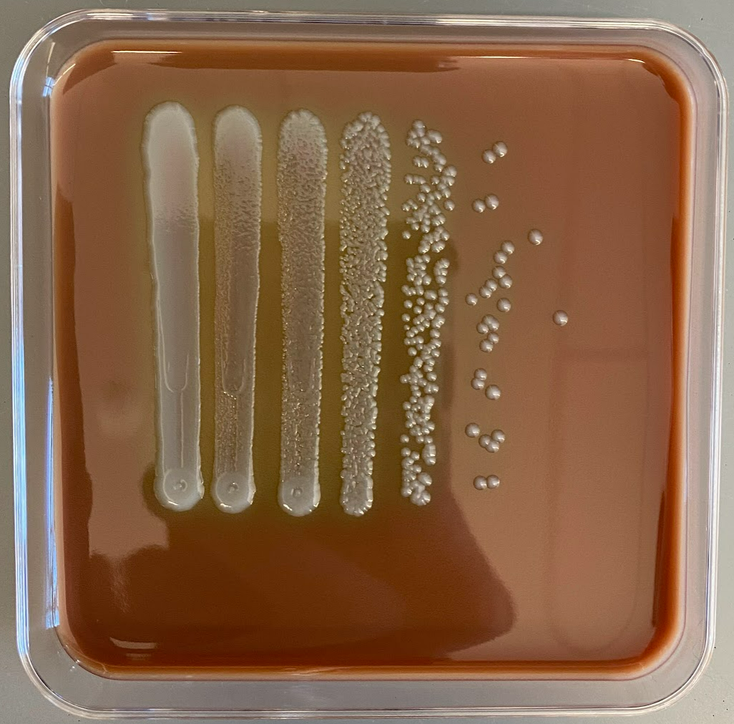
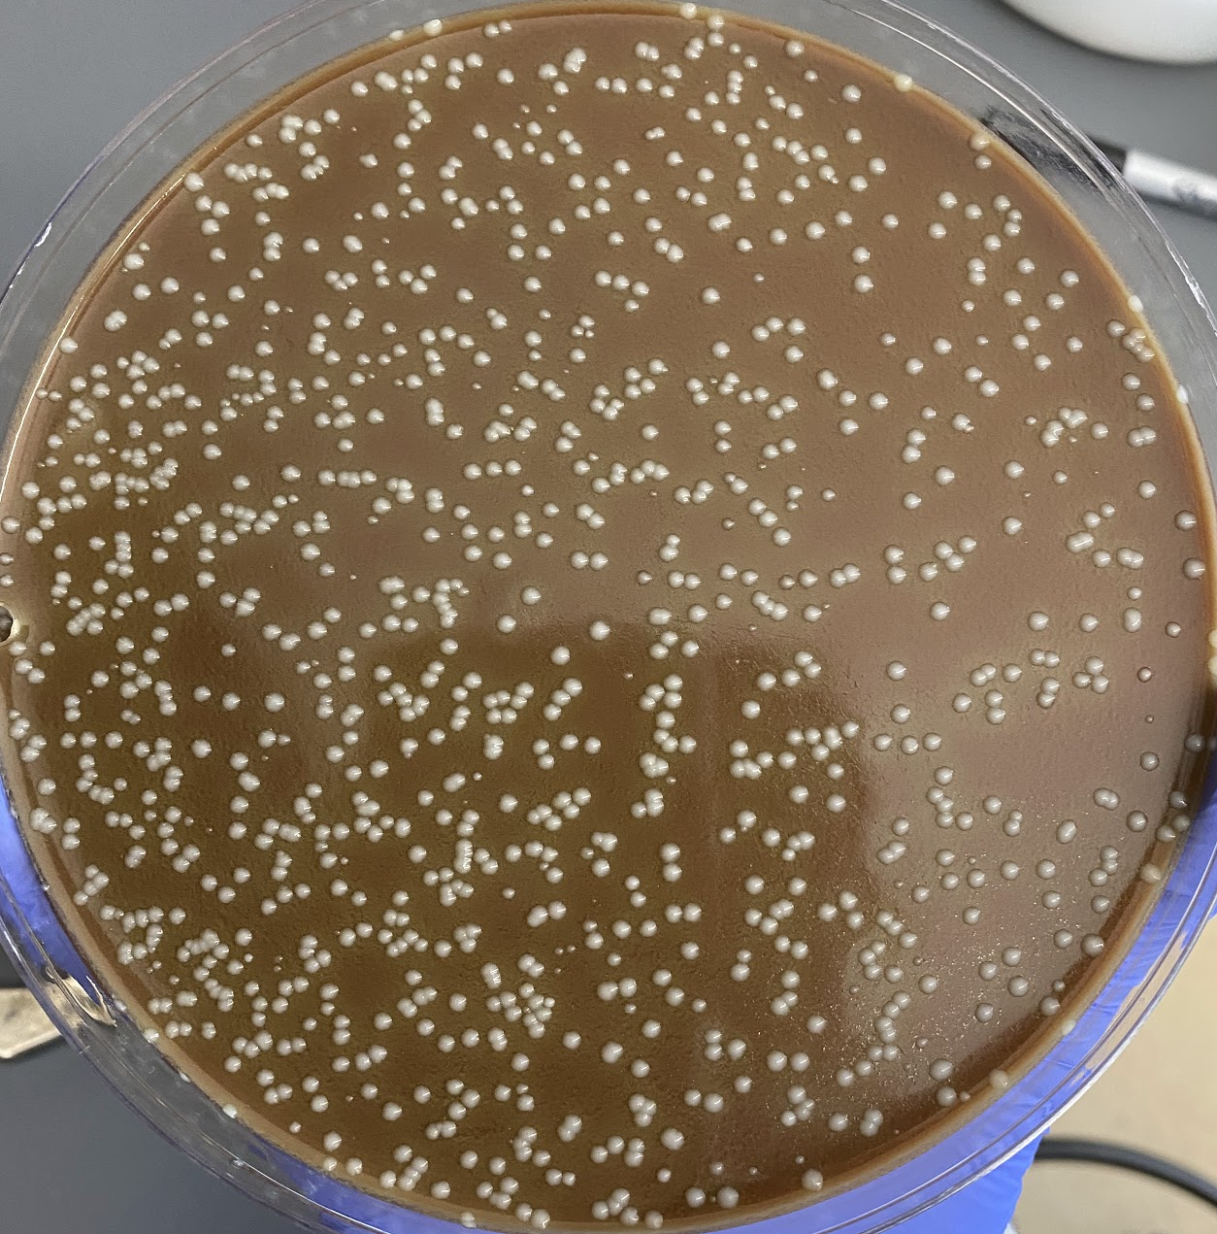
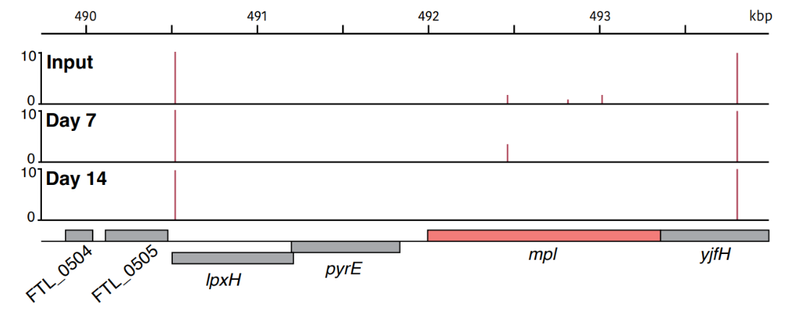
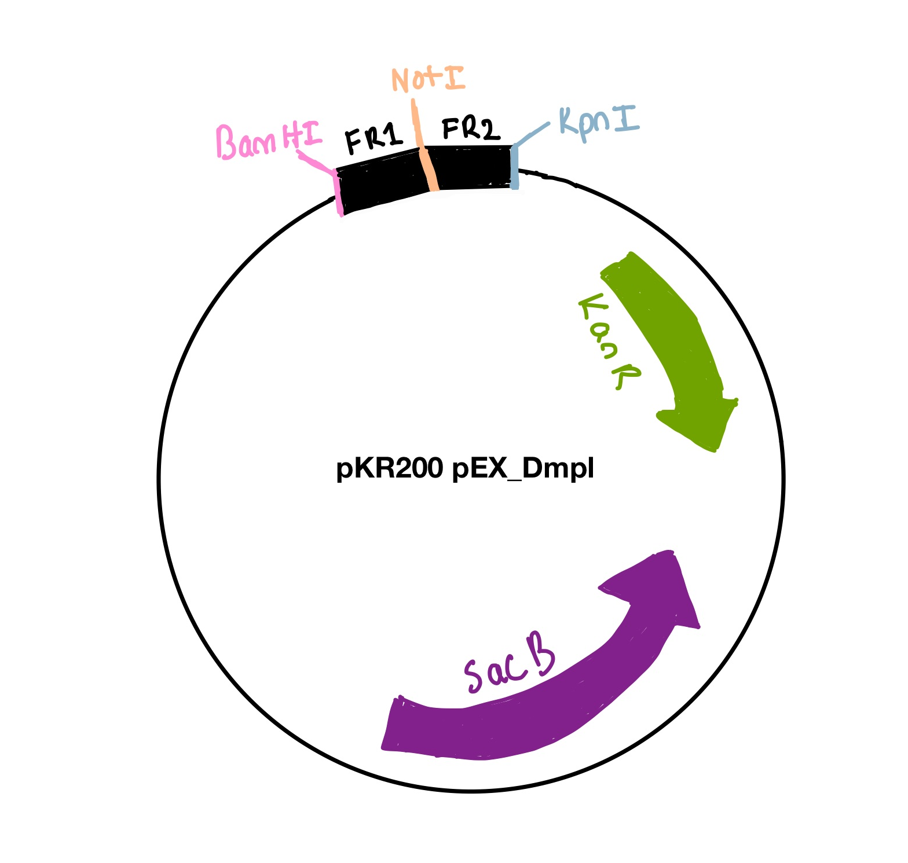
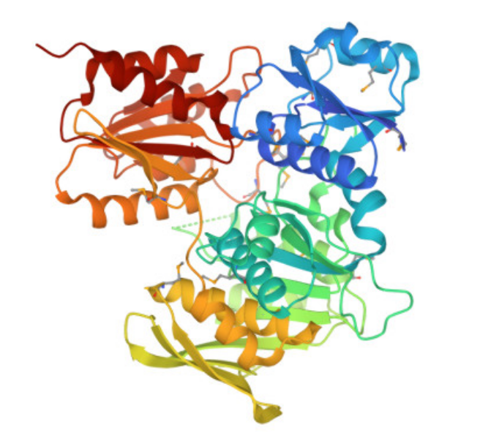
Determining the genetic requirements for Francisella tularensis survival in freshwater
Aisling Macaraeg¹, Johanyx Rodriguez¹, Kira Bernabe¹, Hannah Trautmann¹,
Sierra Schmidt¹, and Kathryn Ramsey¹
¹Department of Cell and Molecular Biology, University of Rhode Island
1
Introduction
2
Freshwater Survival Assay
3
Transposon Insertion Sequencing
Francisella tularensis
  Gram-negative, pathogenic bacterium
  Causes the disease tularemia
F. tularensis can survive in freshwater for long periods of time and subsequently infect animals and humans⁴
A gene has been found that is important during the transition between the host and aquatic environment ⁷
Figure 3. Workflow for Cell Viability. Freshwater was collected from the Beaver River, Rhode Island. The water was filter sterilized and inoculated with F. tularensis LVS. The initial inoculum was distributed to nine flasks, three of each were placed at three different temperatures: 4°C, 16 °C, and 25 °C. Samples were serially diluted and plated over a period of 10 weeks.
Beaver River
+ 0.03 OD LVS
F. tularensis
Figure 1: F. tularensis in macrophage.³
x3
x3
x3
Main Question:
4°C
16°C
25°C
What are the genetic requirements for survival of
F. tularensis in freshwater?
Serially diluted from 1 to 10⁻⁶
Plated on days: 0, 1, 2, 4, 7, 14, 21, 28, 35, 42, 50, 63, 69
Figure 2: F. tularensis modes of aquatic transmission.⁶
Figure 4: Workflow of transposon insertion sequencing protocol (modified from ref 1).
4
Creation of a Transposon Mutant Library
6
Transposon Insertion Sequencing Data
F. Tularensis genome: 1,895,944 bp
Number of genes: 2,020
Final Transformation Efficiency: 2.44 x 10³
Estimated number of transposon mutants: ~5,572
Figure 5: Example of transposon mutant library isolated on cysteine heart agar with hemoglobin plate
Library | Transposon Sequencing Reads | Number of Insertions / mutants detected
Input | 377,164 | 5,733
Day 7 | 696,629 | 6,821
Day 14 | 502,258 | 6,168
5
Survival of F. tularensis in Freshwater at 4°C
7
Ongoing Studies
Figure 6: Comparison of F. tularensis survival in river water at 4°C across experiments.
Average CFU per mL recovered at indicated time points for three replicate experiments, with cells incubated at 4°C. The longest survival was 56 days in replicate 2. In orange diamonds, the average CFU per mL after incubating transposon mutant library in freshwater. Indicated timepoints (day 0, 7, 14) are also when gDNA was extracted for transposon insertion sequencing.
Clone a plasmid to modify the F. tularensis genome
Create a strain of F. tularensis that lacks the mpl gene
Determine the relative survival of different mutants in freshwater, potentially validating the importance of mpl to the survival of F. tularensis in a key environmental condition
8
Conclusion and References
F. tularensis can remain viable between 21 and 56 days at 4°C in freshwater
Assessed survival of transposon mutant library after incubation in freshwater kept at 4°C
FTL_0508, mpI, is a candidate for a gene essential for F. tularensis survival in freshwater
  Encodes for Mpl, murein peptide (UDP-N-acetylmuramate:L-alanyl-γ-D-glutamyl-meso-diaminopimelate) ligase
  Important for cell wall synthesis
Acknowledgments
Figure 6: Crystal Structure of Mpl from Psychrobacter arcticus²
References
Chao, M.C., Abel, S., Davis, B.M., and Waldor, M.K. (2016). The design and analysis of transposon insertion sequencing experiments. Nat Rev Microbiol 14, 119-128.
Das, D., Hervé, M., Feuerhelm, J., Farr, C.L., et al. (2011). Structure and function of the first full-length murein peptide ligase (Mpl) cell wall recycling protein. PLoS One 6, e17624.
Fischer. (2006). Cover image. 103(39)
Golovliov, I., Bäckman, S., Granberg, M., et al. (2021). Long-Term Survival of Virulent Tularemia Pathogens outside a Host in Conditions That Mimic Natural Aquatic Environments. Appl Environ Microbiol 87, 2713.
Goodman, A.L., Wu, M., and Gordon, J.I. (2011). Identifying microbial fitness determinants by insertion sequencing using genome-wide transposon mutant libraries. Nat Protoc 6, 1969-1980.
Hennebique, A., Boisset, S., and Maurin, M. (2019). Tularemia as a waterborne disease: a review. Emerg Microbes Infect 8, 1027-1042.
Williamson, D.R., Dewan, K.K., Patel, T., Wastella, C.M., Ning, G., and Kirimanjeswara, G.S. (2018). A Single Mechanosensitive Channel Protects Francisella tularensis subsp. holarctica from Hypoosmotic Shock and Promotes Survival in the Aquatic Environment. Appl Environ Microbiol 84, 2203.
We would like to thank the Ramsey lab as well as the Gregory Lab for productive joint lab discussions. We would also like to thank the Jenkins and Nelson labs for use of incubator and benchtop space. A big thank you to Janet, with all of her advice and help throughout the entirety of this project! Research reported in this presentation was supported by the Rhode Island Institutional Development Award (IDeA) Network of Biomedical Research Excellence from the National Institute of General Medical Sciences of the National Institutes of Health under grant number P20GM103430 and by the URI MARC U*STAR grant from the National Institute of General Medical Sciences of the National Institutes of Health under grant number T34GM131948.

