Slide 1


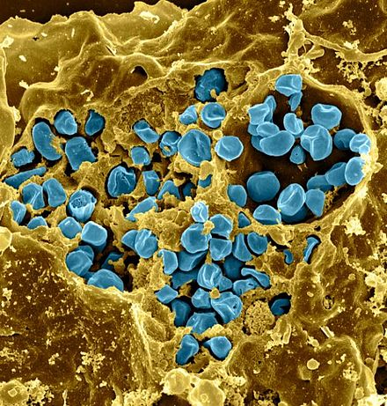
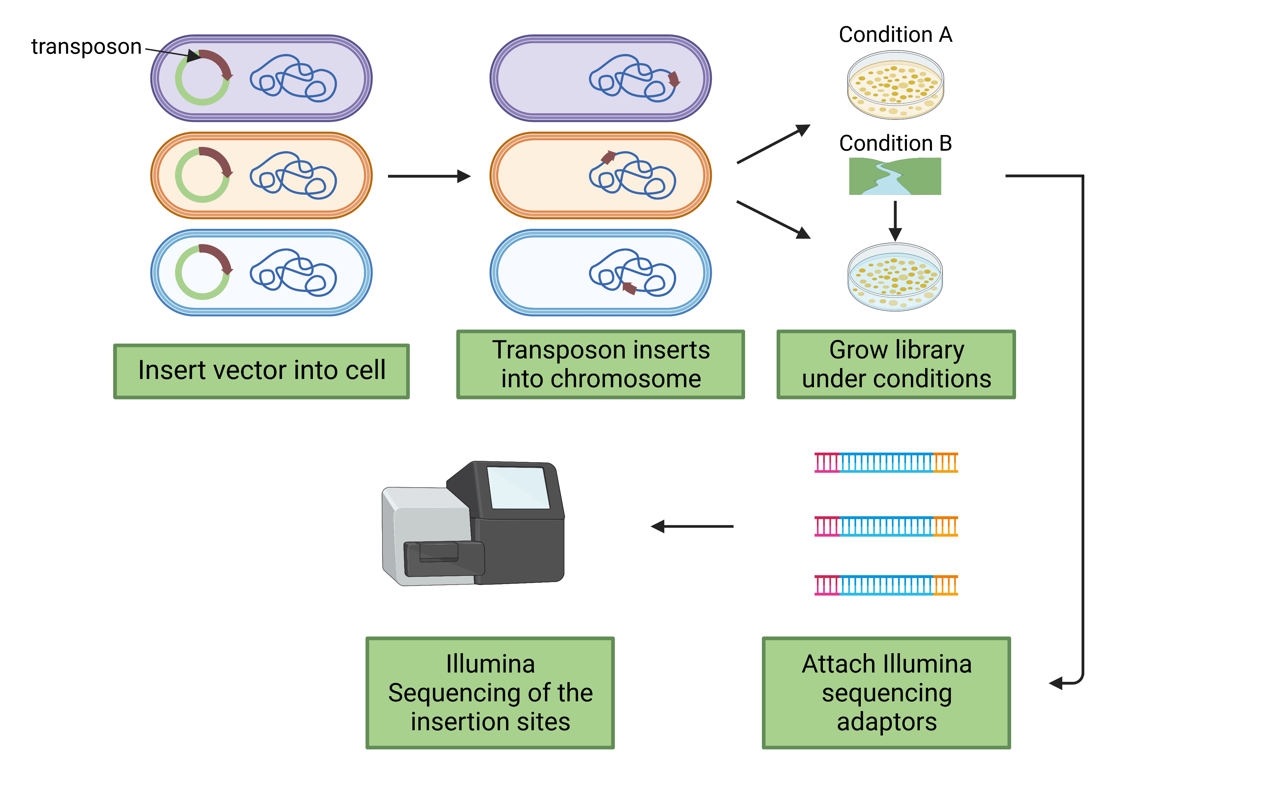


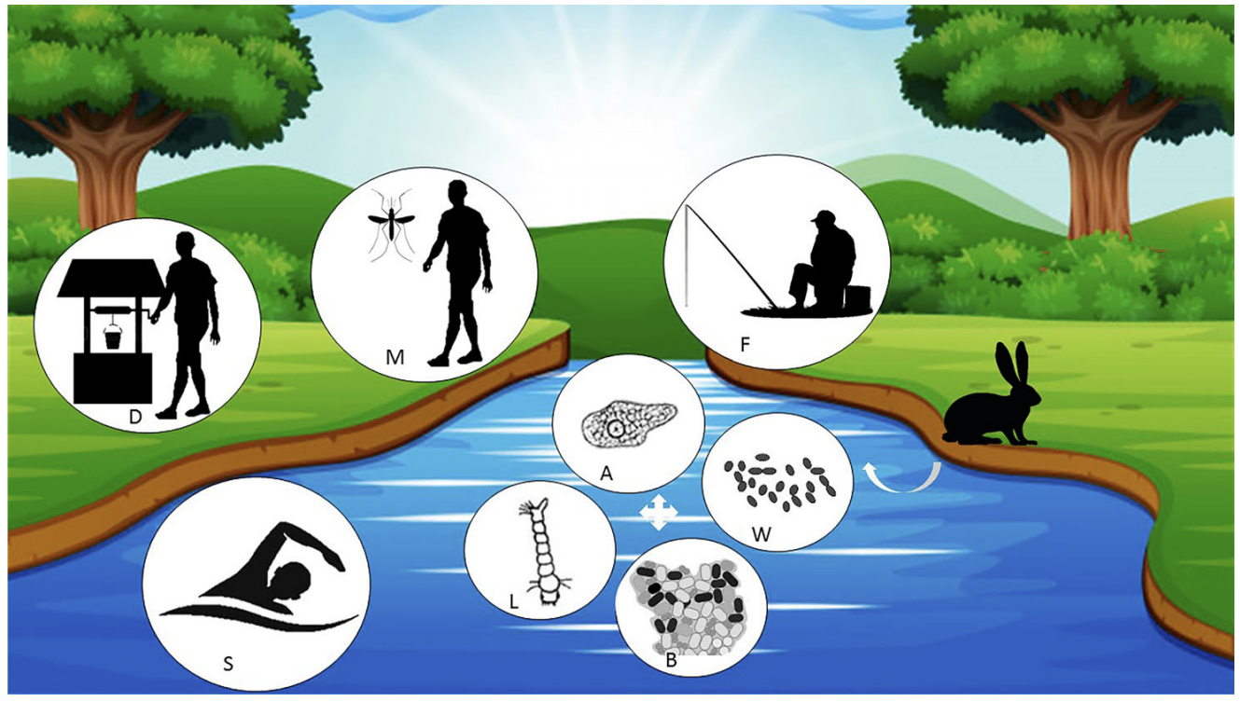
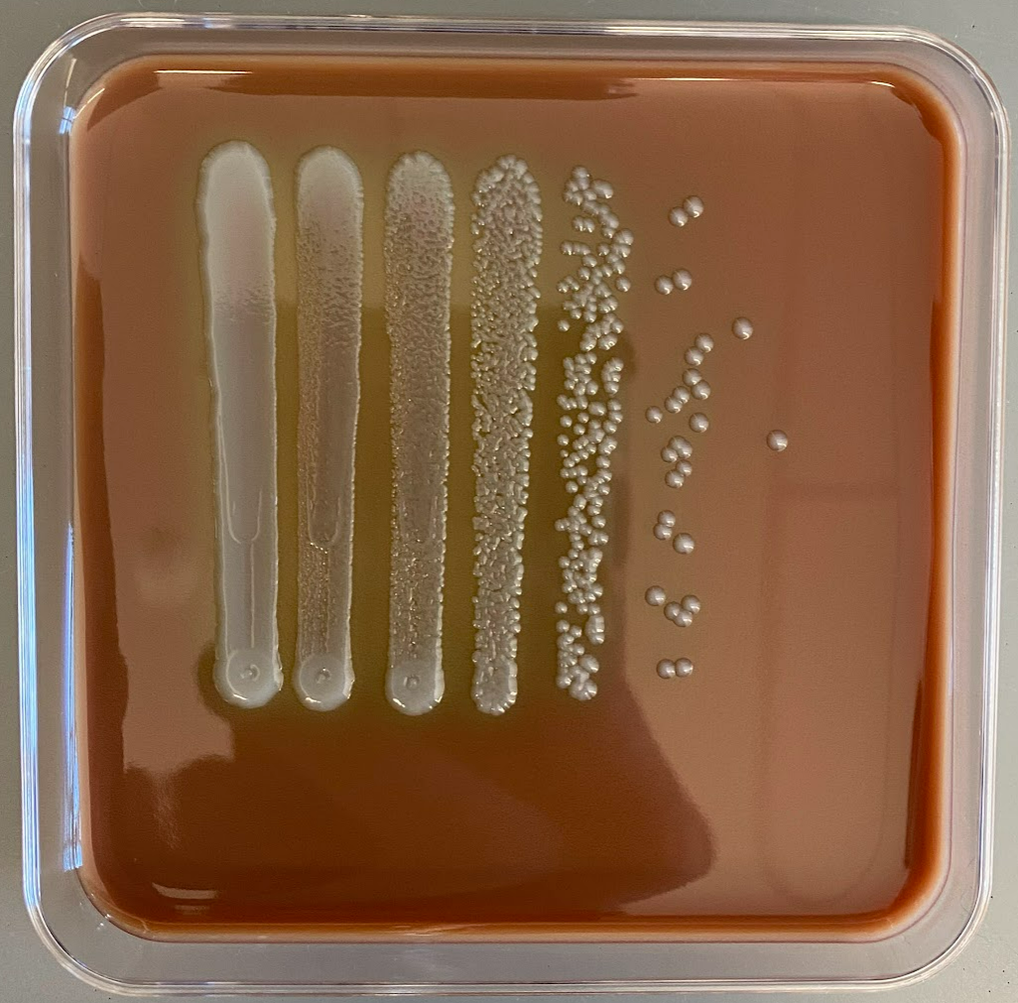
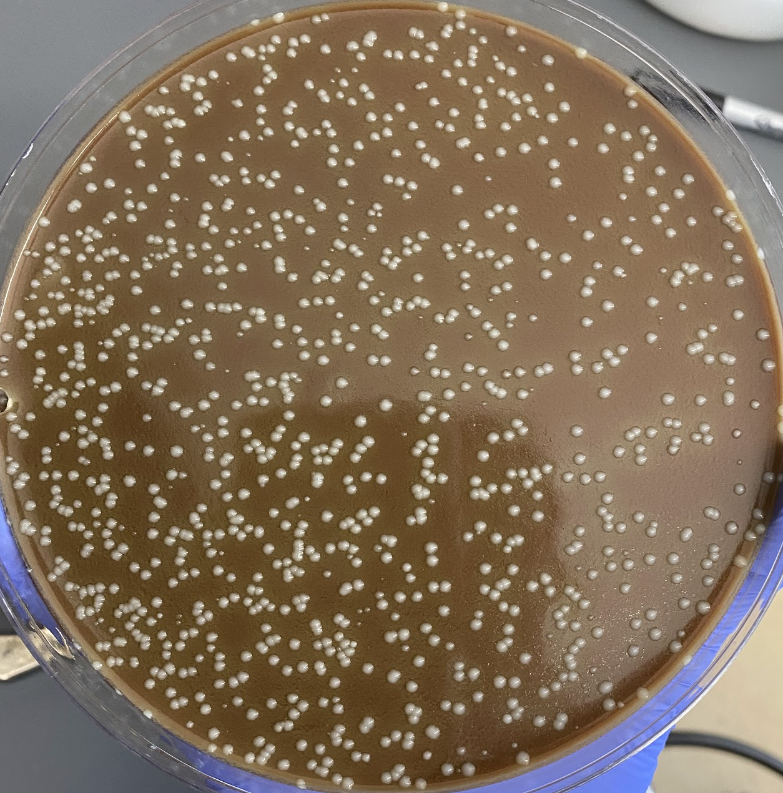
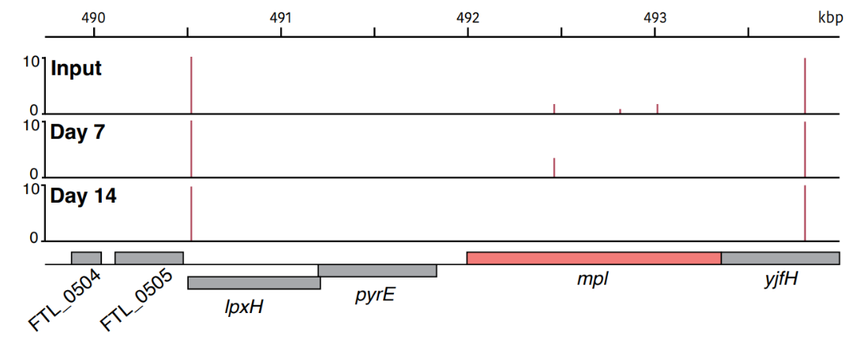
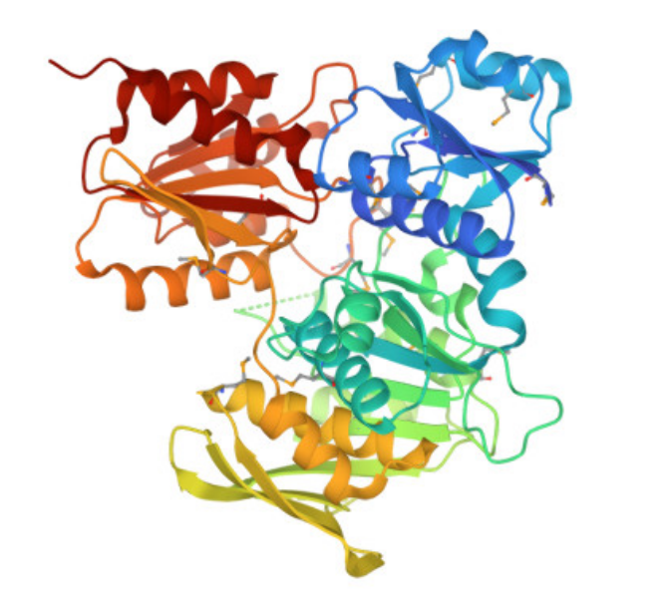
Determining the genetic requirements for Francisella tularensis survival in freshwater
Aisling Macaraeg¹, Hannah Trautmann¹, Sierra Schmidt¹, and Kathryn Ramsey^{1,2}
¹Department of Cell and Molecular Biology, University of Rhode Island
²Department of Biomedical and Pharmaceutical Sciences, University of Rhode Island
1
Introduction
2
Freshwater Survival Assay
3
Transposon Insertion Sequencing
Francisella tularensis
  Gram-negative, pathogenic bacterium
  Causes the disease tularemia
F. tularensis can survive in freshwater for long periods of time and subsequently infect animals and humans²
A gene has been found that is important during the transition between the host and aquatic environment ³
Figure 3. Workflow for Cell Viability. Freshwater was collected from the Beaver River, Rhode Island. The water was filter sterilized and inoculated with F. tularensis LVS. The initial inoculum was distributed to nine flasks, three of each were placed at three different temperatures: 4°C, 16 °C, and 25 °C. Samples were serially diluted and plated over a period of 10 weeks.
Beaver River
+ 0.03 OD LVS
F. tularensis
Figure 1: F. tularensis in macrophage.¹
x3
x3
x3
Main Question:
4°C
16°C
25°C
What are the genetic requirements for survival of
F. tularensis in freshwater?
Serially diluted from 1 to 10⁻⁶
Plated on days: 0, 1, 2, 4, 7, 14, 21, 28, 35, 42, 50, 63, 69
Figure 2: F. tularensis modes of aquatic transmission.⁴
Figure 4: Workflow of transposon insertion sequencing protocol⁵
This is modified from Chao et al. 2016.
4
New Transposon Delivery Plasmid
5
Creation of a Transposon Mutant Library
transposon
Transposon: Fragment of DNA that “jumps” into the chromosome
Why make a new plasmid?
Modified the ends of the transposon to be compatible with the 2011 update to the Illumina adapters⁶
The new plasmid incorporated this modifications (depicted in brown)
F. Tularensis genome: 1,895,944 bp
Number of genes: 2,020
Final Transformation Efficiency: 2.44 x 10³
Estimated number of transposon mutants: ~5,572
pKL97
pKR140
pKR141
Initial transformation efficiency results: 1.88 x 10⁴
Figure 5: Example of transposon mutant library isolated on cysteine heart agar with hemoglobin plate
6
Survival of F. tularensis in Freshwater at 4°C
7
Transposon Insertion Sequencing Data
Figure 6: Comparison of F. tularensis survival in river water at 4°C across experiments.
Average CFU per mL recovered at indicated time points for three replicate experiments, with cells incubated at 4°C. The longest survival was 56 days in replicate 2. In orange diamonds, the average CFU per mL after incubating transposon mutant library in freshwater. Indicated timepoints (day 0, 7, 14) are also when gDNA was extracted for transposon insertion sequencing.
Library | Transposon Sequencing Reads | Number of Insertions/mutants detected
Input | 377,164 | 5,733
Day 7 | 696,629 | 6,821
Day 14 | 502,258 | 6,168
8
Conclusion and References
F. tularensis can remain viable between 21 and 56 days at 4°C in freshwater
Assessed survival of transposon mutant library after incubation in freshwater kept at 4°C
FTL_0508, mpI, is a candidate for a gene essential for F. tularensis survival in freshwater
  Encodes for UDP-N-acetylmuramate:L-alanyl-γ-D-glutamyl-meso-diaminopimelate ligase
  Important for cell wall synthesis
Figure 6: Crystal Structure of UDP-N-acetylmuramate:L-alanyl-gamma-D-glutamyl-meso-diaminopimelate ligase from Psychrobacter arcticus
Acknowledgments
References
1. Fischer. (2006). PNAS cover.
2. Golovliov, I., Bäckman, S., Granberg, M., Salomonsson, E., Lundmark, E., Näslund, J., Busch, J. D., Birdsell, D., Sahl, J. W., Wagner, D. M., Johansson, A., Forsman, M., & Thelaus, J. (2021). Long-Term Survival of Virulent Tularemia Pathogens outside a Host in Conditions That Mimic Natural Aquatic Environments. Applied and Environmental Microbiology, 87(6)
3. Williamson, D. R., Dewan, K. K., Patel, T., Wastella, C. M., Ning, G., & Kirimanjeswara, G. S. (2017). A Single Mechanosensitive Channel Protects Francisella tularensis subsp. holarctica from Hypoosmotic Shock and Promotes Survival in the Aquatic Environment. Applied and Environmental Microbiology, 84(5)
4. Hennebique, A., Boisset, S., & Maurin, M. (2019). Tularemia as a waterborne disease: a review. Emerging Microbes & Infections, 8(1), 1027-1042. 10.1080/22221751.2019.1638734
5. Chao, M. C., Abel, S., Davis, B. M., & Waldor, M. K. (2016). The design and analysis of transposon insertion sequencing experiments. Nature reviews. Microbiology, 14(2), 119–128. https://doi.org/10.1038/nrmicro.2015.7
6. Goodman, A. L., Wu, M., & Gordon, J. I. (2011). Identifying microbial fitness determinants by insertion sequencing using genome-wide transposon mutant libraries. Nature Protocols, 6(12), 1969-1980. 10.1038/nprot.2011.417
We would like to thank the Ramsey lab as well as the Gregory Lab for productive joint lab discussions. We would also like to thank the Jenkins lab for the use of their incubator and the Nelson lab for the use of their benchtop. A big thank you to Janet, with all of her advice and help throughout the entirety of this project! Research reported in this presentation was supported by the Rhode Island Institutional Development Award (IDeA) Network of Biomedical Research Excellence from the National Institute of General Medical Sciences of the National Institutes of Health under grant number P20GM103430.

Slide 2
Determining the genetic requirements for Francisella tularensis survival in freshwater
Aisling Macaraeg¹, Hannah Trautmann¹, Sierra Schmidt¹, and Kathryn Ramsey^{1,2}
¹Department of Cell and Molecular Biology, University of Rhode Island
²Department of Biomedical and Pharmaceutical Sciences, University of Rhode Island
1
Introduction
2
Freshwater Survival Assay
3
Transposon Insertion Sequencing
Francisella tularensis
  Gram-negative, pathogenic bacterium
  Causes the disease tularemia
F. tularensis can survive in freshwater for long periods of time and subsequently infect animals and humans⁴
A gene has been found that is important during the transition between the host and aquatic environment ⁷
Figure 3. Workflow for Cell Viability. Freshwater was collected from the Beaver River, Rhode Island. The water was filter sterilized and inoculated with F. tularensis LVS. The initial inoculum was distributed to nine flasks, three of each were placed at three different temperatures: 4°C, 16 °C, and 25 °C. Samples were serially diluted and plated over a period of 10 weeks.
Beaver River
+ 0.03 OD LVS
F. tularensis
Figure 1: F. tularensis in macrophage.³
x3
x3
x3
Main Question:
4°C
16°C
25°C
What are the genetic requirements for survival of
F. tularensis in freshwater?
Serially diluted from 1 to 10⁻⁶
Plated on days: 0, 1, 2, 4, 7, 14, 21, 28, 35, 42, 50, 63, 69
Figure 2: F. tularensis modes of aquatic transmission.⁶
Figure 4: Workflow of transposon insertion sequencing protocol¹
This is modified from Chao et al. 2016.
4
New Transposon Delivery Plasmid
5
Creation of a Transposon Mutant Library
transposon
Transposon: Fragment of DNA that “jumps” into the chromosome
Why make a new plasmid?
Modified the ends of the transposon to be compatible with the 2011 update to the Illumina adapters⁵
The new plasmid incorporated this modifications (depicted in brown)
F. Tularensis genome: 1,895,944 bp
Number of genes: 2,020
Final Transformation Efficiency: 2.44 x 10³
Estimated number of transposon mutants: ~5,572
pKL97
pKR140
pKR141
Initial transformation efficiency results: 1.88 x 10⁴
Figure 5: Example of transposon mutant library isolated on cysteine heart agar with hemoglobin plate
6
Survival of F. tularensis in Freshwater at 4°C
7
Transposon Insertion Sequencing Data
Figure 6: Comparison of F. tularensis survival in river water at 4°C across experiments.
Average CFU per mL recovered at indicated time points for three replicate experiments, with cells incubated at 4°C. The longest survival was 56 days in replicate 2. In orange diamonds, the average CFU per mL after incubating transposon mutant library in freshwater. Indicated timepoints (day 0, 7, 14) are also when gDNA was extracted for transposon insertion sequencing.
Library | Transposon Sequencing Reads | Number of Insertions/mutants detected
Input | 377,164 | 5,733
Day 7 | 696,629 | 6,821
Day 14 | 502,258 | 6,168
8
Conclusion and References
F. tularensis can remain viable between 21 and 56 days at 4°C in freshwater
Assessed survival of transposon mutant library after incubation in freshwater kept at 4°C
FTL_0508, mpI, is a candidate for a gene essential for F. tularensis survival in freshwater
  Encodes for UDP-N-acetylmuramate:L-alanyl-γ-D-glutamyl-meso-diaminopimelate ligase
  Important for cell wall synthesis
Figure 6: Crystal Structure of UDP-N-acetylmuramate:L-alanyl-gamma-D-glutamyl-meso-diaminopimelate ligase from Psychrobacter arcticus²
Acknowledgments
Reference List
Chao, M.C., Abel, S., Davis, B.M., and Waldor, M.K. (2016). The design and analysis of transposon insertion sequencing experiments. Nat Rev Microbiol 14, 119-128.
Das, D., Hervé, M., Feuerhelm, J., Farr, C.L., Chiu, H., Elsliger, M., Knuth, M.W., Klock, H.E., Miller, M.D., Godzik, A., et al. (2011). Structure and function of the first full-length murein peptide ligase (Mpl) cell wall recycling protein. PLoS One 6, e17624.
Fischer. (2006). Cover image. 103(39)
Golovliov, I., Bäckman, S., Granberg, M., Salomonsson, E., Lundmark, E., Näslund, J., Busch, J.D., Birdsell, D., Sahl, J.W., Wagner, D.M., et al. (2021). Long-Term Survival of Virulent Tularemia Pathogens outside a Host in Conditions That Mimic Natural Aquatic Environments. Appl Environ Microbiol 87, 2713.
Goodman, A.L., Wu, M., and Gordon, J.I. (2011). Identifying microbial fitness determinants by insertion sequencing using genome-wide transposon mutant libraries. Nat Protoc 6, 1969-1980.
Hennebique, A., Boisset, S., and Maurin, M. (2019). Tularemia as a waterborne disease: a review. Emerg Microbes Infect 8, 1027-1042.
Williamson, D.R., Dewan, K.K., Patel, T., Wastella, C.M., Ning, G., and Kirimanjeswara, G.S. (2018). A Single Mechanosensitive Channel Protects Francisella tularensis subsp. holarctica from Hypoosmotic Shock and Promotes Survival in the Aquatic Environment. Appl Environ Microbiol 84, 2203.
We would like to thank the Ramsey lab as well as the Gregory Lab for productive joint lab discussions. We would also like to thank the Jenkins lab for the use of their incubator and the Nelson lab for the use of their benchtop. A big thank you to Janet, with all of her advice and help throughout the entirety of this project! Research reported in this presentation was supported by the Rhode Island Institutional Development Award (IDeA) Network of Biomedical Research Excellence from the National Institute of General Medical Sciences of the National Institutes of Health under grant number P20GM103430.

