Slide 2
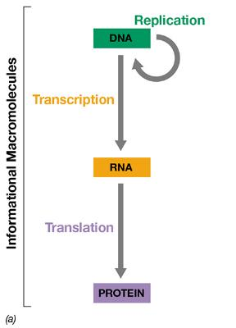
Central Dogma
How information flows in biological systems
Transcribe DNA into RNA
Translate RNA into protein
Notes:
Figure 4.1 Genetic information flow and the components of the nucleic acids.

Slide 3
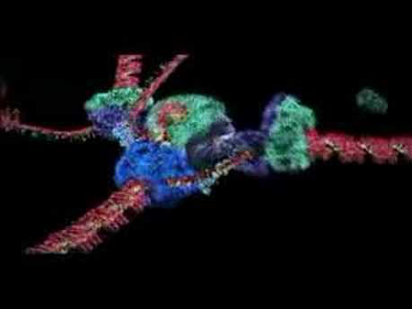
DNA replication
https://youtu.be/4jtmOZaIvS0

Slide 4
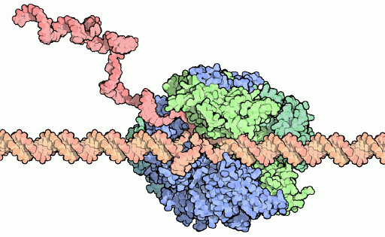
Transcription: DNA is converted into RNA by RNA polymerase
mRNA transcript
RNA Polymerase
DNA template

Slide 5
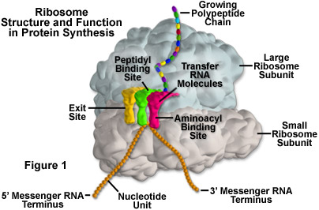
The Mechanism of Protein Synthesis
Ribosome: site of protein synthesis
  thousands of ribosomes per cell
  composed of two subunits (30S and 50S in prokaryotes) to form 70S ribosome
    S = Svedberg units
    30S contains 16S r R N A + 21 proteins
    50S contains 5S + 23S r R N A + 31 proteins
combination of rRNA and protein
Bacterial ribosomes:
  ~50 ribosomal proteins
  3 ribosomal RNAs

Slide 6
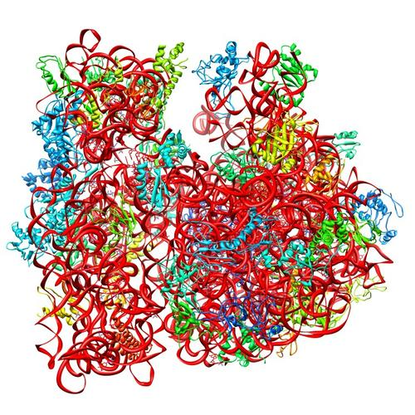
Ribosomes make protein
E. coli ribosome
3 rRNAs
49 proteins
50S
30S
PDB 4V50
Berk et al., 2006

Slide 7
Ribosomes can be heterogenous
E. coli ribosome
3 rRNAs
49 proteins
Sources of heterogeneity
Multiple rRNA operons
rRNA modifications
Ribosomal protein modifications
Multiple ribosomal proteins
50S
30S
PDB 4V50
Berk et al., 2006
How do changes in ribosome composition influence translation?

Slide 8
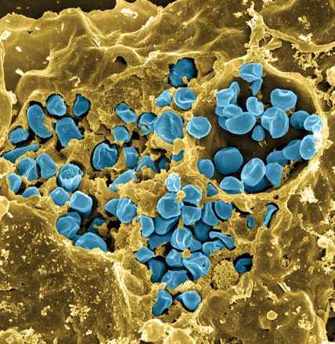
Francisella tularensis
Causes tularemia
Highly infectious, potential bioweapon
F. tularensis subsp. holarctica LVS
Facultative intracellular pathogen
Slow grower
Fischer, PNAS cover 2006
Notes:
Make sure to talk about the picture at the beginning – if I don’t talk about it at the beginning then make sure it doesn’t come in until I want to talk about it
Highly infectious -> fewer than 10 organisms cause infection; don’t have to explain why it is a potential bioweapon, just that it is
We use the live vaccine strain in the lab -> this strain causes disease in animals not humans
When we talk about it being a slow grower, the doubling time is 2 hours compared to E. coli’s doubling time of 30 minutes
Transition: so, in this bacteria we are interested in looking at ribosomes!
Gram-negative, gamma facultative intracellular pathogen
Infectivity similar to Mtb, can upwards of 30% mortality
Tier 1 Select Agent like Ebola
Cover image: Scanning electron micrograph of a murine macrophage infected with Francisella tularensis strain LVS. Macrophages were dry-fractured by touching the cell surface with cellophane tape after critical point drying to reveal intracellular bacteria. Bacteria (colored in blue) are located either in the cytosol or within a membrane-bound vacuole.

Slide 9
Multiples bS21 homologs suggest heterogenous ribosome populations in Francisella tularensis
cspC
rpsU1
Makes bS21-1
rpsU2
yqeY
dnaG
rpoD
Makes bS21-2
rpsU3
Makes bS21-3
Notes:
Even though francisella has a reduced genome, it encodes three copies of the rpsU genes, which encode bS21, a protein in the small ribosomal subunit. Most bacteria have 0 or 1 of this gene. We originally, hypothesized, and have since shown, that these three proteins are produced and incorporated into ribosomes. This is a western blot of purified ribosomes from our wild-type strain as well as strains ectopically expressing each of the bS21 proteins, with a VSVG tag. This, along with some mass spec data we have of purified ribosomes, indicates that multiple classes of ribosomes are possible and occurring
This protein is also interesting to us because it is located close to the mRNA exit channel in the ribosome, and early research has identified that it is involved in translation initiation, so it is in an ideal location to be regulating gene expression at the level of translation initiation.
So this heterogeneity of ribosomes may be a mechanism of regulation, but you may not know that ribosomes are heterogeneous so let me show you other ways that may occur.

Slide 10
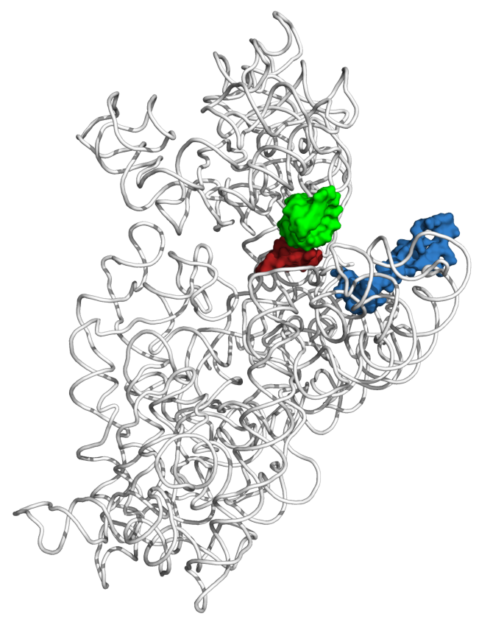
The function of a bS21, a small ribosomal subunit protein
  Involved in translation initiation
  Non-essential
  Implicated in control of specific processes
    biofilm
    motility
    acid stress resistance
    antibiotic resistance
    virulence
  Encoded by phage
mRNA channel
PDB 4V50
Berk et al., 2006
P-site tRNA ASL
mRNA (P-site codon)
bS21
Dr. Steven Gregory

Slide 11
Ribosomes and growth rates
Need ribosomes to grow – essential for cell survival
Observation: cells with less bS21 grow slower

Slide 12
Reduction in bS21 leads to slower growth
In vitro growth of LVS pF and LVS ∆rpsU2
  in vitro: in a test tube
  LVS: normal Francisella tularensis live vaccine strain cells
  ∆rpsU2 : LVS cells without bS21-2
There is a growth defect in cells missing one homolog of bS21
The growth defect is worse when more bS21 is deleted (∆rpsU1 ∆rpsU2)
Strain | Doubling Time (min)
LVS pF | 135.1 +/- 4.7
LVS ∆rpsU2 | 172.8 +/- 4.5
Notes:
Doubling time in this instance is also generation time
Transition – so we know that it reducing growth, but we don’t know why

Slide 13
LVS vs LVS ∆rpsU2 vs LVS ∆rpsU1∆rpsU2
LVS cells
“Wild type”
LVS ∆rpsU2 cells
No bS21-2
LVS ∆rpsU1∆rpsU2 cells
No bS21-1 or bS21-2
Ribosomes with bS21-1 or bS21-2, or bS21-3, or maybe no bS21
Ribosomes with bS21-1 or bS21-3 or maybe no bS21
Ribosomes with bS21-3 or maybe no bS21
Doubling time: ~135 minutes ~173 min >173 min
Notes:
Even though francisella has a reduced genome, it encodes three copies of the rpsU genes, which encode bS21, a protein in the small ribosomal subunit. Most bacteria have 0 or 1 of this gene. We originally, hypothesized, and have since shown, that these three proteins are produced and incorporated into ribosomes. This is a western blot of purified ribosomes from our wild-type strain as well as strains ectopically expressing each of the bS21 proteins, with a VSVG tag. This, along with some mass spec data we have of purified ribosomes, indicates that multiple classes of ribosomes are possible and occurring
This protein is also interesting to us because it is located close to the mRNA exit channel in the ribosome, and early research has identified that it is involved in translation initiation, so it is in an ideal location to be regulating gene expression at the level of translation initiation.
So this heterogeneity of ribosomes may be a mechanism of regulation, but you may not know that ribosomes are heterogeneous so let me show you other ways that may occur.

Slide 14
LVS vs LVS ∆rpsU2 vs LVS ∆rpsU1∆rpsU2
LVS cells
“Wild type”
LVS ∆rpsU2 cells
No bS21-2
LVS ∆rpsU1∆rpsU2 cells
No bS21-1 or bS21-2
Ribosomes with bS21-1 or bS21-2, or bS21-3, or maybe no bS21
Ribosomes with bS21-1 or bS21-3 or maybe no bS21
Ribosomes with bS21-3 or maybe no bS21
Less bS21- fewer options for ribosomes, but no reason to have fewer ribosomes overall!
Notes:
Even though francisella has a reduced genome, it encodes three copies of the rpsU genes, which encode bS21, a protein in the small ribosomal subunit. Most bacteria have 0 or 1 of this gene. We originally, hypothesized, and have since shown, that these three proteins are produced and incorporated into ribosomes. This is a western blot of purified ribosomes from our wild-type strain as well as strains ectopically expressing each of the bS21 proteins, with a VSVG tag. This, along with some mass spec data we have of purified ribosomes, indicates that multiple classes of ribosomes are possible and occurring
This protein is also interesting to us because it is located close to the mRNA exit channel in the ribosome, and early research has identified that it is involved in translation initiation, so it is in an ideal location to be regulating gene expression at the level of translation initiation.
So this heterogeneity of ribosomes may be a mechanism of regulation, but you may not know that ribosomes are heterogeneous so let me show you other ways that may occur.

Slide 15
30S Subunit Assembly Map
5' Domain
Central Domain
3' Domain
uS17
bS20
uS4
uS8
uS15
uS7
Cells don’t need bS21 to make ribosomes!
1ᴼ
bS16
bS6
bS18
uS9
uS13
uS19
2ᴼ
uS11
bS21
uS10
uS14
3ᴼ
uS12
uS5
uS3
uS2
30S subunit assembly map (Nomura)
Notes:
Ribosomal proteins assemble in a certain order that scientists have figured out and then made into an assembly map
This was done in in vitro and there have been some discrepancies in the findings in vivo
Then explain the assembly map
Because of this, we don’t expect there to be a subunit assembly defect but the findings could be explained by it

Slide 16
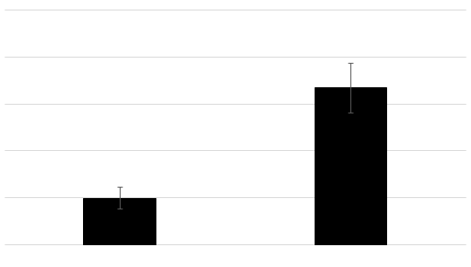
Cells lacking bS21-1 and bS21-2 have smaller colonies compared to wild-type cells
2.5
2
1.5
Diameter of Colonies (mm)
1
0.5
0
ΔrspU1 ΔrpsU2 pF LVS pf
Strains
Notes:
220915 excel sheet

Slide 17
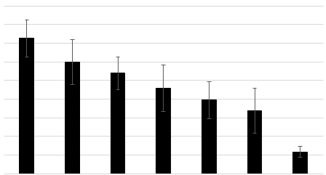
The preliminary hits from the growth suppressor screen restore growth in cells with less bS21
Diameter of Colonies (mm)
LVS pF E2-21 E2-30 E2-27 E2-38 E2-29 ΔrpsU1
ΔrpsU2 pF
ΔrpsU1 ΔrpsU2
Strains
Notes:
This will lead into asking the question : is the restoration of growth caused by the plasmid or by a chromosomal mutation
Because remember, when Hannah made the cloning library she streaked out d1/d2 cells and then froze down colonies that were bigger than normal - these would be mutants
Want to explain why we decided to go forward with looking at E2-38 instead of others – so want to research era gene

Slide 18
Next steps
KMR will find isolates that are LVS ∆rpsU1∆rpsU2 with extra DNA (plasmid) that grow faster
George will isolate extra DNA
George will sequence / analyze extra DNA
George will determine if that DNA allows LVS ∆rpsU1∆rpsU2 to grow faster
Think about why that extra DNA (which genes?) allows cells to grow faster

