Slide 1

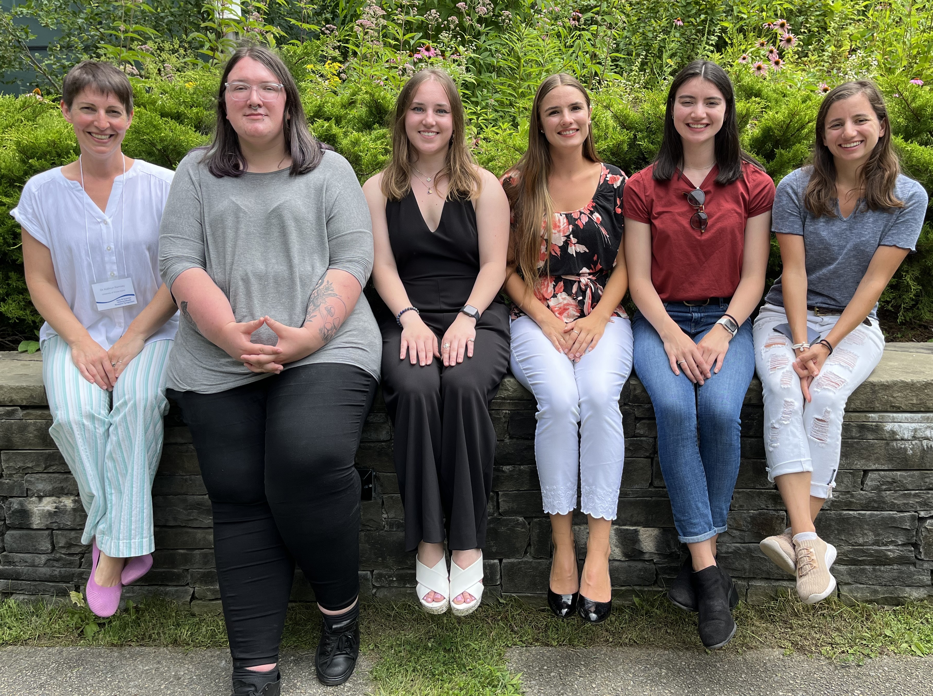





Acknowledgments
University of Rhode Island
Dr. Kathryn Ramsey
Benjamin Moore
Kira Bernabe
Hannah Trautmann
Sierra Schmidt
Aisling Macaraeg
Oli Horyn
Dr. Steven Gregory
Gregory lab
Janet Atoyan
Notes:
In conclusion, I would like to thank Dr. Kathryn Ramsey and the members of the Ramsey lab for their support on this project. I would also like to thank Dr. Steven Gregory and the Gregory lab and Janet from the INBRE Core facility.Thank you all for attending and I’d be happy to take your questions!
thank ramsey and memebrs of lab as well as gregry lab and janet from sequencing center. Thank you and id be happy to take any questions.

