Slide 1
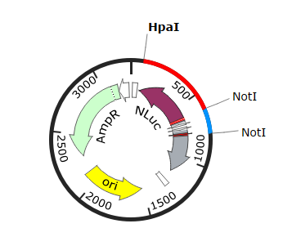
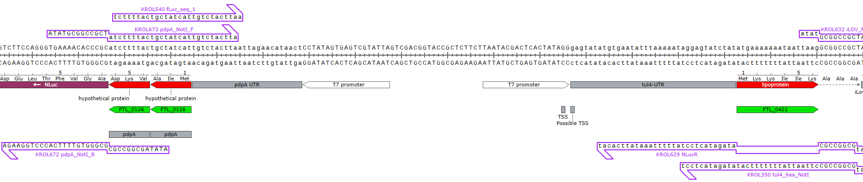
Cloning Project
Not1
Goal: Successfully cloning a plasmid that will allow us to easily modify and switch out the 5’ UTR sequences for genes we want to study including pdpA.
First step: Insert a Not1 cut site in between the pdpA 5’UTR and the nLuc reporter gene.
Notes:
-first step is to insert a Not1 cut site in between pdPa 5’utr and the gene for nLuc which will allow us to easily modify and switch out the 5’ seq.
NOT1 and HPA1 are restriction enzymes that cut DNA
-template were using with is PKR189(dual reporter plasmid that contains genes for the luminescent proteins( nLuc and lanyfp.)
HPA1 and NOT1
PdpA
Gene in francisella - associated w infections properties of francicella
BS21 has an effect on regulating the translation of PdpA gene
Design of intermediate plasmid
WHAT. Goals: introduce a cut sight for NOT 1. (Enzyme) between nLuc and pdPA
WHY. - allows us to easily modify and swap out the region of DNA containing pdPA and tul4(gene on other side- genes we are interested in studying/measuring)

Slide 2
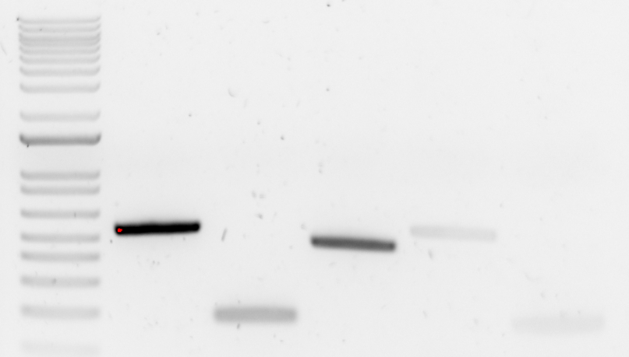
Lab Updates
June 26, 2023
nLuc Fragment
(543 bp)
pdPa/tul 4 UTR
(179 bp)
Ladder
LVS gDNA
Neg. control 1
Neg. Control 1
1500
1000
850
650
500
400
300
200
100
Question: Can we successfully identify the source of contamination in our PCR?
Results: There are still bands in the negative control lanes, so it seems that using fresh nuclease-free water and reagents is not addressing the source of the contamination.
Future Plans: Rerun PCR to test for gDNA
Notes:
Normal pcr with new reagents

Slide 3
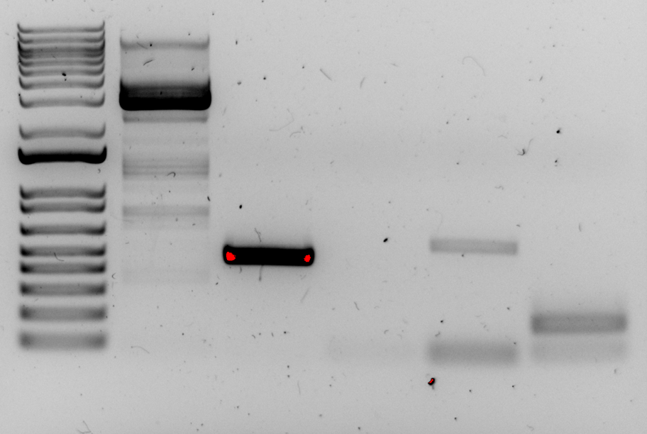
Lab Updates
June 26, 2023
LVS gDNA with KROL 148 and 149
LVS gDNA with KROL 15 and 16
Ladder
KROL 148 and 149
KROL 628 and 672
KROL 673 and KROL 350
1500
1000
850
650
500
400
300
200
100
Question: Can we successfully identify the source of contamination in our PCR?
Results: PCR amplification was successful for gDNA with primer sets KROL148/KROL149 and KROL15/KROL16 and there was no amplification in the negative control lane. There were still bands in the negative control lanes for the primer sets we are investigating for contamination (KROL628/KROL672 and KROL673/KROL350) which means that there is still plasmid contamination in the primer stocks we are using or in the reagents.
Future steps: Test primer stocks for contamination.
Notes:
PCR amplification was successful for gDNA with primer sets KROL148/KROL149 and KROL15/KROL16 and there was no amplification in the negative control lane. This shows that there should be no gDNA contamination in the reagents we are using.
There were still bands in the negative control lanes for the primer sets we are investigating for contamination (KROL628/KROL672 and KROL673/KROL350) which means that there is still plasmid contamination in the primer stocks we are using or in the reagents.

Slide 4
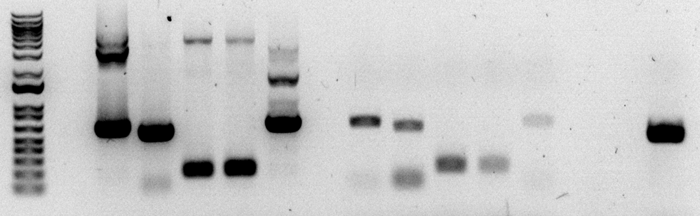
Lab Updates
June 26, 2023
pKR189 with KROL628, KROL518
pKR189 with KROL672, KROL519
pKR189 with KROL673, KROL467
pKR189 with KROL350, KROL349
pKR189 with KROL518, KROL519
LVS gDNA with KROL15, KROL16
Ladder
KROL628, KROL518
KROL672, KROL519
KROL673, KROL467
KROL350, KROL349
KROL518, KROL519
1500
1000
850
650
500
400
300
200
100
Question: Can we successfully identify the source of contamination in our PCR?
Results: Reactions 1-5 with the plasmid template present were successful in amplifying the expected DNA fragment, so we know that these primer sets worked. Reactions 6-8 had distinct bands, so there is most likely contamination present in primer stocks for KROL628, KROL672, and KROL673. Reaction 9 had a faint band, so there is likely contamination in KROL350. Reaction 10 had a very faint band, so it is possible that these primers are amplifying residual plasmid DNA present somewhere, either in the primer stocks or in the Master Mix.
Future Plans: Ordered new primers. Rerun PCR
Notes:
Plasmid w primers and then just primers
Reactions 1-5 with the plasmid template present were successful in amplifying the expected DNA fragment, so we know that these primer sets worked. Reactions 6-8 had distinct bands, so there is most likely contamination present in primer stocks for KROL628, KROL672, and KROL673. Reaction 9 had a faint band, so there is likely contamination in KROL350. Reaction 10 had a very faint band, so it is possible that these primers are amplifying residual plasmid DNA present somewhere, either in the primer stocks or in the Master Mix.

Slide 5
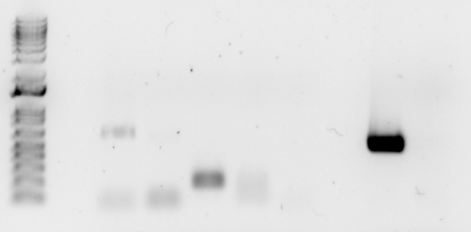
Lab Updates
June 26, 2023
KROL628, KROL518
KROL672, KROL519
KROL350, KROL349
KROL518, KROL519
LVS gDNA with KROL15, KROL16
KROL673, KROL467
1500
1000
850
650
500
400
300
200
100
Question: Can we successfully identify the source of contamination in our PCR?
Results: Reactions 1-4 had distinct bands, so there is most likely contamination present in primer stocks for KROL628, KROL672, KROL673, and KROL350. Reaction 5 did not have a band this time, so it seems like there is no issue with residual DNA in the water or reagents.
Future Plans: Ordered new primers. Rerun PCR
Notes:
Reactions 1-4 had distinct bands, so there is most likely contamination present in primer stocks for KROL628, KROL672, KROL673, and KROL350. Reaction 5 did not have a band this time, so it seems like there is no issue with residual DNA in the water or reagents.

