Slide 1
Investigating genetic factors that regulate rpsU1 and rpsU3
Morgan McPartland

Slide 2
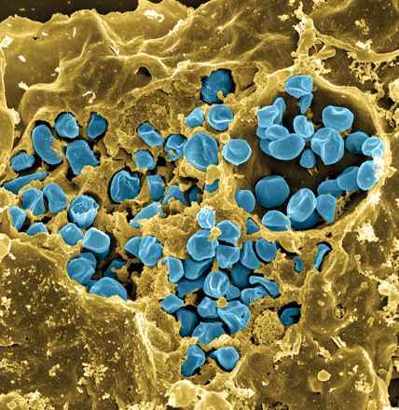
Francisella tularensis
Gram-negative human pathogen
Model: F. tularensis subsp. holarctica LVS (live vaccine strain)
Highly infectious
(as few as 10 bacterial cells are required to cause disease)
Potential bioweapon
Wide range of natural reservoirs, hosts & vectors
Intracellular growth is essential to cause disease
Fischer, PNAS cover 2006
Notes:
As you are all aware, the Ramsey lab studies Francisella tularensis which is the causative agent of tularemia, which can take a number of forms depending on the route of infection.
Francisella tularensis is a gram-negative human pathogen. It has a wide range of natural reservoirs, hosts, and vectors. It requires intracellular growth to cause disease. This is a scanning electron micrograph of a macrophage infected with the Live Vaccine Strain of Francisella tularensis. The macrophage is in yellow and Francisella tularensis is in blue.
We study Francisella tularensis because it is highly infectious, requiring as few as 10 bacterial cells to cause disease. Because of its high pathogenicity and its ability to cause disease from various modes of entry, Francisella tularensis is a potential bioweapon. It has been developed into an aerosol biological weapon by several countries in the past.
We use the attenuated live vaccine strain in the lab, which you will hear me refer to as LVS or KRLVS.
Extra info:
Cover image: Scanning electron micrograph of a murine macrophage infected with Francisella tularensis strain LVS. Macrophages were dry-fractured by touching the cell surface with cellophane tape after critical point drying to reveal intracellular bacteria. Bacteria (colored in blue) are located either in the cytosol or within a membrane-bound vacuole.
There are a large number of hosts and vectors, including ticks, mosquitos, flies, rabbits, and a number of rodents. It can also be water-borne, which makes understanding its epidemiology rather complex.
If infection is via the skin like through a mosquito or tick bite, it produces the ulceroglandular form of the disease, or if infection is by breathing in the bacteria, it causes the respiratory form, which can be fatal.

Slide 3
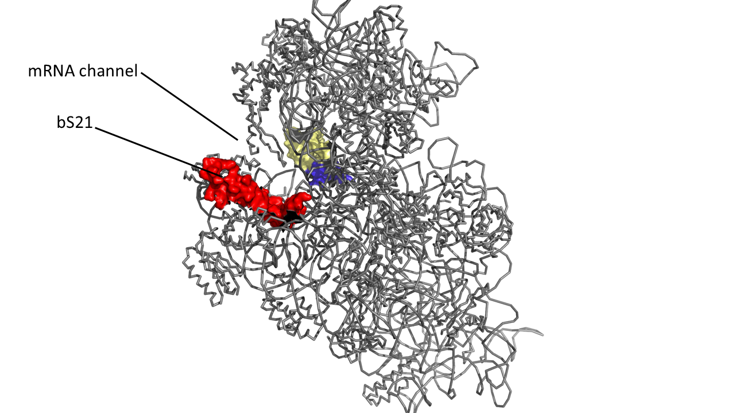
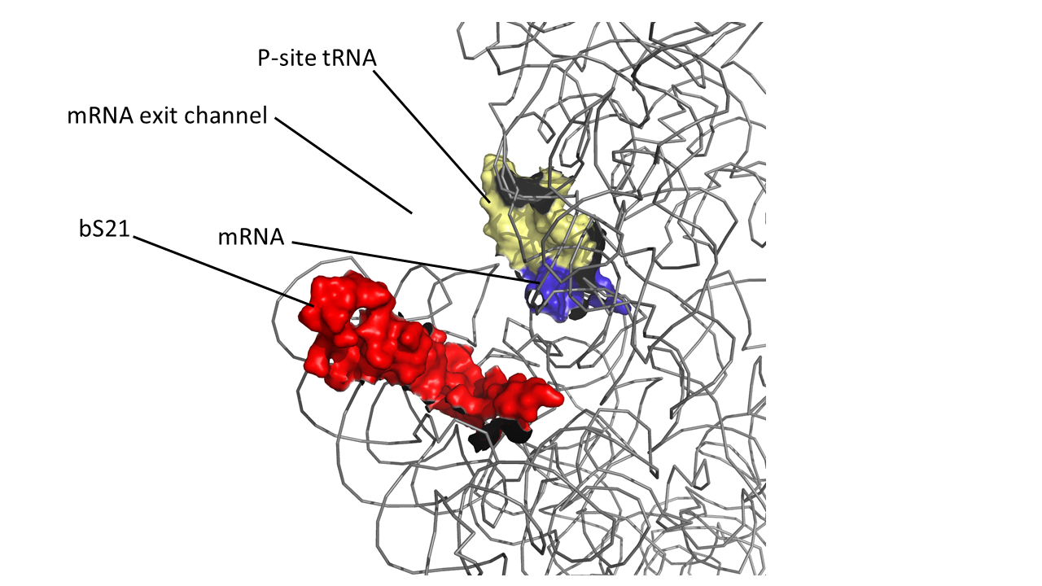
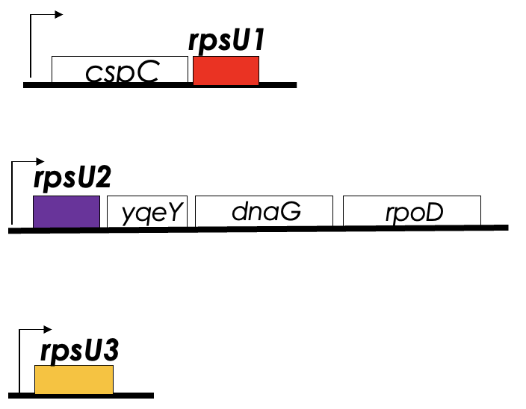
Ribosomal protein bS21
involved in translation initiation
In F. tularensis:
non-essential
implicated in control of specific processes
Three homologs (bS21-1, bS21-2, bS21-3)
Lead to ribosome heterogeneity
30S subunit, modeled from PDB entry: 4V50
bS21-1
bS21-2
gene expression at the level of translation (RNA to Protein)
is the most abundant homolog in standard in vitro conditions
bS21-3
Encoded by rpsU3
its loss leads to defects in intramacrophage growth
have not identified any changes in protein abundance when cells lack rpsU1
Encoded by rpsU1
Encoded by rpsU2
have not identified any changes in protein abundance when cells lack rpsU3
Notes:
The Ramsey lab is currently investigating ribosomal protein bS21. This protein is typically non-essential and involved in translation initiation. The interesting thing about bS21 in Francisella is that, despite francisella’s small genome, there are 3 bS21 homologs; where typically, bacteria have 0 or 1. This leads to ribosomal heterogeneity.
bS21 is encoded by rpsU. For each bS21 homolog francisella has, there is a corresponding rpsU gene. bS21-2 is by far the most abundant homolog in LVS when grown in standard in vitro conditions. The lab has demonstrated that bS21-2 is involved in gene expression at the level of translation, and its loss leads to defects in intramacrophage growth.
Less is known about the roles of bS21-1 and bS21-2. The lab has not identified any changes in protein abundance when cells lack the gene encoding either homolog (rpsU1 or rpsU3). This is most likely due to the low amount of these proteins in our standard growth conditions. My rotation project focused on the bS21-1 and bS21-3 homologs.
Extra info:
This protein is also interesting to us because it is located close to the mRNA exit channel in the ribosome, and early research has identified that it is involved in translation initiation, so it is in an ideal location to be regulating gene expression at the level of translation initiation.
Model in which bS21 homologs function as posttranscriptional regulators, allowing preferential translation of specific subsets of mRNAs

Slide 4
Theory:
Identify genes that lead to changes in production of bS21-1 and bS21-3
Provide insight into the homologs’ function
Provide a condition to be used to study the role of the bS21 homologs in gene expression
Notes:
The theory behind my rotation project is if we could identify genes that lead to changes in the production of these homologs, it could provide insight into the function of bS21-1 and bS21-3, and may also provide a condition we could use to study the role of these bS21 homologs in gene expression.
So how are we going to do this?

Slide 5
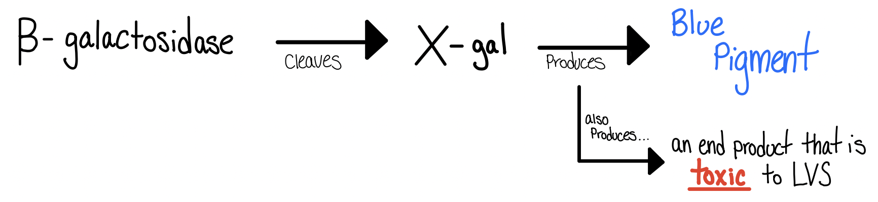

Methods & Goals:
Reporter Strain Name: | bS21 homolog fused with lacZ
KRLVS28.1 LVS rpsU1-lacZ | rpsU1
KRLVS75.2 LVS rpsU3-lacZ | rpsU3
Using transposon mutagenesis to mutate lacZ reporter strains
Screen for colonies with differences in bS21 homolog production by comparing pigment intensity
Validate mutants using ß-galactosidase assays
Determine where the transposon inserted and hypothesize why that mutation affected bS21 homolog abundance
Notes:
For my project, we used transposon mutagenesis to mutate already built lacZ reporter strains. These strains contain the lacZ gene fused to their respective rpsU homolog. LacZ encodes the enzyme beta galactosidase. Beta gal can cleave the chemical X-gal. A product of the cleaved X-gal produces a blue pigment. Next, we would screen for colonies with differences in bS21 homolog production by comparing pigment intensity. From there, we would validate our mutants of interest using beta galactosidase assays. And further, we could determine where the transposon inserted and hypothesize why that mutation affected the bS21 homolog abundance.

Slide 6
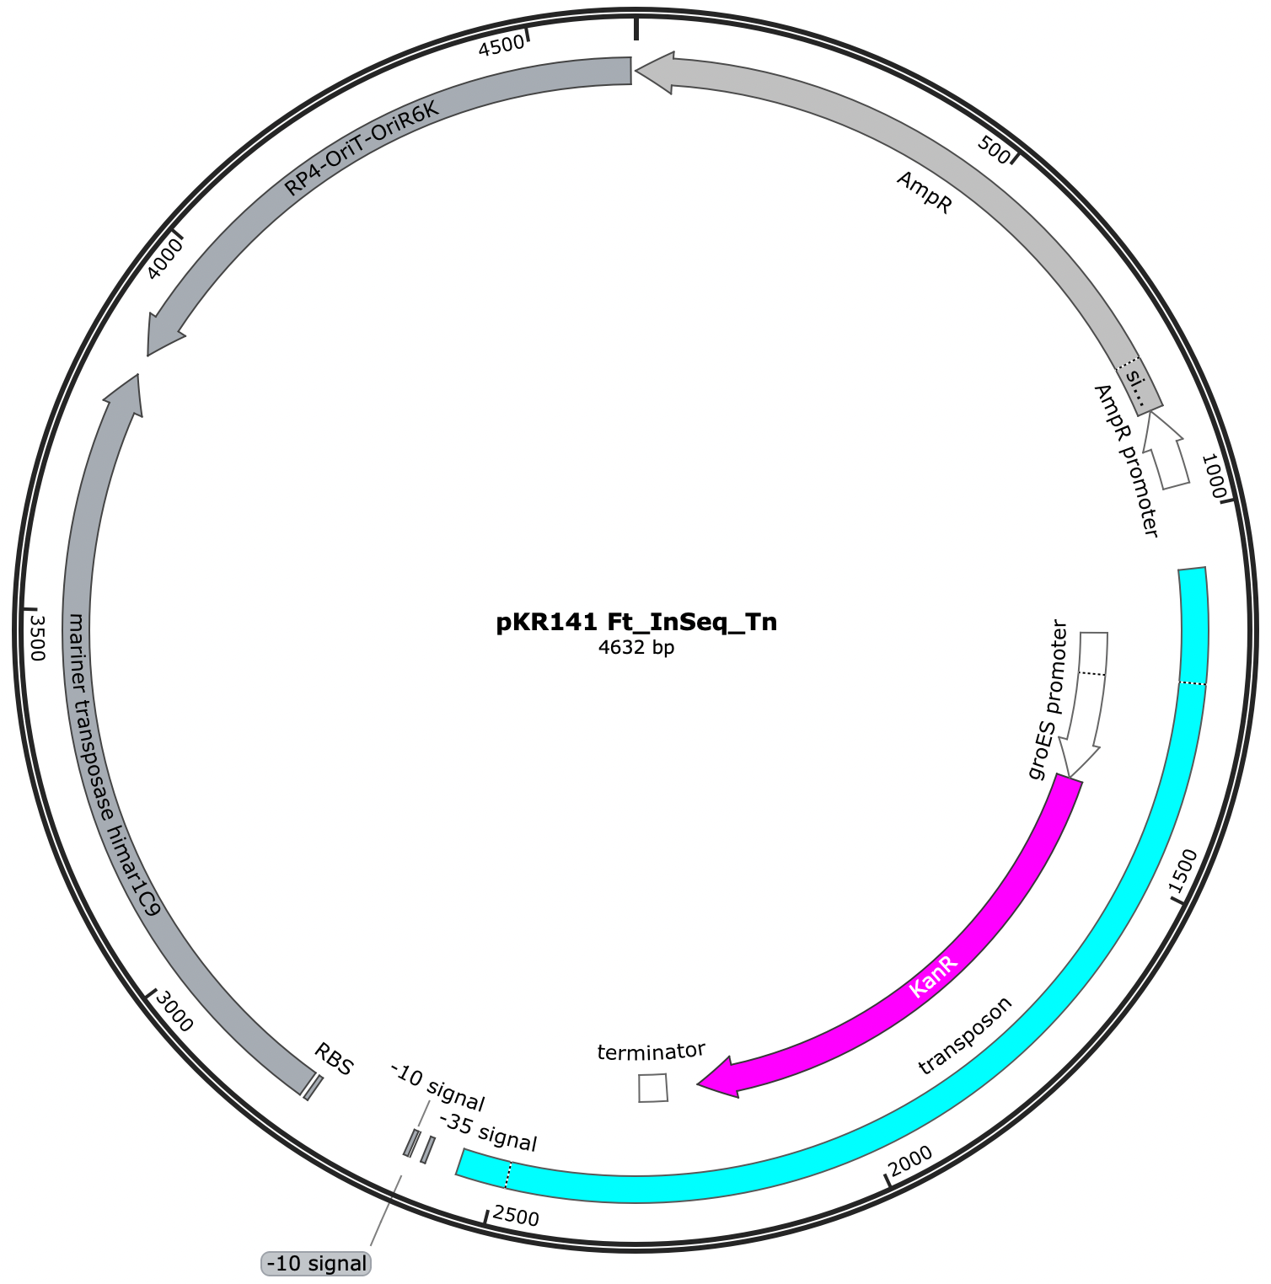
Our plasmid: pKR141 Ft_InSeq_Tn
Made by Aisling Macaraeg
Plasmid is ~4600 bp
Transposon is 1474 bp
Kanamycin was our method of selection for mutants
Transposon mutagenesis:
Transposons are small fragments of DNA that can “hop” around an organism’s genome, creating random insertion mutations
Our transposon does not have the transposases as part of the transposon, so it should insert once and stay put
How?
Using electroporation, our parental strains will take up the plasmid
The transposon (containing the Kanamycin resistance cassette) will move from the plasmid and integrate at random into the genome
…. = Our transposon
…. = Kanamycin resistance
Notes:
For our transposon mutagenesis, we used a previously constructed plasmid containing a transposon with kanamycin resistance, which we will use to select for our mutants. Our plasmid is about 4 thousand 600 base pairs, and the transposon is a little over 14 hundred base pairs. Our transposon does not have the transposases as part of the transposon, so it should insert once and stay put. We used electroporation to get our lacZ reporter strains to take up the plasmid. The transposon, containing the kanamycin resistance cassette, will move from the plasmid and integrate basically at random* into the reporter strain genome.
* the transposon will insert into any “TA” sequence. Francissella tularensis is very TA rich.

Slide 7
How do we test for ß-galactosidase activity?
Screening for ß-galactosidase activity:
Plate electroporated cells on X-gal plates
Screen-based on the blue pigment
Pick mutants of interest
Easy enough, right?
WRONG!
One of the cleaved X-gal products is toxic to LVS
  So, if there is a mutant with increased ß-galactosidase activity the toxic product can kill that colony, and we won’t be able to isolate it
Screening for ß-galactosidase activity in LVS:
Plate electroporated cells on CHAH + Kan plates
Let them grow to single colonies
Soft agar overlay containing X-gal
After 24hrs, “rescue” mutants of interest
Notes:
After we have electroporated our cells, how do we test for beta galactosidase activity? Typically, this is done by plating the electroporated cells onto X-gal plates, and then screening based on the blue pigment produced. Then you can pick your mutants of interest to culture.
Easy enough, right? Wrong.
One of the cleaved X-gal products is toxic to LVS, meaning if we have a mutant with increased beta galactosidase activity, the toxic product may kill that colony, leaving us unable to culture it. So to get around that the Ramsey lab had to be creative. When screening for beta galactosidase activity in LVS, we first plate the electroporated cells onto cysteine heart agar supplemented with hemoglobin, and kanamycin added. We let these plates grow to single colonies and then add a soft agar overlay containing X-gal. After 24hrs, we screen for mutants of interest. Mutants are considered “mutants of interest” if they are producing more or less blue pigment than the “average” mutant. The mutants of interest are then “rescued” and isolated. So now let's look at some results!

Slide 8
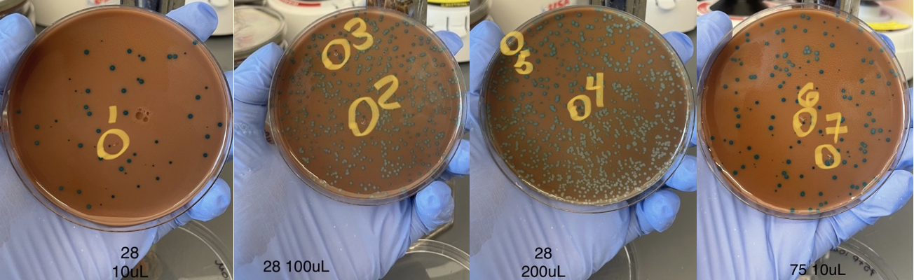
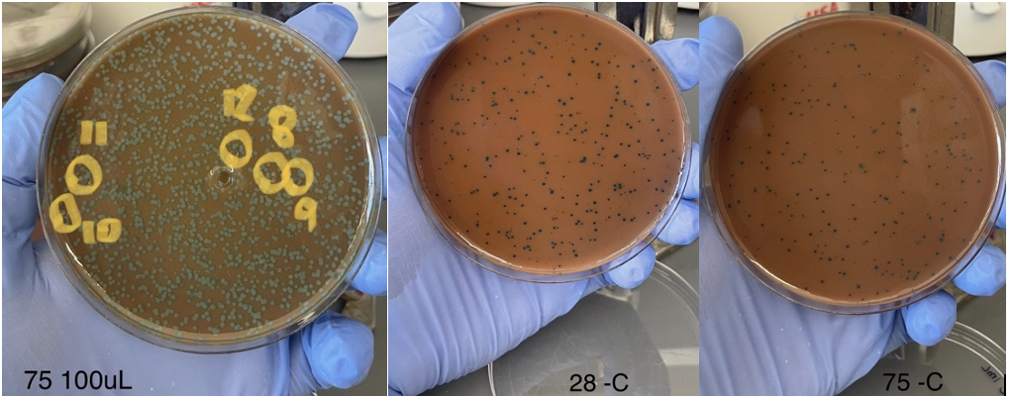
Electroporation & ß-gal Soft agar overlay
Improvements for next time:
Decreasing the concentration of X-gal in the soft agar overlay
  Very difficult to distinguish between shades of blue when they are all very pigmented
Gradient effect seen in some plates
  Caused by uneven soft agar overlay
  Resolved by not stacking plates while the soft agar solidifies
Plating on the large plates
  Difficult to rescue isolated colonies when they are growing that densely
Parental strain: KRLVS28
Volume plated: 10 µL
Parental strain: KRLVS28
Volume plated: 100 µL
Parental strain: KRLVS28
Volume plated: 200 µL
Parental strain: KRLVS75
Volume plated: 10 µL
Mutant Number | Parental Strain | Description
0 | KRLVS28 negative control | N/A
1 | KRLVS28 | Small dark blue colony
2 | KRLVS28 | Medium size medium/dark blue colony
3 | KRLVS28 | Small dark blue colony
4 | KRLVS28 | Medium size dark blue colony
5 | KRLVS28 | Medium size white colony
6 | KRLVS75 | Small very dark blue colony
7 | KRLVS75 | Small very light blue/white colony
8 | KRLVS75 | Small/medium white/light blue colony
9 | KRLVS75 | Small dark blue colony
10 | KRLVS75 | Small white colony
11 | KRLVS75 | Medium size darker blue colony
12 | KRLVS75 | Very small dark blue colony
13 | “Background” from KRLVS75 | Background
14 | “Background” from KRLVS28 | Background
15 | KRLVS75 negative control | N/A
Parental strain: KRLVS75
Volume plated: 100 µL
KRLVS28 Negative Control
Volume plated: 1000 µL
KRLVS75 Negative Control
Volume plated: 1000 µL
Notes:
Here you can see the results from our electroporation and beta galactosidase soft agar overlay. Our negative controls, pictured in the bottom row, had a lot of growth on them. We theorized it was a false flag because we had plated such a large volume at a high cell density. To make sure the negative controls were truly negative and the growth was not due to spontaneous kanamycin resistance or dna contamination in the electroporation cuvettes, we streaked colonies from both plates onto CHAH kan plates and they did not grow. Also on the chart you will see we cultured some mutants we called “background” mutants. The background mutants picked for each parental strain were colonies whose blue pigment intensity was representative of the average mutant colony. Our mutants of interest were colonies that produced more or less blue pigment. We picked a total of 12 mutants of interest for further screening.
We also came up with some improvements for next time. Decreasing the concentration of X-gal in the soft agar overlay would be helpful for identifying mutants of interest. We found that it was very difficult to distinguish between shades of blue, when all of the colonies were very pigmented. As seen on the 200uL KRLVS28 plate, we also noticed a gradient effect on some plates. This was most likely due to uneven soft agar overlay, and we decided to combat this next time by not stacking the plates while the soft agar solidified. Lastly, we decided it would be best to plate the electroporated cells on the large plates next time. It was difficult to rescue isolated colonies on some plates because they grew so densely.

Slide 9
The second round of screening:
Each plate had 4 isolation streaks
  KRLVS
  The parental strain (KRLVS28 or KRLVS75)
  The “background” mutant for the respective strain
  The mutant of interest
What are we looking for?
  a difference in coloration between the mutant and the respective parental strain
  KRLVS is acting as our negative control because it has no ß-galactosidase activity
Notes:
So now our 12 mutants of interest move onto the second round of screening. The second round of screening was made up of 4 isolation streaks on one plate. One quadrant was KRLVS, the next quadrant was the parental reporter strain (either KRLVS28 or KRLVS75), then there was the background mutant for the respective strain, and lastly, the star of the show, our mutant of interest. We were looking to hopefully see a difference in coloration between the mutant and the parental strain. KRLVS was acting as our negative control because it has no beta galactosidase activity.

Slide 10
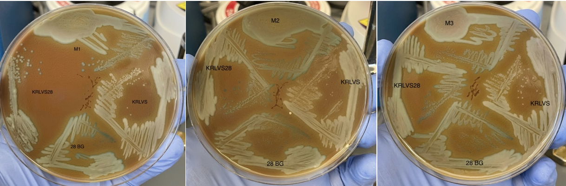
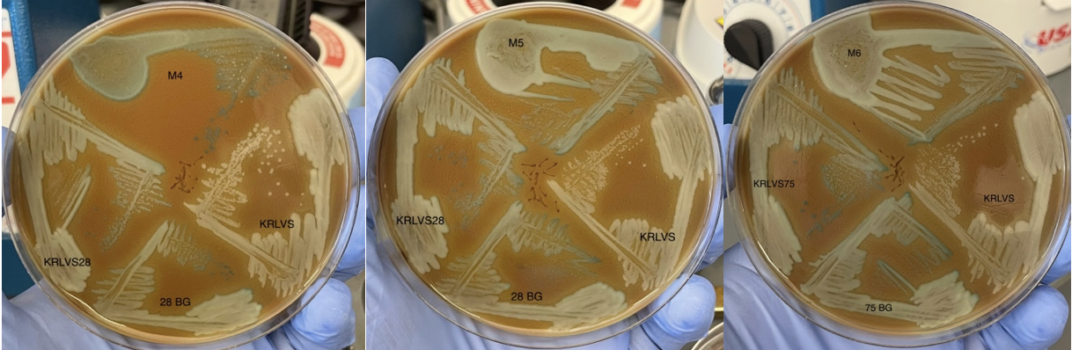
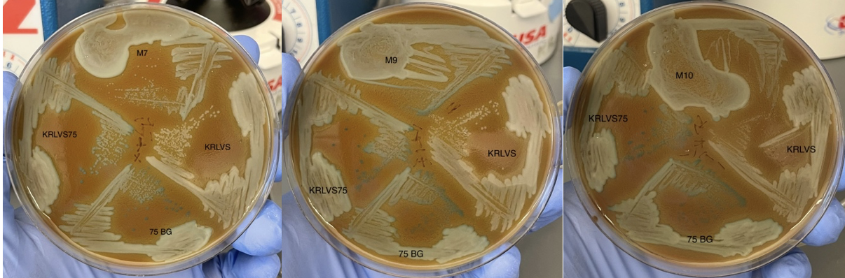
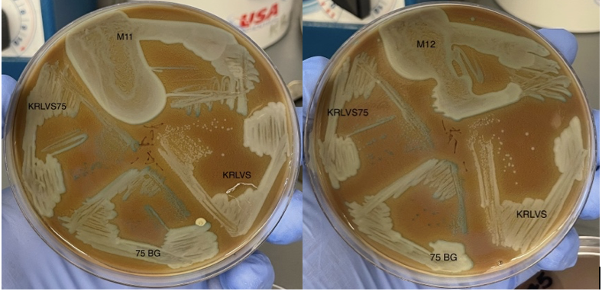
Notes:
So here are the results of the second screening. Out of all these plates there were only 3 that we were really interested in.

Slide 11
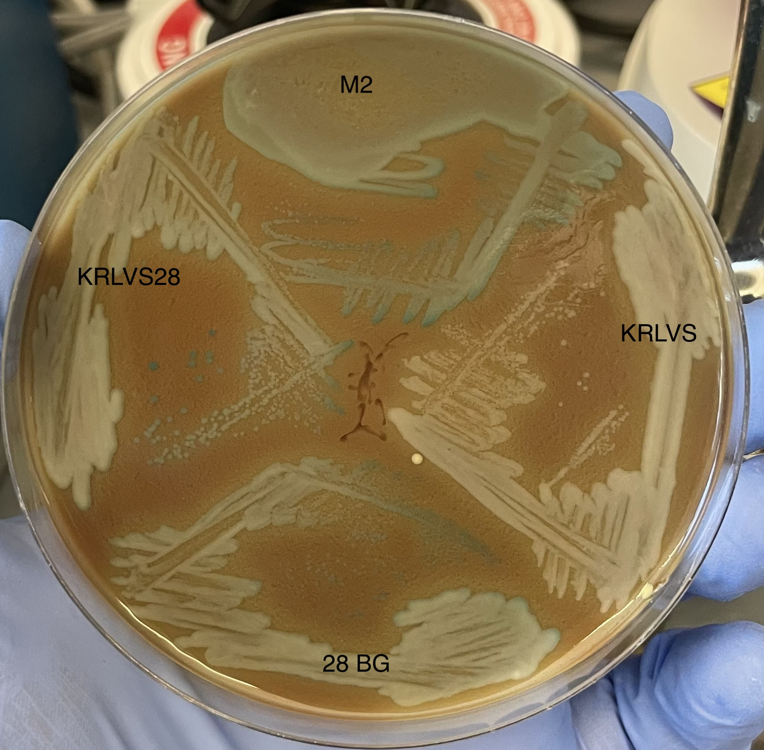
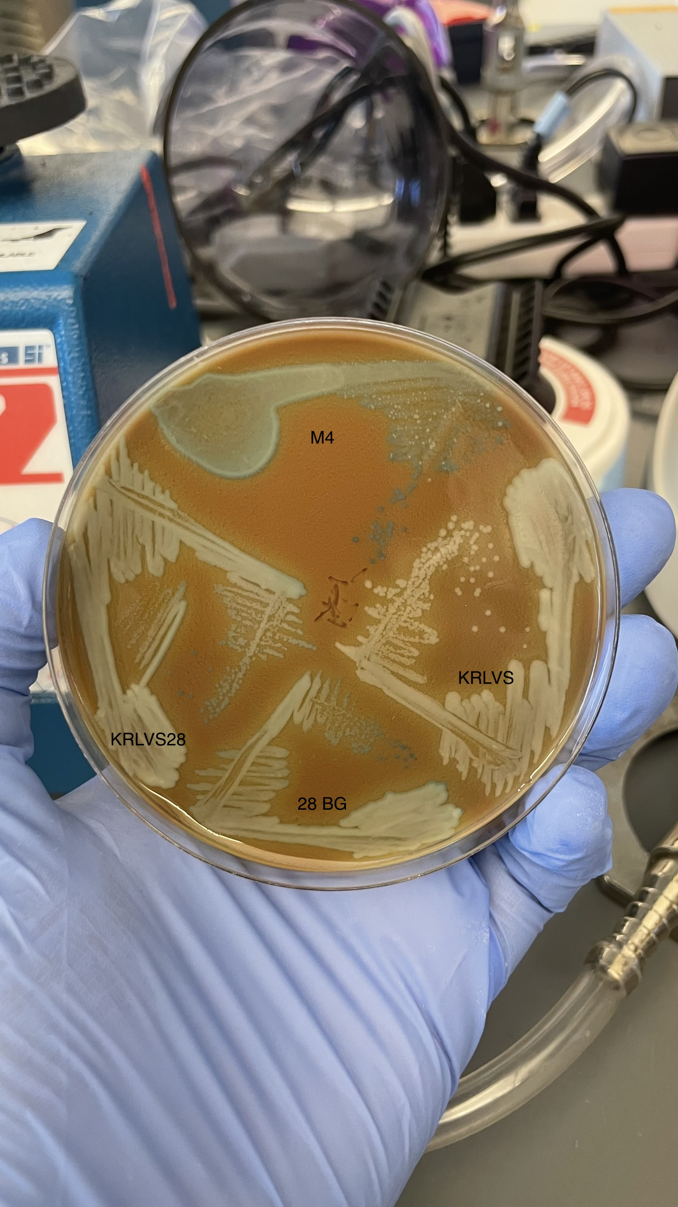
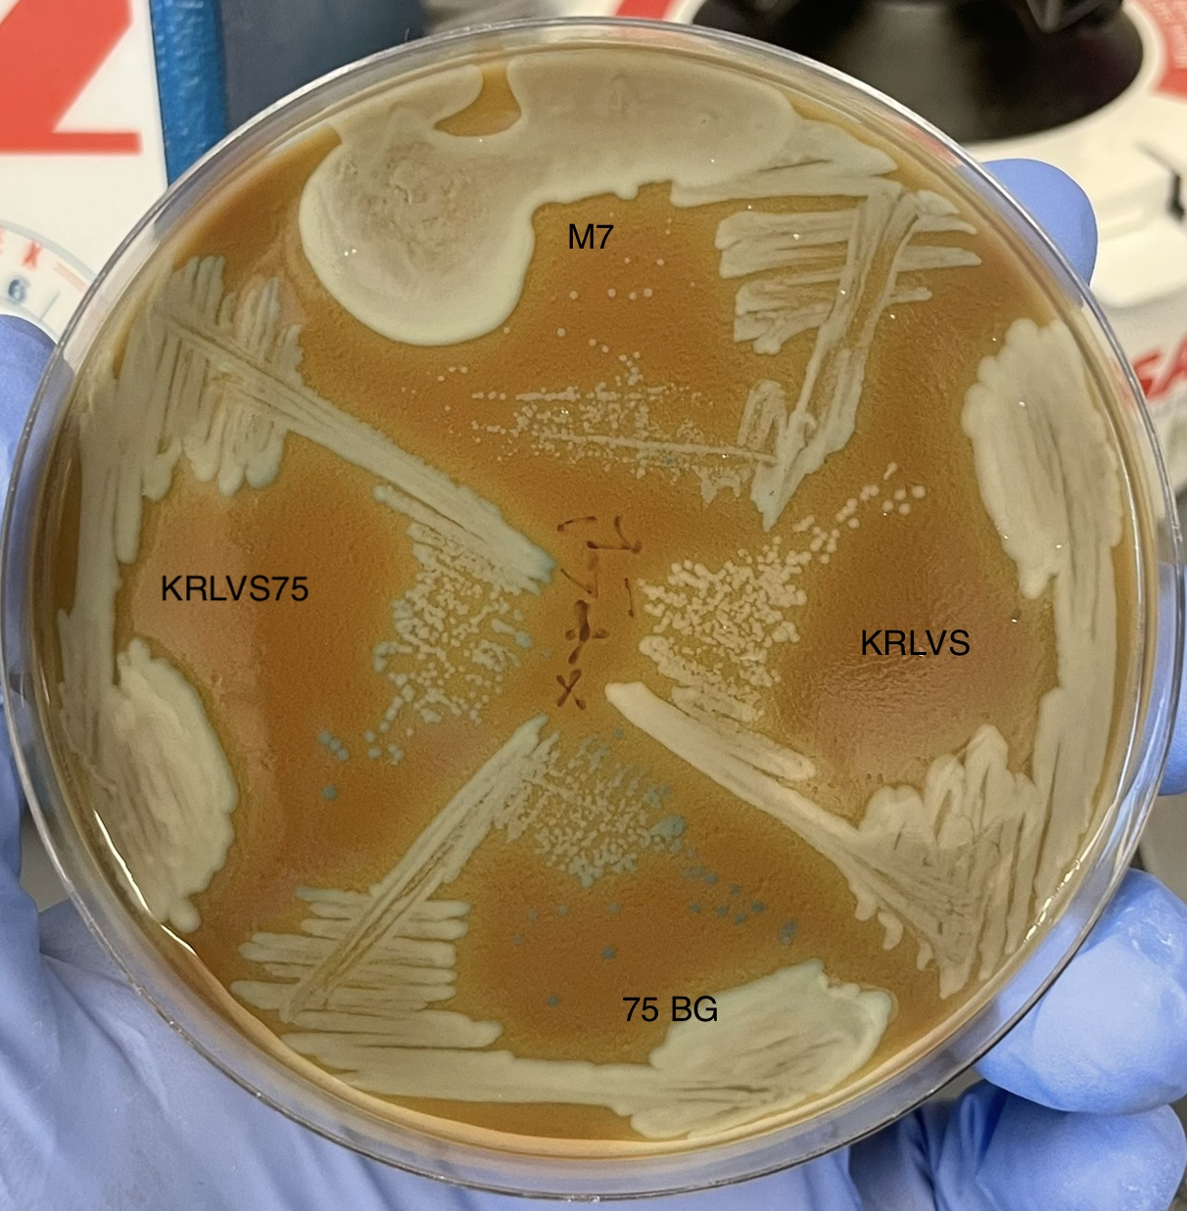
Mutants of interest:
M2: darker colonies than parental strain KRLVS28
M4: darker colonies than parental strain KRLVS28, also two phenotypes presenting
M7: white colonies, possibly an insertion disrupting lacZ
Notes:
The first mutant we were interested in was mutant 2. Mutant 2’s colonies were significantly darker than its parental strain KRLVS28. Next, was mutant 4. Mutant 4’s colonies were also darker than its parental strain and it presented with two phenotypes. The isolation streak showed both blue and white colonies. The last mutant that caught out attention was mutant 7. Mutant 7 presented with white colonies, leading us to believe that the transposon might have inserted disrupting lacZ. We continued testing on these three mutants.

Slide 12
What now?
ß- Galactosidase Activity Assay for Mutant 2, Mutant 4, Mutant 7, and both parental strains (KRLVS28 & KRLVS75)
Isolation streak of Mutant 4
Colony PCR for Mutant 7 and the parental strain KRLVS75
Notes:
We decided to perform a beta galactosidase activity assay for mutant 2, mutant 4, mutant 7, and both parental strains. In addition, I performed an isolation streak for Mutant 4, and we did colony PCR for mutant 7 and its parental strain, KRLVS75.

Slide 13
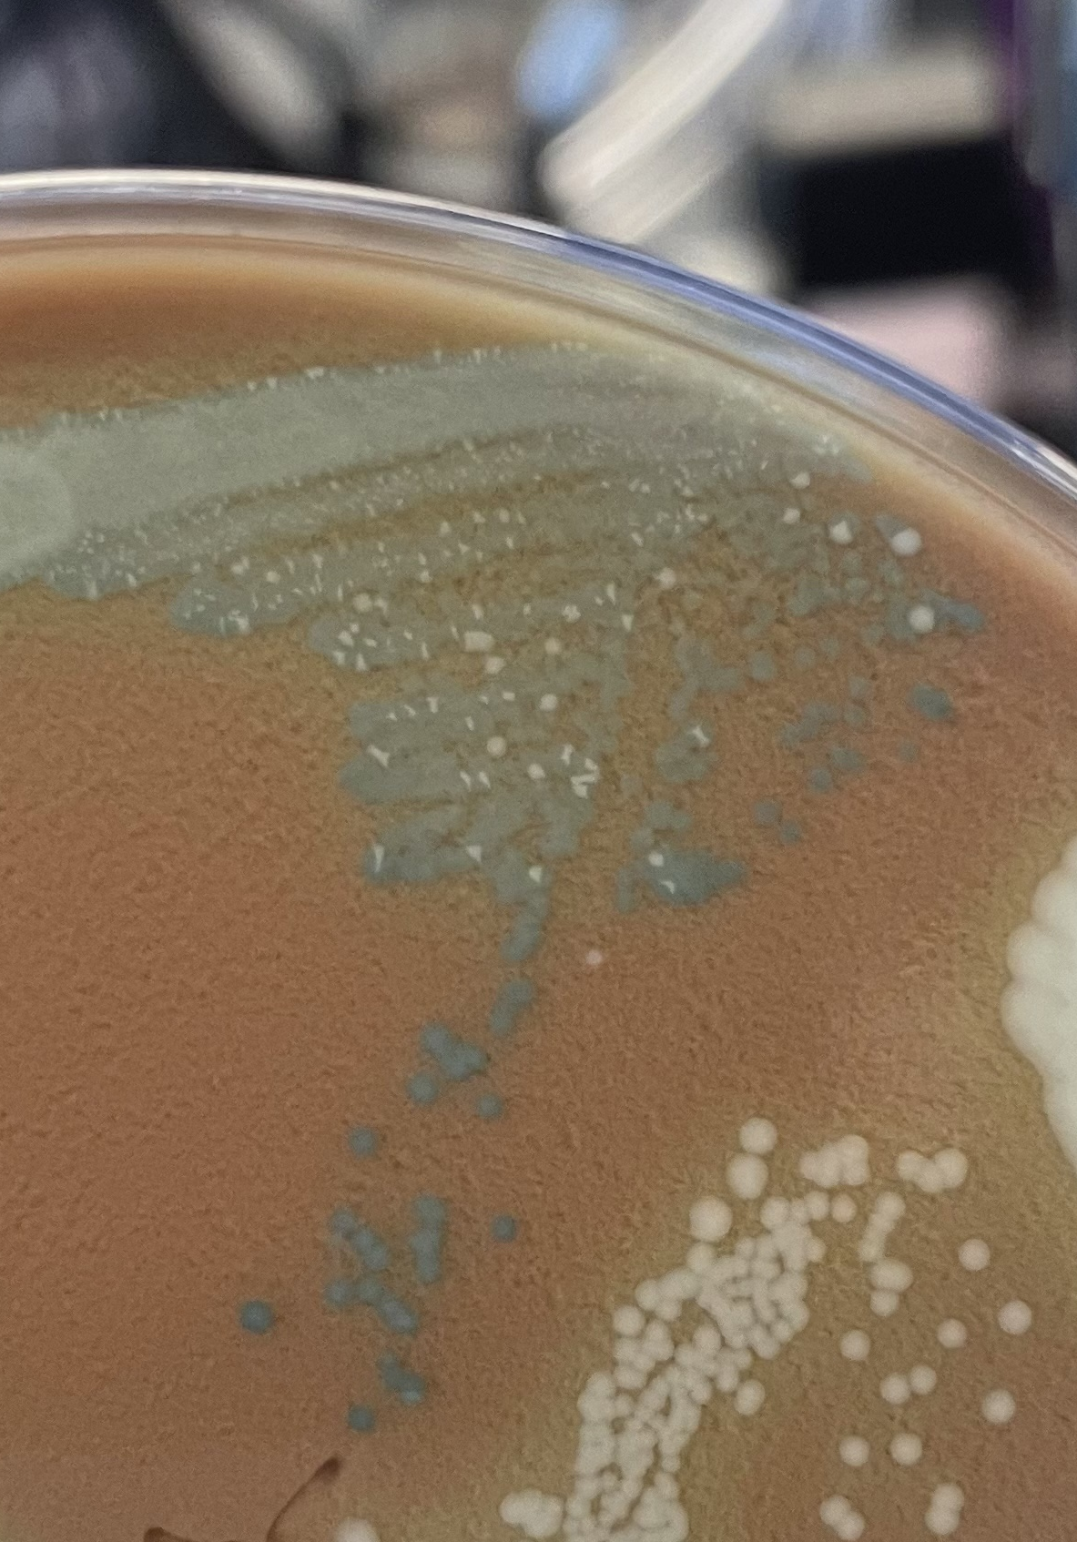
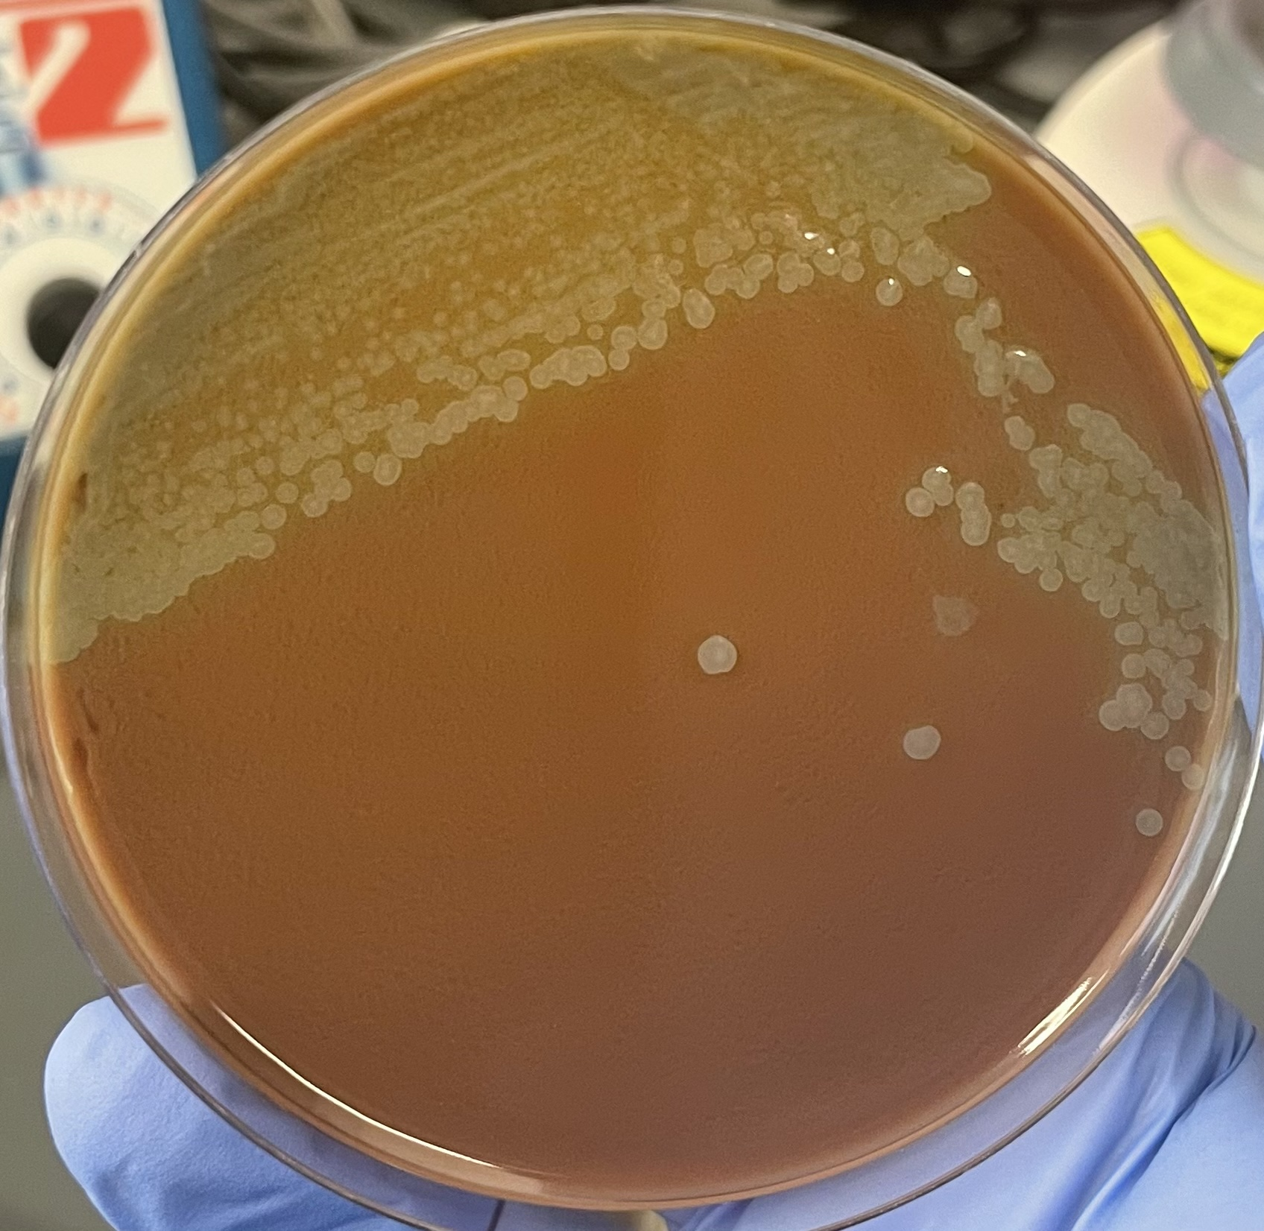
Mutant 4 Isolation Streak:
Purpose:
  Investigate the two opposing phenotypes
How:
  Isolation streak from one of the isolated blue colonies
  Let grow up until we have isolated colonies
  ß-galactosidase soft agar overlay
  Check for ß-galactosidase activity
Results:
  M4 grew white, indicating little to no ß-galactosidase activity
Above: The second round of screening plate
Right: Close-up of the M4 isolation streak demonstrating 2 phenotypes
Notes:
The purpose of performing an isolation streak for mutant 4 was to investigate the two opposing phenotypes presenting. I streaked out from one of the blue isolated colonies, and let it grow until we had isolated colonies. Then we added the soft agar overlay and checked for beta galactosidase activity after 24hrs. The results were that the mutant 4 colonies grew white, indicating there was little to no beta galactosidase activity. This was not at all the result we were anticipating, and we still don’t have a clear answer for why they grew white. One possibility is that what grew, was not Francisella. The other possibility is that maybe the cells I took from the blue colony had mutated to stop producing beta galactosidase. The mutant 4 colonies were very dark blue, so I have to assume the cells were very stressed and dying from the high concentration of toxic product produced when beta galactosidase cleaves X-gal. Regardless, further investigation is required.
***I struck out this plate before thanksgiving break and we left it on the bench to grow at room temp until we came back. After break, there was no visible growth on the plate so we put it into the 37 degree incubator. The next day, we had growth and isolated colonies

Slide 14
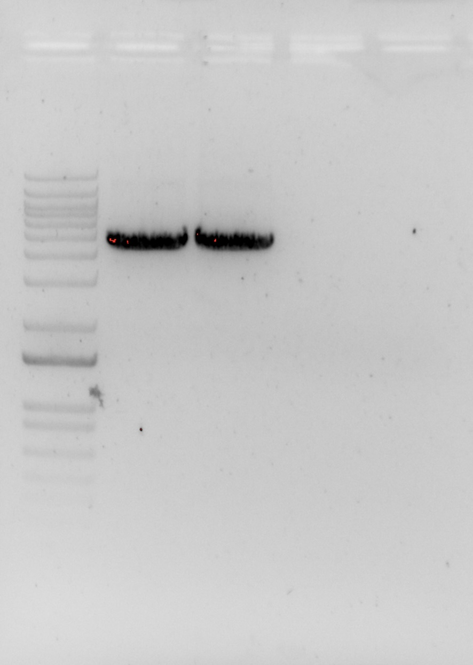
Colony PCR for Mutant 7:
Negative control
Mutant 7
KRLVS75
KRLVS G DNA
Ladder
Purpose:
  M7 had white colonies during our second screening, indicating that lacZ may have been interrupted
  By performing Colony PCR and running a gel, we could see if the transposon inserted into either lacZ or rpsU3
Results:
  The band matched the band of the parental strain, indicating the transposon did not insert into lacZ or rpsU3
  If the transposon had inserted right before the promotor for rpsU3/lacZ, maybe that could have influenced ß-galactosidase production
5,000 bp
3,000 bp
1,500 bp
Notes:
We performed colony PCR on Mutant 7 because it presented with white colonies during our second screening, leading us to believe that lacZ may have been interrupted. Performing colony PCR and running a gel would allow us to see if the transposon inserted into either lacZ or rpsu3. Our result was that the band for mutant 7 matched the band of its parental strain. This would indicate that the transposon did not insert into lacZ or rpsU3. This was also not a result we anticipated, and again there are two possible causes we could come up with to explain this. My first thought was maybe the transposon had inserted right before the promotor for rpsU3/lacZ. Maybe this could still have affected beta galactosidase activity but have not been caught by the primers we used. The other answer is maybe mutant 7 wasn’t really white. The issue with screening mutants by beta galactosidase activity/ blue pigment production, is that is all subjective. Where I may have classified mutant 7 as white, another may have interpreted it as light blue.
The beta galactosidase activity assay should provide a more quantitative lens to view mutants 2, 4, and 7 in.

Slide 15
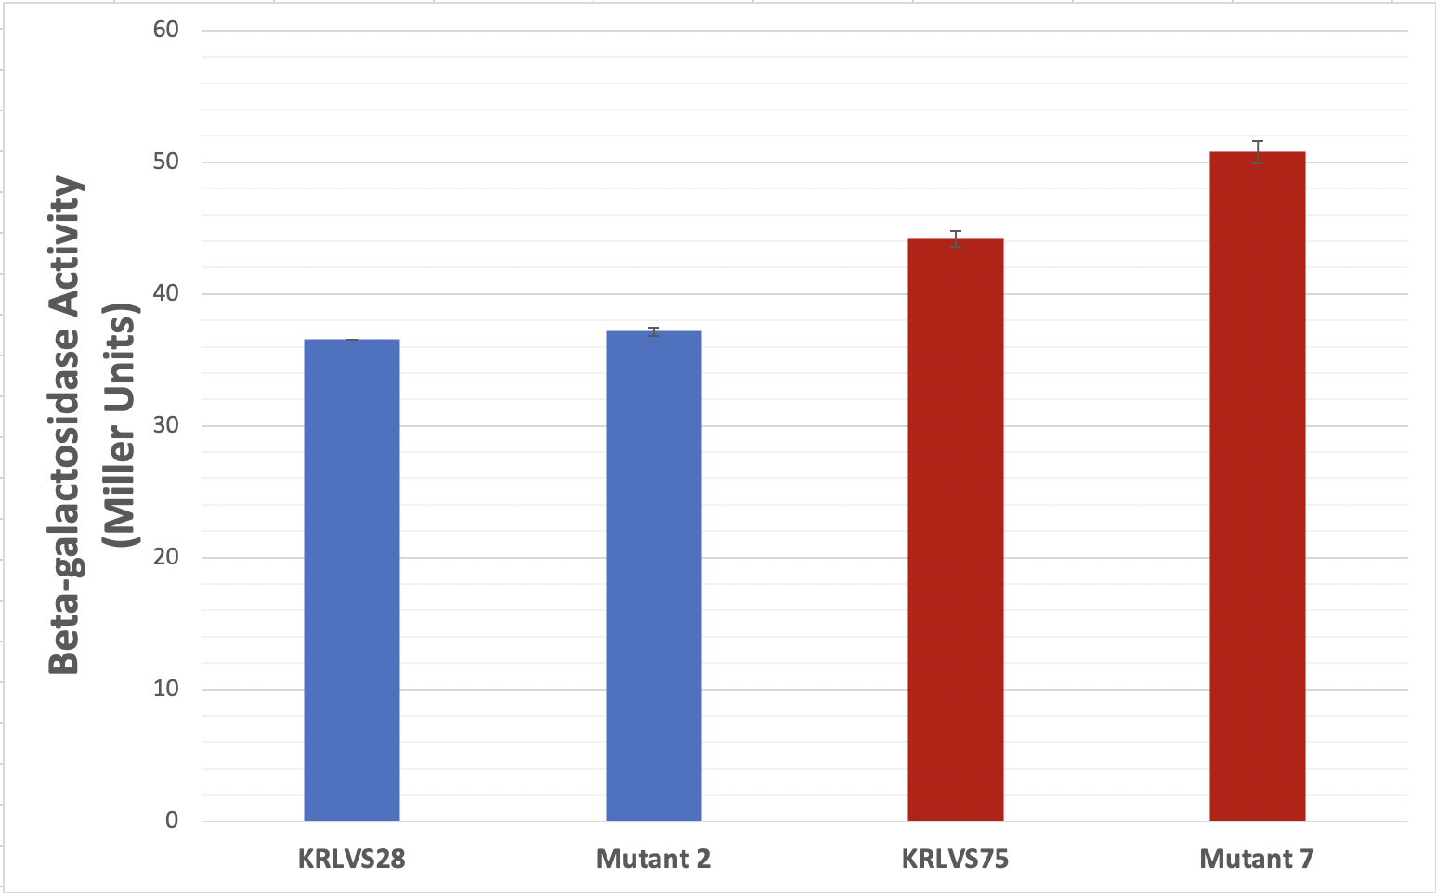
ß- Galactosidase Activity Assay
Mutant 2 and Parental strain KRLVS28
  Expectation:
    We expected M2 to have more ß-galactosidase activity because the colonies, when screening, seemed to produce more blue pigment than the parental strain
  Result:
    The was only a 0.6 Miller Units increase in ß-galactosidase activity activity
    Not statistically significant
Mutant 7 and Parental strain KRLVS75
  Expectation:
    We expected to see reduced ß-galactosidase activity since, during screening, the colonies were white or very, very light blue
  Result:
    The was about a 6.55 Miller Units difference in ß-galactosidase activity
    Statistically significant! P-value = 0.0017
rpsU1
rpsU3
Notes:
Starting off, Mutant 4 did not cooperate and did not grow to a high enough cell density to be on this assay.
Our expectation for mutant 2 was to see an increase in beta galactosidase activity in comparison to its parental strain KRLVS28, because it’s colonies seemed to produce more blue pigment. Our result was only a 0.6 miller unit increase in beta galactosidase activity, which was not statistically significant.
Our expectation for mutant 7 was to see a decrease in beta galactosidase activity in comparison to its parental strain KRLVS75, because its colonies were white, or very very light blue during screening. The result was a 6.55 miller until increase in beta galactosidase activity, which is statistically significant. However, as Kathryn pointed out on Wednesday, just because something is statistically significant, doesn’t mean it is meaningful.

Slide 16
Conclusions:
Mutant 2:
  ß-galactosidase Activity Assay:
    There was no significant increase or decrease in ß-galactosidase activity.
    Probably not worth further investigation
Mutant 4
  Still want to perform ß-galactosidase Activity Assay
  Isolation streak:
    Interested in if an isolation streak of the freezer stock would show the same results
Mutant 7
  Colony PCR:
    Double-check primer locations
  ß-galactosidase Activity Assay
    We would have expected to see a decrease in ß-galactosidase activity since the colonies were white on the plate. So, to see a statistically significant increase in ß-galactosidase activity is strange.
Notes:
Conclusions!
For mutant 2, there was no significant increase or decrease in beta galactosidase activity, and it is probably not worth further investigation.
For mutant 4, we still want to perform a beta galactosidase activity assay. As for the isolation streak, I would be interested in seeing if an isolation streak from the freezer stock of this mutant would produce the same results.
Lastly mutant 7, the colony PCR results and the beta galactosidase activity assay results are in direct opposition of the colony morphology presented during the screening. After discussing these opposing results with the lab, we concluded that our screening plate was probably incorrect. Along with being a very subjective tool, the mutant screening using the beta galactosidase soft agar overlay is not very reproducible. It might still be worthwhile to look into the primers we used during colony PCR, but besides that, further investigation is probably not worth the effort.

Slide 17
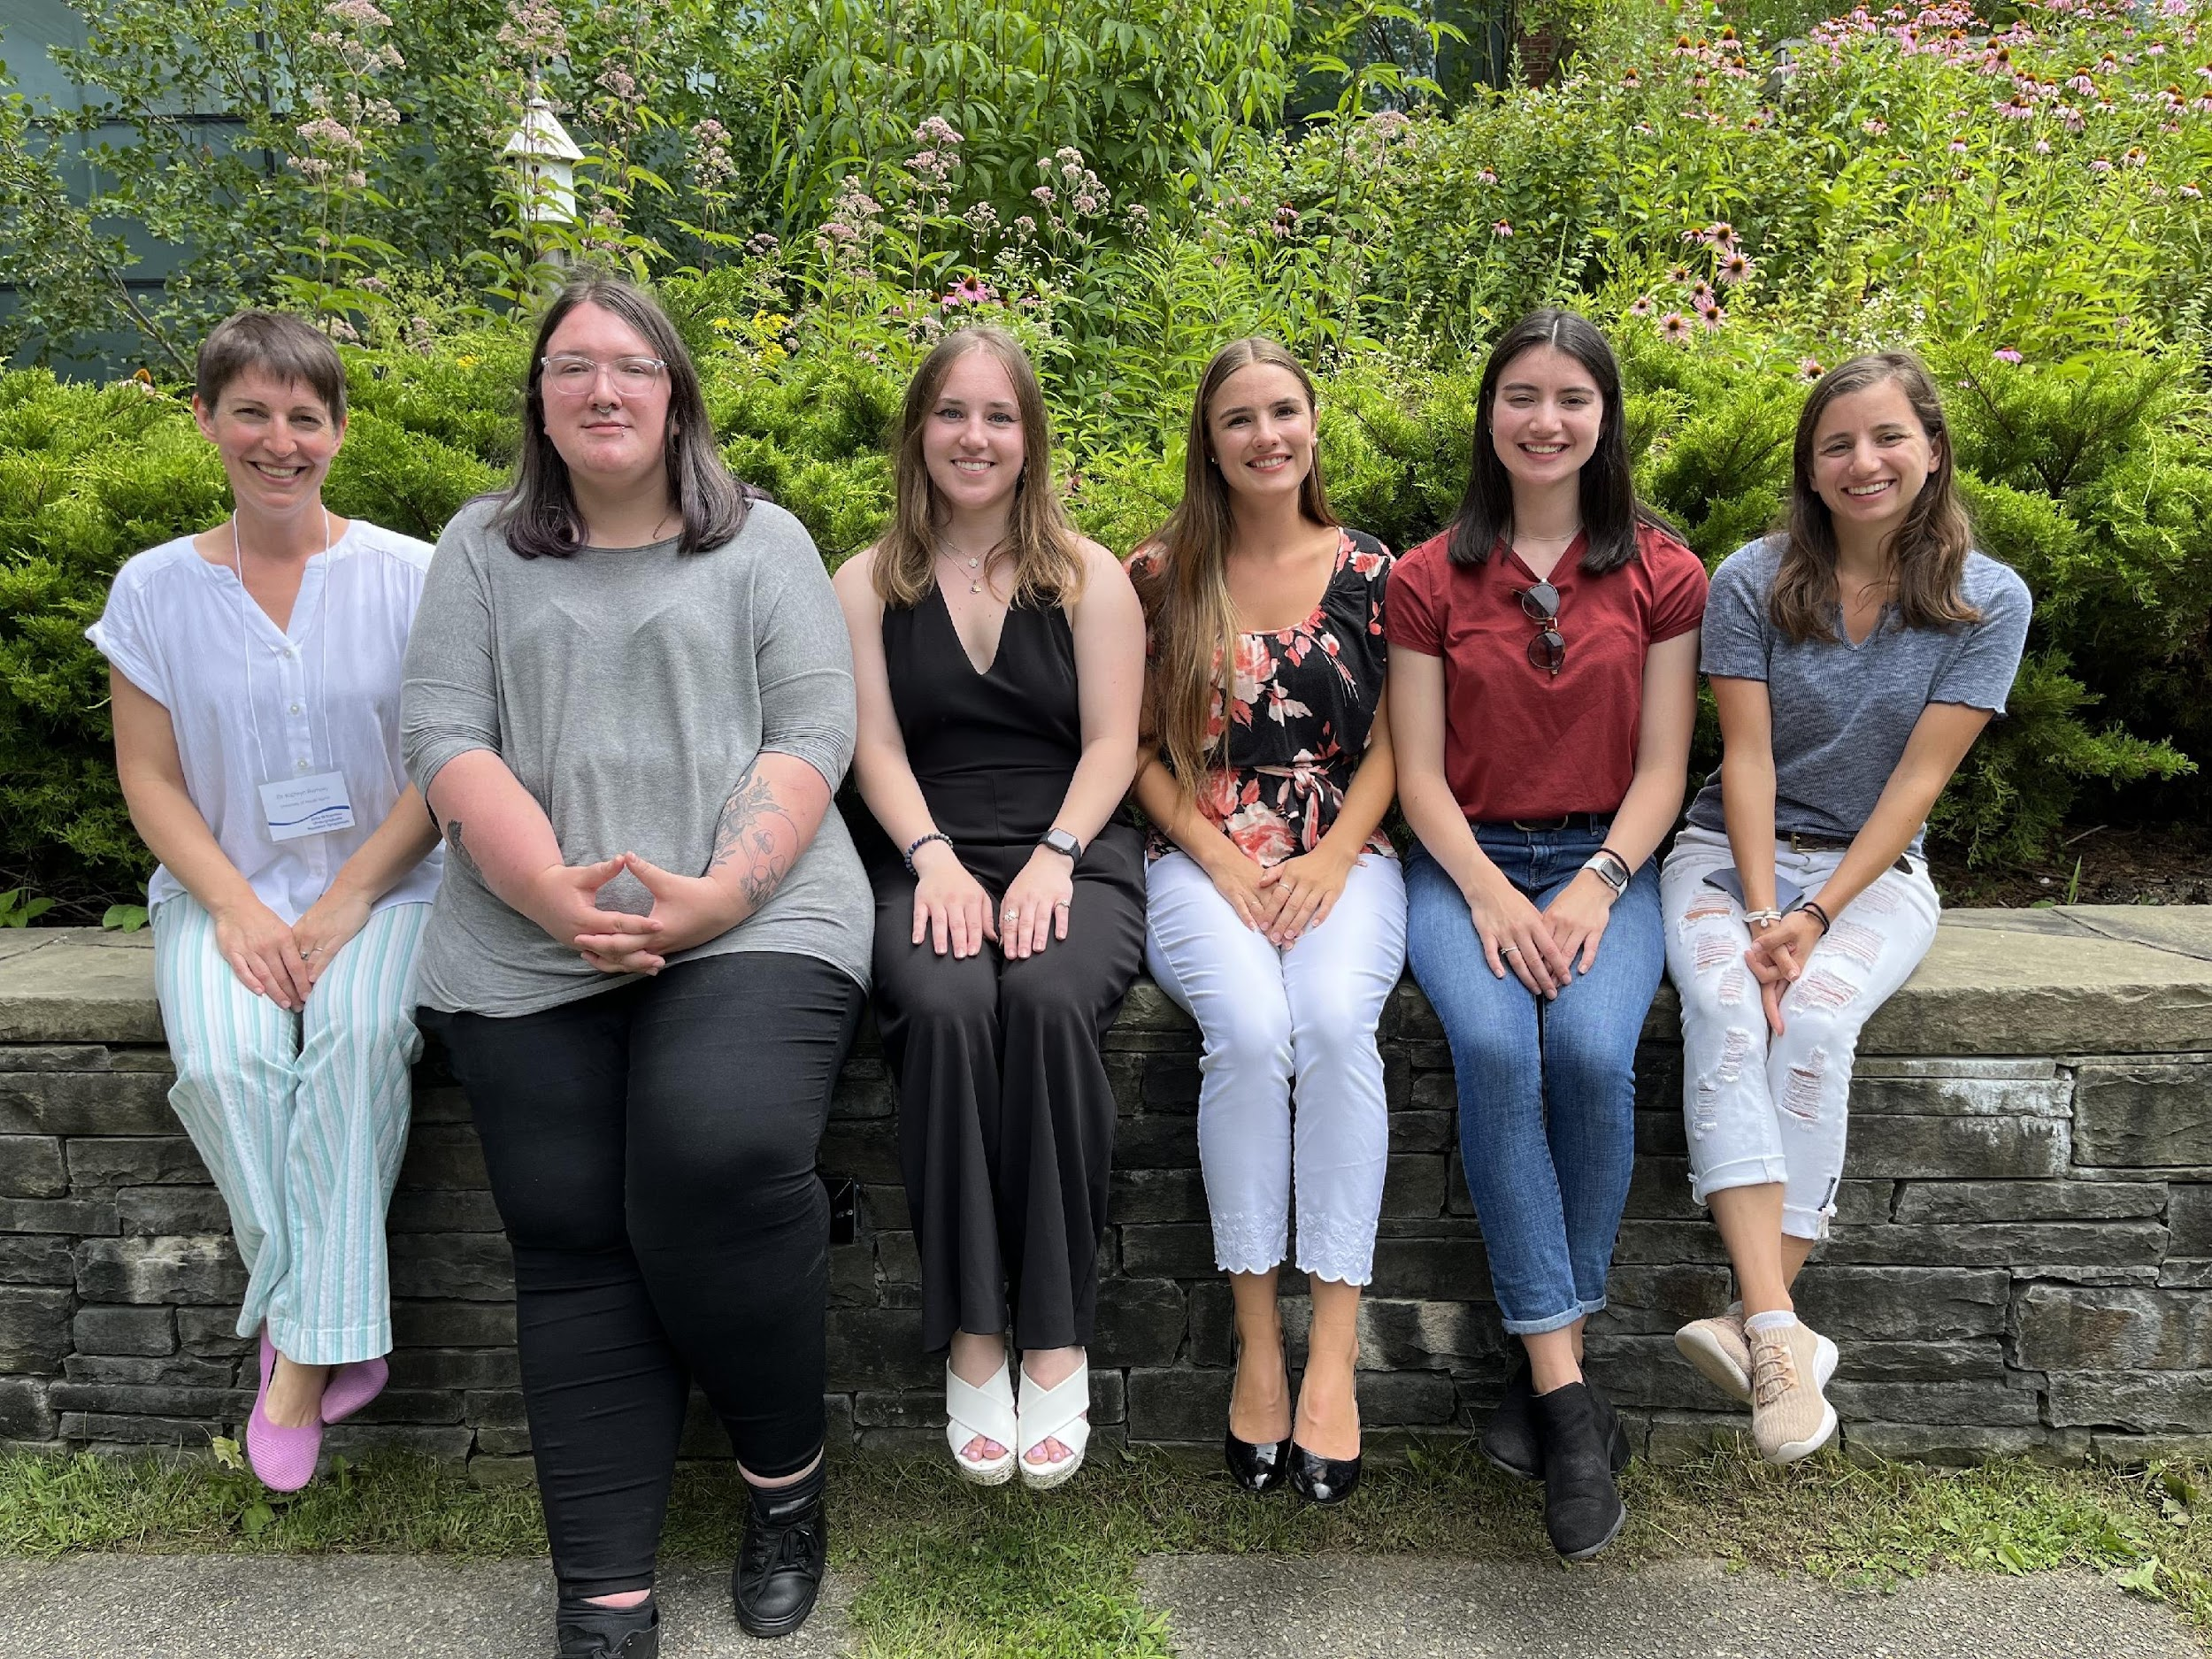





ACKNOWLEDGEMENTS
The entire KRamsey Lab!
  Dr. Kathryn Ramsey
  Hannah Trautmann
  Sierra Schmidt
  Aisling Macaraeg
  Former lab members
An extra special thank you to Sierra! Thank you for training me and helping me throughout this project!
Dr. Steven Gregory
URI INBRE core

Slide 18
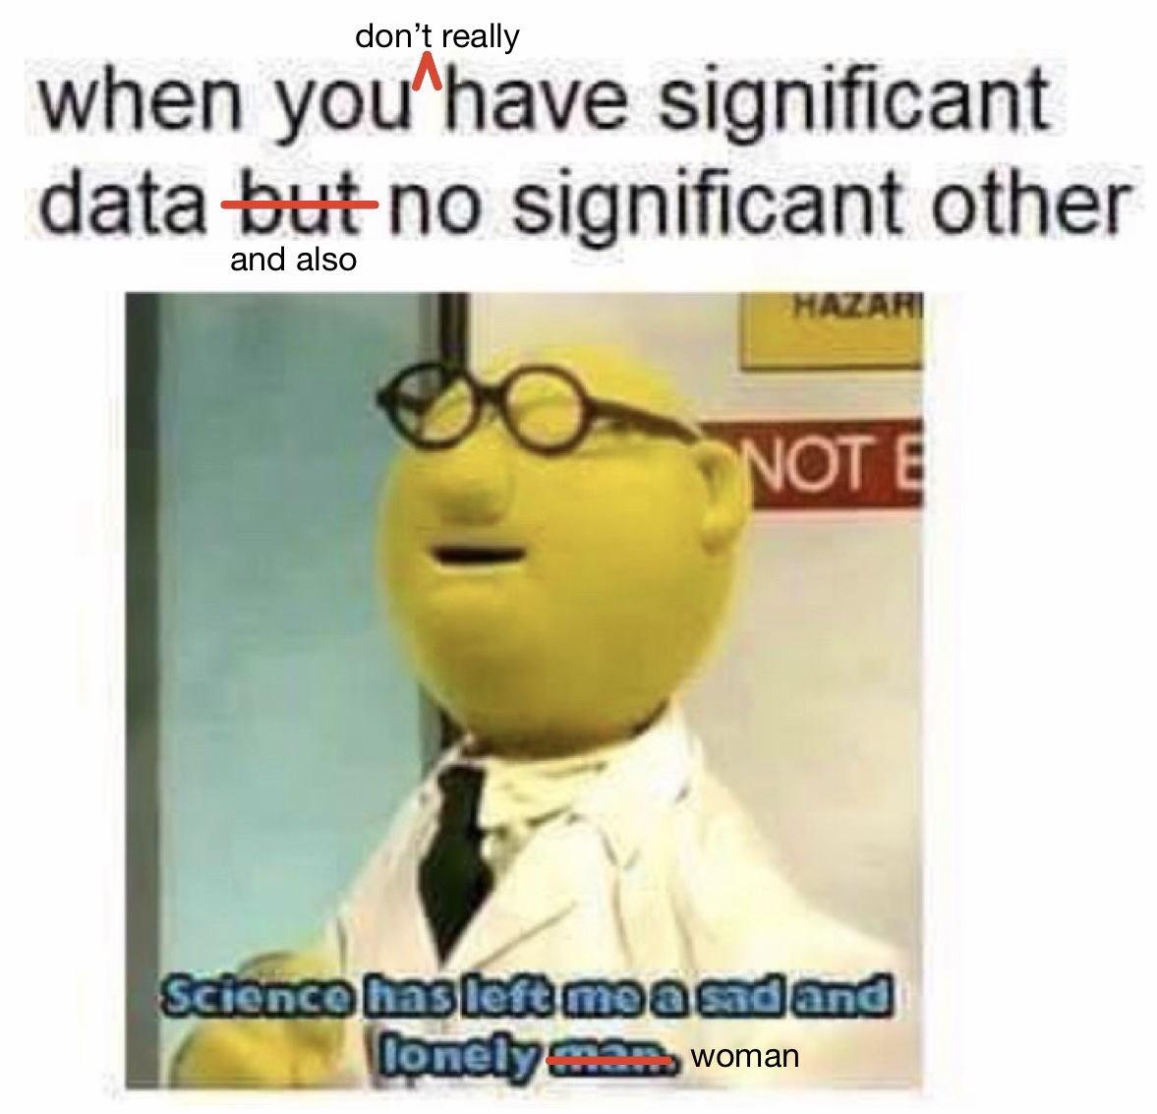
Questions?

Slide 19
Colonies from first screening plated on CHAH+Kan
Mutant Number | Plate | Description | Patch growth?
0 | KRLVS28 negative control | N/A | No
1 | KRLVS28 | Small dark blue colony | Very light growth
2 | KRLVS28 | Medium size medium/dark blue colony | Yes
3 | KRLVS28 | Small dark blue colony | Yes
4 | KRLVS28 | Medium size dark blue colony | Very light growth
5 | KRLVS28 | Medium size white colony | Yes
6 | KRLVS75 | Small very dark blue colony | Yes
7 | KRLVS75 | Small very light blue/white colony | Yes
8 | KRLVS75 | Small/medium white/light blue colony | No
9 | KRLVS75 | Small dark blue colony | Very light growth
10 | KRLVS75 | Small white colony | Yes
11 | KRLVS75 | Medium size darker blue colony | Yes
12 | KRLVS75 | Very small dark blue colony | Yes
13 | “Background” from KRLVS75 | Background | Yes
14 | “Background” from KRLVS28 | Background | Contamination
15 | KRLVS75 negative control | N/A | No

