Slide 1
Current projects:
Cloning plasmid pKR187
Testing growth curves comparing BHI and MHB

Slide 2
1
2
3
4
5
1st Gel run from PCR products to create pKR187

Slide 3
Reaction Number | Plasmid/Region | Source DNA | Primers | Length (bps)
1 | pKR152 | same | KROL622, KROL326 | 212
2 | pKR152 | same | KROL623, KROL550 | 103
3 | + control | LVS gDNA | KROL15, KROL16 | 441
4 | - control | - | KROL622, KROL326 | -
5 | - control | - | KROL623, KROL550 | -
PCR reactions that produced the products used for the gel

Slide 4
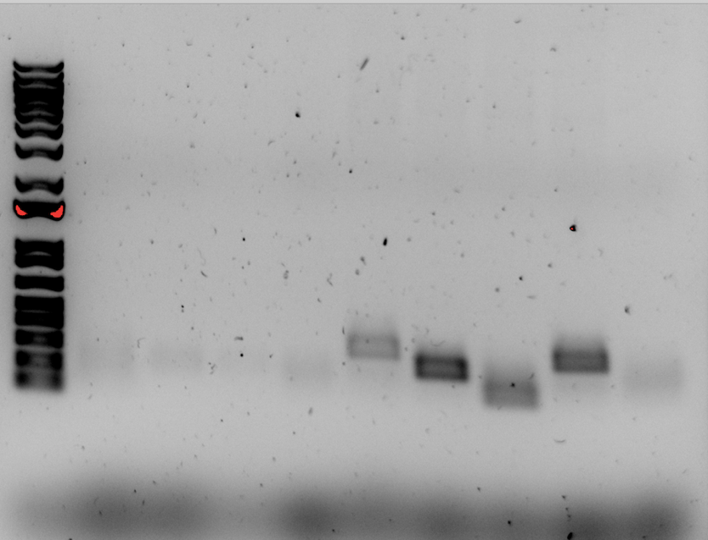
1
2
2
3
4
1
2
3
4
Second PCR reaction to form target plasmid pKR187

Slide 5
Reaction Number | Plasmid/Region | Source DNA | Primers | Length (bps)
1 | pKR152 | same | KROL622, KROL326 | 212
2 | pKR152 | same | KROL623, KROL550 | 103
3 | + control | pKR152 | KROL326, KROL550 | 290
4 | - control | - | KROL550, KROL326 | -

