Slide 1
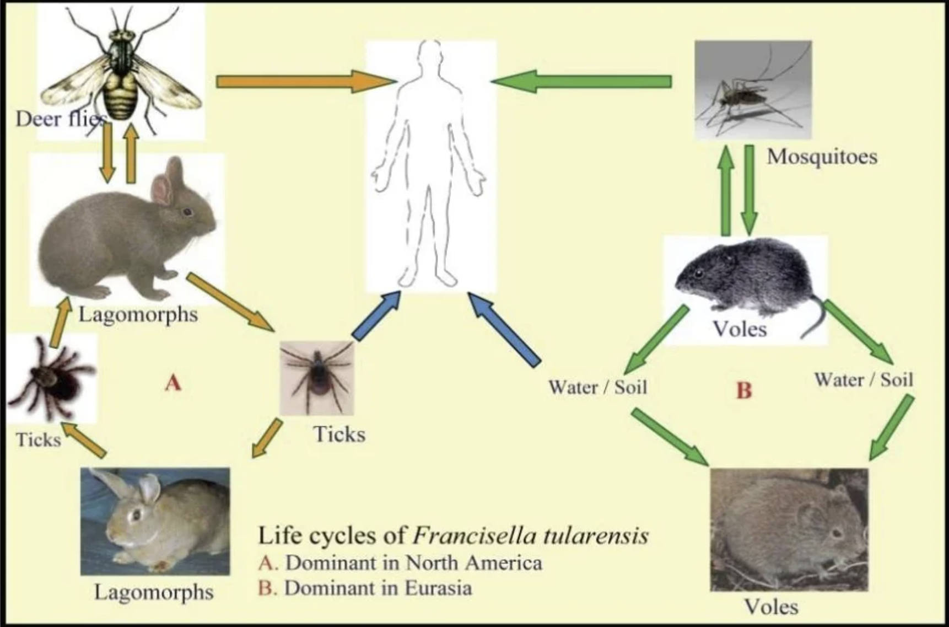
The Search for bS21-1 Upregulation in Francisella tularensis
Brenna Levesque
Kathryn Ramsey Lab Rotation II

Slide 2
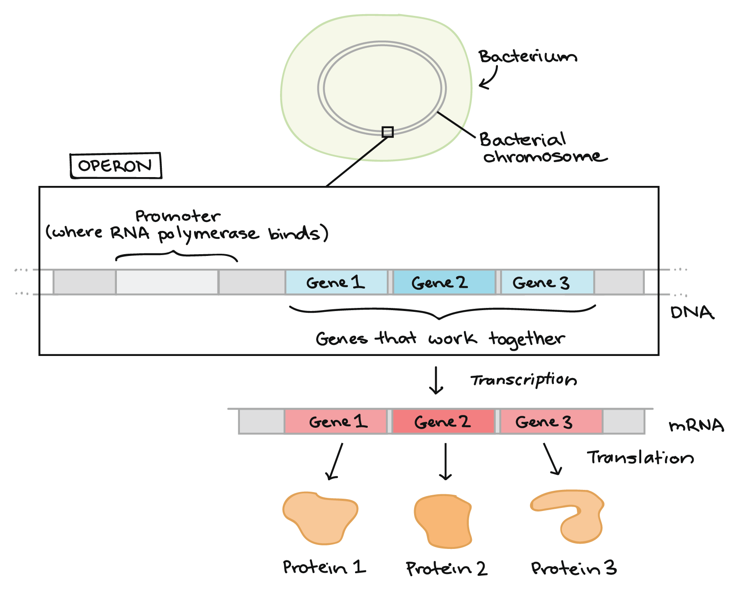
Big Picture What Are We Studying?
Gene Regulation
Protein Upregulation
https://www.google.com/url?sa=i&url=https%3A%2F%2Fwww.khanacademy.org%2Fscience%2Fap-biology%2Fgene-expression-and-regulation%2Fregulation-of-gene-expression-and-cell-specialization%2Fa%2Foverview-gene-regulation-in-bacteria&psig=AOvVaw0JW7PaXkN7WLSAEEx7Ar2v&ust=1667360420468000&source=images&cd=vfe&ved=0CA0QjhxqFwoTCMCb5t6HjPsCFQAAAAAdAAAAABAM

Slide 3
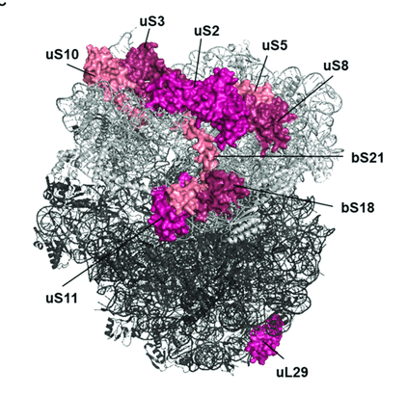
Study of bS21
Nonessential ribosomal protein involved in translation initiation
Model in which bS21 homologs function as posttranscriptional regulators, allowing preferential translation of specific subsets of mRNAs
Notes:
F. tularensis encodes three distinct heterogeneous homologs for bS21

Slide 4
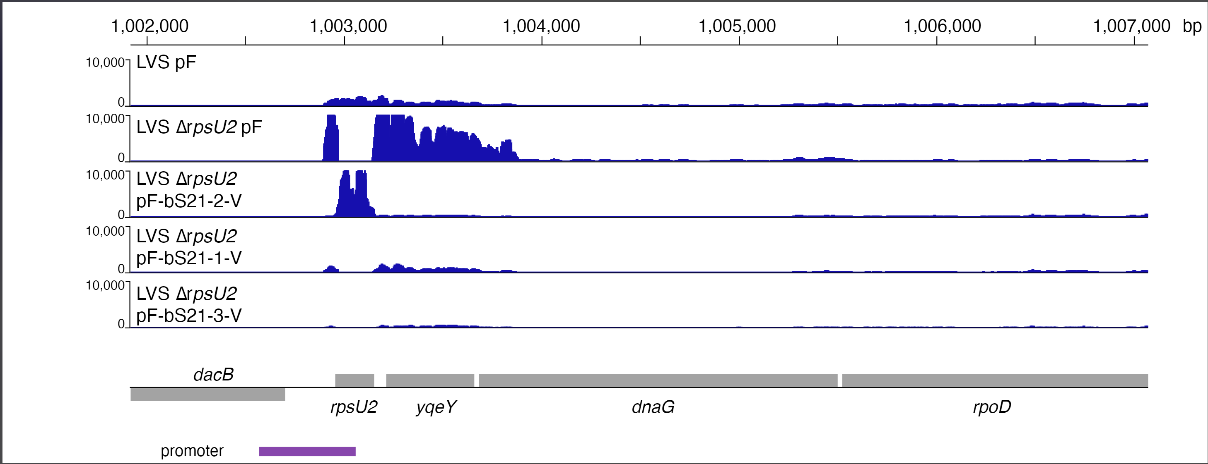
RNA Seq Data Suggest bS21-2 Negatively Regulates its Own mRNA
bS21-2 is encoded by rpsU2
Notes:
I will be showing you some RNA seq data, but to first orient you to where on the chromosome we are looking, we have thi FTL region, followed by the promoter for rpU2, the rpsU2 gene, as well as the ret of the genes of the operate, yqeY, dnaG, ropA.Now in the wildtype confirguation of this this operon, we see some peaks in the first part of the operon, rpsU2 and its promoter, followed by a decrease in the relative abundance of the following genes. ON this scale, it doesn’t seem too drastic, but there is that relationship. So, next, in order to look at the effects of bS21=2 on the operon, we took it out of the cells and we see this. There is high level of transcript abundance for the promoter of rpsU2, this empty region which is bS21-2, which of course we took out so we see no transcript abundance, followed by high levels of expression of the rest of the genes in the operon. Now this presents two possibilities: Some indirect effect by the loss of bS21-2 or bS21-2 itelf is unctioning as a negative regulation of its own transcription. To test this, bS21-2 was added back to the cell on a plasmid, as this would eptopically express the protein, were this negative regulation to be recovered, then we would expect the second possibility to be true, and, in fact, we do.

Slide 5
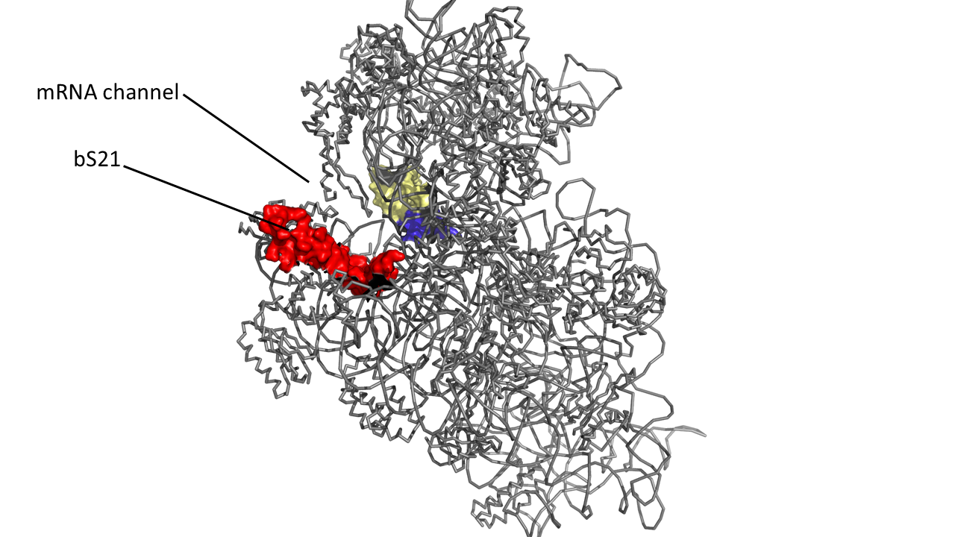
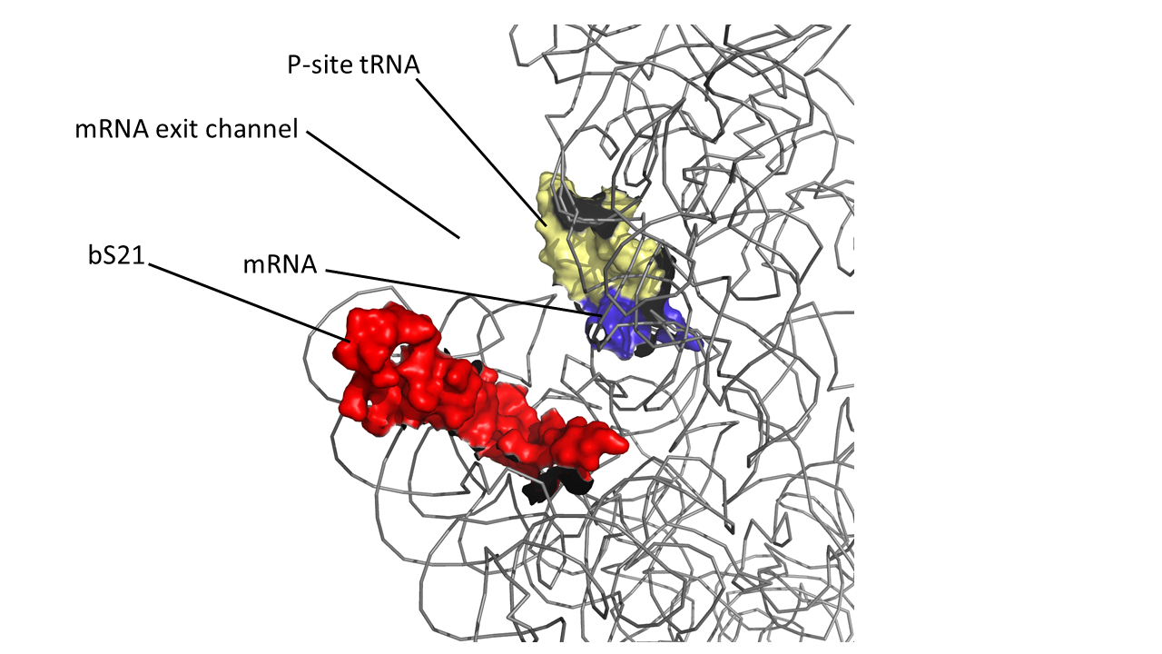
bS21, a small subunit ribosomal protein
Involved in translation initiation
Non-essential
Encoded by phage
Impacts different phenotypes in different species
Take home: bS21 may act as a regulator of translation
30S subunit, modeled from PDB entry: 4V50
Notes:
Even though francisella has a reduced genome, it encodes three copies of the rpsU genes, which encode bS21, a protein in the small ribosomal subunit. Most bacteria have 0 or 1 of this gene. We originally, hypothesized, and have since shown, that these three proteins are produced and incorporated into ribosomes. This is a western blot of purified ribosomes from our wild-type strain as well as strains ectopically expressing each of the bS21 proteins, with a VSVG tag. This, along with some mass spec data we have of purified ribosomes, indicates that multiple classes of ribosomes are possible and occurring
This protein is also interesting to us because it is located close to the mRNA exit channel in the ribosome, and early research has identified that it is involved in translation initiation, so it is in an ideal location to be regulating gene expression at the level of translation initiation.

Slide 6
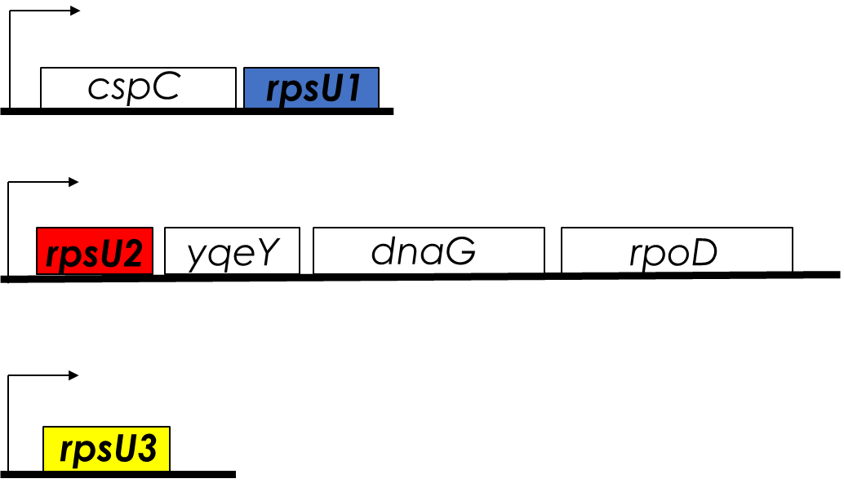
Multiple bS21 Homologs Cause Heterogenous Ribosome Populations in Francisella tularensis
Loss of bS21-2
change in virulence protein abundance
reduces ability to grow in macrophage
bS21 is encoded by rpsU
Notes:
Even though francisella has a reduced genome, it encodes three copies of the rpsU genes, which encode bS21, a protein in the small ribosomal subunit. Most bacteria have 0 or 1 of this gene. We originally, hypothesized, and have since shown, that these three proteins are produced and incorporated into ribosomes. This is a western blot of purified ribosomes from our wild-type strain as well as strains ectopically expressing each of the bS21 proteins, with a VSVG tag. This, along with some mass spec data we have of purified ribosomes, indicates that multiple classes of ribosomes are possible and occurring
This protein is also interesting to us because it is located close to the mRNA exit channel in the ribosome, and early research has identified that it is involved in translation initiation, so it is in an ideal location to be regulating gene expression at the level of translation initiation.

Slide 7
Why Look At bS21-1 (and bS21-3)?
bS21-1 seem to contribute a similar negative regulatory effect on rpsU2 transcript abundance
Address the contribution of bS21-1 on the regulation of bS21-2
Exploring environmental conditions to determine what may up-regulate the production of either bS21-1
    1 and 3 less abundant in cell - harder study
Notes:
NOTE bS21-3 got contaminated and was not working so in short time focused on bS21-1

Slide 8
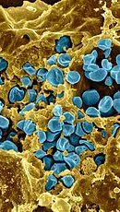
Why Francisella tularensis?
Highly Infectious Tularemia AKA “Rabbit Fever”
  <10 organisms of the bacteria
Large number hosts and modes of transmission
Possible severe respiratory illness
  Including life-threatening pneumonia and systemic infection
  Potential bioweapon
Model: F. tularensis subsp. holarctica LVS (live vaccine strain)
Notes:
one of the most infectious pathogenic bacteria known
Francisella is a gram -, facultative intracellular bacteria. It is pathogenic and causes a disease called tularemia, which can take a number of forms based on the route of infection. If infection is via the skin like through a mosquito or tick bite, it produces the ulceroglandular form of the disease, or if infection is by breathing in the bacteria, it causes the respiratory form, which can be fatal.
There are a large number of hosts and vectors including ticks, mosquitos, horse flies, rabbits, and a number of other rodents. It can also be water-borne, which makes understanding its epidemiology rather complex.
This image here is colored so that the francisella are blue and are in a yellow macrophage, and you can clearly see that a ton of organisms replicate in a single host cell.

Slide 9
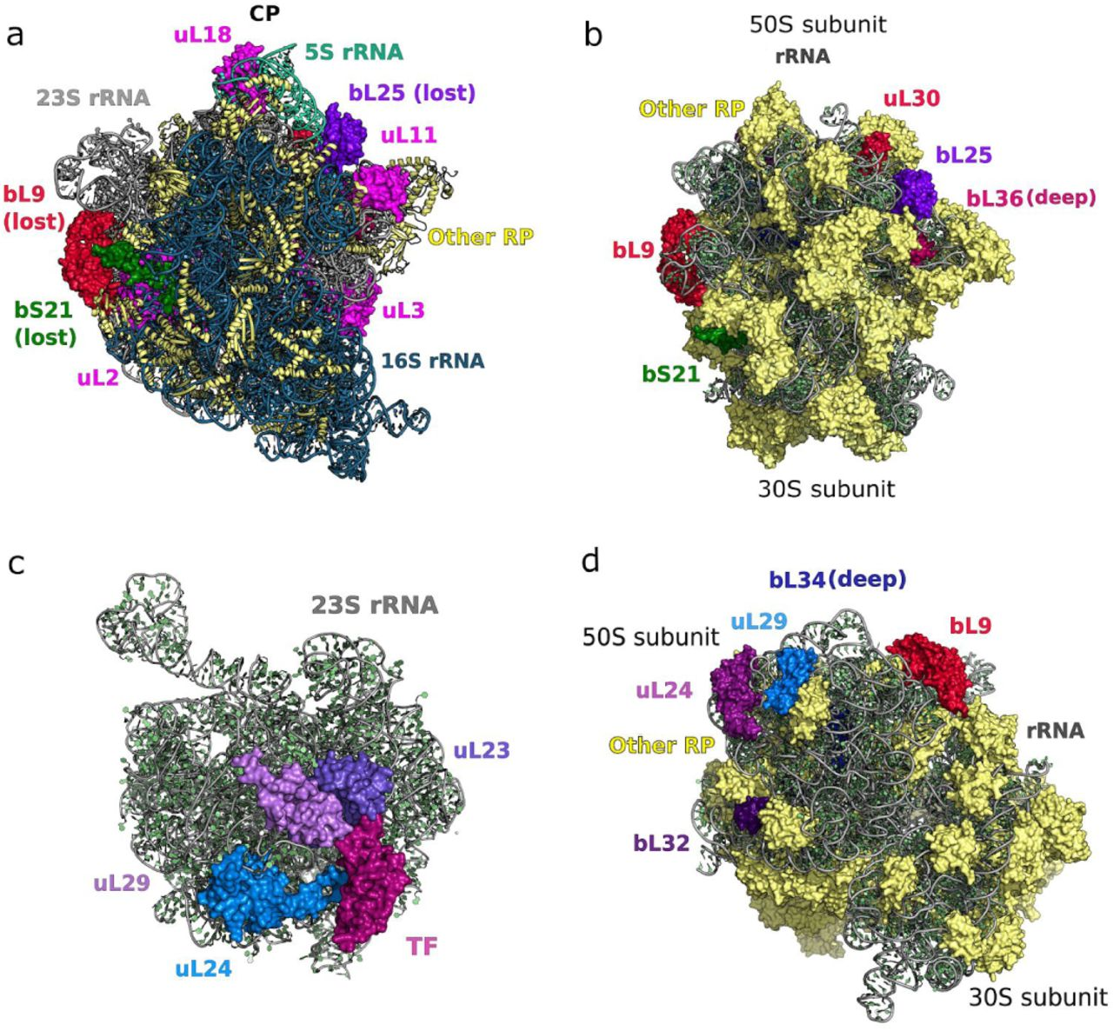
Study of BS21 Homologs in F. Tularensis: Why?
Most bacteria have 0 or 1 homolog of this gene
Loss of bS21-2 : decreased virulence & intramacrophage growth defect.
RNA Seq Data suggests bS21-2 negatively regulates its own mRNA
Simplification of ribosomes in bacteria with tiny genomes | bioRxi
https://www.google.com/url?sa=i&url=https%3A%2F%2Fwww.biorxiv.org%2Fcontent%2F10.1101%2F755876v1.full&psig=AOvVaw0_glOjXPzZTwN0G97sbVsp&ust=1667360811952000&source=images&cd=vfe&ved=0CA0QjhxqFwoTCPjs6ZmJjPsCFQAAAAAdAAAAABAR
Notes:
F. tularensis encodes three distinct heterogeneous homologs for bS21

Slide 10
How to Look at Upregulation of bS21-1: Transposon
Check for Kanamycin resistance → shows transposon successfully inserted into the chromosome of the KRLVS28 strain.
Overproduction Beta-Galactosidase toxic to growth
Is there anywhere in the chromosome that can cause upregulation
Most of the time it won’t have any effect. Want to pick the cells where the transposon is in the LacZ -> The blue colored colonies
Impacts production Bs21-1 on same operon with LacZ - inc beta galactosidase add x gal beta galactosidase toxic (toxicity is bi-product x gal being cleaved by beta galactosidase)
upregulation bS21-1 = upregulation Lac-z produce more beta galactosidase. Overlay x gal. Galactosidase interact with x gal. 2 Products. 1 make blue color see in overlay. Very toxic kill cell.
Notes:
Growth on the control plate with no X-gal means the plasmid is still viable just not in presence of X-gal
Beta-Galactosidase hydrolyzes X-gal to produce a blue product
LacZ gene is the structural gene for Beta-galactosidase -> present as part of the inducible system lac operon which is activated in the presence of lactose -> lactose leads to synthesis allolactose which binds to lac repressor and reduces its affinity for the lac operon -> this allows the synthesis of beta-galactosidase, the product of the lacZ gene
Transposon 🡪 Can disrupt LacZ gene 🡪 beta-galactosidase synthesis does not happen 🡪 no X-gal is produced 🡪 no production X-gal means no resistance to X-gal in CHAH 🡪 no growth on the CHAH X-gal means the transposon was successfully inserted into the LacZ gene

Slide 11
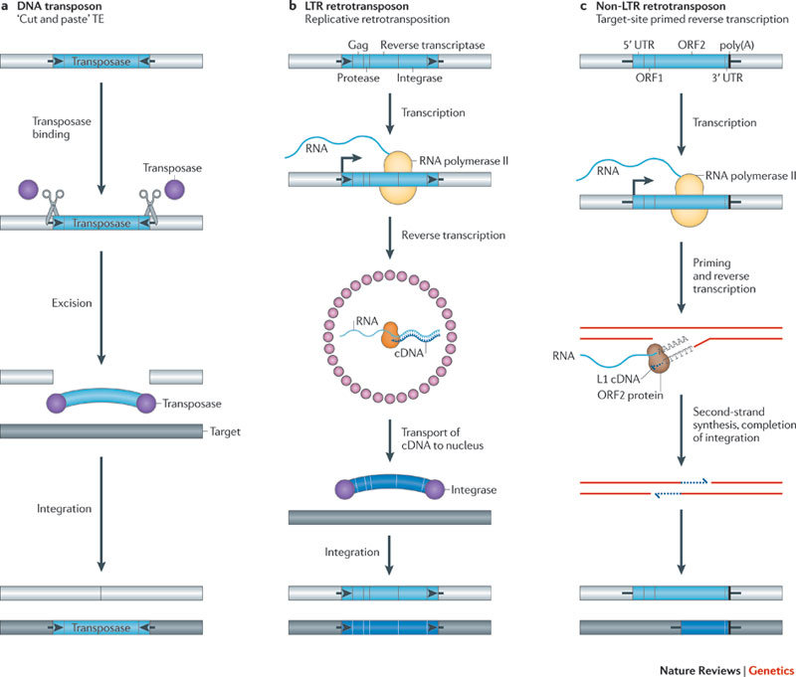
Transposon Mechanism and Significance
DNA transposons move from one genomic location to another by cut-and-paste mechanisms
They have played a significant role in the evolution of many genomes
Jump into the chromosome and insertion can disrupt gene function
They can be used to introduce a piece of foreign DNA into a genome
Notes:
DNA transposons move from one genomic location to another by a cut-and-paste mechanism. They are powerful forces of genetic change and have played a significant role in the evolution of many genomes. As genetic tools, DNA transposons can be used to introduce a piece of foreign DNA into a genome

Slide 12


Kan R
IR
Plasmid pKR141
IR
Replicates in E. Coli not LVS
Transposase
Kan R
Kan R
Transposon
Transposase
LVS
TA
No more transposase gene or enzyme
Manner Tn → insert into TA dinucleotide

Slide 13






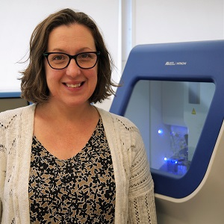


Team
Me
The Fire Hazard
Kathryn
Hannah
Sierra
Aisling
Janet
The Boss
The pHd
The Master
The Undergrad
The Sequencer

Slide 14
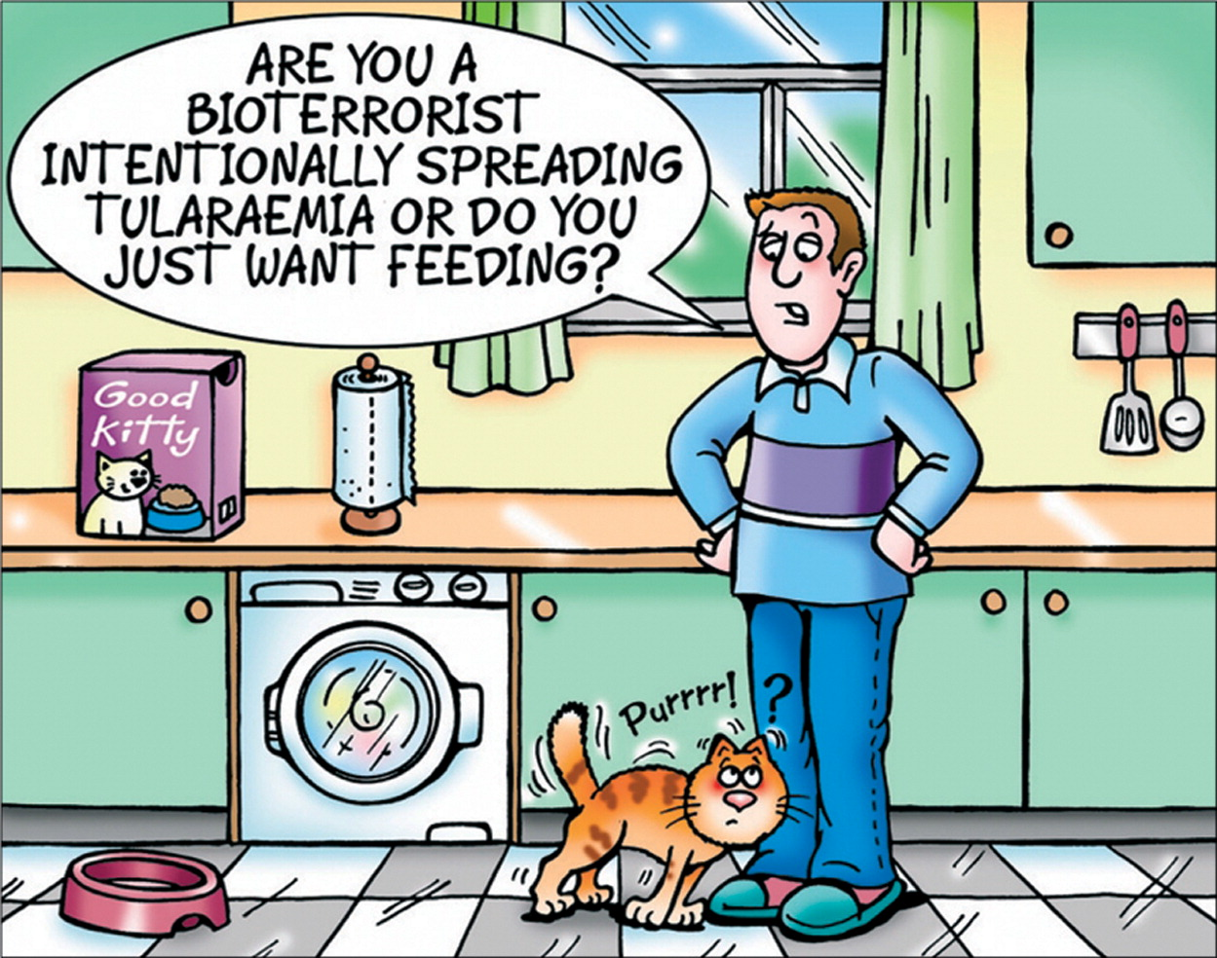
Thank you
Kathryn Ramsey
Sierra Schmidt
Hannah Trautmann
Aisling Macaraeg
Janet Atoyan

