Slide 1
Ramsey Lab Meeting 10/18
Brenna Levesque

Slide 2
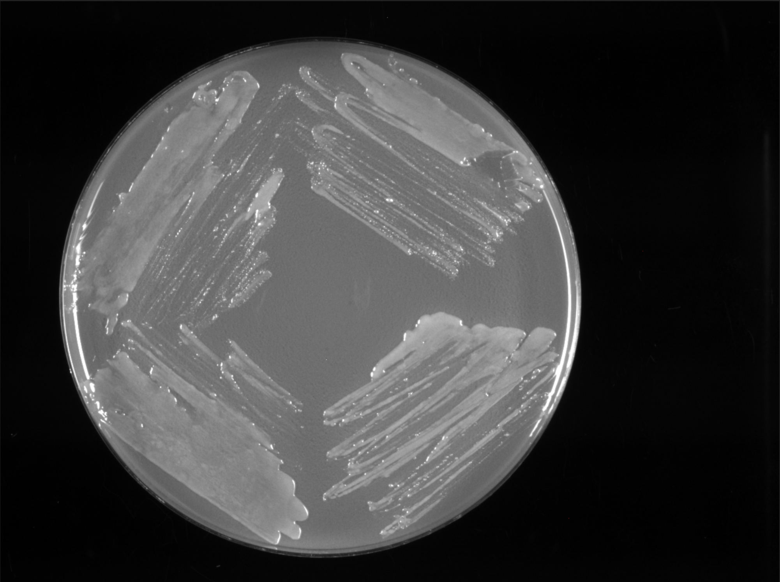
221013_CHAH_1_2_3_4_KRLVS28_transposon

Slide 3
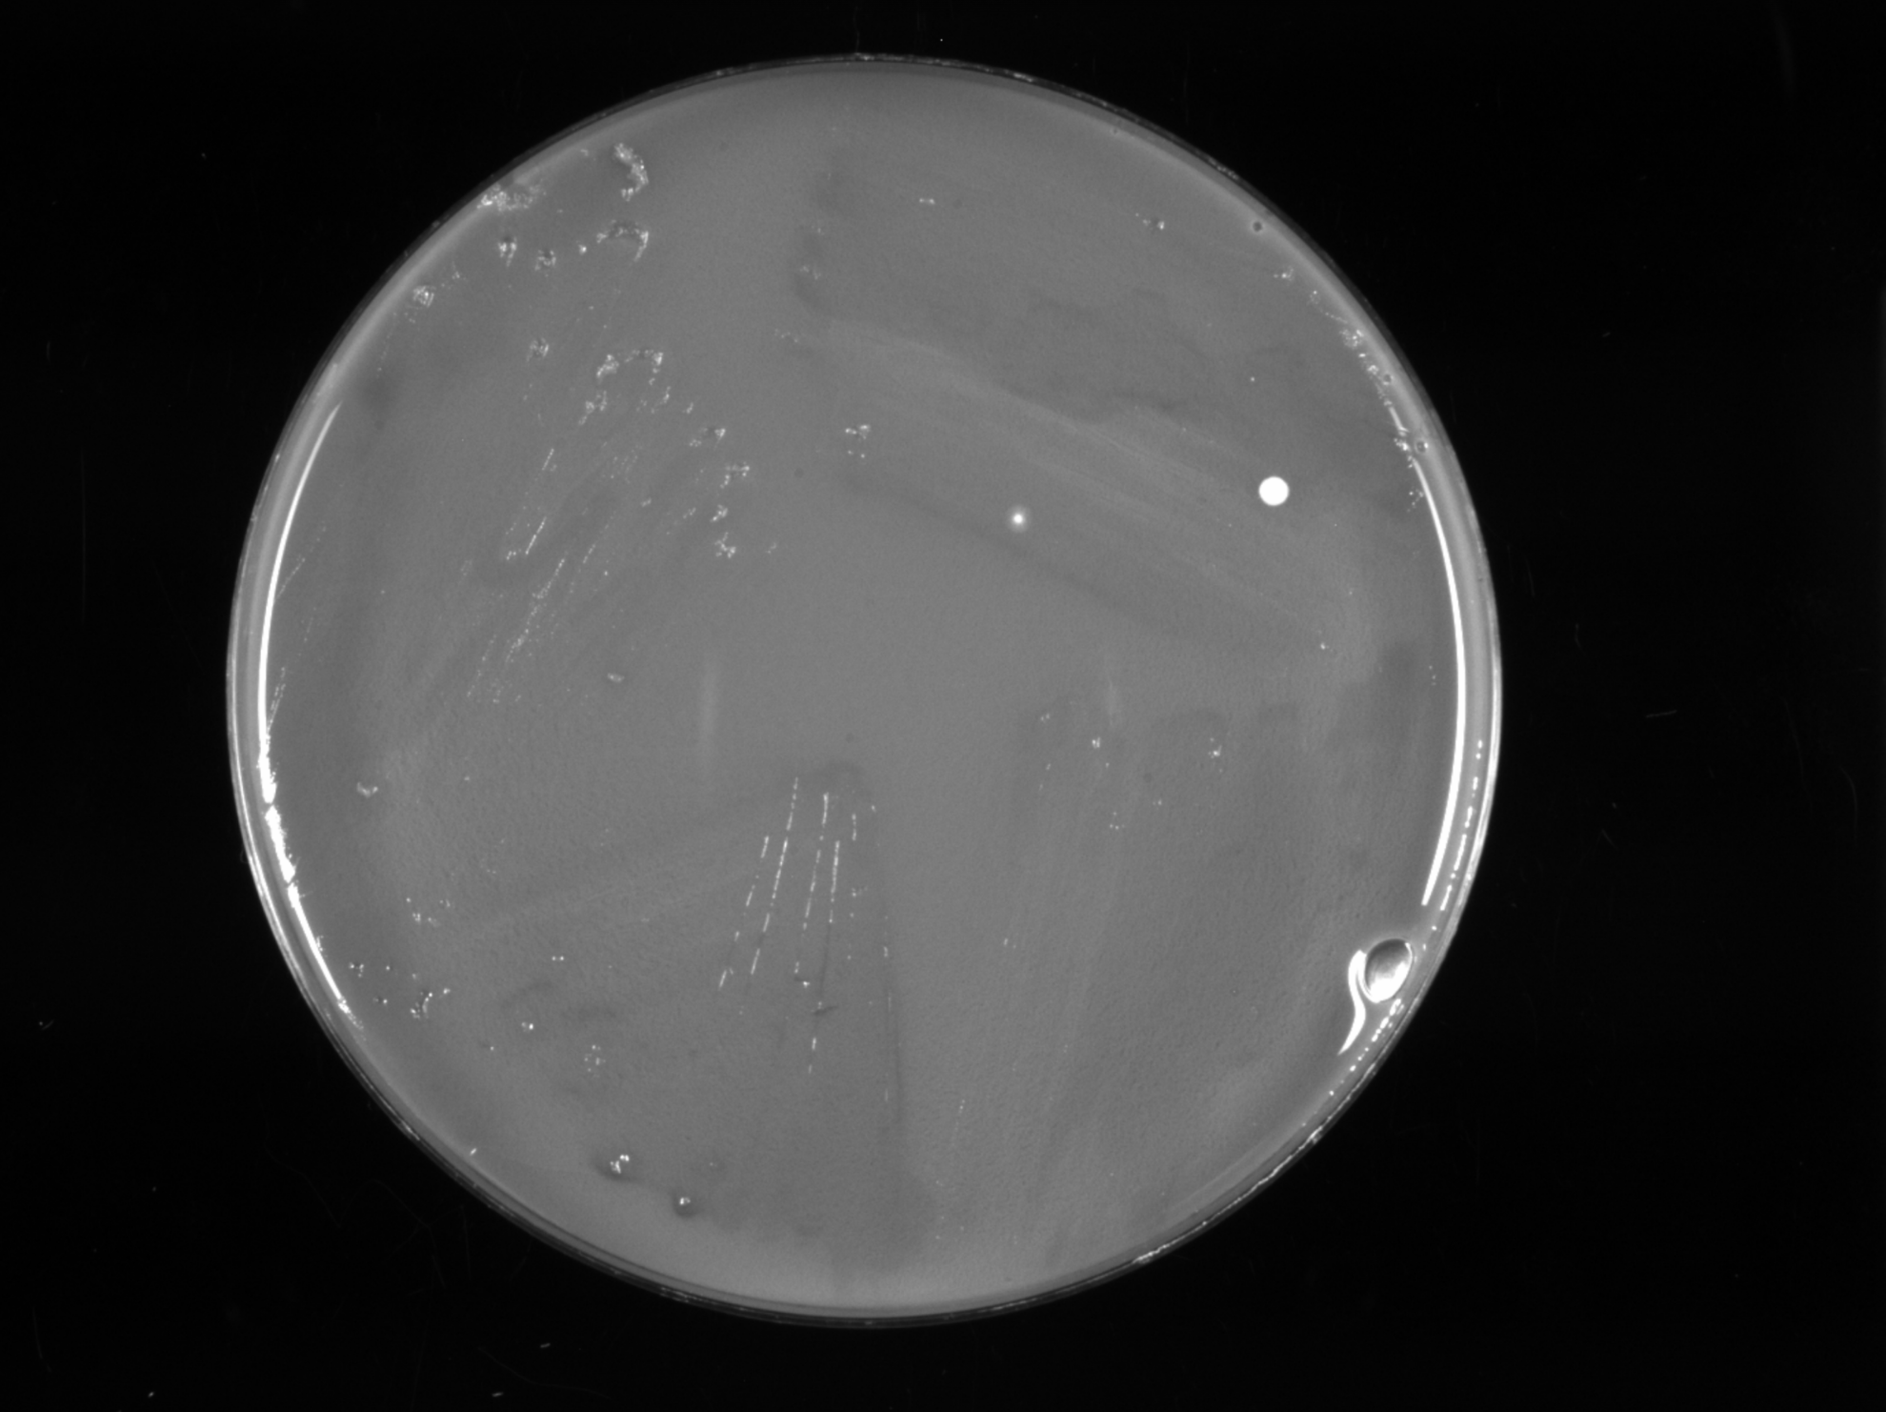
221013_CHAH_XGal_1_2_3_4_KRLVS28_transposon

Slide 4
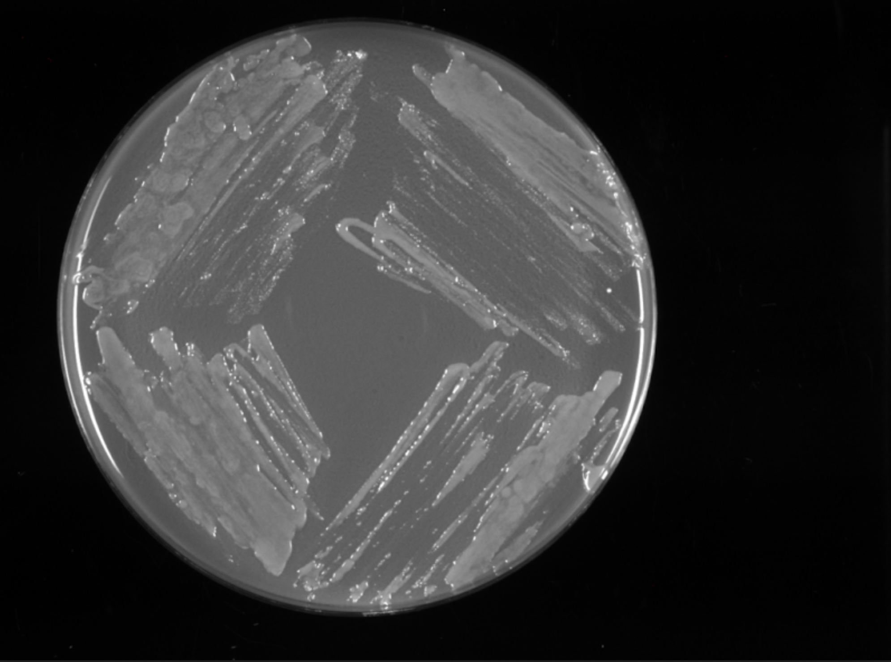
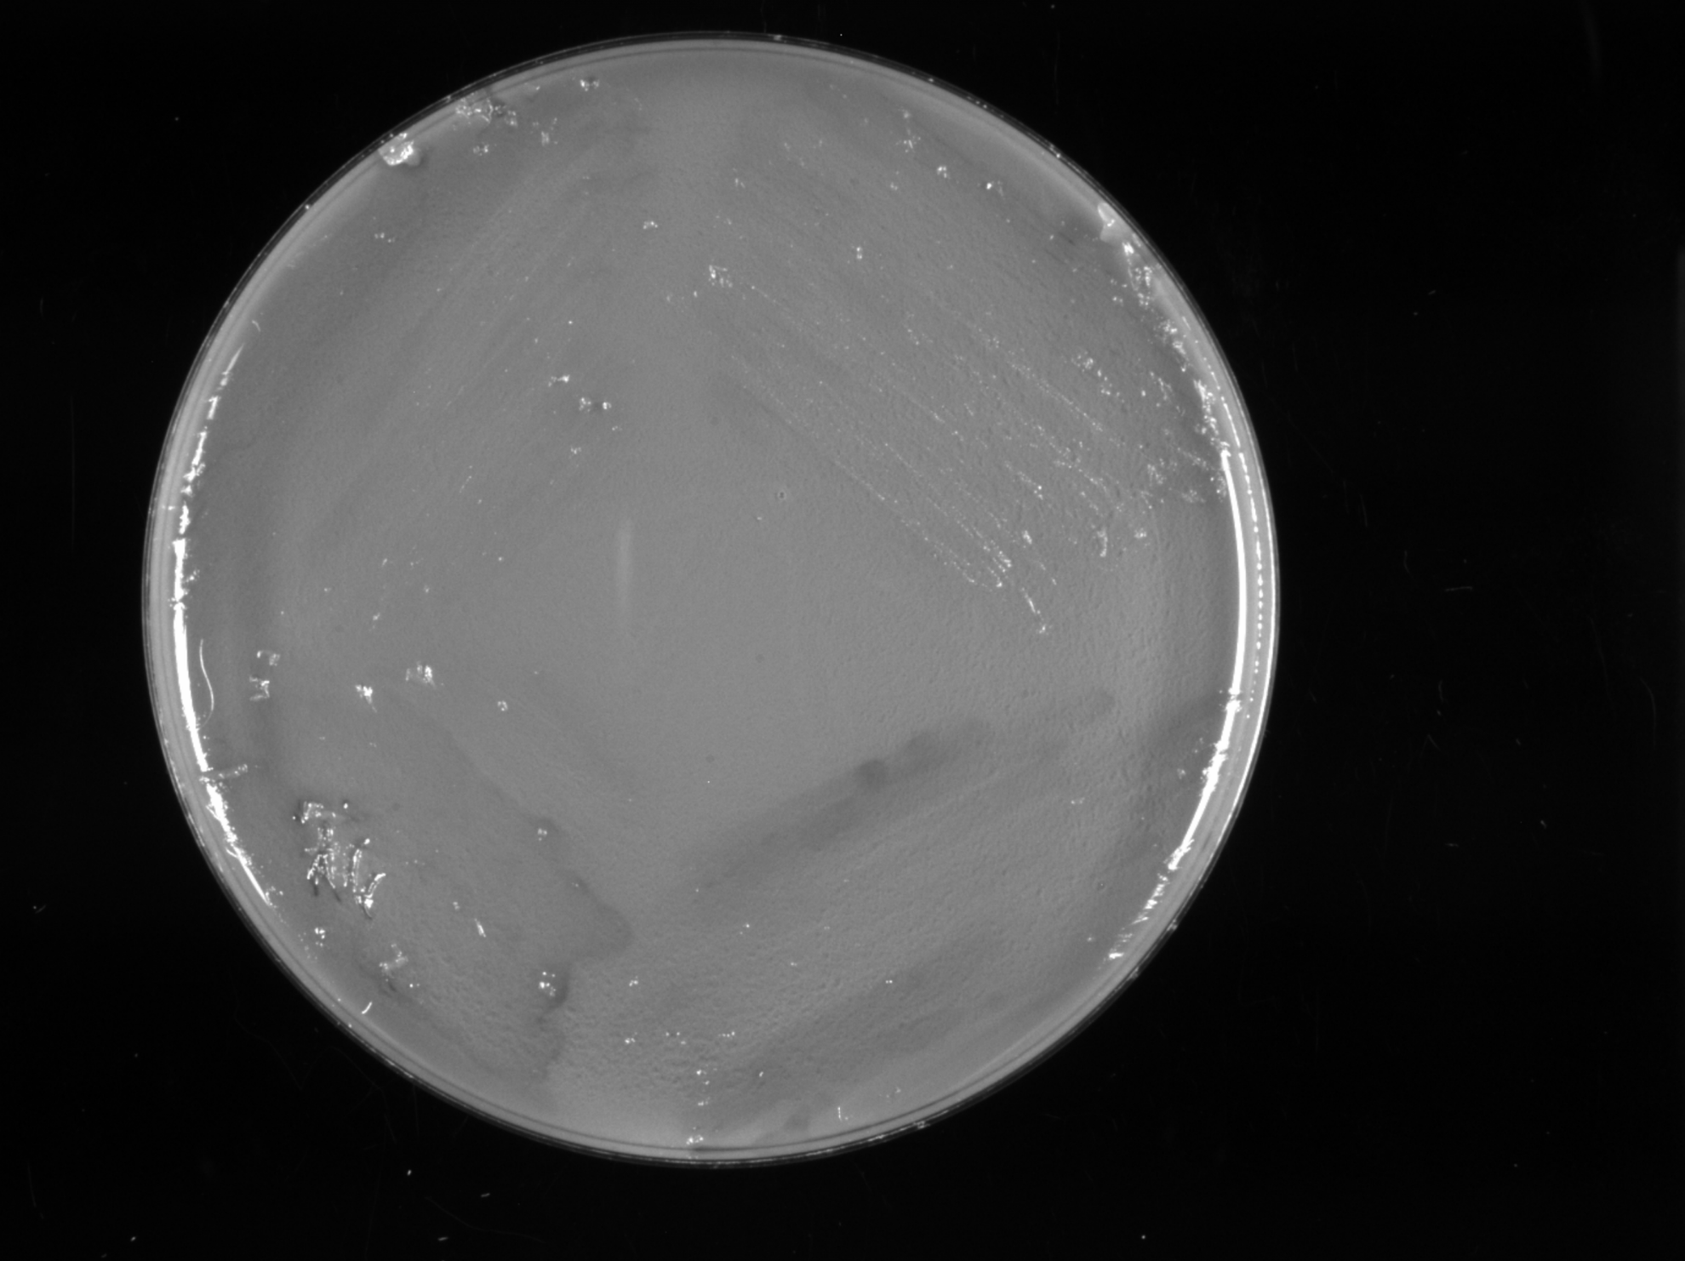
221013_CHAH_5_6_7_8_KRLVS28_transposon
221013_CHAH_XGal_5_6_7_8_KRLVS28_transposon

Slide 5

Question
Will the plasmid with the transposon grow on the CHAH with the Xgal antibiotic and the plain CHAH or just the plain CHAH plates?

Slide 6
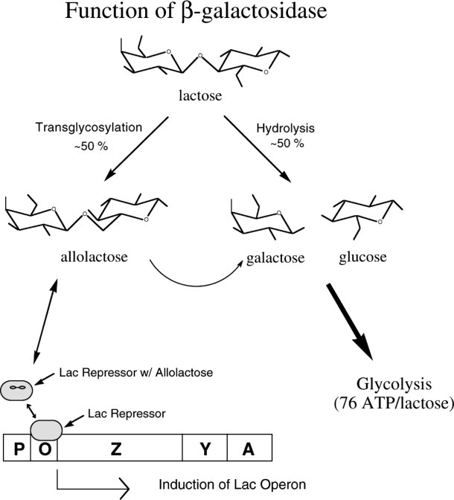
Control
A KRLVS28 strain sample without the inserted transposon should still grow on the CHAH-Xgal antibiotic plate as well as the regular CHAH plate
This Photo by Unknown Author is licensed under CC BY

Slide 7
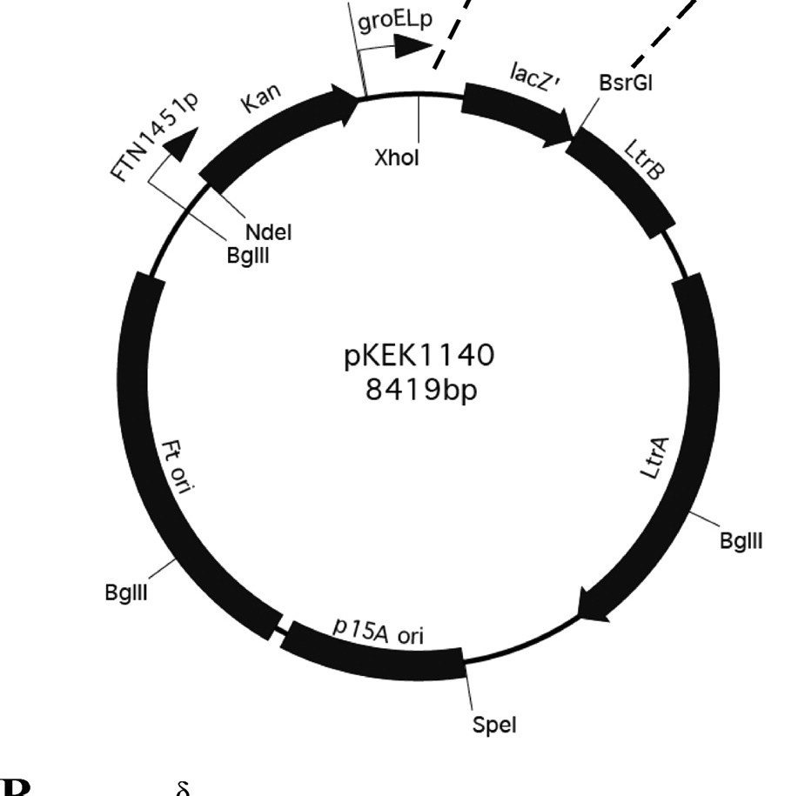
Conclusion/Interpretation
Control should have growth on the Xgal. Its lack of growth means the Xgal could be too toxic to the cell growth in general. Try again - see if fluke? Try grow parental strain on it?
Sierra electroporated a plasmid with a transposon into cells that had lacZ fused to the potential rpsU1 promoter region
Growth on the CHAH regular plats and no growth on the CHAH plates with X-gal means that the transposon did jump into the chromosome and disrupted a gene
  This is happening because the cells are producing a lot of beta galactosidase due to cleavage of beta galactosidase by the X-gal.
  The beta galactosidase is now a toxic product that in high abundance does not allow the cells to grow
Whatever gene it broken caused an up-regulation of rpsU1 production
Notes:
Less to no cell production on X-gal plates is good, this means the transposon was successfully inserted into the plasmid of the KRLVS28 strain.
Growth on the control plate with no X-gal means the plasmid is still viable just not in presence of X-gal
X-gal is toxic – No antibiotic resistance
Beta-Galactosidase hydrolyzes X-gal to produce a blue product
Transposon insertion can disrupt the function of a gene
LacZ gene is the structural gene for Beta-galactosidase -> present as part of the inducible system lac operon which is activated in the presence of lactose -> lactose leads to synthesis allolactose which binds to lac repressor and reduces its affinity for the lac operon -> this allows the synthesis of beta-galactosidase, the product of the lacZ gene
Transposon 🡪 Disrupt LacZ gene 🡪 beta-galactosidase synthesis does not happen 🡪 no X-gal is produced 🡪 no production X-gal means no resistance to X-gal in CHAH 🡪 no growth on the CHAH X-gal means the transposon was successfully inserted into the strain

Slide 8

Breakdown Cause I’m New Here
Kanamycin resistance shows transposon successfully inserted into the chromosome of the KRLVS28 strain.
Growth on the control plate with no X-gal means the plasmid is still viable just not in presence of X-gal
Beta-Galactosidase hydrolyzes X-gal to produce a blue product
Transposon insertion can disrupt the function of a gene
LacZ gene is the structural gene for Beta-galactosidase -> present as part of the inducible system lac operon which is activated in the presence of lactose -> lactose leads to synthesis allolactose which binds to lac repressor and reduces its affinity for the lac operon -> this allows the synthesis of beta-galactosidase, the product of the lacZ gene
Transposon 🡪 Can disrupt LacZ gene 🡪 beta-galactosidase synthesis does not happen 🡪 no X-gal is produced 🡪 no production X-gal means no resistance to X-gal in CHAH 🡪 no growth on the CHAH X-gal means the transposon was successfully inserted into the LacZ gene
No know where transposon will end up jumping into the chromosome. Most of the time it won’t have any effect. Want to pick the cells where the transposon is in the LacZ -> The blue colored colonies
Overproduction Beta-Galactosidase toxic to growth

Slide 9
