Slide 1
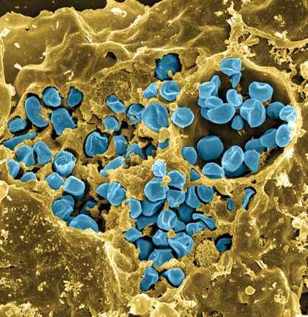
Francisella tularensis
Causes tularemia
Highly infectious
Potential bioweapon
F. tularensis subsp. holarctica LVS
Intracellular growth is essential to cause disease
Fischer, PNAS cover 2006
Notes:
Gram-negative, gamma facultative intracellular pathogen
Infectivity similar to Mtb, can upwards of 30% mortality
Tier 1 Select Agent like Ebola
Cover image: Scanning electron micrograph of a murine macrophage infected with Francisella tularensis strain LVS. Macrophages were dry-fractured by touching the cell surface with cellophane tape after critical point drying to reveal intracellular bacteria. Bacteria (colored in blue) are located either in the cytosol or within a membrane-bound vacuole.

Slide 2
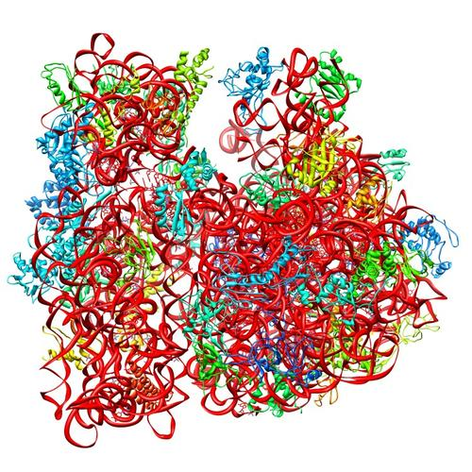
Ribosomes can be heterogenous
E. coli ribosome
3 rRNAs
49 proteins
Sources of heterogeneity
Multiple rRNA operons
rRNA modifications
Ribosomal protein modifications
Multiple ribosomal proteins
50S
30S
PDB 4V50
Berk et al., 2006
How do changes in ribosome composition influence translation?

Slide 3
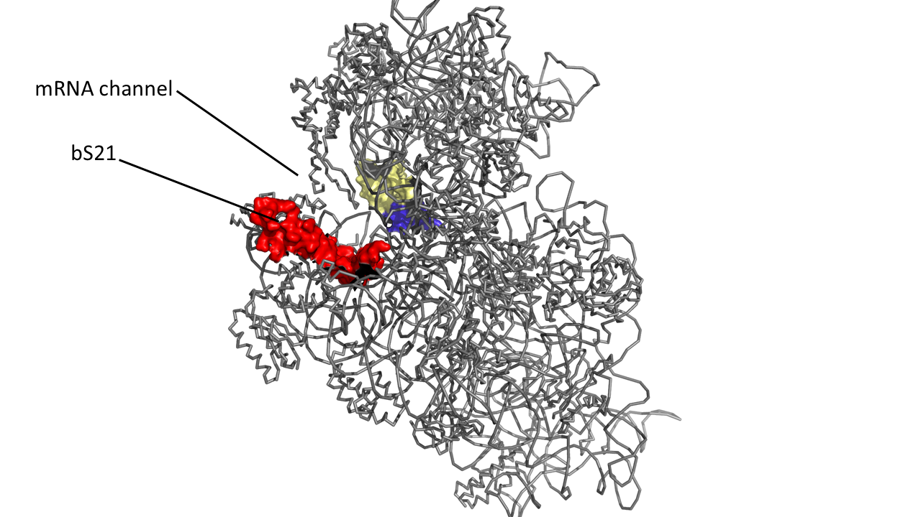
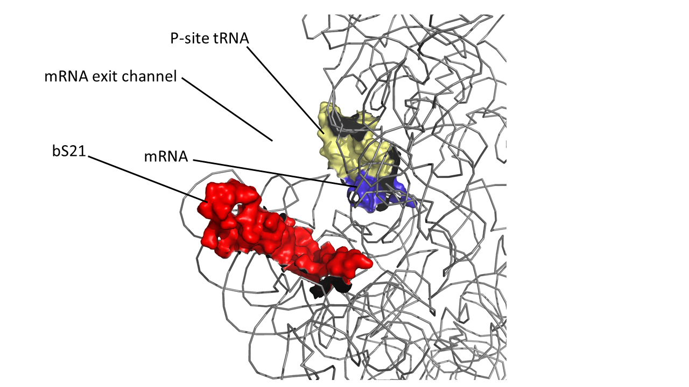
bS21, a small ribosome subunit protein
bS21 is:
  involved in translation initiation
  non-essential
  implicated in control of specific processes
  In F. tularensis:
  Three homologs
  Lead to ribosome heterogeneity
  Changes of ribosome bS21 content alters sensitivity to kasugamycin
  Loss of bS21-2
  change in virulence protein abundance
  reduces virulence
30S subunit, modeled from PDB entry: 4V50
Notes:
Particular bS21 paralogs translate specific transcripts more efficiently (ribosome “sigma factors”)
Ribosomes with specific bS21 paralogs could modulate gene expression

Slide 4
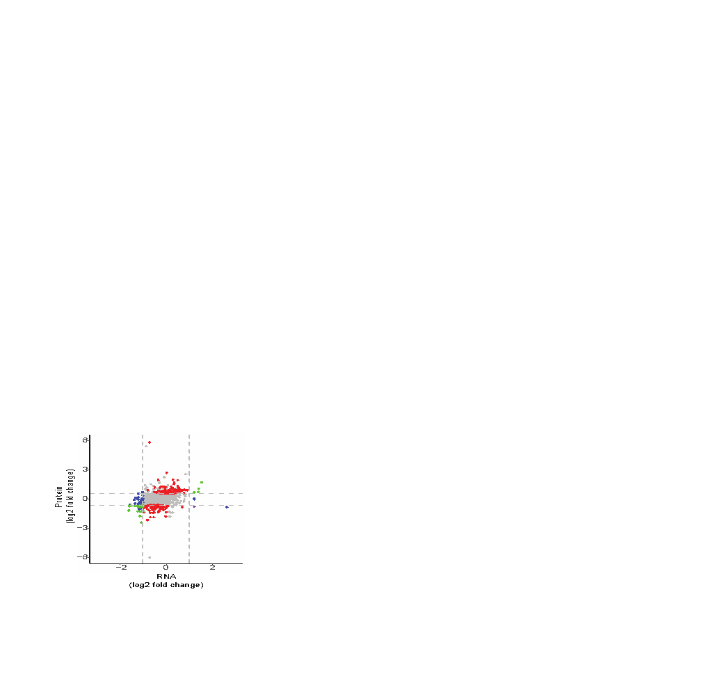


Cells lacking bS21-2 have changes in protein, not transcript, abundance
WT vs ∆bS21-2
Significant abundance change:
Protein (166)
Transcript (62)
Transcript and protein (concordant; 22)
Transcript and protein (discordant; 1)
Consistent with bS21 regulating gene expression at level of translation
Notes:
251 (about 250 genes)
Green: 22
Purple: 1
Red: 166
Blue: 62

Slide 5
Can we validate genes with upregulated products in cells lacking bS21-2?
Genes with less protein and unchanged transcripts have been validated
What about the up-regulated genes?
FTL_0144
Notes:
60 fold up regulation of FTL_0144
What does FTL_0144 do?

Slide 6
Strategy: Single integration
pKR124
FTL_0144
VSVG
Plasmid (Kan R)
FTL_0144
VSVG
frag
Notes:
Single integration strategy
We started by amplifying the FTL_0144 fragment using KPN1 and NOT1. We then digested the PCR fragment and another plasmid with the epitote tag right after the attachment point. We ligated the FTL_0144 fragment and pKR36 together to make the new plasmid with tagged FTL_0144.
This was then electroporated into LVS and cells lacking bS21-2.

Slide 7
Electroporating into WT and ∆bS21-2
pKR124
FTL_0144
VSVG
5’
3’
FTL_0144
WT
∆bS21-2
FTL_0143
Notes:
describe electroporation into WT and lacking bS21-2.
small region of homology

Slide 8
Conclusions
Notes:
Observe the differences in FTL_0144 expression in WT vs. lacking bS21-2 by quantitative western blot analysis. Is it actually upregulated 60-fold

