Slide 1



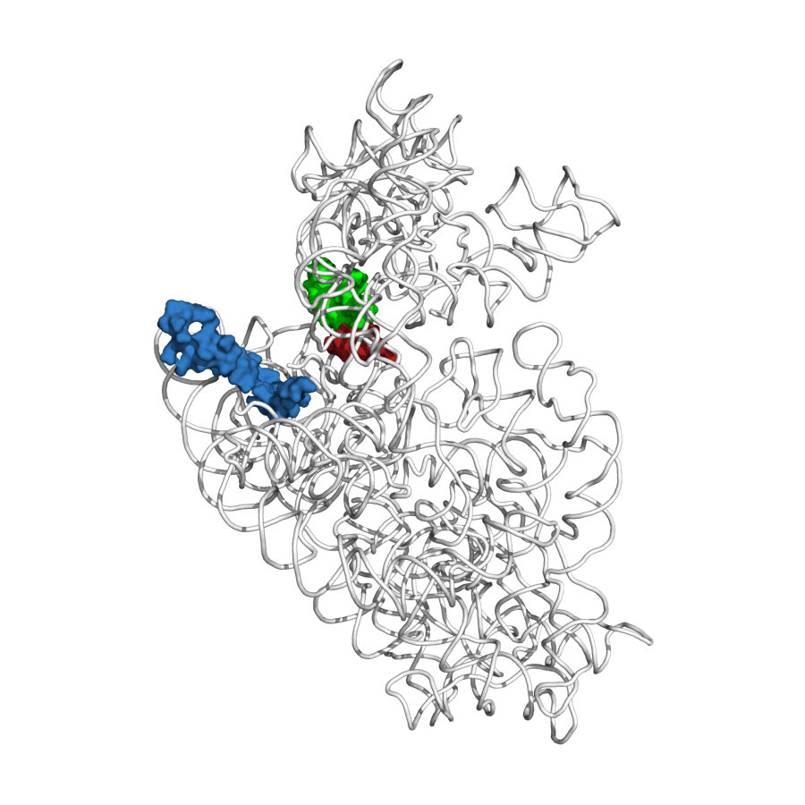
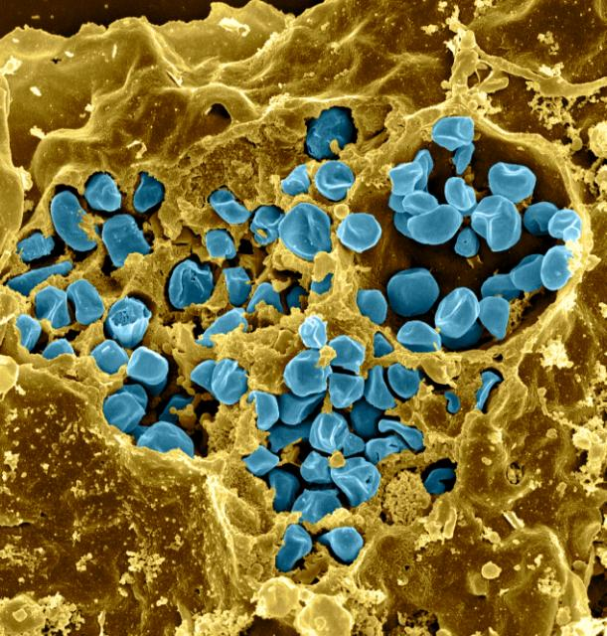
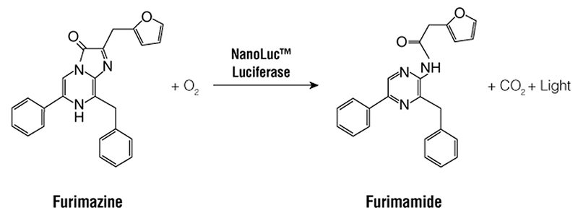
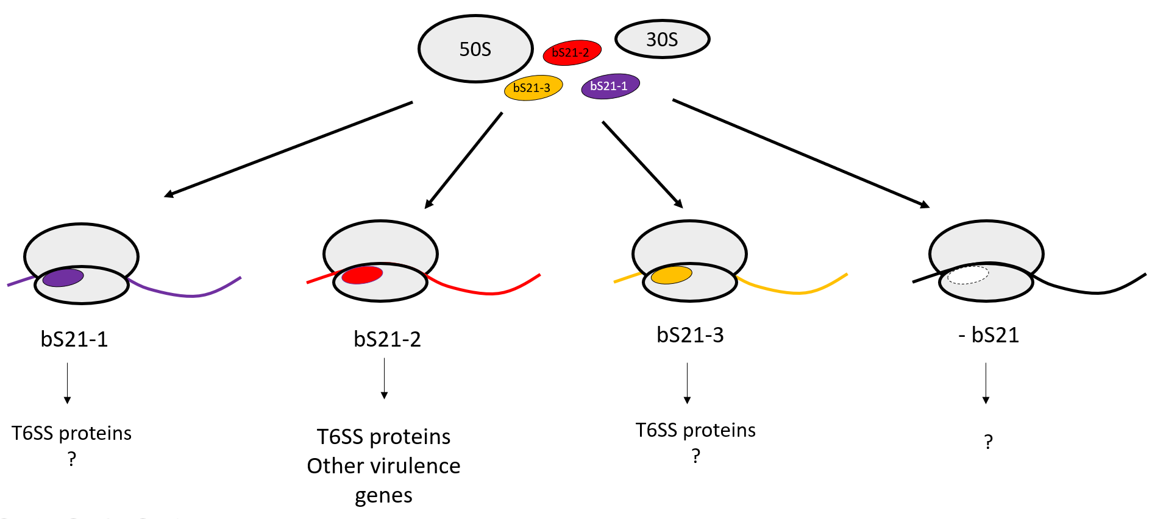
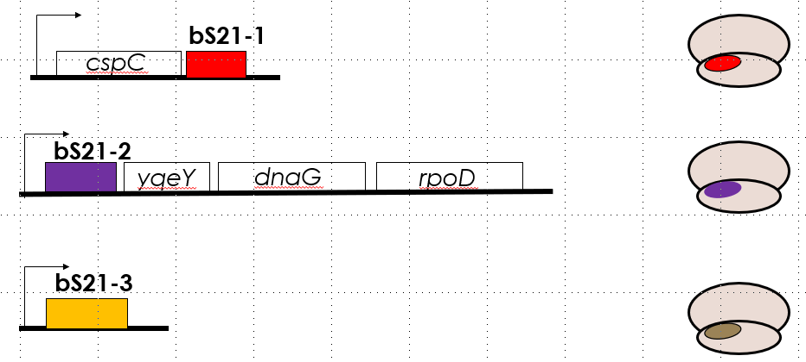
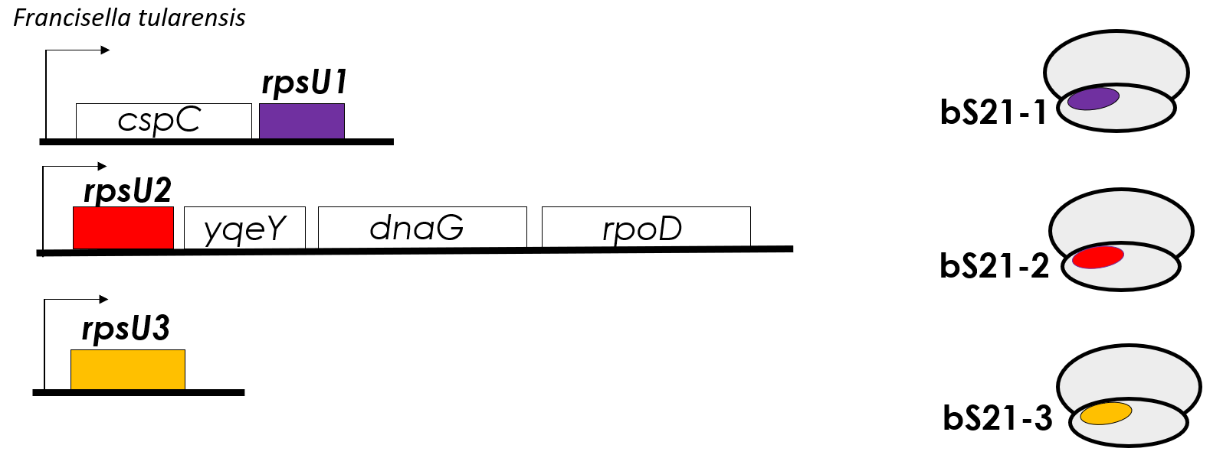
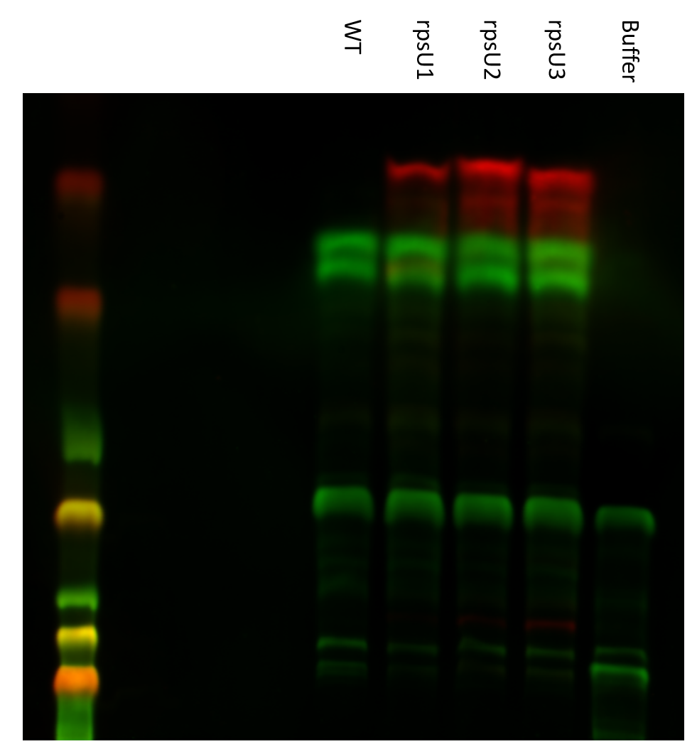
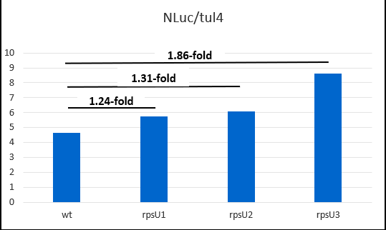
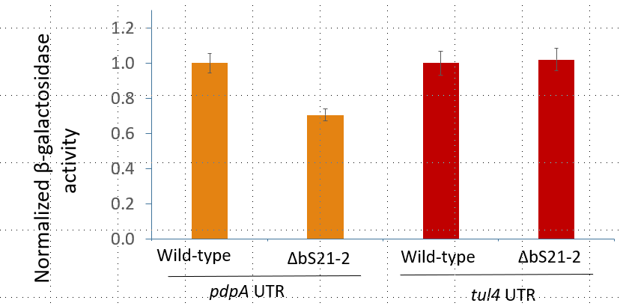
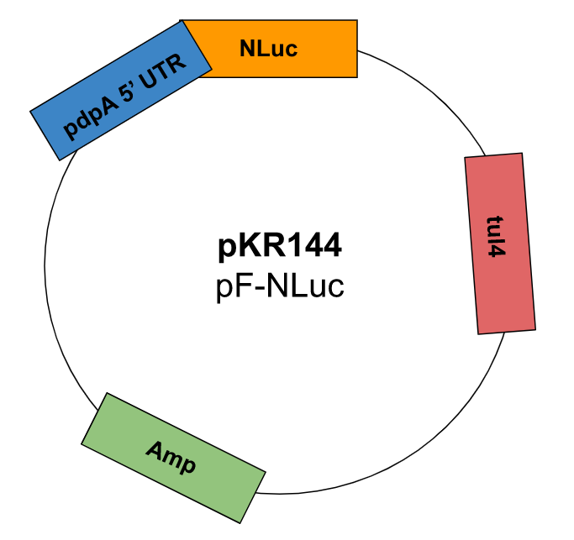
Developing an assay to compare translation by Francisella tularensis ribosomes with different bS21 homologs
Marisa C. Cogswell¹, Hannah Trautmann², and Kathryn M. Ramsey^{2,3}
  Biochemistry and Biophysics, Rensselaer Polytechnic Institute, Troy, NY 12180
  Cell and Molecular Biology, University of Rhode Island, Kingston, RI 02881
  Biomedical and Pharmaceutical Sciences, University of Rhode Island, Kingston, RI 02881
Introduction
Developing in vitro assay
Conclusions
Francisella tularensis is a bacterial pathogen that causes tularemia and is considered a potential bioweapon
P-site tRNA ASL
mRNA (P-site codon)
bS21
F. tularensis is a Gram negative
facultative intracellular bacterium
F. tularensis encodes three homologs of ribosomal protein bS21. pdb entry 2i2p; figure made by Dr. Steven Gregory
F. tularensis has heterogenous populations of ribosomes
Results
Three bS21 homologs in F. tularensis
Role in translation initiation
bS21-2 shown to play role in virulence
Cells without bS21-2 translate from the pdpA 5’ UTR less efficiently
Next Steps
Future experiments
Acknowledgements
We thank the Ramsey lab and core analytical facilities RI-INBRE Core and RIGSC as well as Dr. Steven Gregory and lab for productive joint lab group meetings.
Research reported in this release was supported in part by the Institutional Development Award (IDeA) Network for Biomedical Research Excellence from the National Institute of General Medical Sciences of the National Institutes of Health under grant number P20GM103430.
References
Printing services provided by the RI-INBRE Centralized Research Core Facility supported by Grant # P20 GM103430 from NIGMS, NIH

