Slide 1



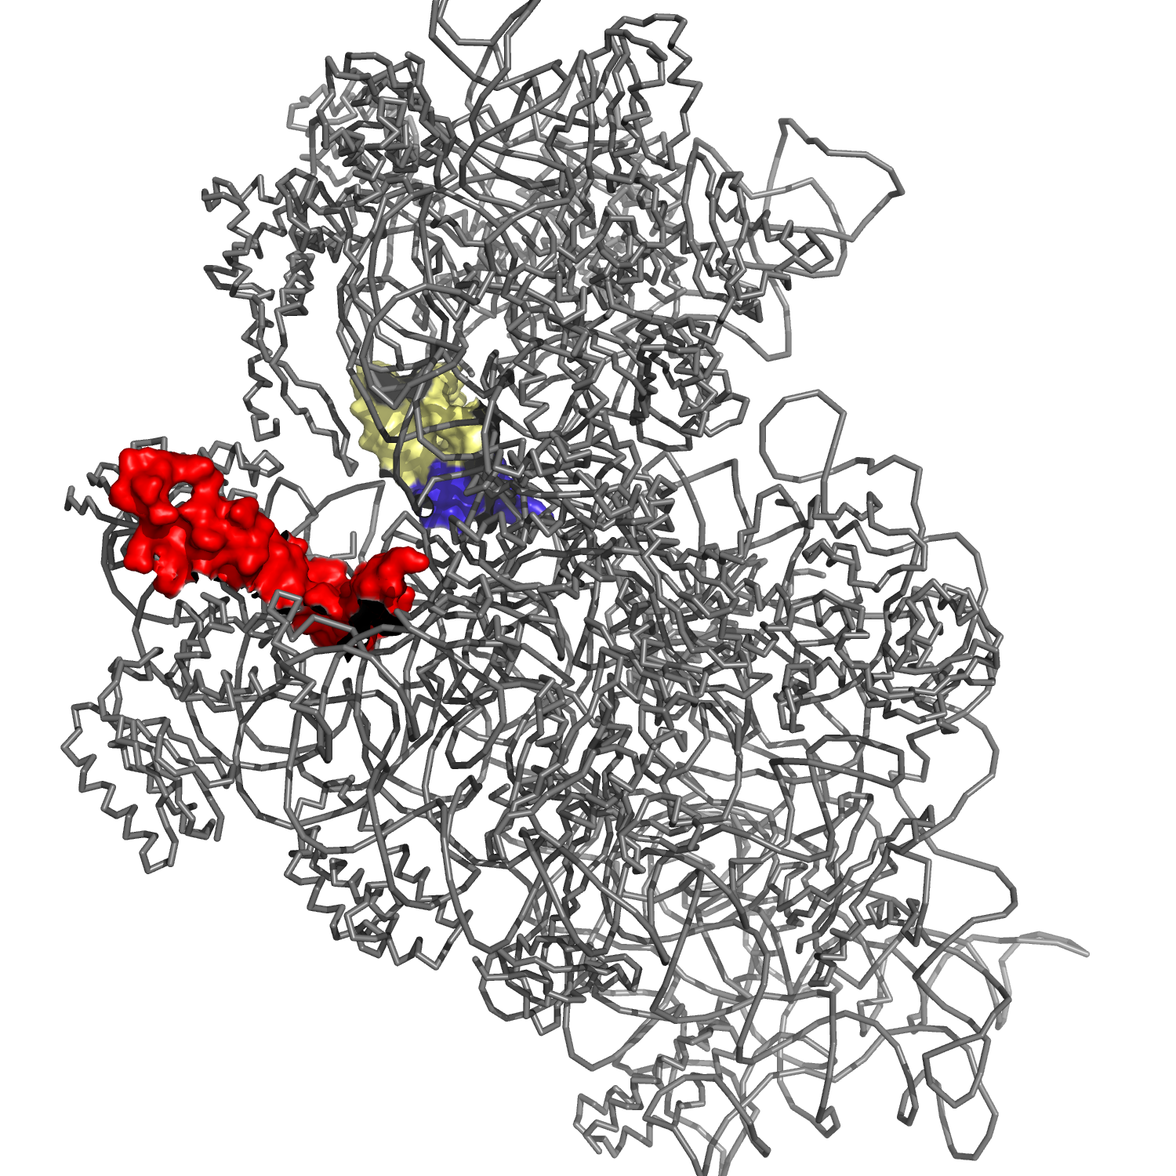
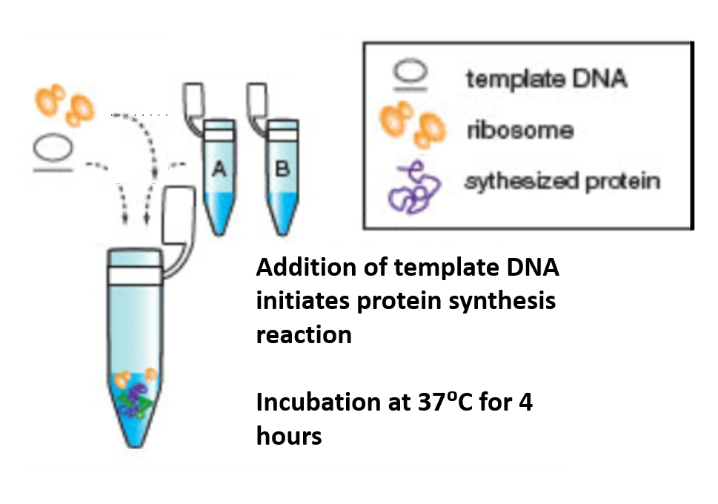
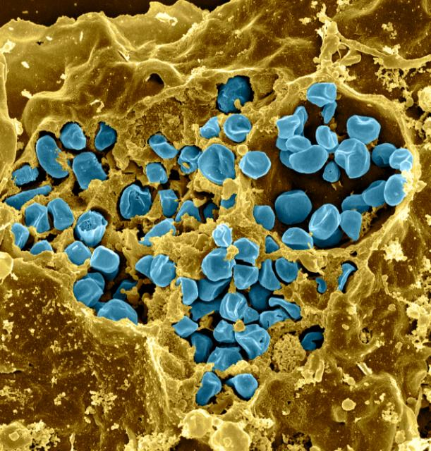
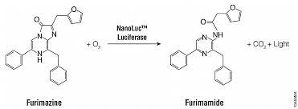
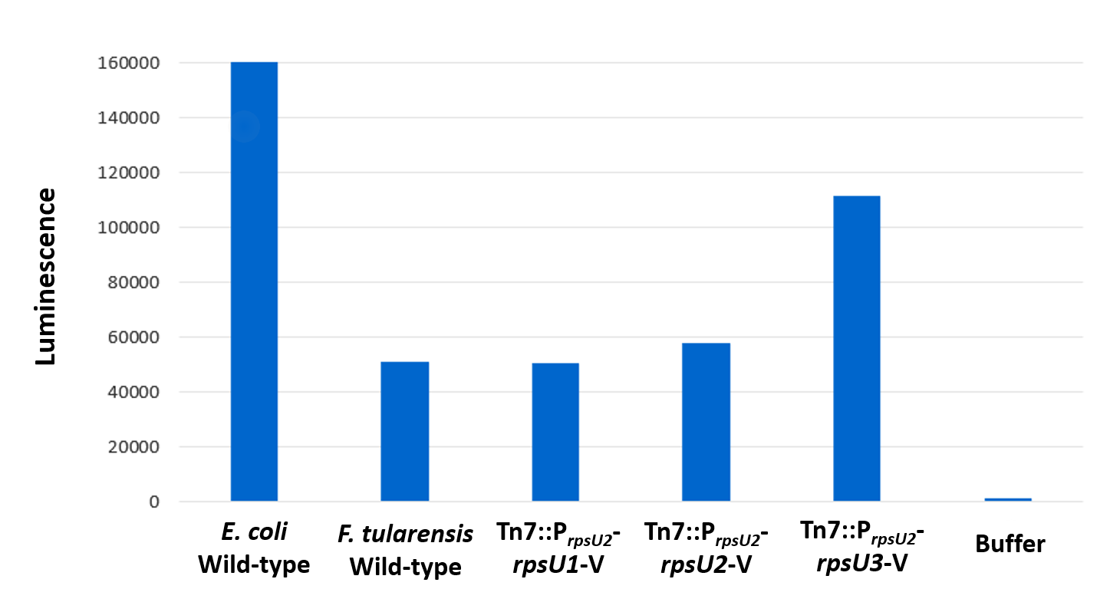
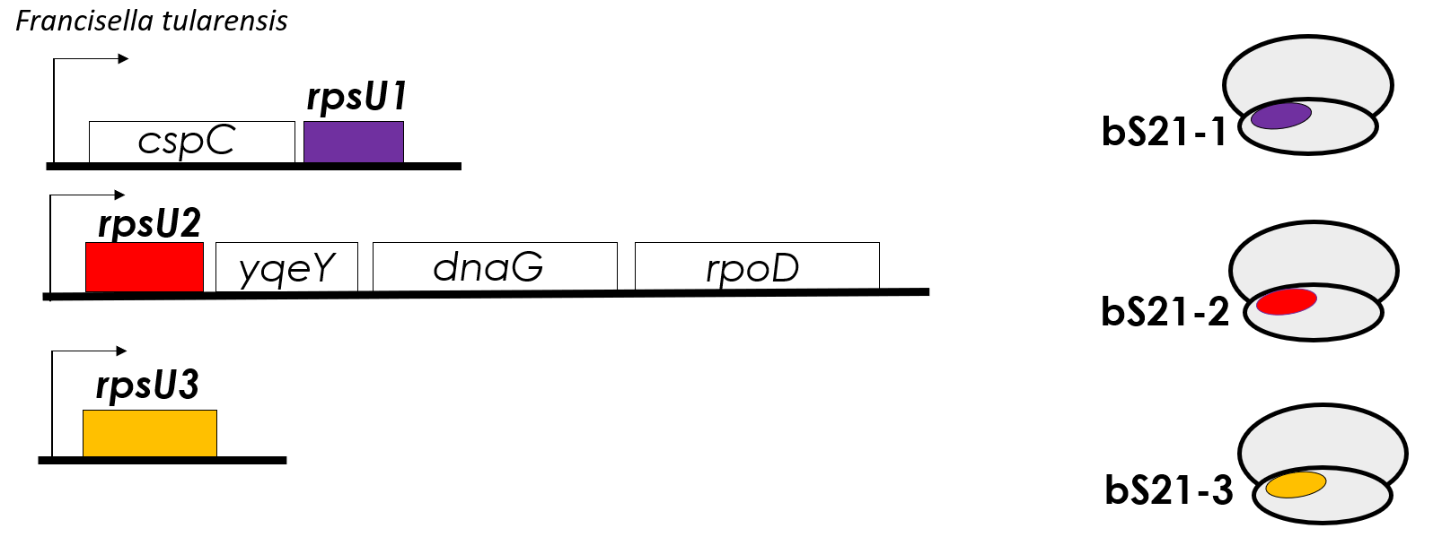
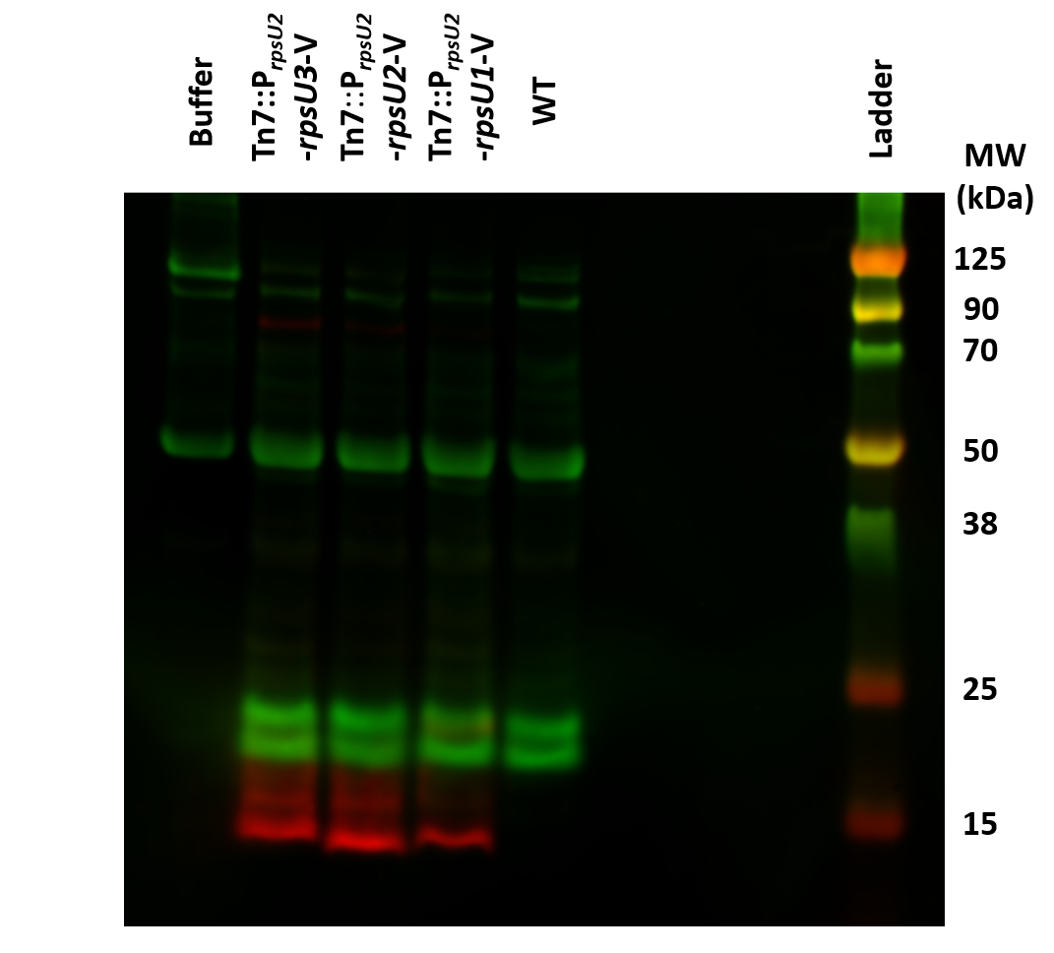
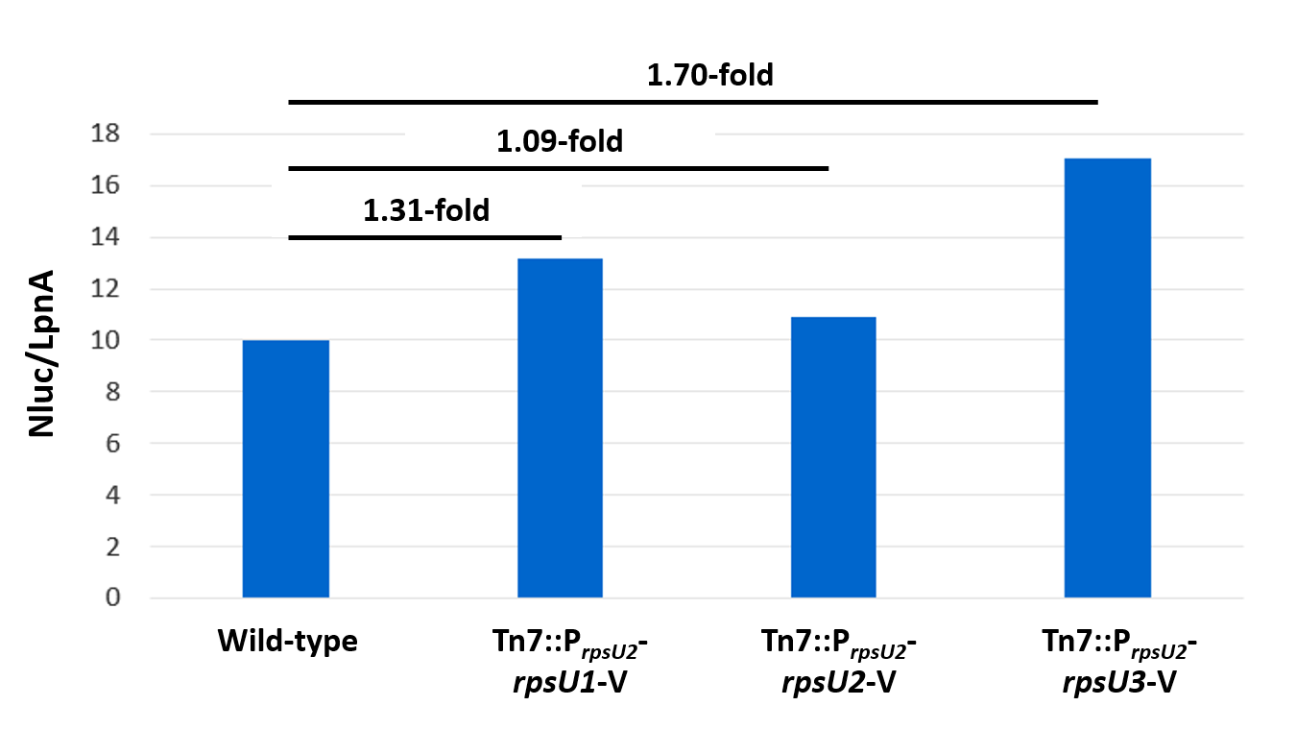
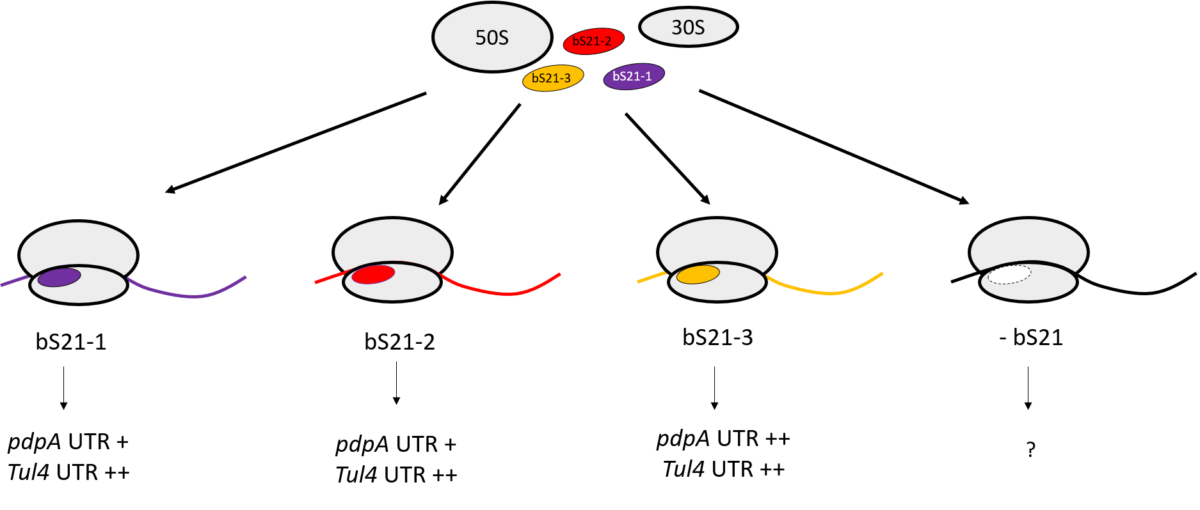
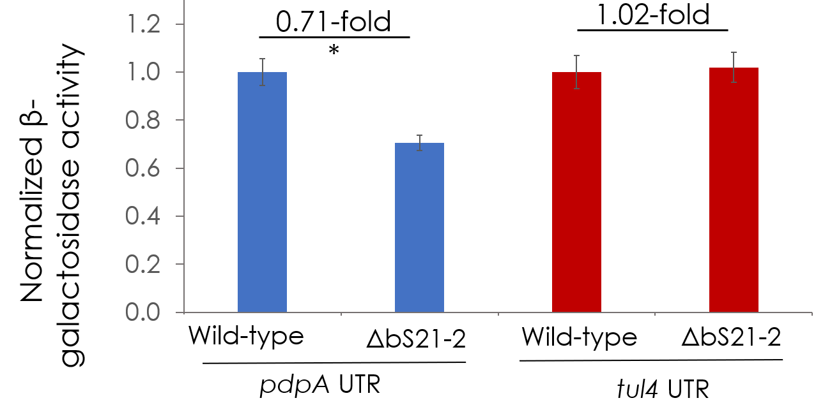
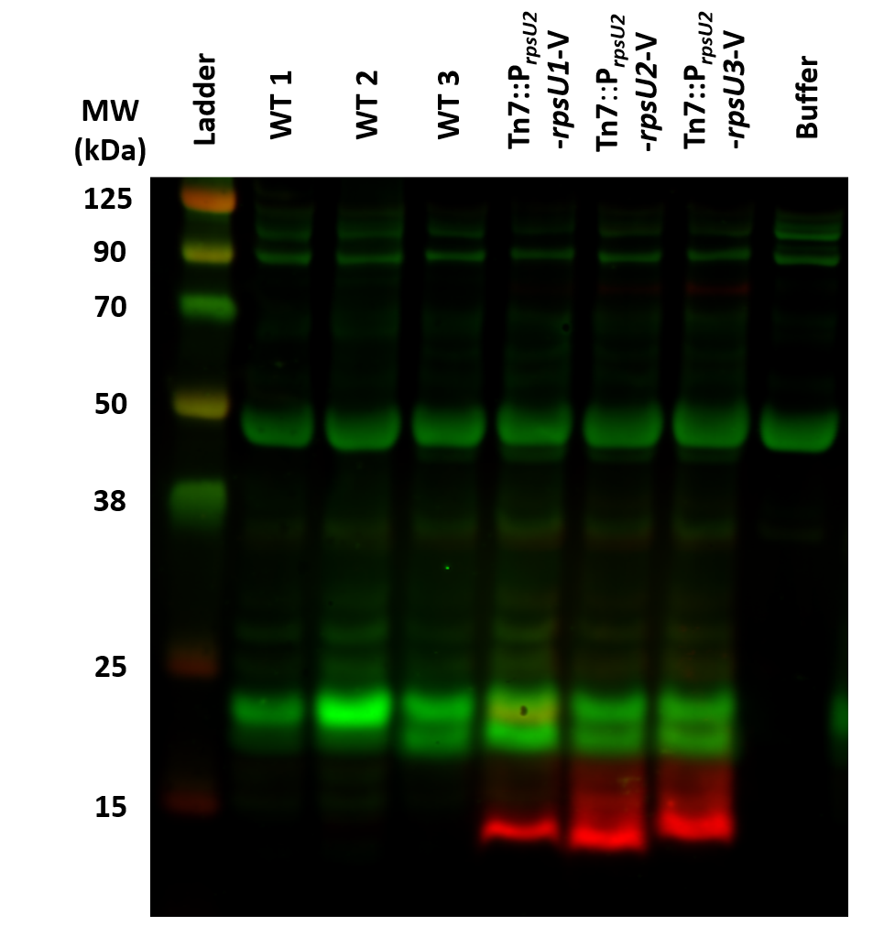
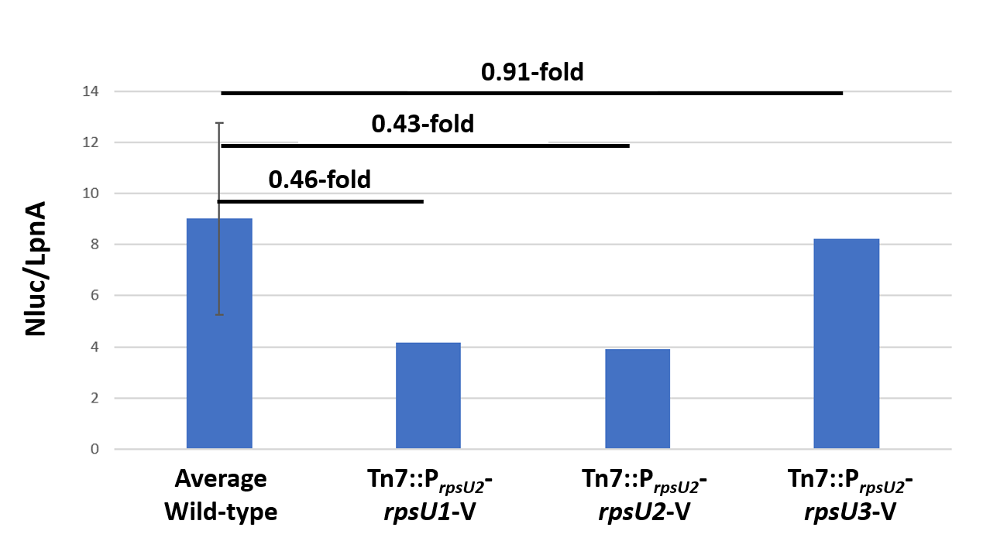
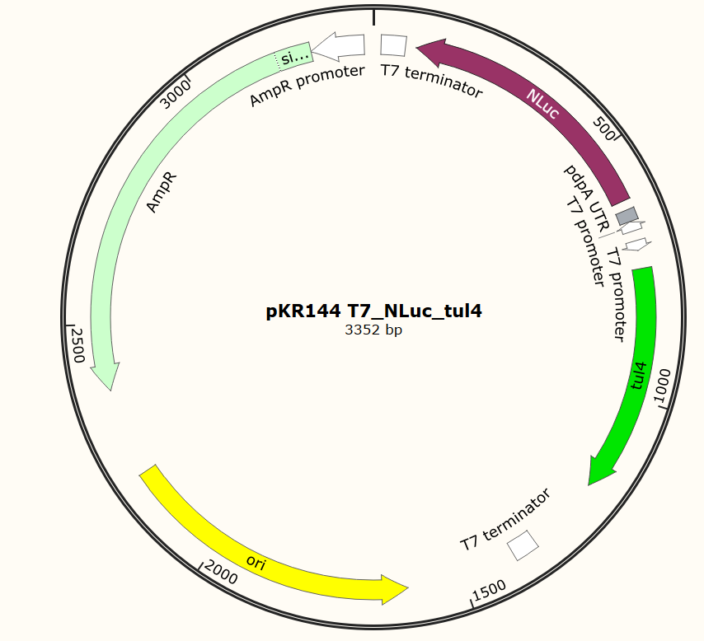
Developing an assay to compare translation by Francisella tularensis ribosomes with different bS21 homologs
Marisa C. Cogswell¹, Hannah Trautmann², and Kathryn M. Ramsey^{2,3}
  Biochemistry and Biophysics, Rensselaer Polytechnic Institute, Troy, NY 12180
  Cell and Molecular Biology, University of Rhode Island, Kingston, RI 02881
  Biomedical and Pharmaceutical Sciences, University of Rhode Island, Kingston, RI 02881
Introduction
In vitro assay method
Conclusions
Francisella tularensis is a bacterial pathogen that encodes three homologs of ribosomal protein bS21
Detection
  pdpA 5’ UTR-NLuc: luminometer
  tul4 5’ UTR-tul4: immunoblot for LpnA
More sensitive and faster
Observe interaction between purified ribosomes and transcript to examine relationship between 5’ UTR and translation
Successfully created pKR144 plasmid for in vitro transcription/translation assay
Able to clone in E. coli (not toxic, compared to previous reporter constructs)
Able to detect translation by F. tularensis ribosomes (Figure 6)
All bS21 homologs allow translation of pdpA 5’ UTR
Reductions in PdpA in cells lacking bS21-2 may be due to less bS21 overall
mRNA channel
F. tularensis is a Gram negative
facultative intracellular bacterium
bS21
mRNA
P-site tRNA
16S rRNA
²
Causes tularemia
Highly infectious
Considered potential bioweapon
Diagram depicting the protocol for using the PURExpress Δribosome kit to produce NLuc and LpnA. Adapted from NEB PURExpress product diagram³.
Figure 6: Luminescence produced by E. coli compared with F. tularensis ribosomes. Max value of x-axis was minimized to 1.6 x 10⁵. Actual E. coli value: 1.4 x 10⁷
bS21 in E. coli is in close proximity to the mRNA exit channel in the 30S subunit⁴. Figure made by Hannah Trautmann.
PDB entry: 4V50
F. tularensis has heterogenous populations of ribosomes
Results
Three bS21 homologs in F. tularensis
Role in translation initiation
rpsU2 encodes bS21-2
bS21-2 important for virulence
Ribosomes from
Ribosomes with bS21-3 seem to translate transcripts with the pdpA 5’ UTR most efficiently
-
The pdpA 5’ UTR leads to reduced translation in cells without bS21-2
LpnA
Ribosomes from
bS21
Diagram depicting a potential model for how bS21 homologs may differentially regulate translation of the type VII secretion system protein pdpA’s 5’ UTR.
Figure 2: Immunoblot detecting production of LpnA from replicate 1 of in vitro assay. Amounts of bS21-V homolog present in purified ribosomes are also detected.
Figure 3: Relative translation of transcripts with pdpA versus tul4 5’ UTRs from replicate 1 of in vitro assay. Ratio of luminescence produced from NLuc to amount of LpnA quantified from immunoblot for each sample.
Next Steps
* p < 0.01
Test ribosomes in biological triplicate to assess variability
Test ribosomes with and without bS21
Use ribosomes isolated from cells with inducible bS21 to ensure consistent abundances
Test other 5’ UTRs fused to NLuc to examine impacts on relative translation
Ribosomes from
-
Figure 1: Cells lacking bS21-2 translate the pdpA 5’ UTR less efficiently than wild-type cells. β-galactosidase activity was assessed in reporter fusions with the tul4 promoter and either the pdpA or tul4 UTR. No significant difference was detected between wild-type and ΔbS21-2 in the tul4 UTR reporter. Activity was normalized to wild-type cells for each UTR reporter.
Acknowledgements
Developing an in vitro assay
We thank the Ramsey lab and core analytical facilities RI-INBRE Core and RIGSC as well as Dr. Steven Gregory and lab for productive joint lab group meetings.
Research reported in this presentation was supported by the Rhode Island Institutional Development Award (IDeA) Network of Biomedical Research Excellence from the National Institute of General Medical Sciences of the National Institutes of Health under grant number P20GM103430.
Amplified pdpA 5’ UTR-NLuc fusion using PCR
Digested then ligated into plasmid with T7 promoter
Transformed into E. coli
Purified plasmid and confirmed sequence
Phenol-chloroform purified plasmid
Ribosomes from
LpnA
References
bS21
Figure 5: Relative translation of transcripts with pdpA versus tul4 5’ UTRs from replicate 2 of in vitro assay. Ratio of luminescence produced from NLuc to amount of LpnA quantified from immunoblot for each sample. Ratios from wild-type ribosomes were averaged and error bar represents standard deviation.
1. Asahara, H., & Chong, S. (2010). In vitro genetic reconstruction of bacterial transcription initiation by coupled synthesis and detection of RNA polymerase holoenzyme. Nucleic Acids Research, 38(13), e141.
2. Choosing a Luciferase Reporter Assay, Promega.
3. PURExpress In Vitro Protein Synthesis, New England BioLabs (2021).
4. Van Duin, J., & Wijnands, R. (1981). The function of ribosomal protein S21 in protein synthesis. European Journal of Biochemistry, 118(3).
Figure 4: Immunoblot detecting production of LpnA from replicate 2 of in vitro assay. Amounts of bS21-V homolog present in purified ribosomes are also detected.
Printing services provided by the RI-INBRE Centralized Research Core Facility supported by Grant # P20 GM103430 from NIGMS, NIH
Plasmid map indicating pdpA 5’ UTR-NLuc fusion and tul4 gene¹. Adapted from Snapgene.

