Slide 1
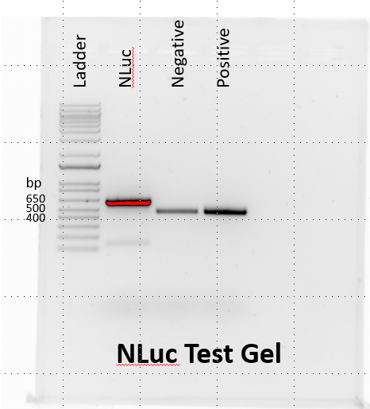
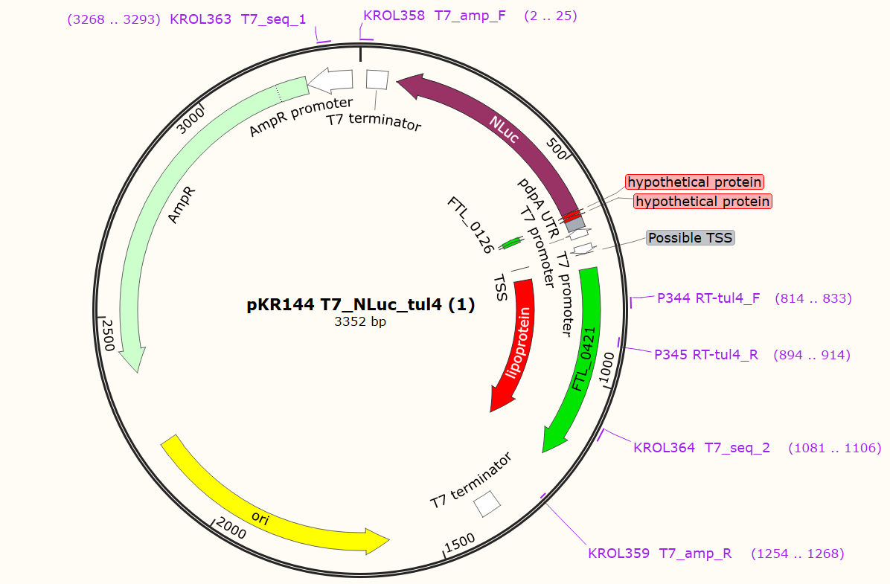
Design and Clone Plasmid
PCR Product: 606 bp
LVS gDNA Control: 400 bp

Slide 2
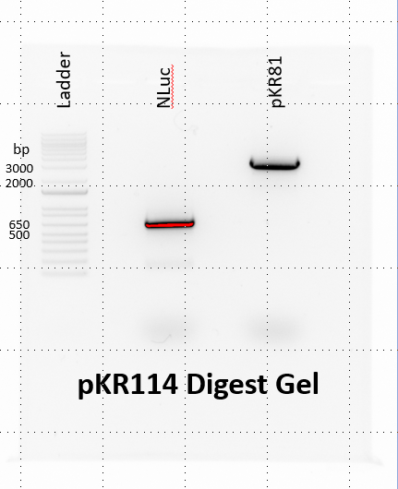
Question: Was the DNA digestion successful?
Controls: None :/
Results: Both insert and backbone were at their expected locations; the digestion was a success
PCR product: 606 bp
Backbone: 2762 bp
pKR144 Digest Gel

Slide 3
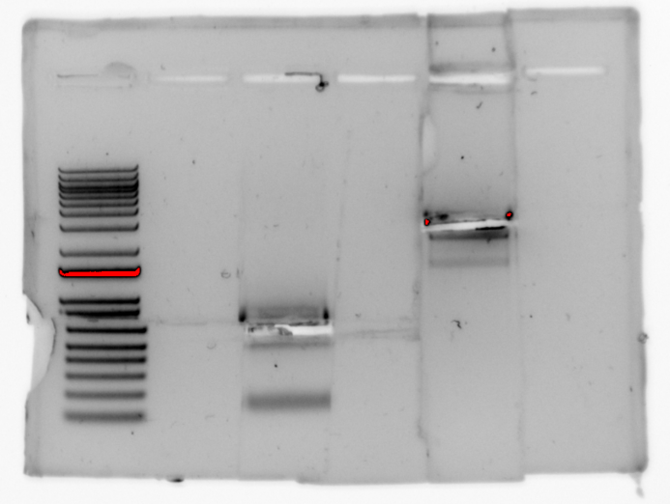

Slide 4
Side Project
Question: How do the growth rates of LVS and ΔrpsU2 compare in fresh vs. conditioned MHB media?
Controls: Compared growth rates to Hannah’s previous experiments
Results: LVS grew better than ΔrpsU2 in both conditions. Both strains grew better in fresh MHB than conditioned media.
Generation Times | 1.5-3 (hours)
LVS Fresh | 227.9443936
LVS Conditioned | 191.3579718
ΔrpsU2 Fresh | 385.6540485
ΔrpsU2 Conditioned | 158.4067221
Generation Times
 | 0-2 hrs
LVS + pF | 110.12773
ΔrpsU2 + pF | 150.78264
Very poor growth. Next step - should repeat experiment
Notes:
Control: sterile conditioned media
Blank with media grown in

Slide 5
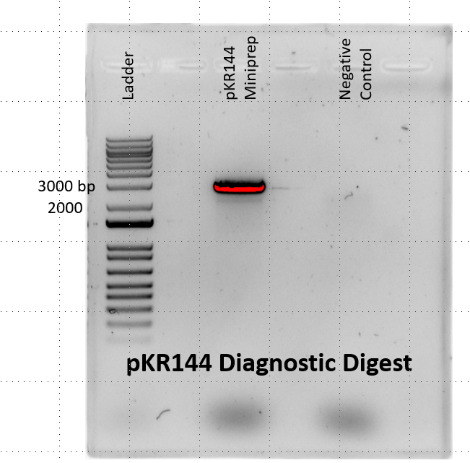
Question: Did the NLuc gene successfully insert into the backbone?
Controls: Used water as a negative control during the digestion
Results: Two bands present in the miniprep column. One at approximately 2500 bp and the other around 3000 bp
Two bands could represent digested and un-digested plasmid.
Next step – Do another ligation using different ratios of insert:backbone to try and improve ligation efficacy
Insert: 606 bp
Backbone: 2762 bp
Plasmid: 3352 bp
Notes:
Negative control: not adding enzymes (supercoiled plasmid – runs faster)
Positive control: another plasmid with same cut sites

Slide 6
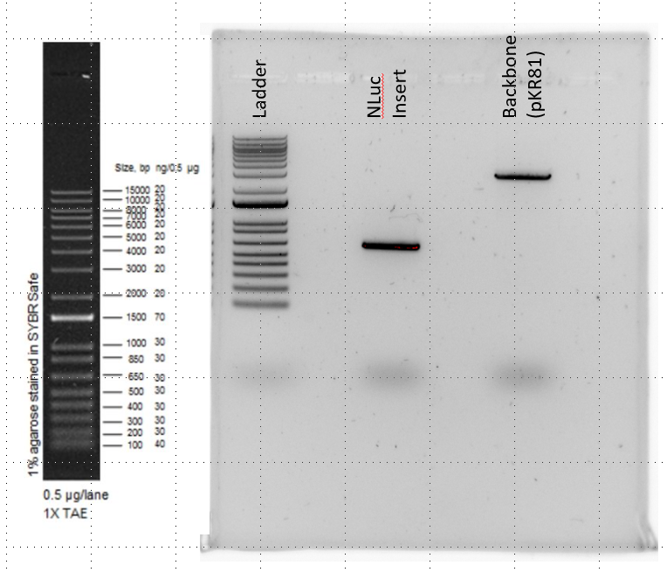
Re-Do of Ligation
Question: What are the concentrations of my gel purified insert and backbone?
Results: Both bands appear at their expected locations (590 and 2762 bp respectively). Compared to the 1500 bp band, the insert band is approximately 3X the intensity while the backbone is about the same intensity.
1500 band = 140 ng (the concentration of the ladder we use is double)
Insert: 420 ng / 5 uL = 84 ng/uL
Backbone: 140 ng / 5 uL = 28 ng/uL
Nanodrop Concentrations →
Insert: 60.4 ng/uL
Backbone: 33 ng/uL

Slide 7
Model for bS21-mediated regulation
50S
30S
bS21-2
bS21-3
bS21-1
bS21-1
bS21-2
bS21-3
- bS21
pdpA UTR +
Tul4 UTR ++
pdpA UTR +
Tul4 UTR ++
pdpA UTR ++
Tul4 UTR ++
?
Notes:
We’ve shown that wild-type Francisella cells have multiple bS21 homologs incorporated into ribosomes. When bS21-2 incorporates into ribosomes it leads to increased production of certain proteins including the Type 6 and some other virulence genes. We hypothesize that this is because bS21-2 allows for preferential translation initiation for particular subsets of transcripts, almost analogous to a sigma-factor.
Similarly, ribosomes incorporating other homologs may lead to increased translation of specific genes, including the Type 6 proteins, and this is something we’re continuing to investigate.
There also might be translationally-active ribosomes that have NO bS21 which may translate different subsets mRNAs.
Because bS21 can be easily exchanged among ribosomes, this suggests a mechanism by which cells can rapidly modulate their proteome to adapt to changing environments. This model is consistent with the idea that phages use bS21 in this way to hijack host ribosomes and influence gene expression.

Slide 8
Side Project
Question: How do the growth rates of LVS and ΔrpsU2 compare in fresh vs. conditioned MHB media?
Controls: Compared growth rates to Hannah’s previous experiments
Results: Both strains grew better in fresh MHB compared to conditioned media.
Generation Times | 0-2 (hours) | 2-4 (hours) | 4-6 (hours)
LVS Fresh | 131.098 | 154.0235688 | 223.0153148
LVS Conditioned | 271.189 | 337.591975 | 820.3827353
ΔrpsU2 Fresh | 145.3063624 | 191.7151694 | 234.795012
ΔrpsU2 Conditioned | 271.5490397 | 341.1966109 | 523.3159576
The cells grew much better this time. The growth defect in ΔrpsU2 is not apparent in conditioned media. Next step - should repeat experiment to validate results

Slide 9
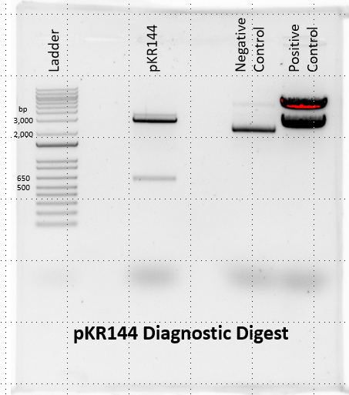
Question: Did a non-mutated NLuc gene successfully insert into the backbone?
Controls: Didn’t use enzymes for the negative control; used pKR82 as a positive control
Results: There was an insertion as seen in the diagnostic digest gel! Even more exciting, the gene was not mutated as seen by the sequencing results
pKR82→ pKR144→
Backbone: 2762 bp Backbone: 2762 bp
Insert: 606 bp Insert: 2560 bp

Slide 10
Side Project
Question: How do the growth rates of LVS and ΔrpsU2 compare in fresh vs. conditioned MHB media?
Controls: Compared growth rates to previous experiments
Results: Both strains grew better in fresh MHB compared to conditioned media.
Generation Times | 0-2 (hours) | 2-4 (hours) | 4-6 (hours)
LVS Fresh | 124.09957 | 153.03831 | 189.93779
LVS Conditioned | 260.43395 | 373.37395 | 443.64395
ΔrpsU2 Fresh | 149.25906 | 176.78559 | 288.42517
ΔrpsU2 Conditioned | 265.84725 | 363.0225 | 518.71043
These results validate the most recent growth experiment. Next steps – Figure out way to remove siderophore from media
Notes:
Add more sources of other type of iron to media
Determine if we can buy siderophore commercially, have someone purify it for us, fractionate media to add concentrated version of it to fresh MHB

Slide 11
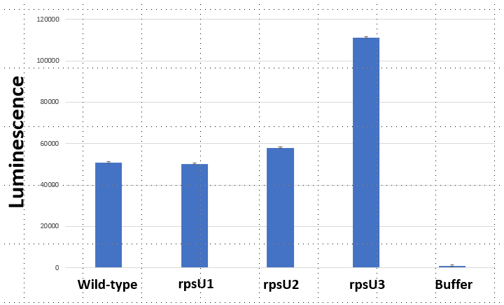
Question: Is the pdpA 5’ UTR differentially recognized / translated between the three bS21 homologs
Controls: E. coli ribosomes and buffer
Results: bS21-3 preferentially translates mRNAs with the pdpA 5’ UTR
Next step – perform Western blot to measure tul4 levels; determine NLuc/tul4 ratios; repeat assay to validate results

Slide 12
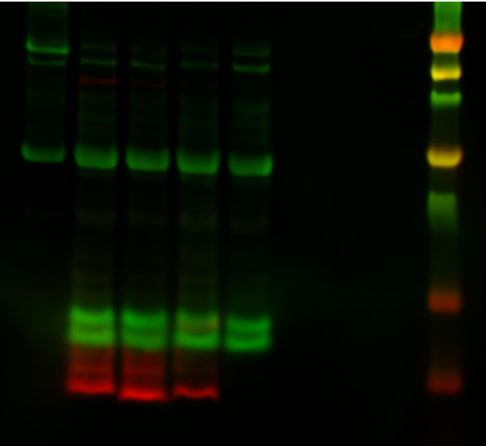
WT
Buffer
Ladder
Tn7::P_{rpsU2}-rpsU2-V
Tn7::P_{rpsU2}-rpsU3-V
Tn7::P_{rpsU2}-rpsU1-V
MW (kDa)
Question: How much tul4 was produced in each sample
Controls: WT ribosomes and buffer
Results: Visually it appears they all have similar levels of tul4. Noticeably, there are very strong bands for bS21 for the three Tn7 strains.
125
90
70
50
38
25
15

Slide 13
WT 1
WT 2
Ladder
WT 3
Buffer
Tn7::P_{rpsU2}-rpsU1-V
Tn7::P_{rpsU2}-rpsU2-V
Tn7::P_{rpsU2}-rpsU3-V
MW (kDa)
125
90
70
50
38
25
15

Slide 14
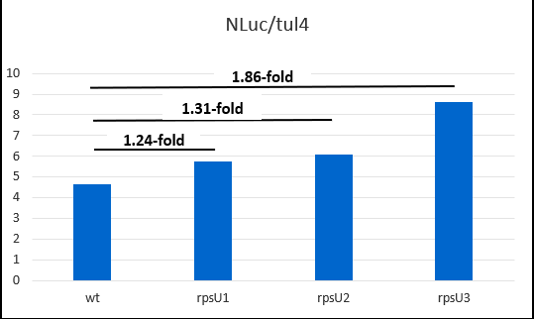
Results: The NLuc/tul4 ratio for each ribosome follows the same pattern as the original NLuc graph. rpsU3 has the highest expression, while rpsU1 and rpsU2 are similar to wild-type levels.
Next step – repeat ribosome assay and western blot to validate

Slide 17
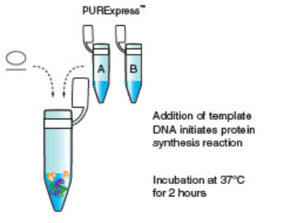
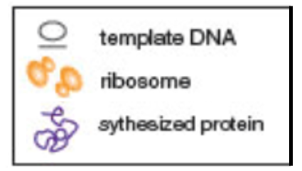


Addition of template DNA initiates protein synthesis reaction
Incubation at 37ºC for 4 hours

Slide 18
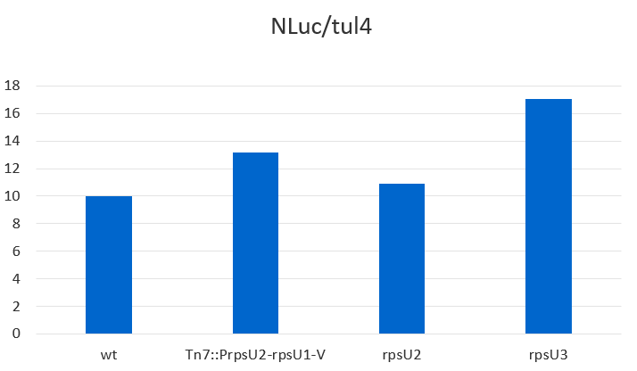
1.70-fold
1.09-fold
1.31-fold
Nluc/LpnA
Wild-type
Tn7::P_{rpsU2}-rpsU1-V
Tn7::P_{rpsU2}-rpsU2-V
Tn7::P_{rpsU2}-rpsU3-V

Slide 19
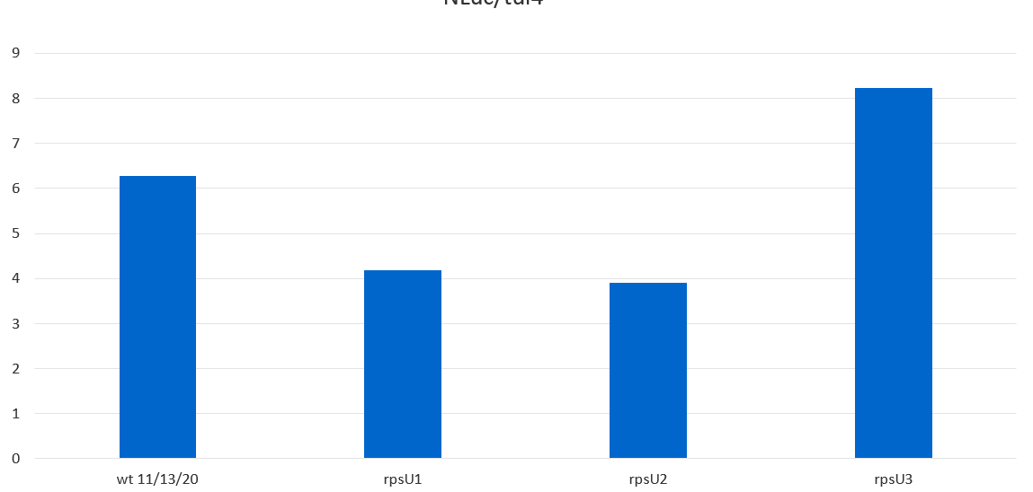
Nluc/LpnA
Wild-type
Tn7::P_{rpsU2}-rpsU1-V
Tn7::P_{rpsU2}-rpsU2-V
Tn7::P_{rpsU2}-rpsU3-V

Slide 20
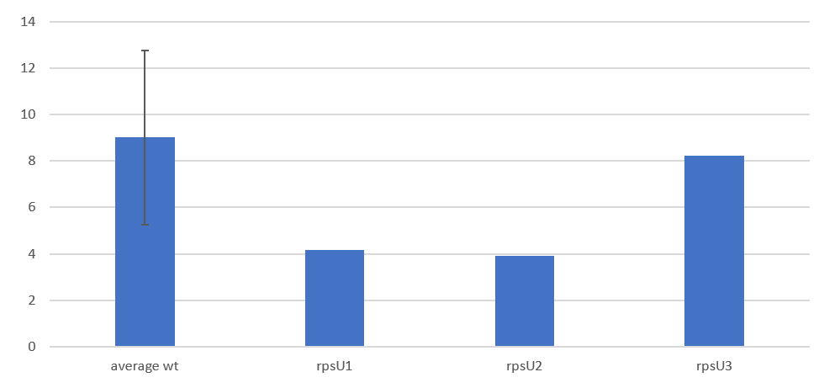
0.91-fold
0.43-fold
0.46-fold
Nluc/LpnA
Average
Wild-type
Tn7::P_{rpsU2}-rpsU1-V
Tn7::P_{rpsU2}-rpsU2-V
Tn7::P_{rpsU2}-rpsU3-V

Slide 21
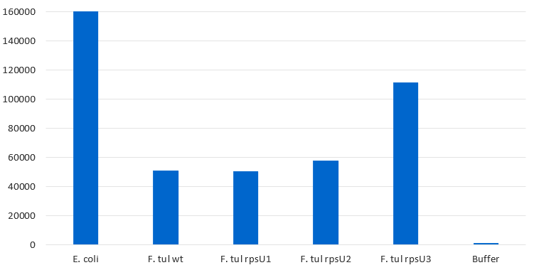
Luminescence
E. coli
Wild-type
F. tularensis
Wild-type
Tn7::P_{rpsU2}-rpsU1-V
Tn7::P_{rpsU2}-rpsU2-V
Tn7::P_{rpsU2}-rpsU3-V
Buffer

