Slide 1
Lab Contributions
John and Joe

Slide 2
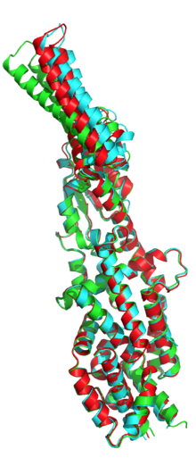
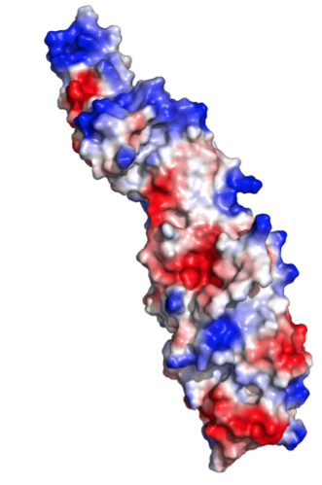
PriM
Inhibits growth in macrophage
Contains disulfide bond
Virulence

Slide 3
Plasmids
pKL115
pKL116
pKL118
pKL125
pKR4
pKR5
pKR25
pKR21

Slide 4
pKL115
Deactivation of acetate-binding pocket of PriM
Currently creating a strain of ∆Pmra that contains this mutant
Acetate
binding

Slide 5
pKL116
Electropositive tip region → electronegative

Slide 6
pKL118
Destabilization of hydrophobic core
Inhibit protein function

Slide 7
pKR4 & pKR5
Cysteines → Alanines
Affects disulfide bond formation

Slide 8
pKL125
Deletion of FPI
1) Simplifies future mutations
2) May provide evidence of evolutionary benefits

Slide 9
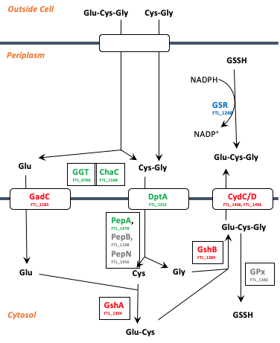
pKR25 & pKR21

Slide 10
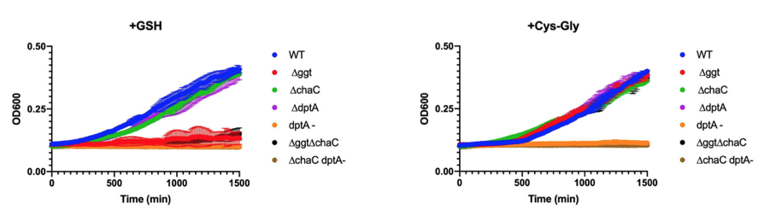
pKR25 & pKR21

Slide 11
pKR25
Overexpression of GGT
Notes:
Should promote cell growth

Slide 12
pKR21
Overexpression of DptA
Notes:
Should inhibit cell growth

Slide 13
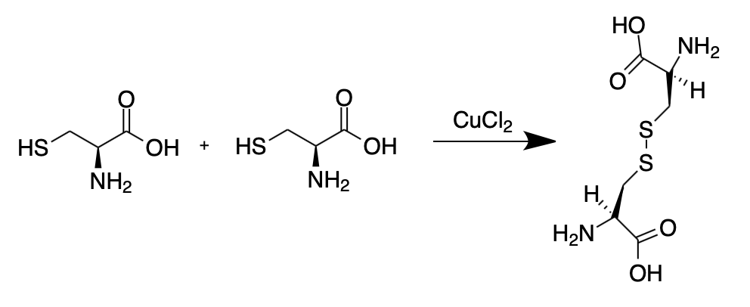
Copper Assay
DsbB: Disulfide bond formation B
  Aka FipB
FipB causes folds in cysteines by forming disulfide bonds:

Slide 14
Copper Assay
Copper changes redox potential of cysteines
Cysteines cannot form disulfide bonds and the cell dies
FipB mutants have been shown to be avirulent in mice (Aiping, Zhang, et al., 2014)
For results, note that 2 hour time point was removed

Slide 15
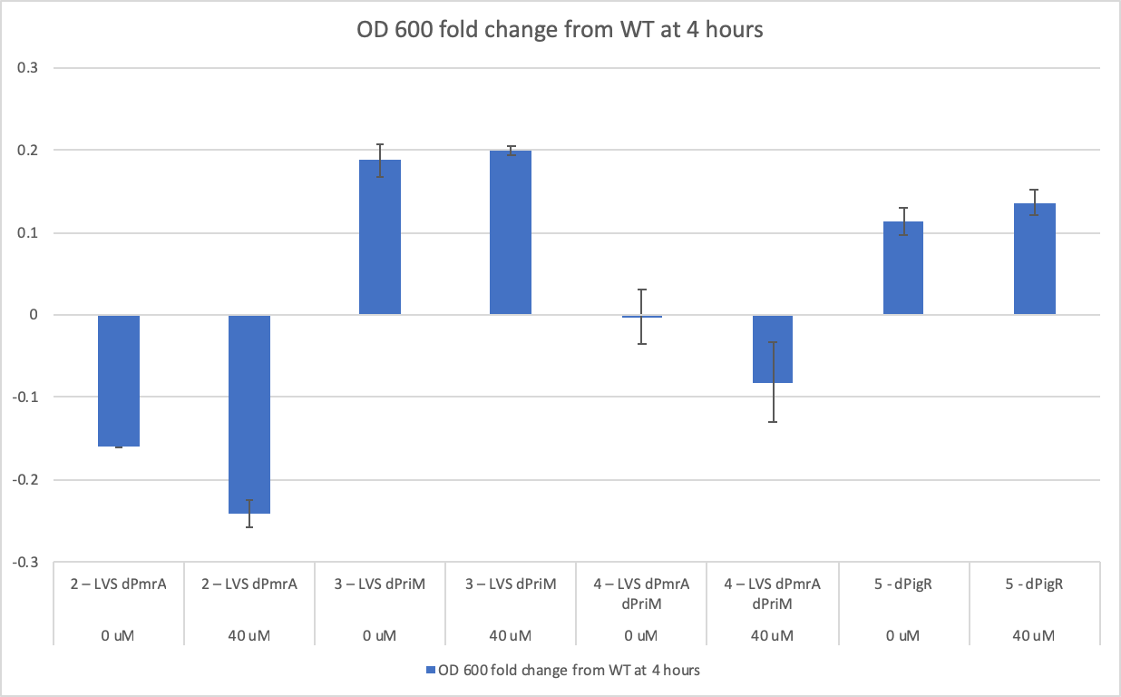

Slide 16
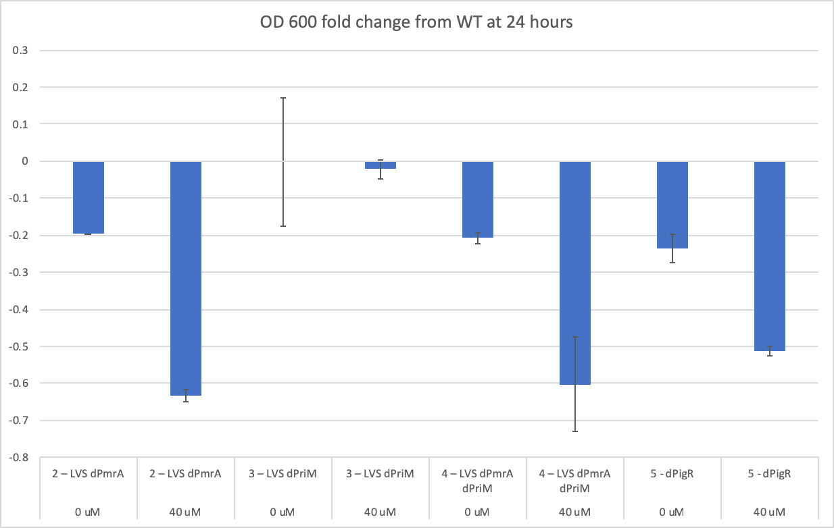

Slide 17
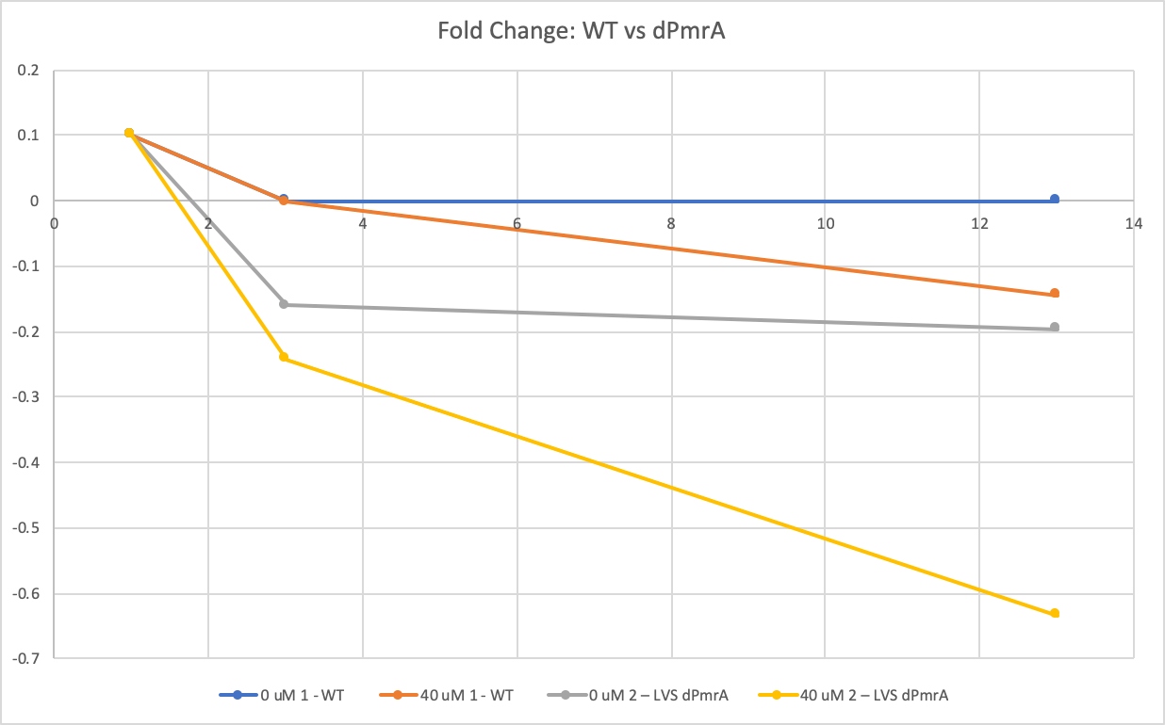
WT
WT
dPmrA
dPmrA

Slide 18
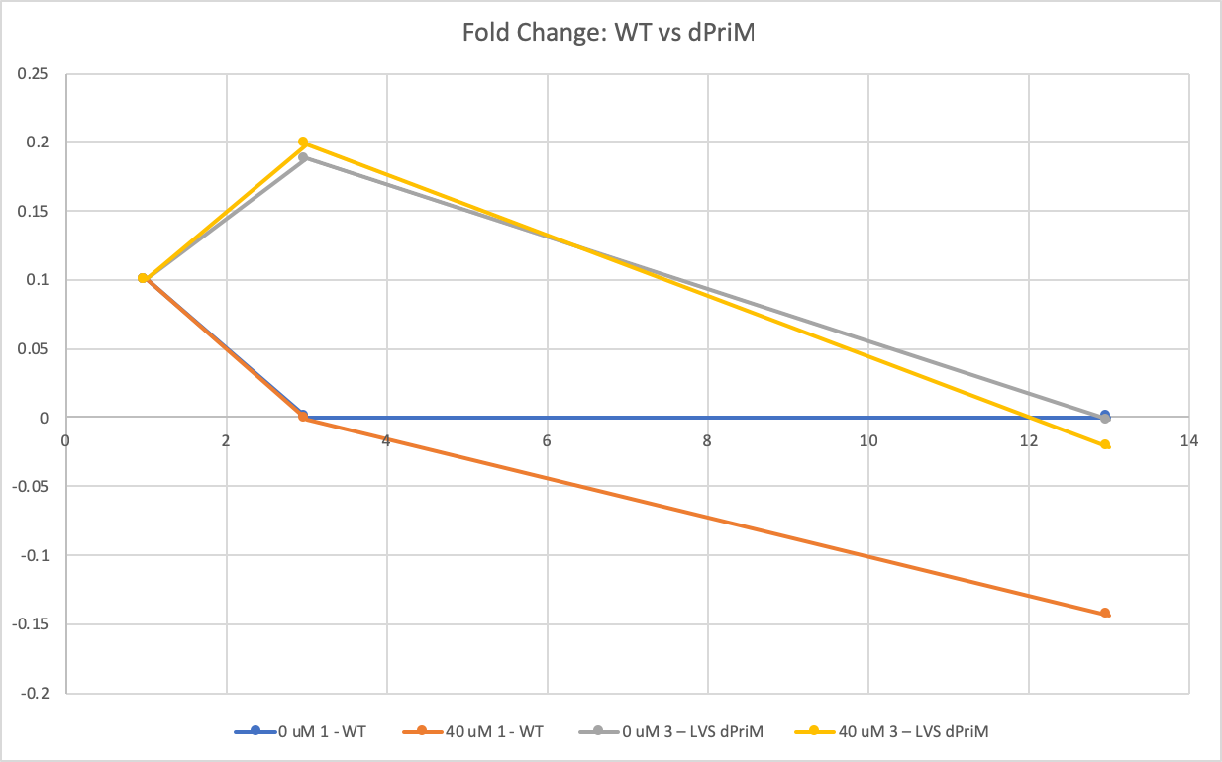
WT & dPriM
dPriM
WT

Slide 19
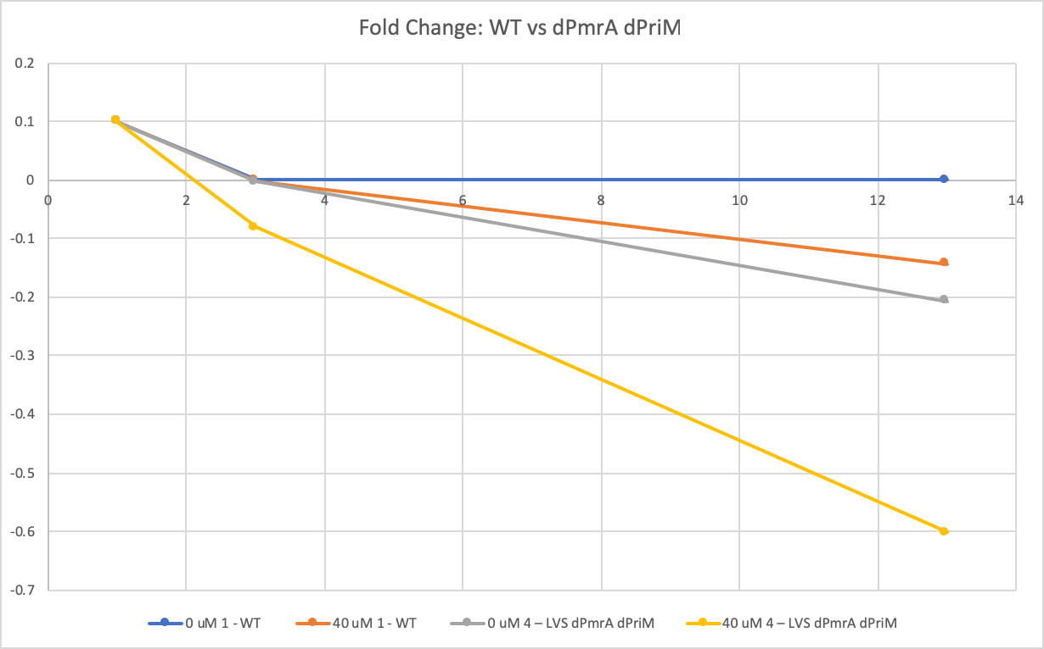
WT
WT
dPmrA dPriM
dPmrA dPriM
Notes:
dPmrA must be responsible for growth defect.

Slide 20
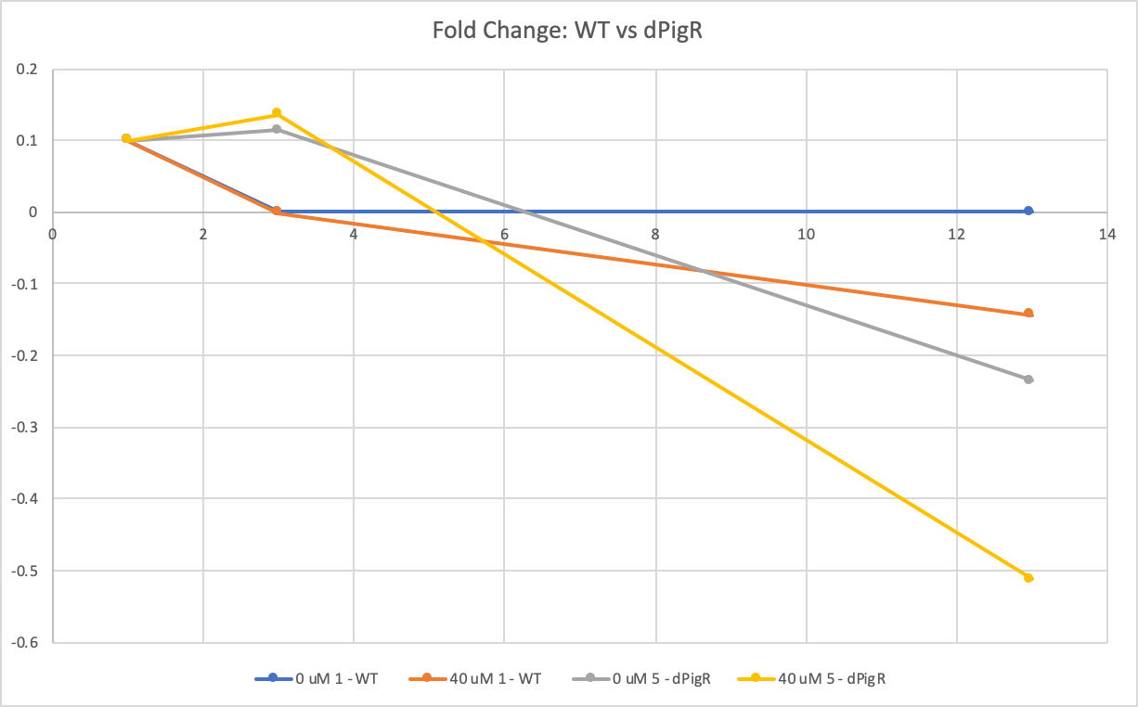
WT
WT
dPigR
dPigR
Notes:
Wasn’t what we expected
Hard to draw conclusion

Slide 21
Moving Forward
Use 0 uM, 20 uM, and 40 uM concentrations
Create FipB mutant to test
  Cells should not be able to survive in copper concentrated solution

Slide 22
Chemically Defined Media Project
Goal: Make medium that will produce better Francisella growth than traditional media (i.e. MHB)
Steps:
  Create stock solutions of individual components
  Make a chemically defined media using components
  Test this media against Mueller-Hinton broth

Slide 23
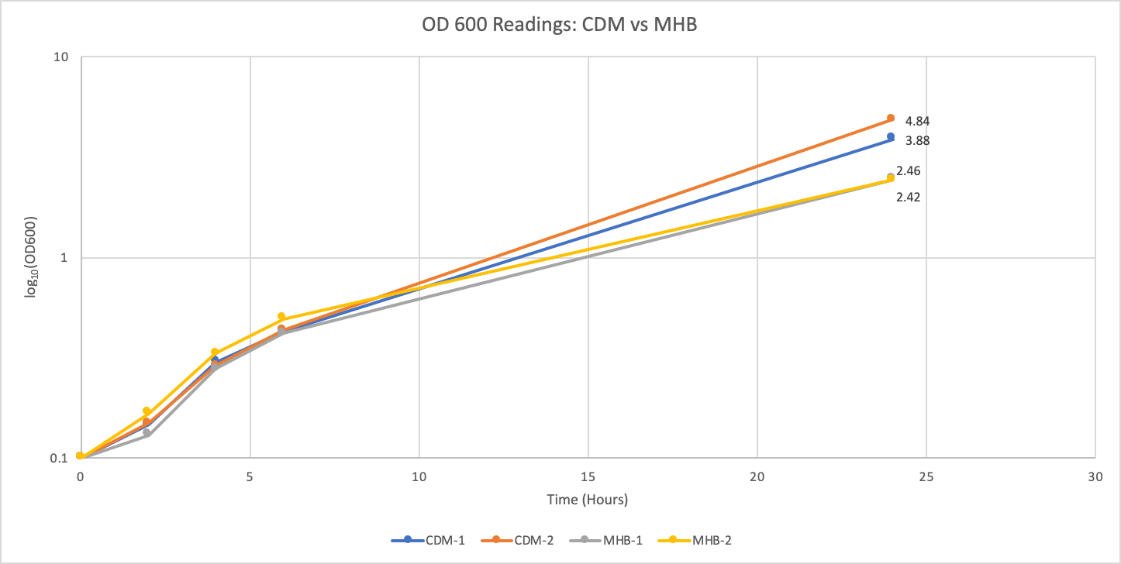
Notes:
CDM eventually beats out MHB.

Slide 24
Notes:
After ~11 hours, CDM provides better growth than MHB. For anything that will be grown overnight or longer, CDM will be best.

Slide 25
Supplemented Mueller-Hinton Sucrose Agar
Substituted MH sucrose agar after CHA sucrose did not work
MH also did not work
Since these both contain salt, it may be that the salt is preventing the sucrose selection from working
Homemade CHAH + sucrose recipe (no salt) is working thus far

Slide 26
Citations
Qin, A., Zhang, Y., Clark, M. E., Rabideau, M. M., Barea, L. R., & Mann, B. J. (2014). FipB, an Essential Virulence Factor of Francisella tularensis subsp. tularensis, Has Dual Roles in Disulfide Bond Formation. Journal of Bacteriology, 196(20), 3571-3581. doi:10.1128/jb.01359-13

