Slide 1
Lab Meeting Presentation
October 20, 2020
John Church

Slide 2
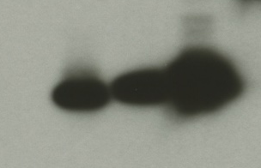
F. tularensis has heterogeneous populations of ribosomes
(Slide courtesy of Hannah Trautmann)
rpsU1
cspC
bS21-1 - V
bS21-2 - V
bS21-3 - V
bS21-2-V
bS21-1-V
bS21-3-V
WT
rpsU2
yqeY
dnaG
rpoD
α-VSVG
rpsU3
Why do the ribosomes have these different proteins? Are they sensitive to antibiotics?
Notes:
Even though francisella has a very small genome, it encodes three copies of the rpsU genes, which encode bS21. This is especially noteworthy because most bacteria have 0 or 1 of this gene.
We originally hypothesized, and have since shown, that these three proteins are produced and incorporated into ribosomes. I purified ribosomes from wild-type cells as well as cells ectopically expressing each of the bS21 proteins with a VSVG tag. We then ran these on a gel and immunoblotted. This, along with some mass spec data we have of purified ribosomes, indicates that F. tularensis can incorporate each paralog into ribosomes, so Francisella is producing heterogeneous ribosomes.
Now that we have seen that structurally heterogeneous ribosomes exist, the question is why Francisella may have these and if they affect translation? We have developed a model for our hypothesis about this, which I will show you now.

Slide 3
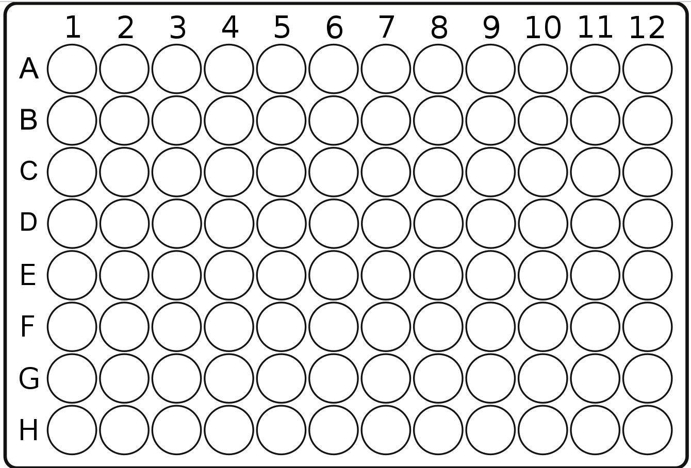
MIC: Minimum Inhibitory Concentration
An assay used for finding the lowest concentration of a chemical (antibiotic) that prevents growth of bacteria
Lab Application: Using antibiotics that target ribosomes in Francisella, potentially inhibiting translation
  Differing MICs between strains help us to infer how the differences in ribosomes are affecting Francisella
  Also, are these ribosomes sensitive to antibiotics?
https://en.m.wikipedia.org/wiki/File:96-Well_plate.svg
Notes:
Do these ribosomes have different structures? Are they sensitive to antibiotics?

Slide 4
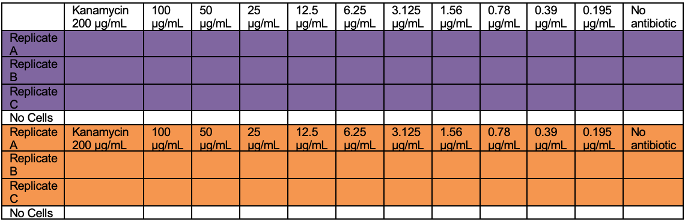
MIC: Minimum Inhibitory Concentration
Antibiotic concentrations
https://en.m.wikipedia.org/wiki/File:96-Well_plate.svg
LVS
MHB with no cells
Tn7::rpsu1, 2, or 3

Slide 5
MIC Results: rpsu1 and kanamycin
6.25
MIC is estimated to be 6.25

Slide 6
MIC Results: rpsu2 and kanamycin
6.25
MIC is estimated to be 6.25

Slide 7
MIC Results: rpsu2 and kanamycin
12.5
MIC is estimated to be 12.5

Slide 8
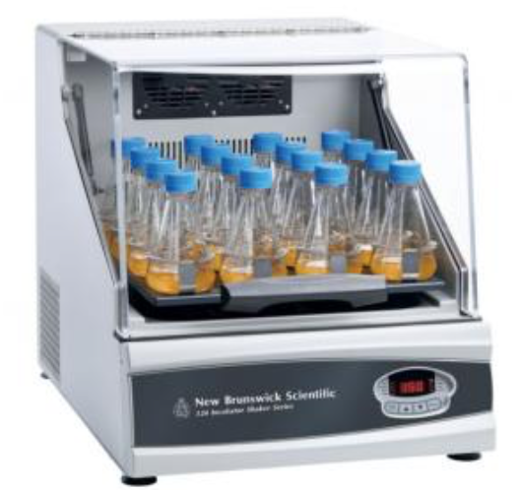
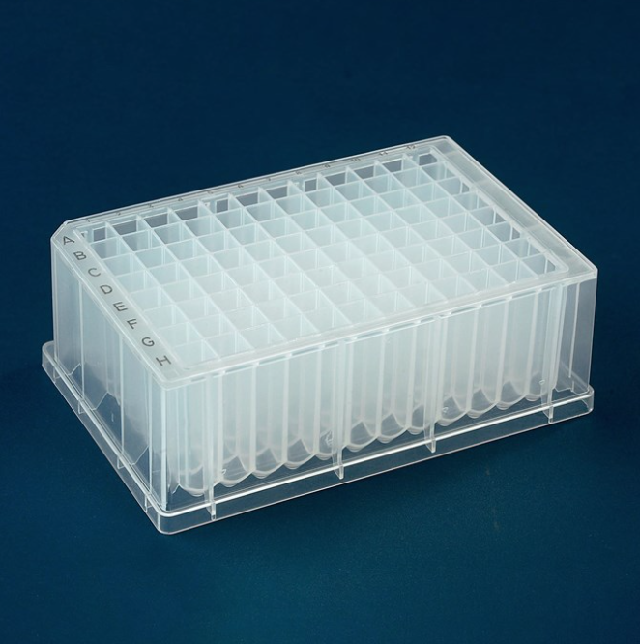
Problems and future aims
Replicability – differing MICs
  Trouble getting replicable results after 24 vs 48 hours
  Not switching tips when serially diluting
  Low ODs
    Try using shaking incubator
https://www.usascientific.com/plateone-96-deep-well-2ml/p/PlateOne-96-Deep-Well-2mL
https://lab.equipment/new-brunswick-i24r-shaker-19-mm--from-eppendorf

Slide 9



Acknowledgements
Dr. Kathryn Ramsey & Lab
  Hannah Trautmann
  Tala Allababidi
Dr. Steven Gregory & Lab
Dr. Jodi Camberg & Lab
INBRE Core
Janet Atoyan & GSC

Slide 10
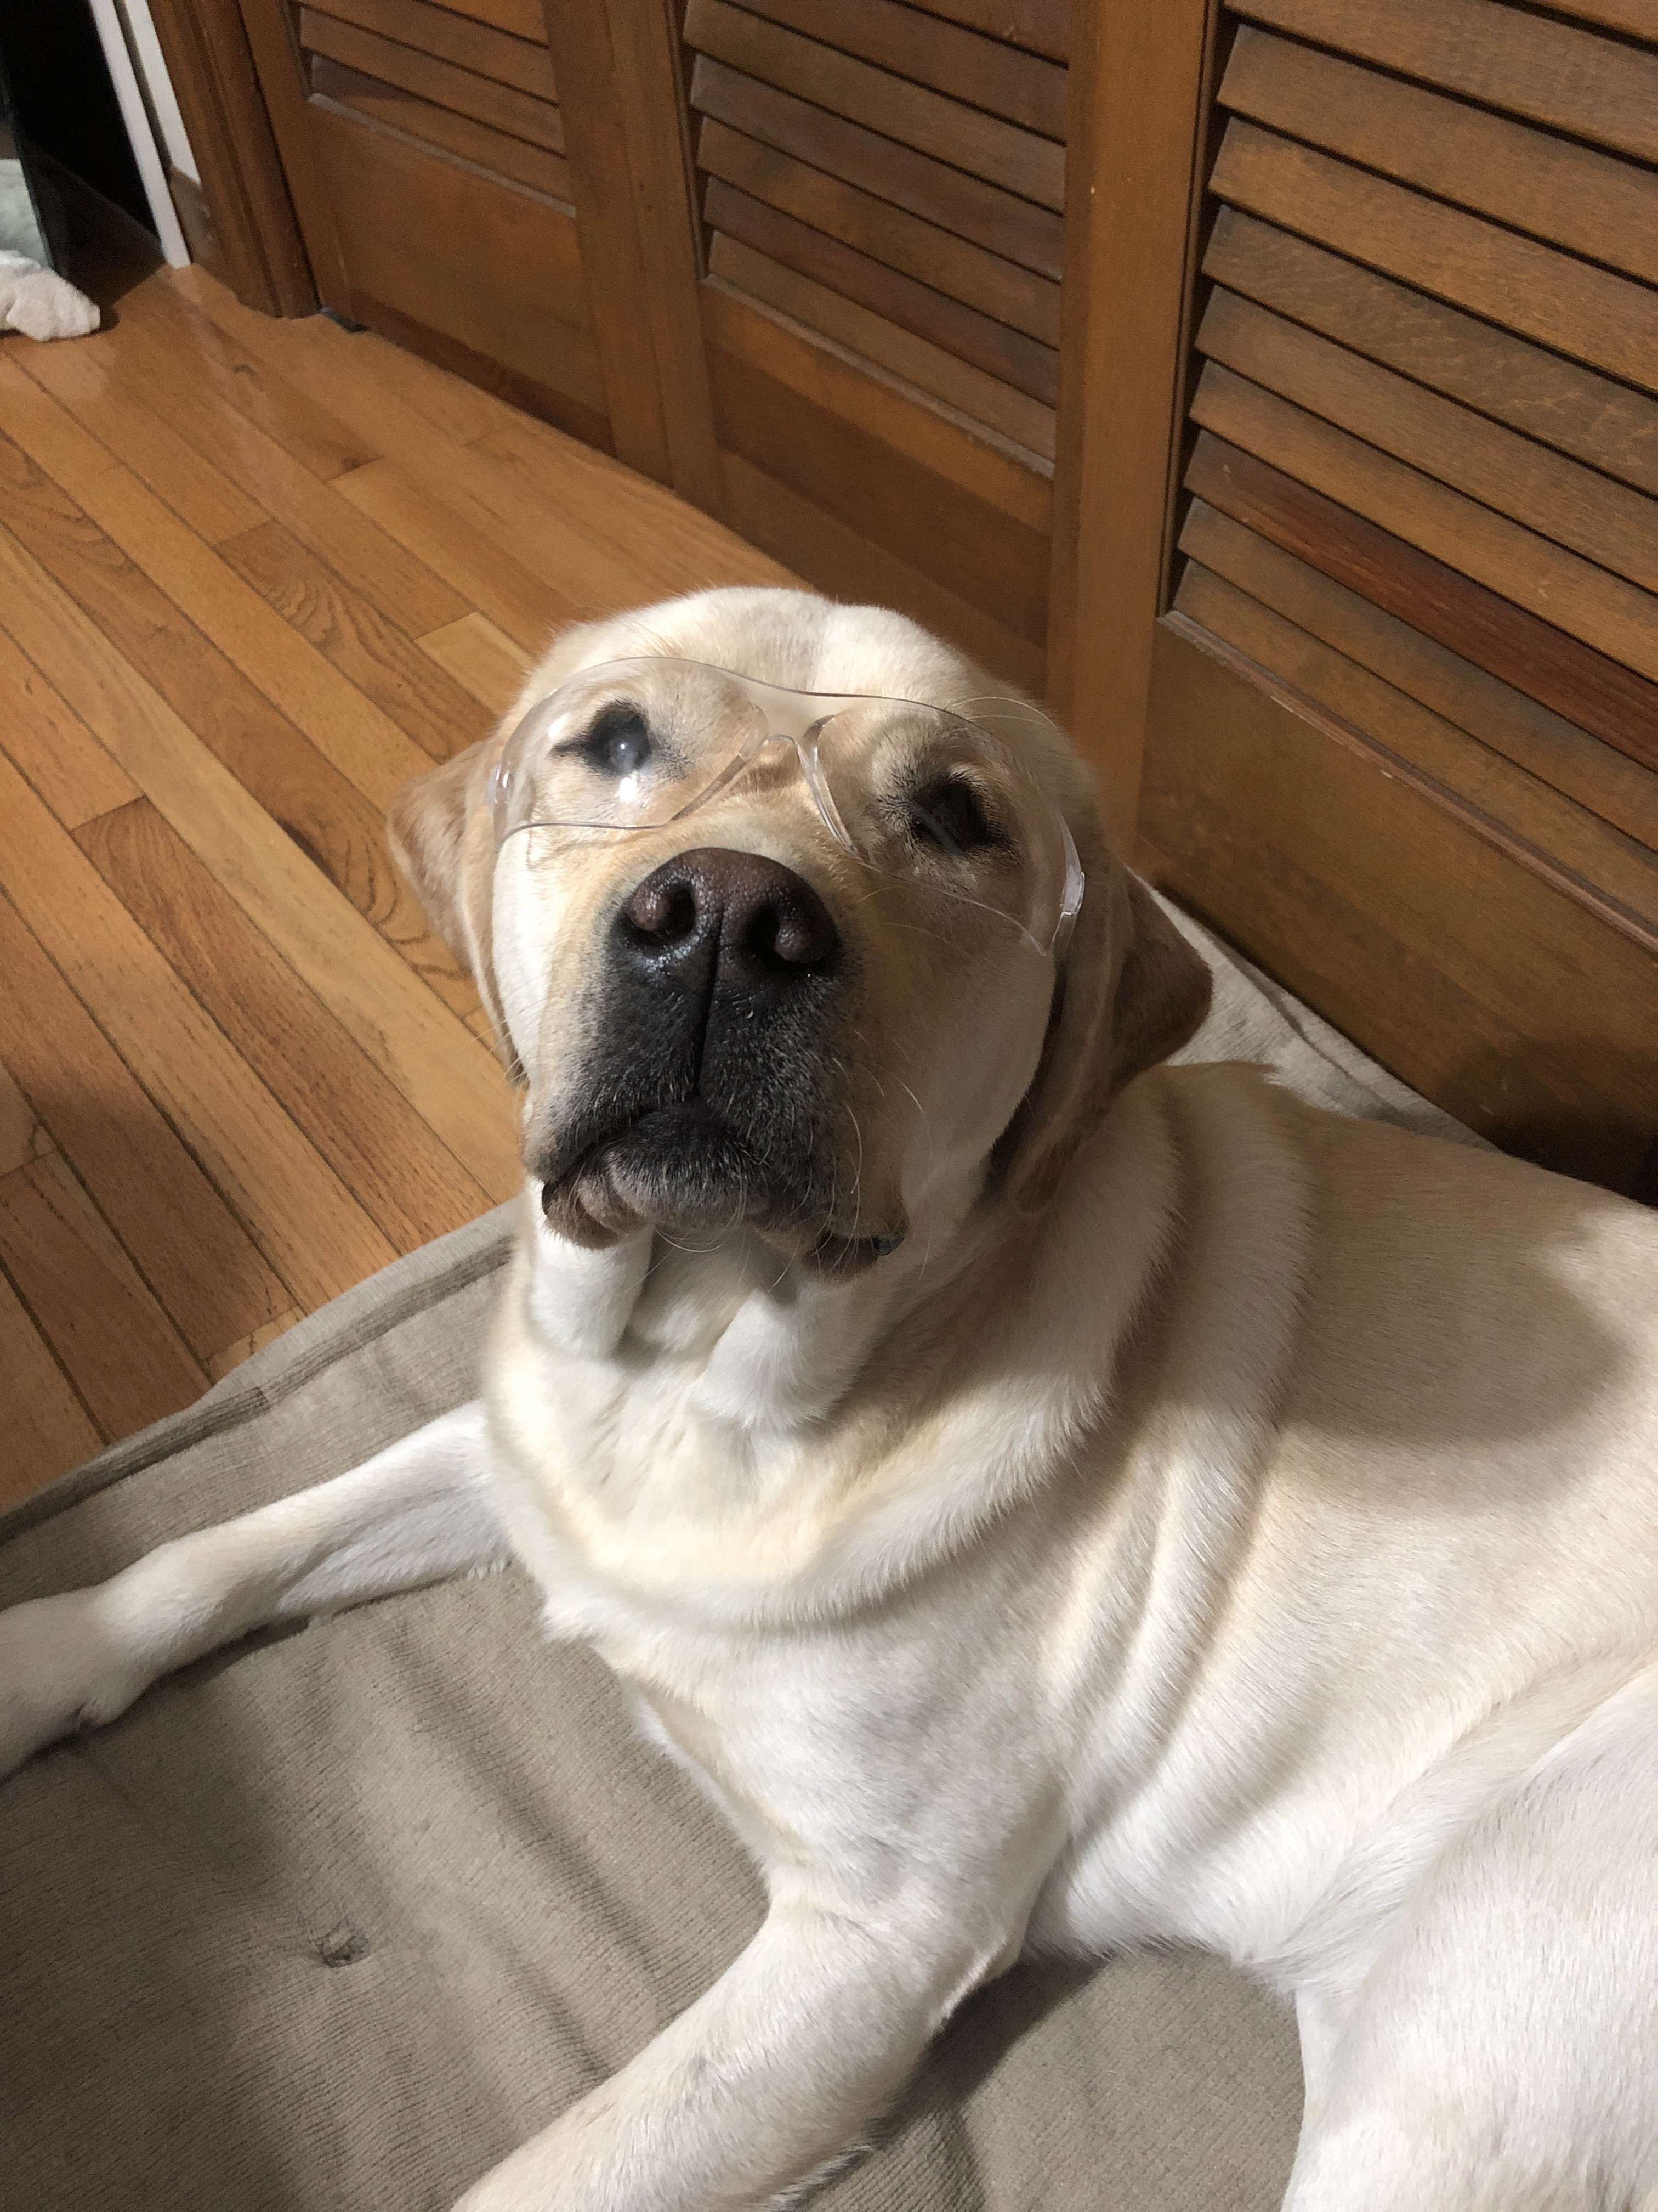
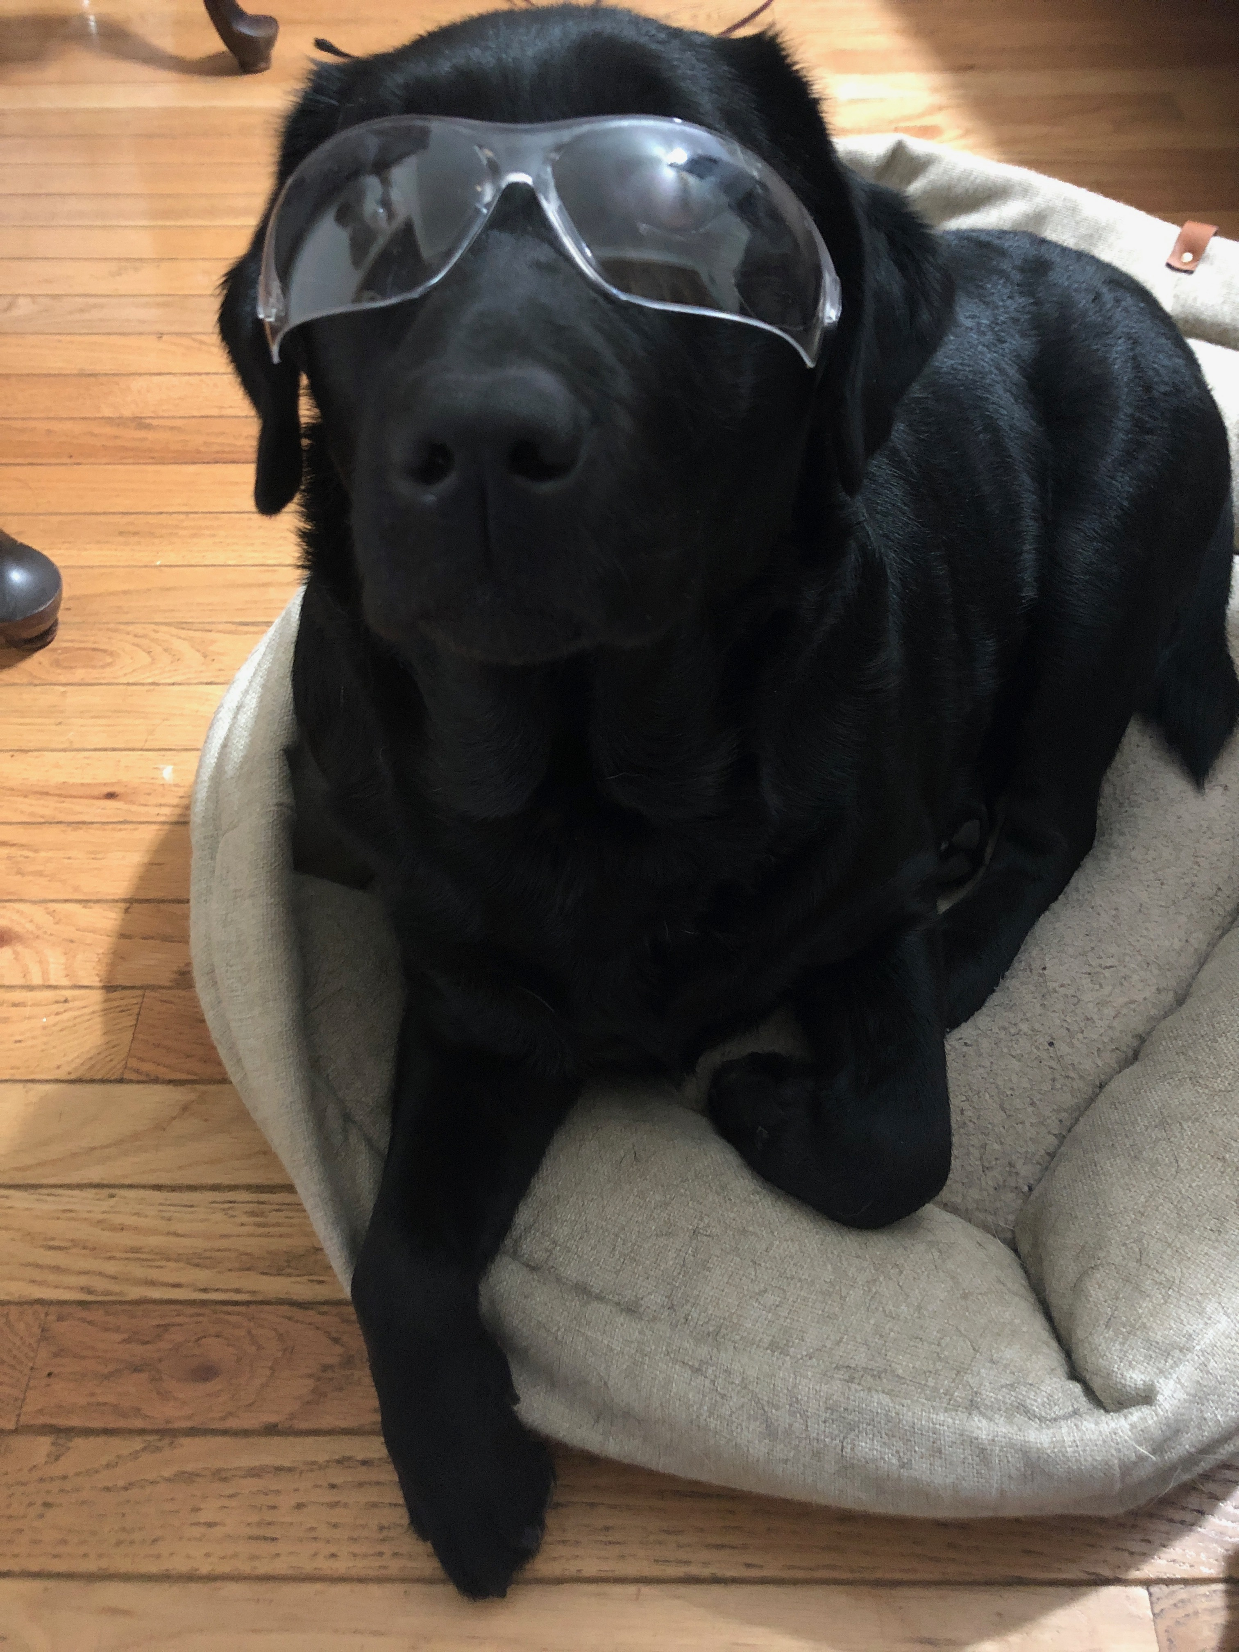
Questions?

