Slide 1
KMR Lab PriM Project
By John Church

Slide 2
PmrA & PriM
PmrA represses PriM in Francisella and allows the bacteria to grow in macrophage
Without PmrA, PriM is expressed and Francisella is attenuated for virulence

Slide 3
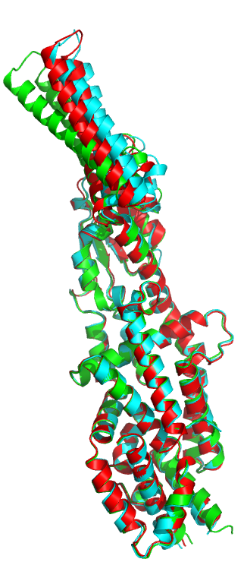
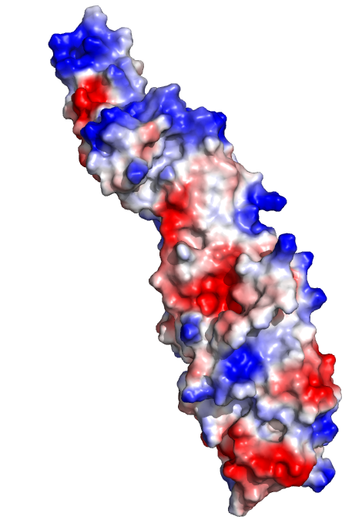
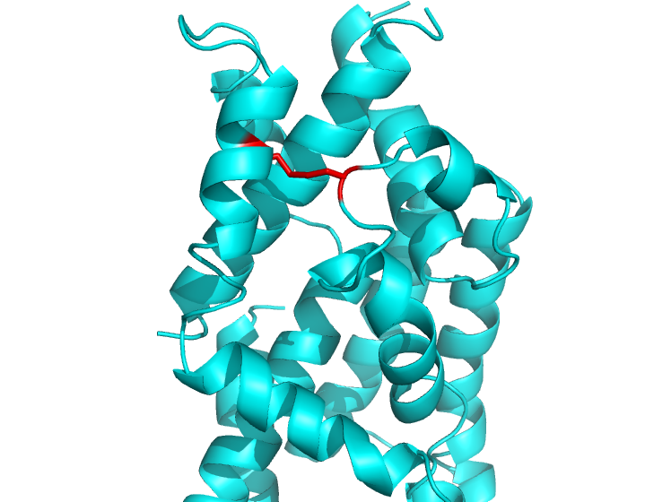
PriM Structure
Electropositive, flexible
tip or head
Flexible
“head”
Disulfide bond
Acetate
binding
Dr. Maria Schumacher

Slide 4
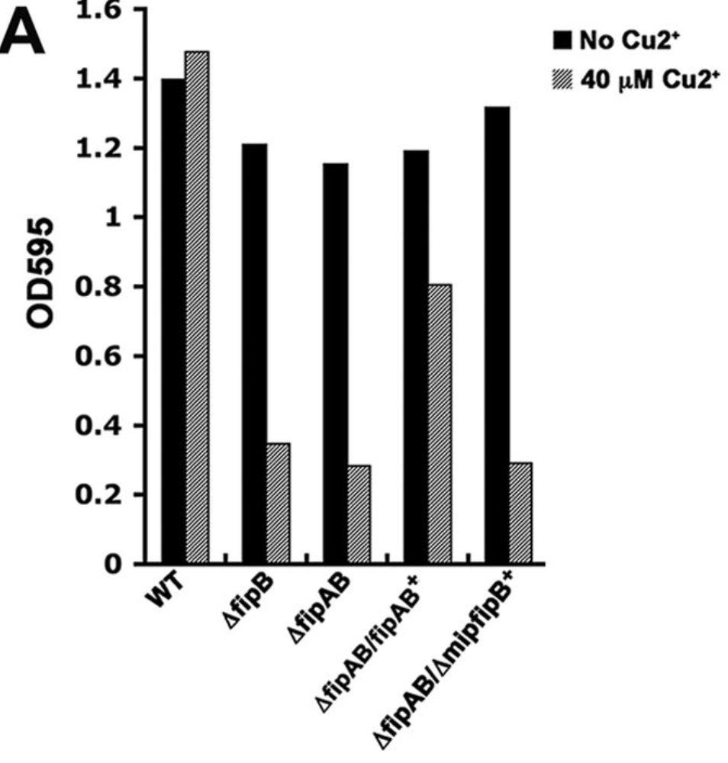
Spring 2019: FipB Mutant pKR31
FipB is a virulence factor responsible for making disulfide bonds
FipB mutation should result in significantly increased copper sensitivity
Copper changes the redox potential of cysteines
Qin, A., et al. “FipB, an Essential Virulence Factor of Francisella Tularensis Subsp. Tularensis, Has Dual Roles in Disulfide Bond Formation.” Journal of Bacteriology, vol. 196, no. 20, Apr. 2014, pp. 3571–3581., doi:10.1128/jb.01359-13.

Slide 5
DsbA activity in the absence of PriM
DsbA activity in the presence of PriM
>
S
S
S
>
>
S
S
S
S
S
S
S
>
S
S
S
S
S
S
>
DsbA
S
DsbA
S
S
S
S
S
S
S
Functional virulence factors
S
PriM
PriM
S
PriM
S
S
Notes:
DsbA catalyzes Disulfide bond formation.

Slide 6
Suppressor mutant intramacrophage assay
Notes:
Copper assay results are not relevant because of dPmrA suppressor mutant.

Slide 7
Whole Genome Resequencing (WGRS)
3 SNPs were identified:
Mutation in FTL_0146 (ABC Transport Protein)
  C → A
  Phenylalanine → Leucine
Mutation in FTL_1339 (POT Transporter)
  C → A
  Glycine → Glycine (synonymous mutation)
Mutation in intergenic region near FTL_0869
  84% T, 16% G
Notes:
dPmrA mutation much more promising than FipB mutant.

Slide 8
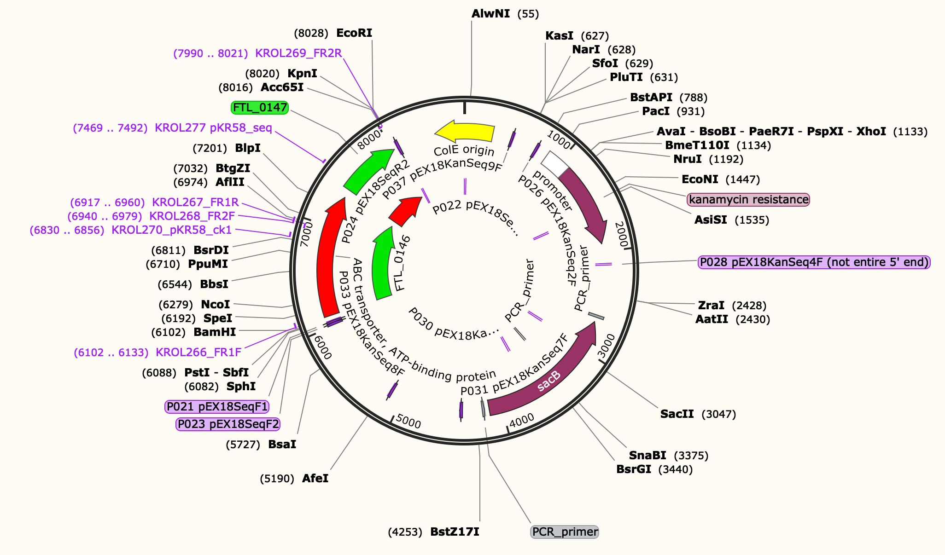
New Goal: Create pKR58 and Introduce into Francisella
pKR58: Francisella strain with ONLY ABC transporter mutation
  F315 → L
Plasmid created successfully
Working to get pKR58 into Francisella

Slide 9
Results of intramacrophage assay testing cysteine mutant
Notes:
Disulfide bonds are not important
Cysteine to Alanine

