Slide 1





WT-LVS
ΔpmrA PriM-V
ΔpmrA noC1 PriM-V
ΔpmrA mtip PriM-V
ΔpmrA mpk PriM-V
Anti-VSV-G
Anti-Tul4

Slide 2


WT-LVS
ΔpmrA PriM-V (C303A)
ΔpmrA PriM-V (mtip)
ΔpmrA PriM-V (mpk)
ΔpmrA PriM-V
Anti-VSV-G
Anti-Tul4

Slide 3

LVS
ΔpmrA PriM-V
ΔpmrA PriM
(C303A)-V
ΔpmrA PriM
(mtip)-V
ΔpmrA PriM (mpk)-V
anti-VSV-G
anti-LpnA

Slide 4
C-terminal AAA
associated domain
ATP Binding Domain
26
136
301
419
1
439
F315L

Slide 5
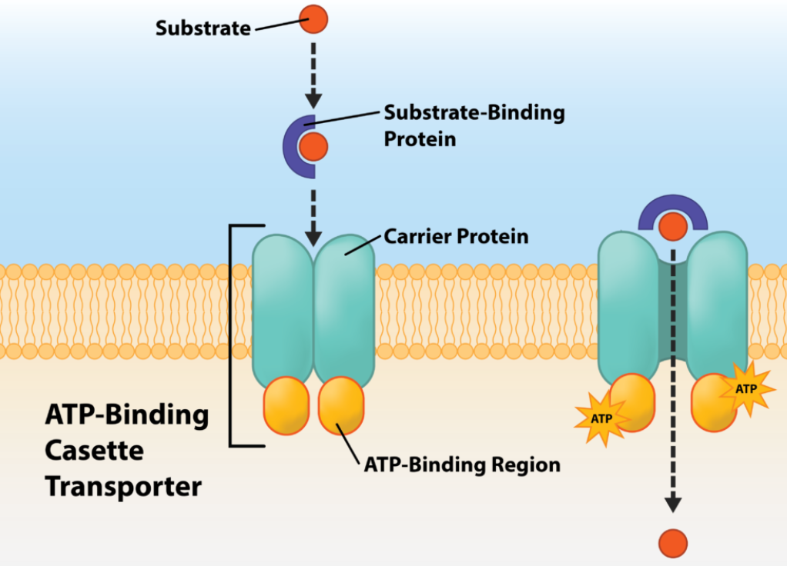
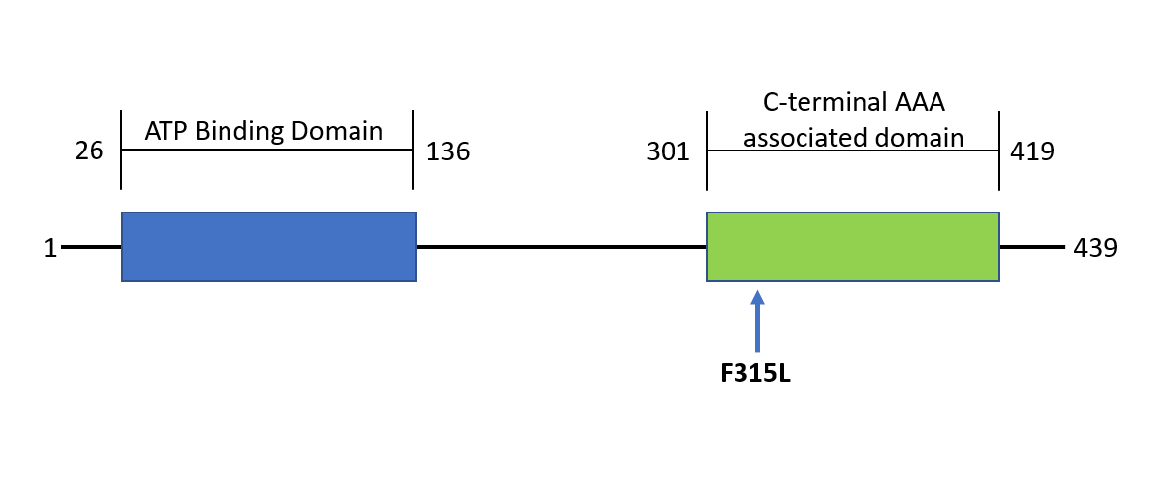
A
B

Slide 6


LVS
ΔpmrA PriM-V
ΔpmrA(sup)PriM-V
anti-VSV-G
anti-LpnA

Slide 7
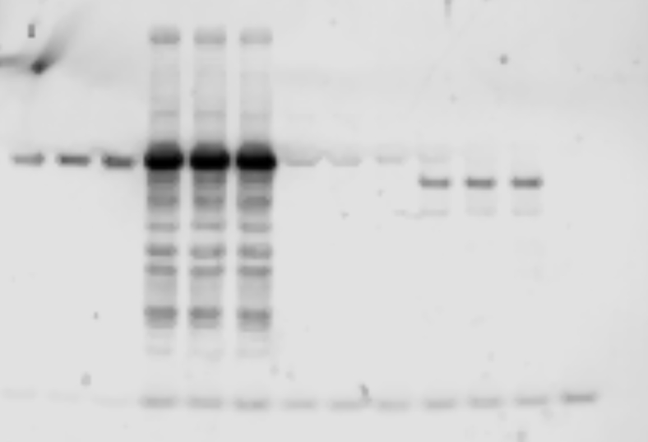

Slide 8
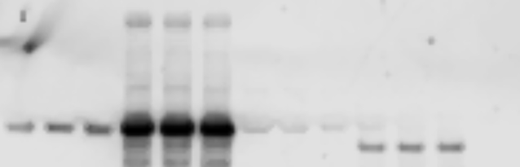
LVS
kDa
ΔpmrA
PriM(C303A)-V
ΔpmrA
PriM(mtip)-V
ΔpmrA PriM(mpk)-V
ΔpmrA PriM-V
100
anti-VSV-G
50
25
anti-LpnA

