Slide 1
Single-copy chromosomal integration systems for Francisella tularensis
Lab Meeting: 9-17-19

Slide 2
What is the Tn7 system?
Way of introducing genetic elements into the genome
Uses the Tn7 transposon
  Site and orientation specific
  Inserts downstream of highly conserved glmS
Notes:
Tn7 transposon plasmid will target a 300-350bp site following the highly conserved glmS gene which encodes the essential glucosamine-6-phosphate synthetase

Slide 3
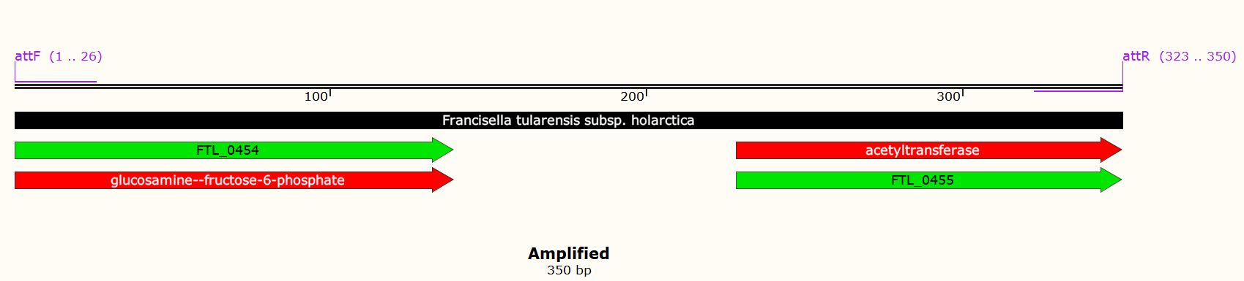
Insertion Site in LVS
Notes:
Tn7 transposon plasmid will target a 300-350bp site following the highly conserved glmS gene which encodes the essential glucosamine-6-phosphate synthetase

Slide 4
Insertion requires transformation with three plasmids
pMP720- helper plasmid
  - Delivers the transposase complex
pMP749- transposon plasmid
  - Delivers your gene of interest into the insertion site
3. pMP672- resolvase plasmid
  - Removes the kanamycin resistance cassette

Slide 5
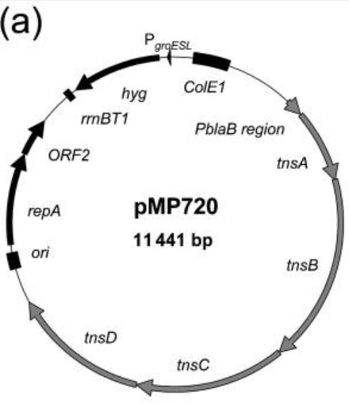
1. pMP720 Helper Plasmid
Replicating plasmid
Hygromycin resistance
Transposase genes
    tnsABCD
Notes:
Replicating plasmid with hygromycin resistance, contains transposase genes, allows the cell to produce a sufficient amount of the transposase genes before Tn7 is introduced, they were not able to put both the transposase genes and the Tn7 on the same plasmid, uses the blaB promoter

Slide 6
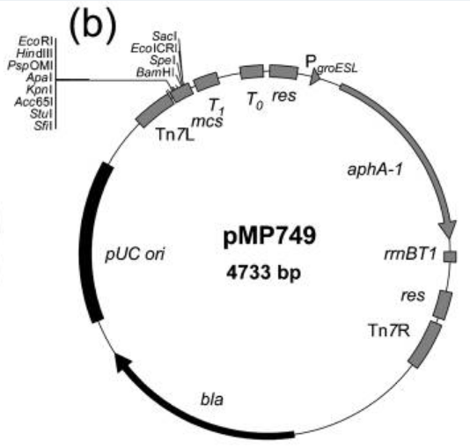
2. pMP749- Tn7 transposon
Tn7 transposon
Kanamycin/ampicillin resistance flanked by resolvase recognition sites
    aphA-1
Contains genetic element to be inserted
    mcs- multiple cloning site
Notes:
Multiple cloning site allows you to insert your gene of interest with many restriction enzyme site that can be digested out of an existing plasmid or primers can be designed using two of the existing enzymes

Slide 7
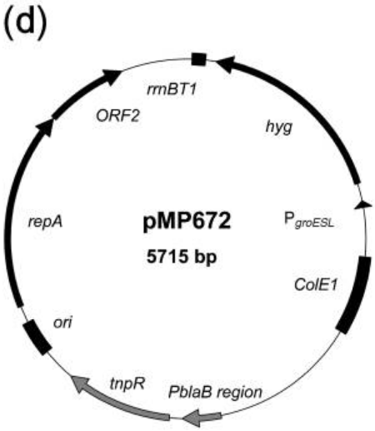
3. pMP672- Resolvase plasmid
Hygromycin resistance
γδ-resolvase
    tnpR
Recognizes the resolvase sites left from the Tn7 plasmid to remove the kanamycin resistance

Slide 8
Overview
Transform with helper plasmid
pMP720
+ LVS
tnsABCD
Select on hygromycin
make electrocompetent cells for transformation
LVS pMP720 (Hyg^{R})
pMP749
Tn7R
Term
res
aphA-1
res
yfg
Tn7L
Transform with Tn7 plasmid
gDNA
glmS
Tn7att
FTL-0455
tnsABCD
Select on kanamycin
KanR cells will have mini-Tn7 element
Make electrocompetent cells from transformants
glmS
Tn7R
res
aphA-1
res
yfg
Tn7L
FTL-0455
Cure helper plasmid then transform with resolvase plasmid
Select on hygromycin
Cure resolvase plasmid to lose hygromycin resistance
glmS
Tn7R
res
yfg
Tn7L
FTL-0455

Slide 9
Timeline
Transform with helper plasmid (2-3 days to obtain colonies)
Patch out colonies to and make electrocompetent cells (1 day)
Transform new electrocompetent cells with Tn7 plasmid (2-3 days to obtain colonies)
Cure helper plasmid by growing transformants in liquid media lacking a selective agent overnight (1 day)
Subculture 1:10 and grow an additional 24 hours (1 day)
Streak to single colony on plates lacking antibiotics then cross patch on Hygromycin plates to view cross outs and make electrocompetent cells (3-4 days)
Transform with resolvase plasmid (2-3 days to obtain colonies)
Grow transformants in liquid media containing hygromycin overnight and then streak to single colony (3-4 days for single colonies)
Cross patch on Kan to identify the Kan sensitive mutants and use colony PCR to verify the insertion (1 day)
Cure of the resolvase plasmid same way as cured for helper plasmid (~5 days)

Slide 10

Questions?

