Slide 1
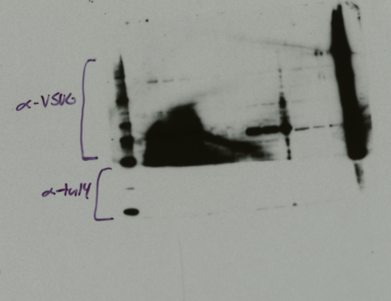
ΔpmrA mpk1 PriM-V
ΔpmrA no_C1 PriM-V
Samples isolated on 1/28/20
Exposed: 1/31/20
Anti-VSVG: 1:4444
Anti-tul4: 1:100,000
ΔpmrA mtip2 PriM-V
ΔpmrA PriM-V
LVS

Slide 2
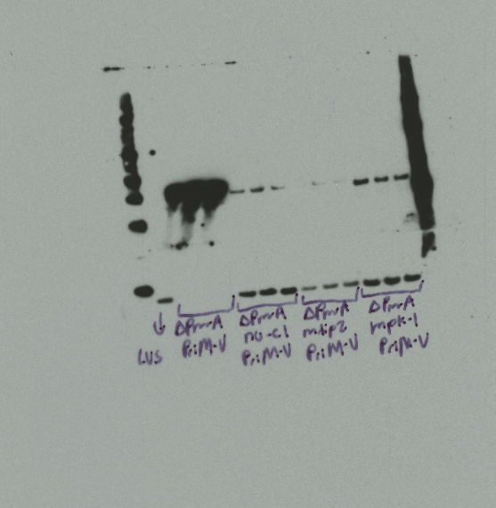
Samples isolated on 1/28/20
Exposed: 2/4/20
Anti-VSVG: 1:4444
Anti-tul4: 1:100,000

Slide 3
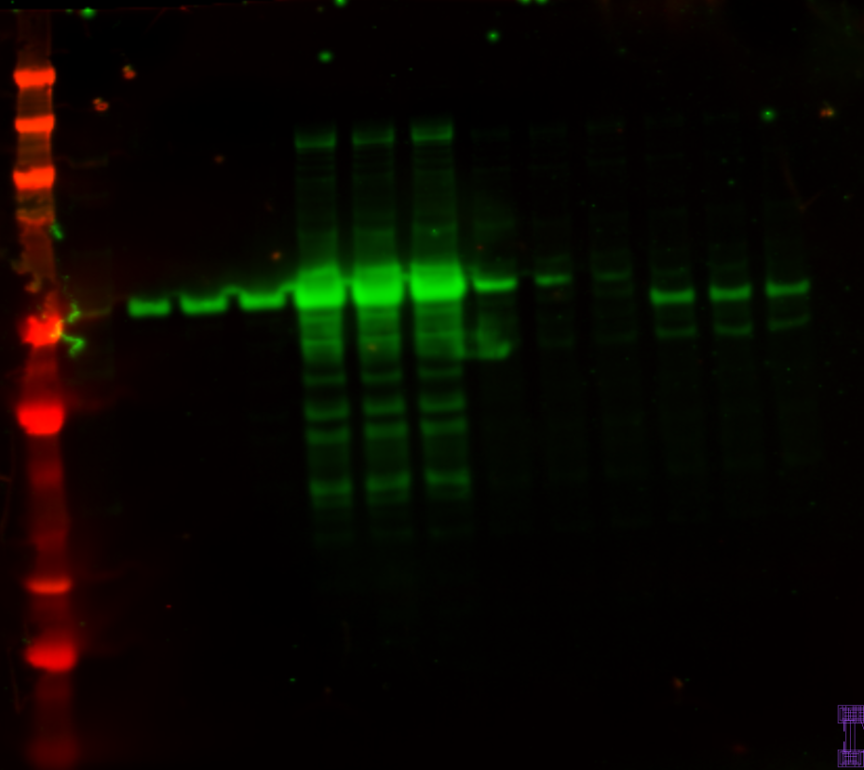
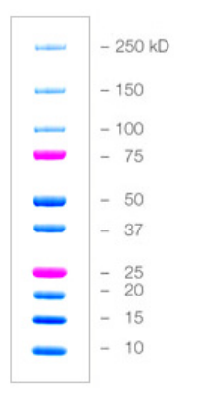
ΔpmrA no_C1 PriM-V
Samples isolated on 2/14/20
Imaged: 2/19/20
Anti-VSVG: 1:2222
Anti-tul4: 1:10,000
ΔpmrA mtip2 PriM-V
ΔpmrA mpk1 PriM-V
ΔpmrA PriM-V
LVS

Slide 4
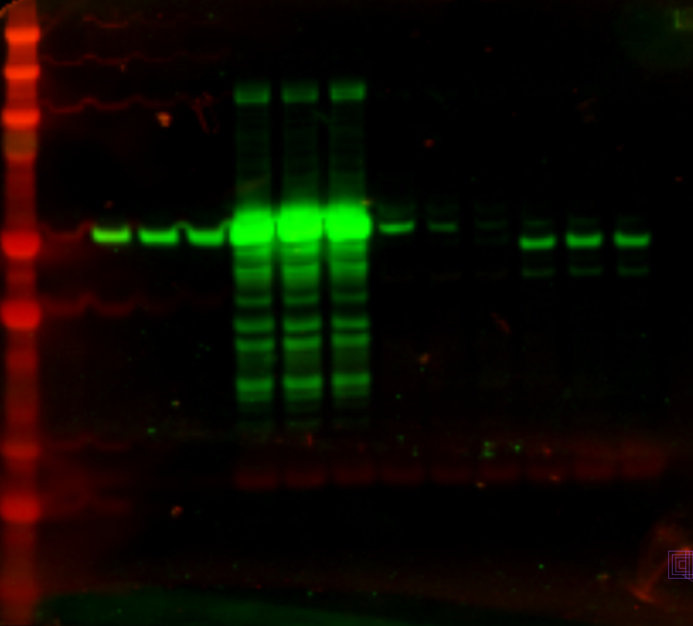
ΔpmrA no_C1 PriM-V
Samples isolated on 2/14/20
Imaged 2/21/20
Anti-VSVG: 1:2222
Anti-tul4: 1:10,000
ΔpmrA mtip2 PriM-V
ΔpmrA mpk1 PriM-V
ΔpmrA PriM-V
LVS

Slide 5
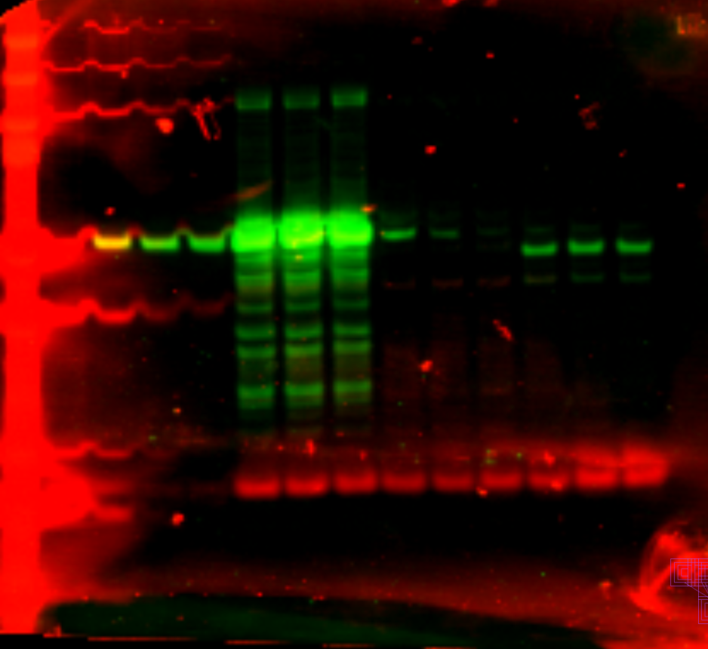
Samples isolated on 2/14/20
Imaged 2/21/20
Anti-VSVG: 1:2222
Anti-tul4: 1:10,000

Slide 6
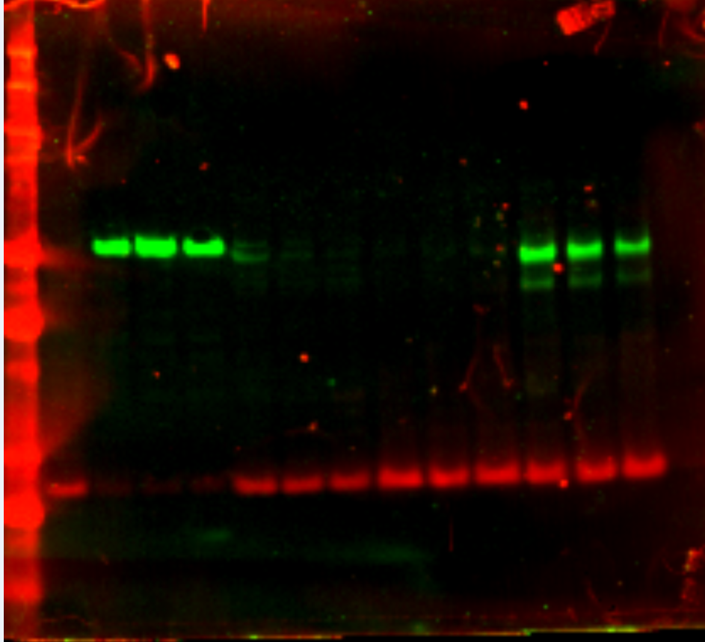
Samples isolated on 1/28/20
Imaged: 2/25/20
Anti-VSVG: 1:2222
Anti-tul4: 1:10,000
Used 1ul of ladder
ΔpmrA no_C1 PriM-V
ΔpmrA mtip2 PriM-V
ΔpmrA mpk1 PriM-V
ΔpmrA PriM-V
LVS

Slide 7
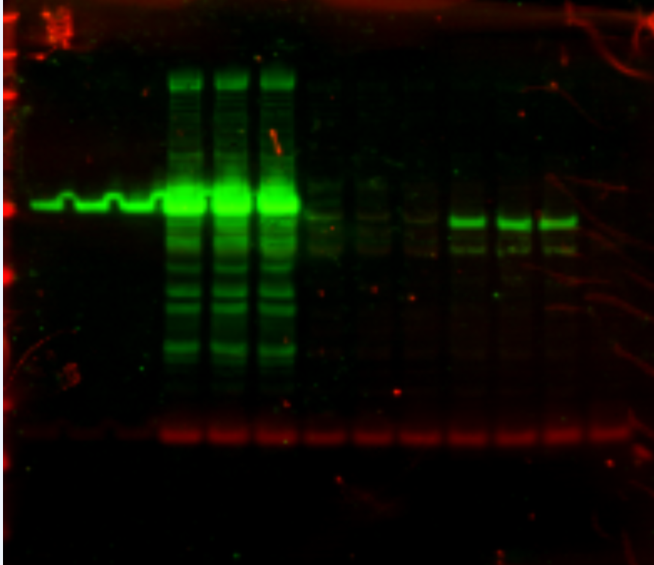
ΔpmrA no_C1 PriM-V
Samples isolated on 3/04/20
Imaged:
Anti-VSVG: 1:2222
Anti-tul4: 1:10,000
Used 1ul of a 1:5 dilution of ladder
ΔpmrA PriM-V
ΔpmrA mtip2 PriM-V
ΔpmrA mpk1 PriM-V
LVS

