Slide 1
Transposons Amplification Assembly
The Hide & Seq Genomic Elements

Slide 2
Randomized Non-Specific Insertions
The genome is one big target.
No clear defined targets
Transposon elements typically affect bacterial fitness
How to pinpoint insertions of interest?

Slide 3
Finding Mutants of Interest/Phenotypes of Interest
Arbitrary Primed Polymerase Chain Reaction (AP-PCR)
Method allows for finding of specific Transposon insertion events
It is a two step reaction.
Part one of AP-PCR involves a non biased, non specific primer that anneals to the genomic sequence and a coupled transposon specific primer.
Products of the first step are then subjected to the second step reaction of AP-PCR with a nested transposon primer and a arbitrary primer sharing 5’ region of arbitrary primers.

Slide 4
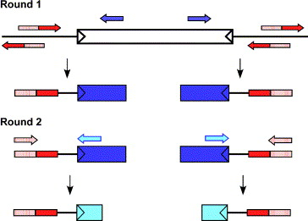
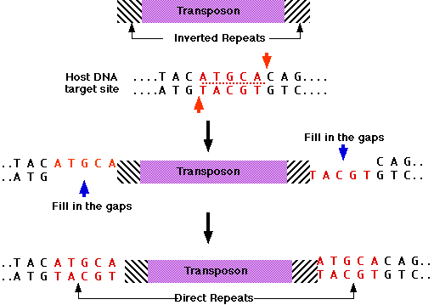
A Closer Look at Transposon Insertions
Fig. 1
Das, S., Noe, J. C., Paik, S., & Kitten, T. (2005). An improved arbitrary primed PCR method for rapid characterization of transposon insertion sites. Journal of Microbiological Methods, 63(1), 89–94. https://doi.org/10.1016/j.mimet.2005.02.011
Figure from:
http://www.biology-pages.info/T/Transposons.html

Slide 5
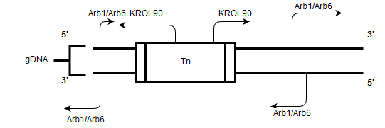
A Closer Look at Transposon Insertions Cont.
Arb1/KROL 87: GGCCACGCGTCGACTAGTACNNNNNNNNNNGATAT
Arb6/KROL 89: GGCCACGCGTCGACTAGTACNNNNNNNNNNACGCC
Tn_Mar1/KROL90:TTTGTCAAACAAGCTCTCGATTTTAAC
Arb2/KROL88: GGCCACGCGTCGACTAGTAC
Tn_Mar2/KROL91: TTGGATAATTGCTCGAGGGCGCGC
AP-PCR primers owe their annealing specificity to annealing temperature. This leaves room for experimentation for resolving amplicons on agarose gels.

Slide 6
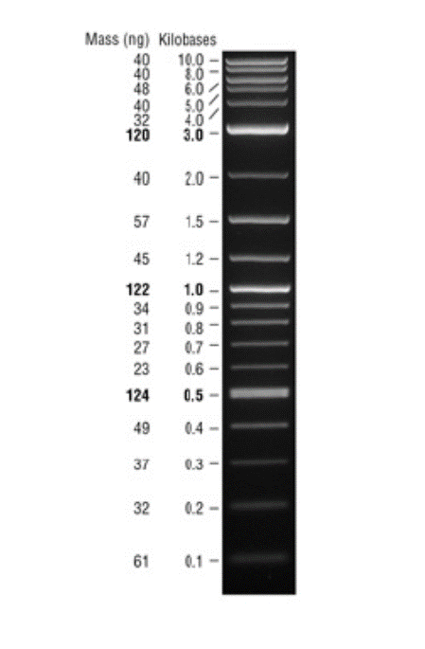
Gallery- February
Lane 1 (Read from left to right) is the 2log DNA ladder. Shown here, the ladder spans from 10kb to 1kb. The gel is cutoff from 1kb downward. Adjacent to the ladder is T_{n}3 mutant. In lane 3 is Tn6 mutant with a band that is indistinguishable. The lane furthest right is the LVS gDNA. Feb. 6, 2019 Arb1 APPCR 1° /2°

Slide 7
Feb 8, 2019
Arb 1 AP-PCR 1° and 2°

