Slide 1
Investigating the structure and function of a novel bacterial anti-virulence factor
Jamie Wandzilak

Slide 2
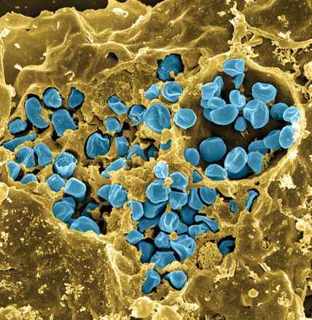
Francisella tularensis
Gram-negative, facultative bacteria
Causative agent of tularemia
    Can be fatal in humans
Potential bioweapon
Model: F. tularensis subsp. holartica LVS
Fischer, PNAS cover 2006

Slide 3
Transcription Regulators in Francisella spp.
MglA and SspA with PigR
  Regulate the Francisella Pathogenicity Island
Few other known regulators of virulence

Slide 4
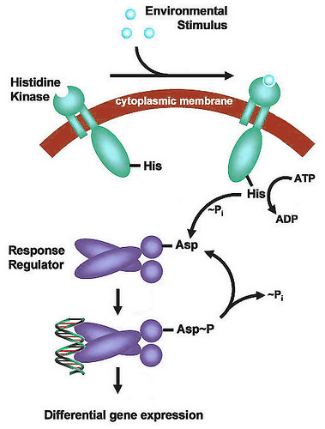
Two Component Systems (TCS)
Regulation systems- respond to environmental conditions
No intact TCS in F. tularensis LVS
  Orphan response regulator identified in F. novicida

Slide 5
PmrA- The Orphan Response Regulator
pmrA identified as a response regulator
  Found to be phosphorylated at an aspartate residue (Bell 2010)
Not encoded next to membrane-bound sensor in Francisella
Mohapatra et al. 2007
  pmrA disruption mutant in F. novicida
  Incapable of survival in macrophage

Slide 6
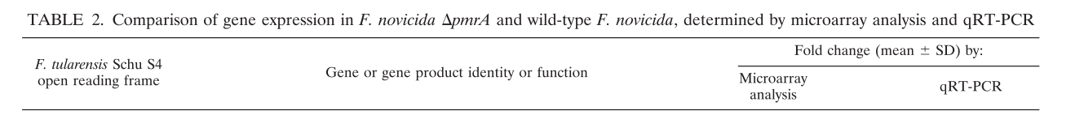
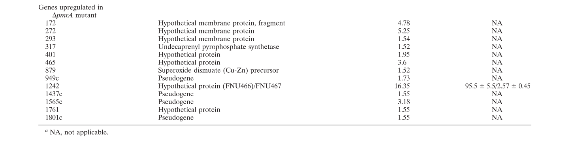
Microarray and qRT-PCR Analysis

Slide 7
PmrA is a transcription factor essential for intramacrophage growth
ChIP-Seq
Found at 252 locations
Not found at critical FPI promoters
RNA-Seq
Positively regulates 14 genes
Negatively regulates 28 genes
No effect on FPI gene expression
Ramsey and Dove, 2016
Notes:
Interested in further understanding how this model of FPI regulation fits with our previous models so I performed several unbiased genome-wide studies to further probe this model

Slide 8
PmrA functions mainly as a repressor
Had been suggested as a regulator of the FPI
  Not found at FPI promotors
Regulates level of gene expression (mainly negatively)
Largest effect on priM
  PmrA-repressed inhibitor of intramacrophage growth

Slide 9
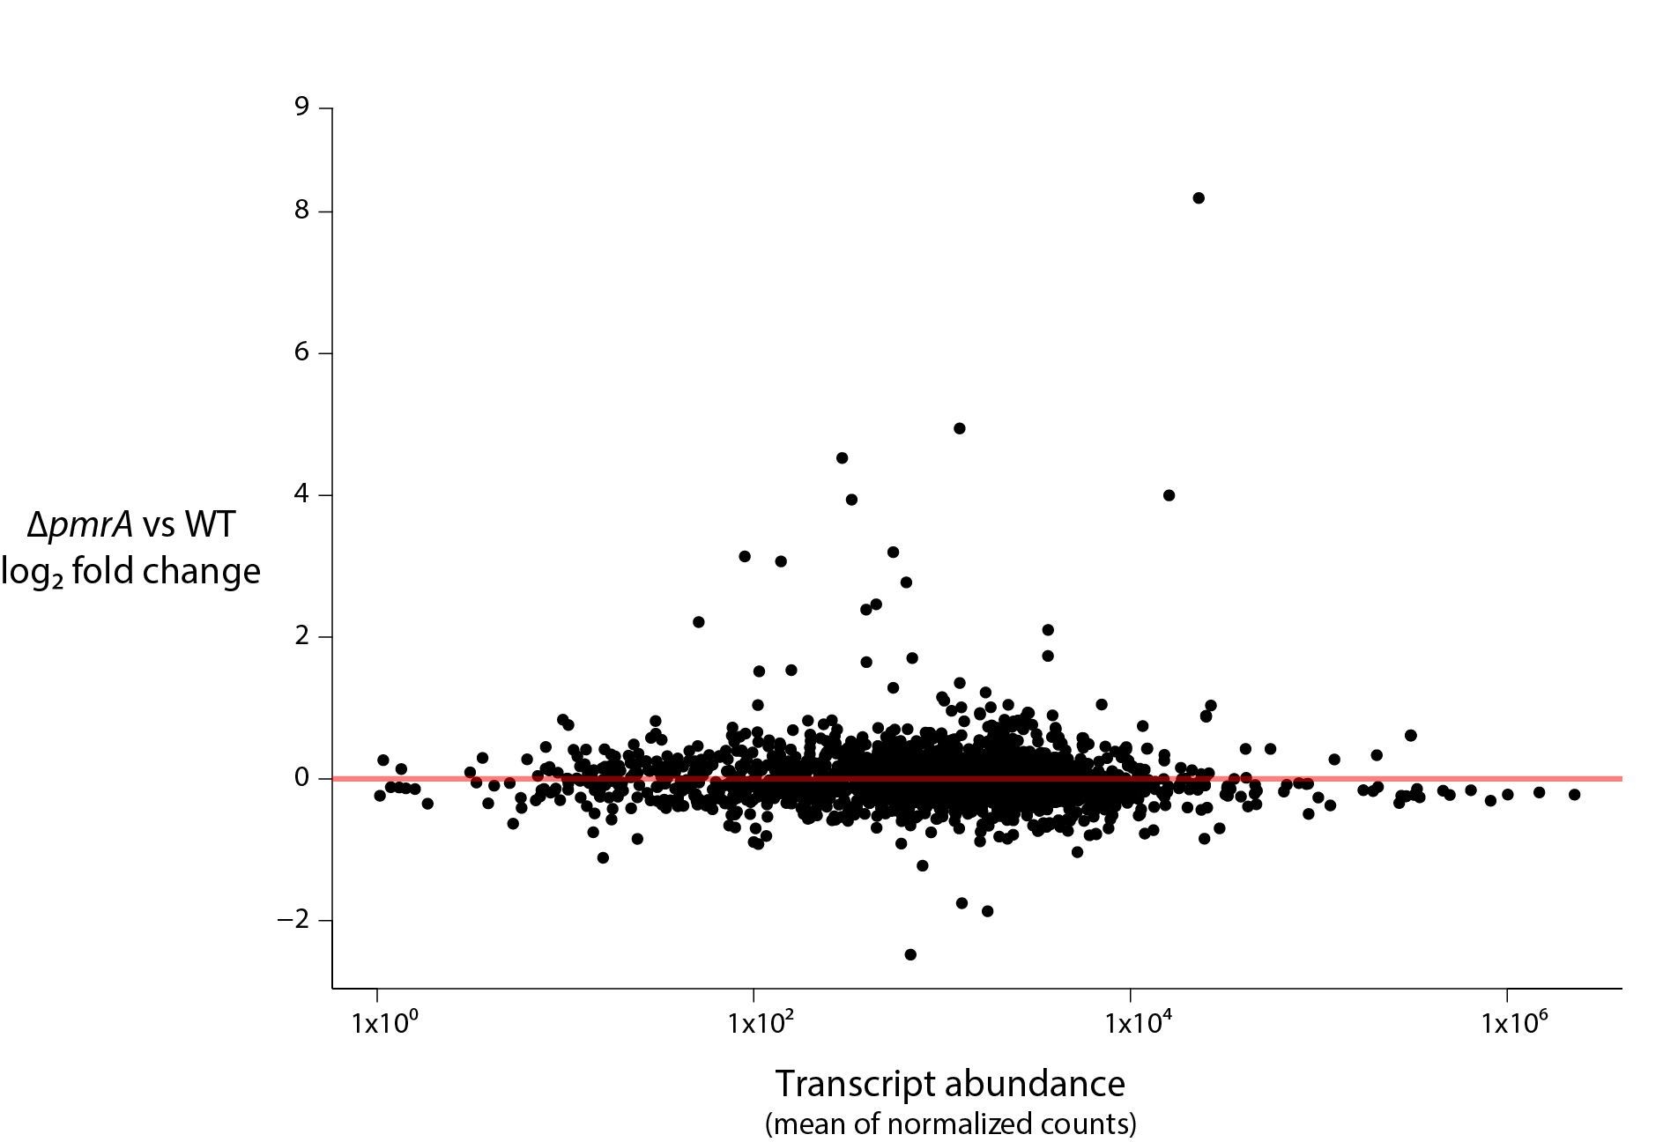
priM is the gene most repressed by PmrA
priM
Negatively regulated
Positively regulated
Ramsey and Dove, 2016
Notes:
24 genes

Slide 10
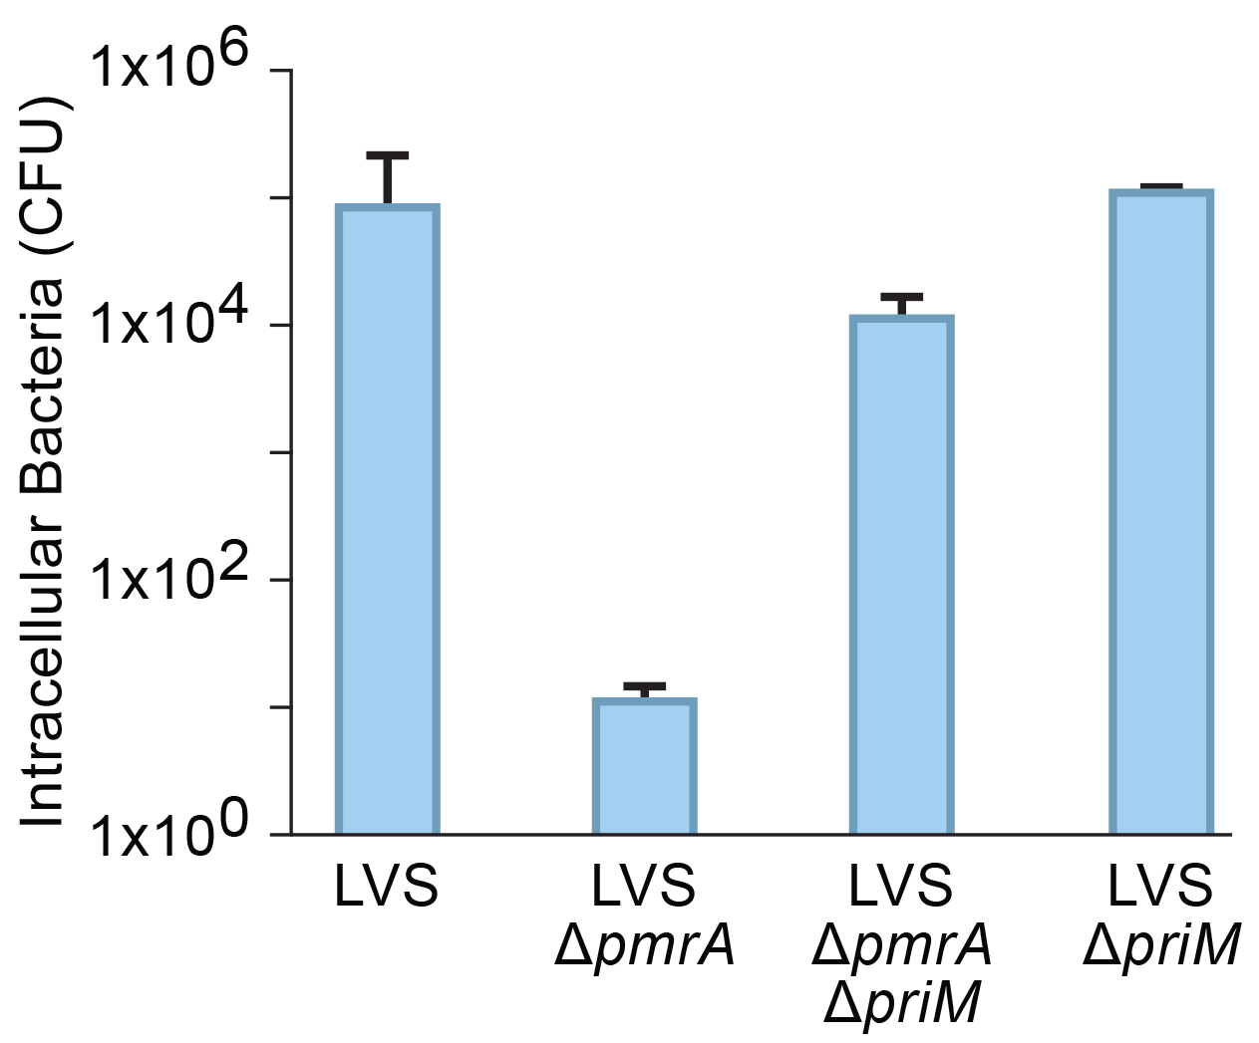
PriM is inhibitory to intramacrophage survival
↑PriM
Ramsey and Dove, 2016

Slide 11
Goal: Uncover how PriM prevents intramacrophage survival
Two approaches:
Structure driven approach
    Biased targeted mutations
Transposon mutagenesis
- Random non-biased mutations

Slide 12
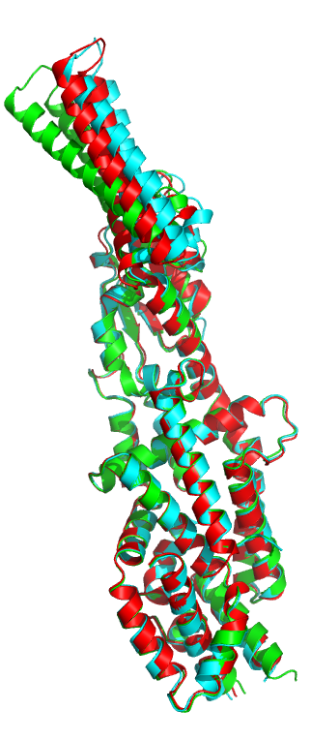
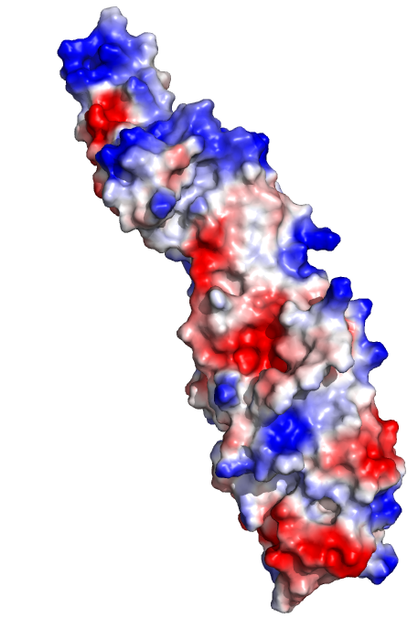
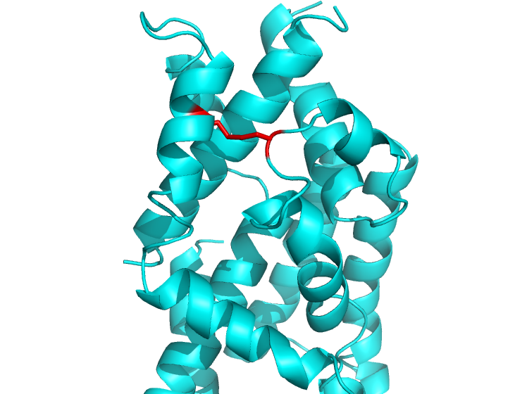
PriM:
PmrA-repressed inhibitor of intramacrophage growth
Electropositive, flexible
tip or head
Flexible
“head”
Disulfide bond
Acetate
binding
Dr. Maria Schumacher

Slide 13
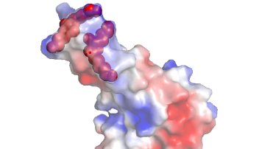
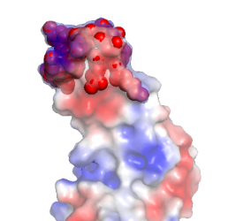
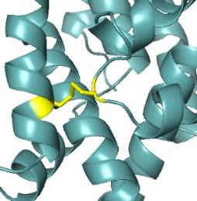
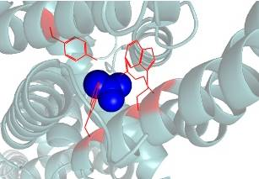
Plasmid design:
Name | Purpose | Description | Illustration
PriM_mtip1 | Changes the tip region from an electropositive charge to electronegative | Mutations in the tip region: two lysine doublets to glutamic acid doublets (colored as red spheres)
PriM_mtip2 | Changes the tip region from an electropositive charge to neutral charge | Mutations in the tip region: entire tip region to polyglycine (colored as red spheres)
PriM_noC1/C2 | Removes 1 of the 2 cysteines to prevent disulfide bond production | Mutations changing the cysteines (colored in yellow) to alanines targeting disulfide bond formation.
PriM_mpk1 | Prevents small molecules from binding in the pocket region | Mutations in the small molecule binding pocket region: arginine, two tryptophans and one tyrosine to alanine (acetate molecule colored in blue)

Slide 14
Is the disulfide bond in PriM critical to its activity as an anti-virulence factor?
DsbA creates disulfide bonds in proteins essential for virulence
PriM is a substrate for DsbA
(Qin et al., 2016)
S
S
SH
S
S
SH
DsbA
DsbA
PriM
SH
SH
SH
SH
S
SH
SH
DsbA
S
DsbA
PriM
S
S
Does production of PriM titrate DsbA activity from critical virulence factors?
Notes:
Test by removing cysteines. Expect

Slide 15
Transposon mutagenesis
Transposon: complex genetic element capable of inserting itself anywhere in the genome
Transform ΔpmrA cells with transposon plasmid
Inactivates the genes it inserts itself into (many mutants created)
Can screen mutants to see if any can rescue virulence in macrophage

Slide 16
Summary
PmrA is essential for virulence because its main purpose is to repress expression of PriM
Goal: To figure out what PriM is doing to prevent virulence
1. Structure based approached
- Targeted mutations
2. Transposon mutagenesis
- Random genome-wide mutations to identify potential interacting partners

Slide 17
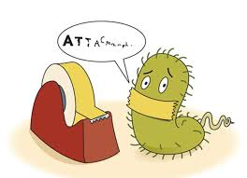
Questions?

Slide 18
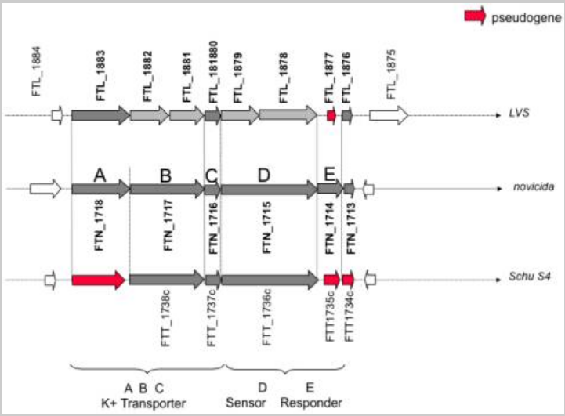
Example of TCS in F. novicida
→

Slide 19
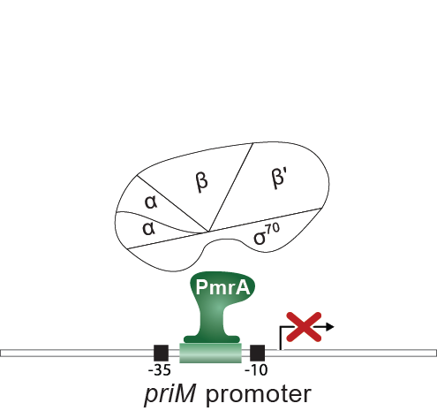
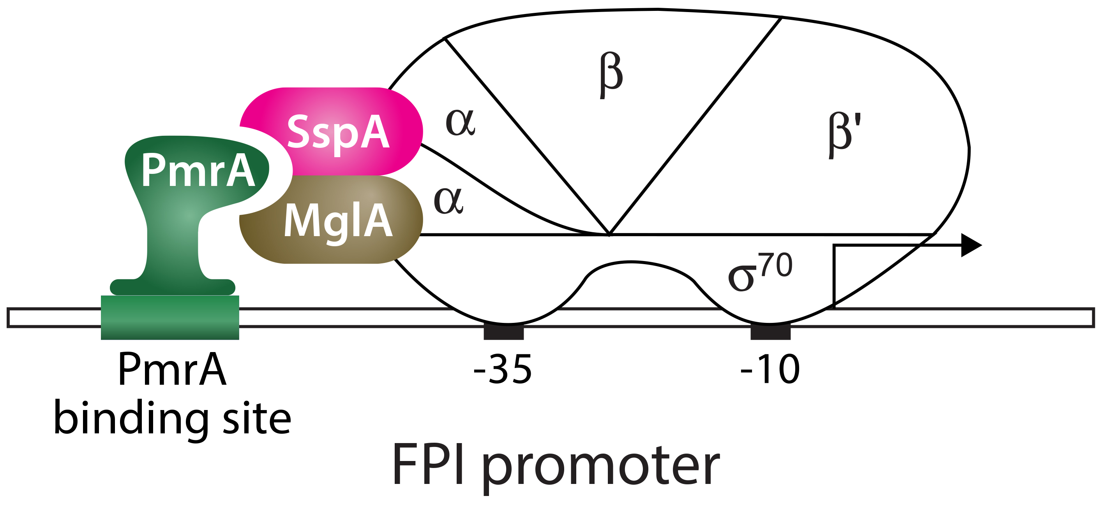
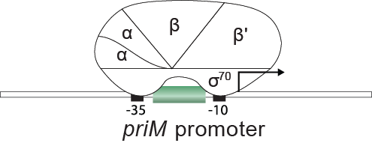
The role of PmrA in intramacrophage infection
PmrA does not appear to control FPI gene expression
Primary function of PmrA in intramacrophage growth is repression of priM
Wild type
∆pmrA
Notes:
PmrA influences intramacrophage growth and survival
by functioning as a repressor
Repression of anti-virulence factors is essential for intramacrophage replication

