Slide 1
K. Ramsey Lab Meeting 12/9/19
Jamie Wandzilak

Slide 2
Overall Goal: Uncover how PriM functions to prevent intramacrophage survival

Slide 3
PriM
PmrA-repressed inhibitor of intramacrophage growth
Anti-virulence factor identified in F. tularensis
  Molecular mechanism unknown
Repressed by transcription factor PmrA
PmrA identified as being essential for virulence
  Mutants incapable of survival in macrophage and murine models (Sammons-Jackson, 2008)
PmrA mainly functions as a negative regulator
  Largest effect on priM
Notes:
Now I have shown you the data supporting this information and it was found that PmrA functions mostly as a negative regulator with the largest effect on the gene PriM which stands for the PmrA repressed inhibitor of intramacrophage growth. So now Ill show you the model for PmrAs role in macrophage.

Slide 4
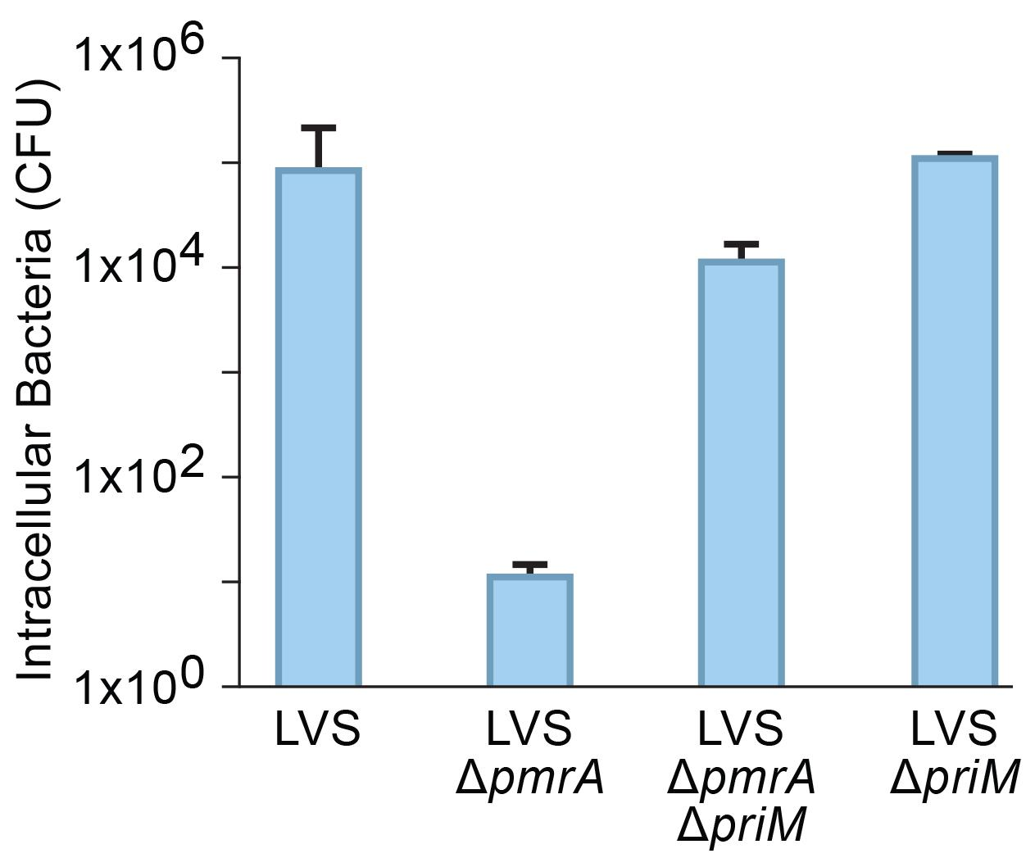
PriM is inhibitory to intramacrophage survival
Ramsey and Dove, 2016
Notes:
Here I am showing you results from an intramacrophage infection assay with the number of intracellular bacteria in on the y-axis comparing 4 different strains. In this assay we know that about 100 bacterial cells get into the macrophage and you can see a large increase in bacterial number in the wildtype cells after 24 hours. when pmrA is absent meaning that priM is being produced, the cells can no longer replicate to high numbers. However when both pmrA and PriM are deleted we can almost completely recover the wildtype level of intramacrophage growth. So now we know that the production of PriM is inhibitory to intramacrophage growth.

Slide 5
Overall Goal: Uncover how PriM functions to prevent intramacrophage survival
Specific Aim 1: Identify critical structural features of PriM
Specific Aim 2: Identify factors critical to the function of PriM

Slide 6
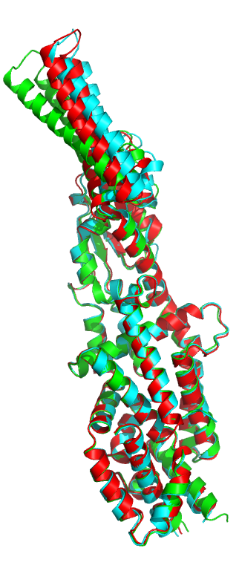
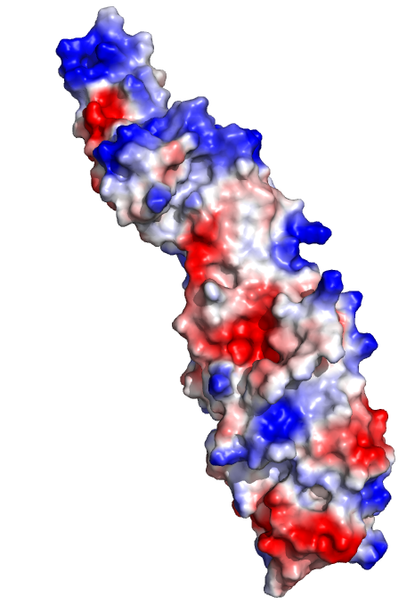
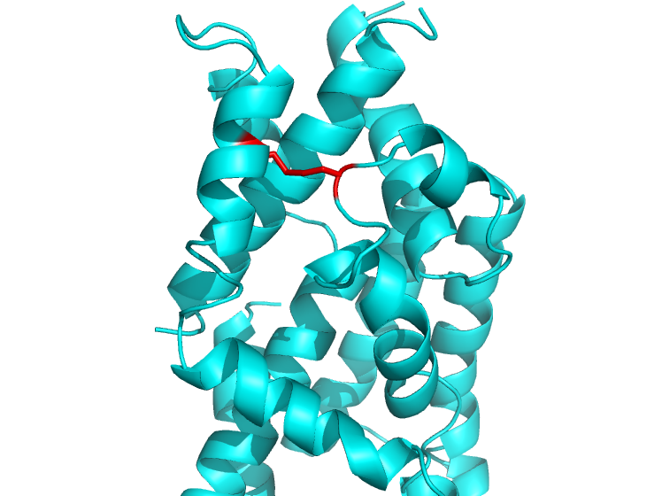
PriM:
PmrA-repressed inhibitor of intramacrophage growth
Electropositive, flexible
tip or head
Flexible
“head”
Disulfide bond
Acetate
binding
Dr. Maria Schumacher
Notes:
Crystal structure of PriM as solved by our collaborators at Duke. Described as a novel fold with no structural homology to known proteins. Structure revealed an electropositive flexible tip, a potential small molecule binding pocket where acetate was found during crystallization, disulfide bond. Not shown in this structure is a secretion signal that would be cleaved by the transport machinery and the presence of that secretion signal and disulfide bond suggest that PriM makes it into the periplasm.

Slide 7
Specific Aim 1: Identify critical structural features of PriM
Use the structure of PriM to create targeted mutations
  Use allelic exchange protocol to create mutants in the wildtype and ΔpmrA background
Test these mutants for the ability to replicate in macrophage
  Identify structural mutants that regain ability to survive in macrophage
Notes:
We have a crystal structure of PriM that was solved by our collaborators at Duke university and we can use this structure to create targeted mutations based on structural features that may be critical to the function of PriM.

Slide 8
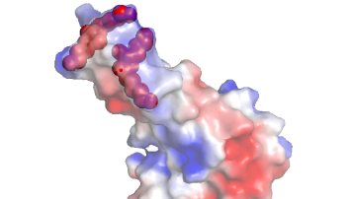
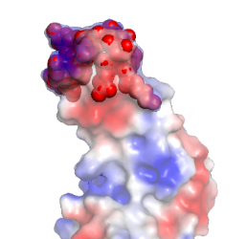
Mutant design
Name | Purpose | Description | Illustration
PriM_mtip1 | Changes the tip region from an electropositive charge to electronegative | Mutations in the tip region: two lysine doublets (colored as red spheres) mutated to glutamic acid doublets
PriM_mtip2 | Changes the tip region from an electropositive charge to neutral charge | Mutations in the tip region: all amino acids in tip region (colored as red spheres) mutated to glycines

Slide 9
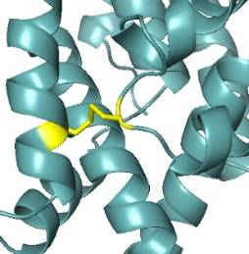
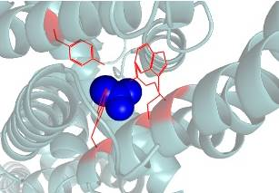
Mutant design
Name | Purpose | Description | Illustration
PriM_noC1/C2 | Removes 1 of the 2 cysteines to prevent disulfide bond production | Mutations changing the cysteines (colored in yellow) to alanines
PriM_mpk1 | Prevents small molecules from binding in the pocket region | Mutations in the small molecule binding pocket region: arginine, two tryptophans and one tyrosine to alanines (acetate molecule in the potential binding pocket colored in blue)
Notes:
I have been able to test both of these mutants in macrophage with some preliminary results but I just want to point out that these experiments bear repeating to confirm.

Slide 10
Results of intramacrophage assay testing cysteine mutant
Notes:
Results of the intramacrophage infection assay testing the importance of the disulfide bond after 24 hours of growth. The first strain is our wildtype, the second is the cysteine mutation in our wildtype background to ensure the mutation is not exerting any downstream effects. The third strain is our dpmrA strain and the last one is the cysteine mutation in the dpmrA background where priM is actually being produced. This data suggests that the removal of the disulfide bond does not affect the function of PriM.

Slide 11
Results of intramacrophage assay testing pocket mutant
Notes:
Results of the intramacrophage infection assay testing the mutation in the small molecule binding pocket after 24 hours of growth. This data suggests that disruption of the small molecule binding pocket restores the ability of cells lacking pmrA to replicate in macrophage. Potentially indicating that the pocket region is critical to the function of PriM. But bear in mind that both of these experiments need repeating. It is possible that I won’t fully uncover the function of PriM using the structure alone. So I am also going to be also taking a genetic approach to identify factors that are critical to the function of PriM.

Slide 12
Repeat of pocket mutant mac assay

Slide 13
Conclusions and Future Directions For Aim 1
Conclusions:
Removal of disulfide bond seems to not affect PriM function
Pocket mutation potentially restored virulence
Future Directions:
Finish making ΔpmrA_mtip1 mutant (cross-patched for 1st colony PCR)
Test ΔpmrA_mtip2 mutant in macrophage assay (this week!)
Tag mutant strains with VSVG tag by incorporating plasmid with VSVG tag on PriM

Slide 14
Specific Aim 2: Identify factors critical to the function of PriM
Transposon: genetic element capable of inserting itself into the genome
Transform ΔpmrA PriM+ cells with transposon containing plasmid
      Use the pSD26 plasmid containing the mariner transposon
Inactivates the genes it inserts itself into
      Create a transposon mutant library
Can select for mutants that can rescue virulence in macrophage
Notes:
For my second aim I am going to take a more genetic based approach. We can use transposon mutagenesis to identify factors that are critical to the functions of PriM. This transposon has been used successfully in francisella and this plasmid contains the mariner transposon which recognizes TA dinucleotides which are highly abundant in francisella. We expect that these mutants would be in genes that produce products that are necessary for PriM to prevent intramacrophage growth.

Slide 15
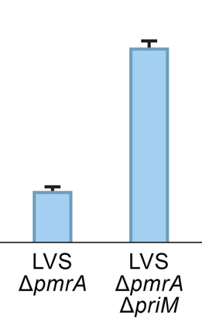
Expected outcome from mutant selection
PmrA + - - - -
PriM + + - ++ ++
*
Tn Mutant
Notes:
This is what the expected outcome of what the transposon mutant selection will look like. The wildtype will have a certain level of intramacrophage replication that will not be seen in the cells lacking pmrA. When both pmrA and PriM are deleted we recover most of that replication. This is the strain with the extra priM before the transposon mutagenesis which should not have good replication and we are expecting to get some transposon mutants that grow better than the cells that are producing PriM indicating that the gene that the transposon has interrupted is critical for priM to function as an anti-virulence factor.

Slide 16
Making the PriM+ Strains
Using the Tn7 system to add additional priM
  Uses transposon to insert gene into conserved region of the genome
Successfully integrated extra priM in LVS
In process of integrating extra priM into ΔpmrA

Slide 17
Mac assay testing control strains
Notes:
LVS PriM+ strain made and here it was tested in the mac assay to ensure that the extra PriM did not affect intramacrophage growth, also tested dPmrA with VSVG tag on PriM to make sure the tag did not affect the phenotype of the dPmrA strain

Slide 18
Future Directions For Aim 2
1. Finish making ΔpmrA PriM+ mutant and test in macrophage assay
2. Perform transposon mutagenesis
3. Select for mutants using macrophage infection assay
4. Identify genes that are critical to the function of PriM as an anti-virulence factor

Slide 19
Suppressor mutant intramacrophage assay

Slide 20
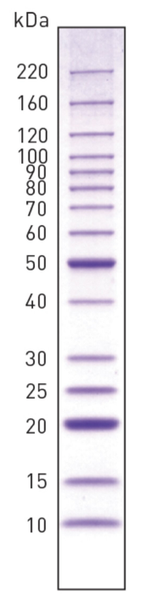
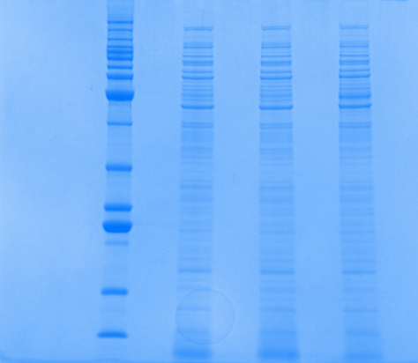
New ΔpmrA
LVS
Old ΔpmrA
PriM
PriM - ~53kDa

Slide 21
Whole Genome Resequencing Results Comparing Suppressor Mutant PmrA and Remade PmrA Strains
3 snips were identified in the suppressor mutant
1. Mutation in FTL_0146 (ABC Transport Protein)
  C → A
  Phenylalanine → Leucine
2. Mutation in FTL_1339 (POT Transporter)
  C→ A
  Glycine→ Glycine
3. Mutation in intergenic region near FTL_0869
  84% T, 16% G

Slide 22
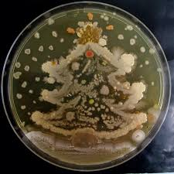
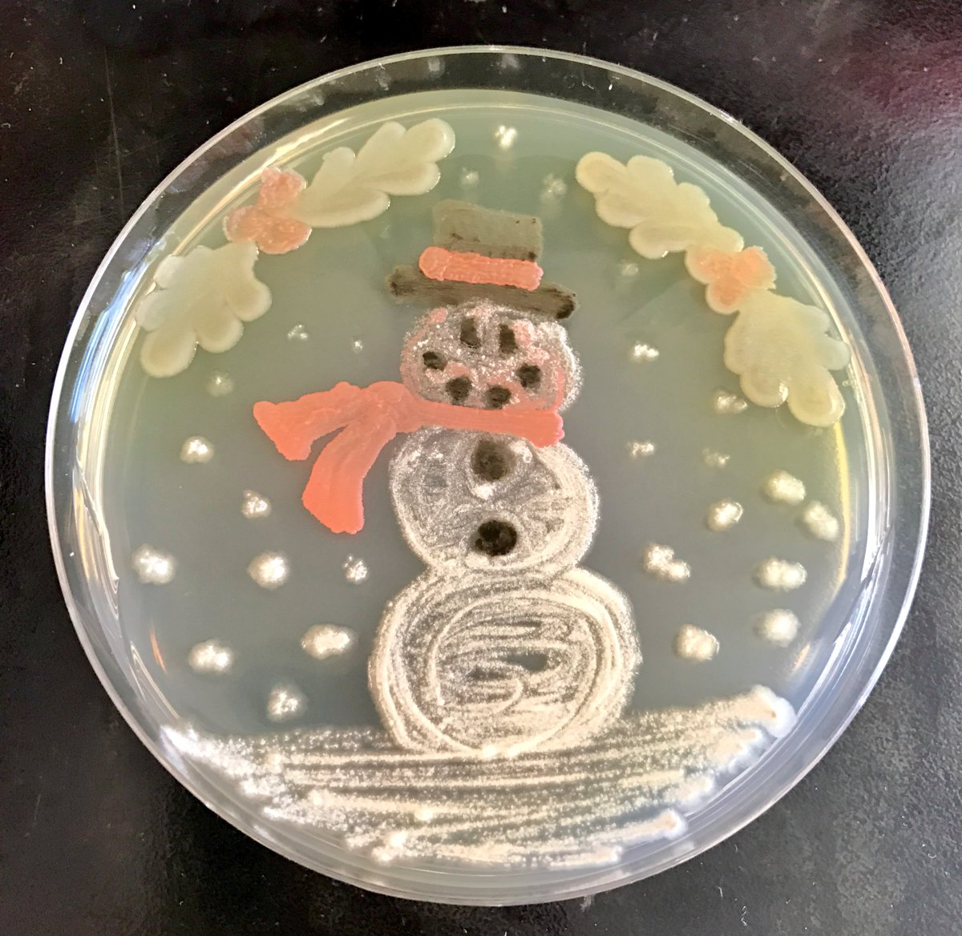
Questions?

