Slide 1
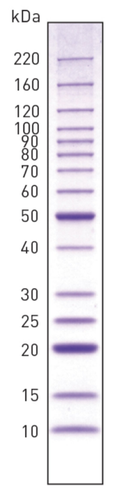
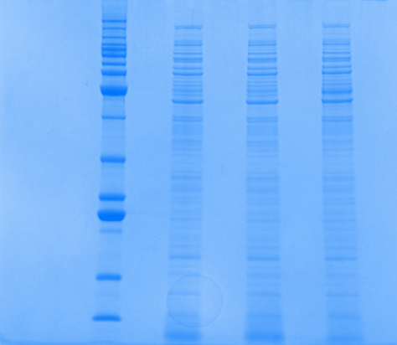
New ΔpmrA
LVS
Old ΔpmrA
PriM
PriM - ~53kDa

