Slide 1
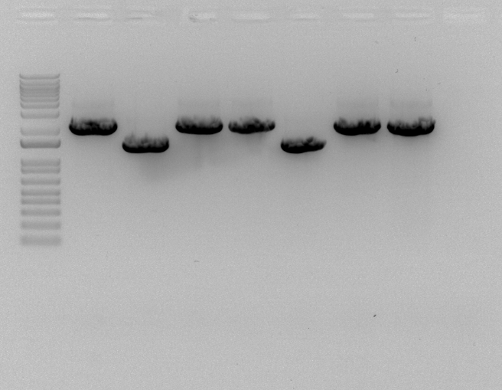
LVS
ΔchaC-Tn7-chaC-V
ΔchaC-Tn7-bfr-chaC-V
ΔchaC-Tn7-chaC-V
ΔchaC-Tn7-bfr-chaC-V
ΔchaC
ΔchaC
1500bp
KMR Strains
JW Strains
WT - 2243bp
ΔchaC - 1460bp
ΔchaC-Tn7-chaC-V

