Slide 1
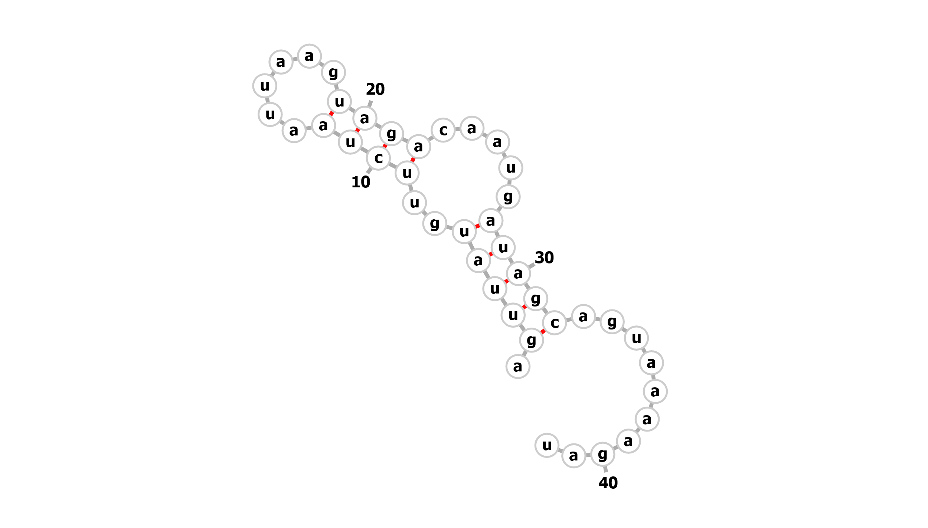
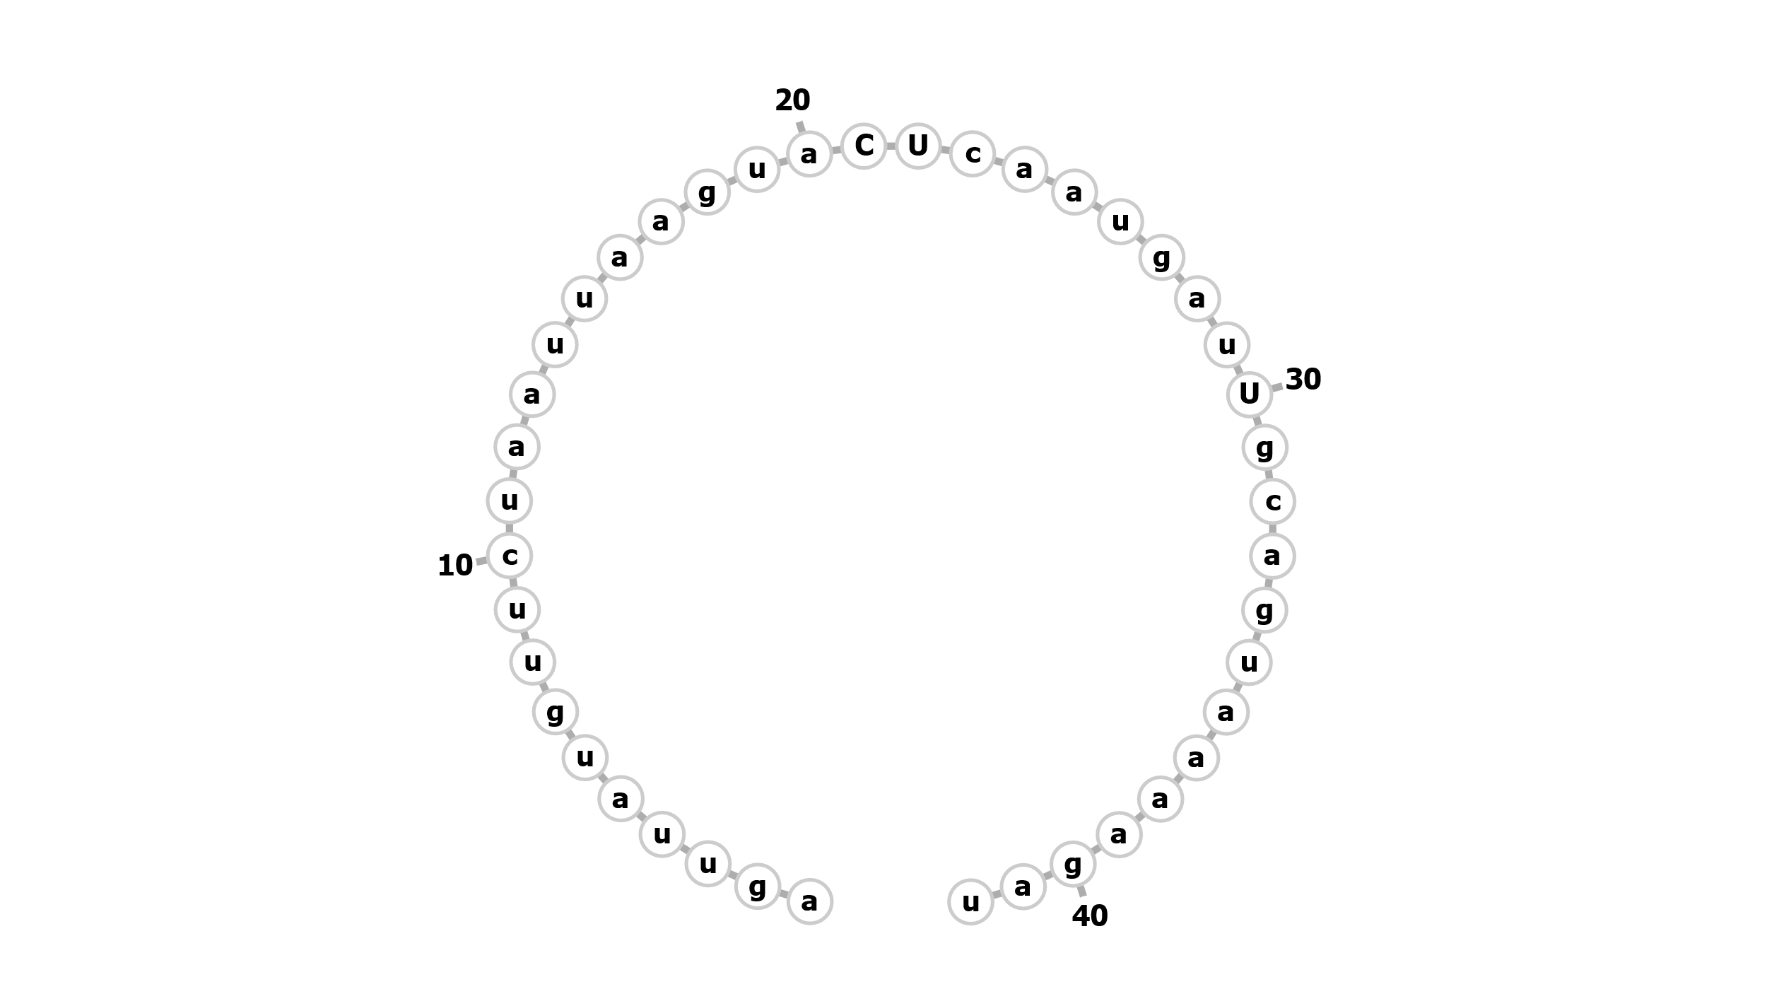
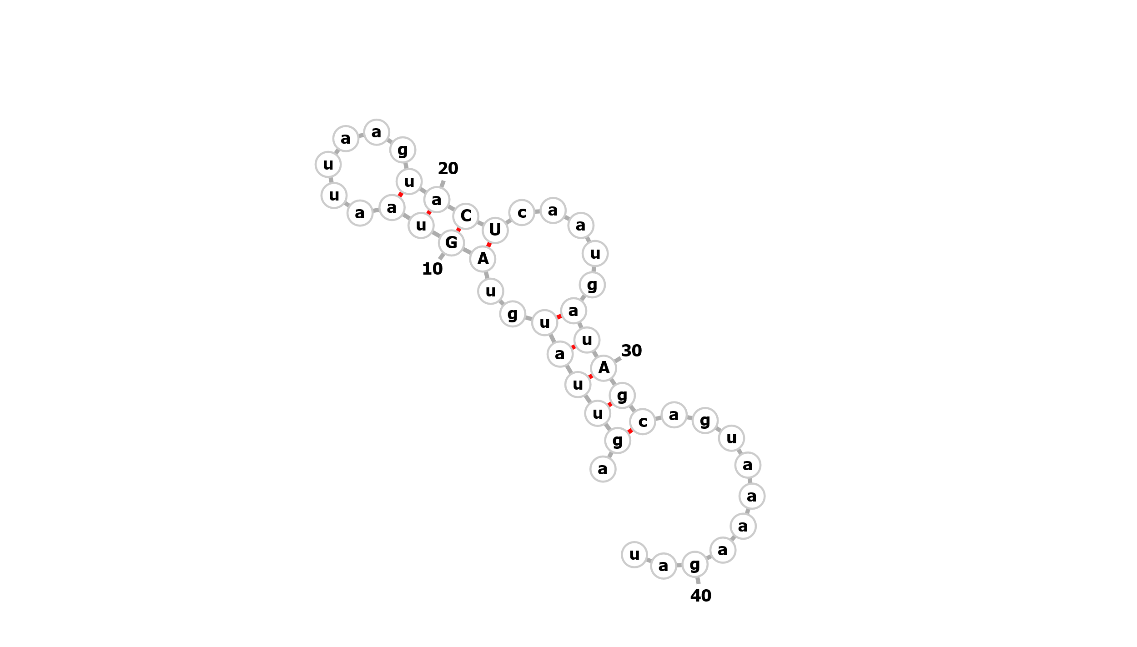
pdpA
Mutation 1
pdpA
Mutation 1 restored
WT pdpA
Notes:
A – to go below (or above) graph of B gals

