Slide 1
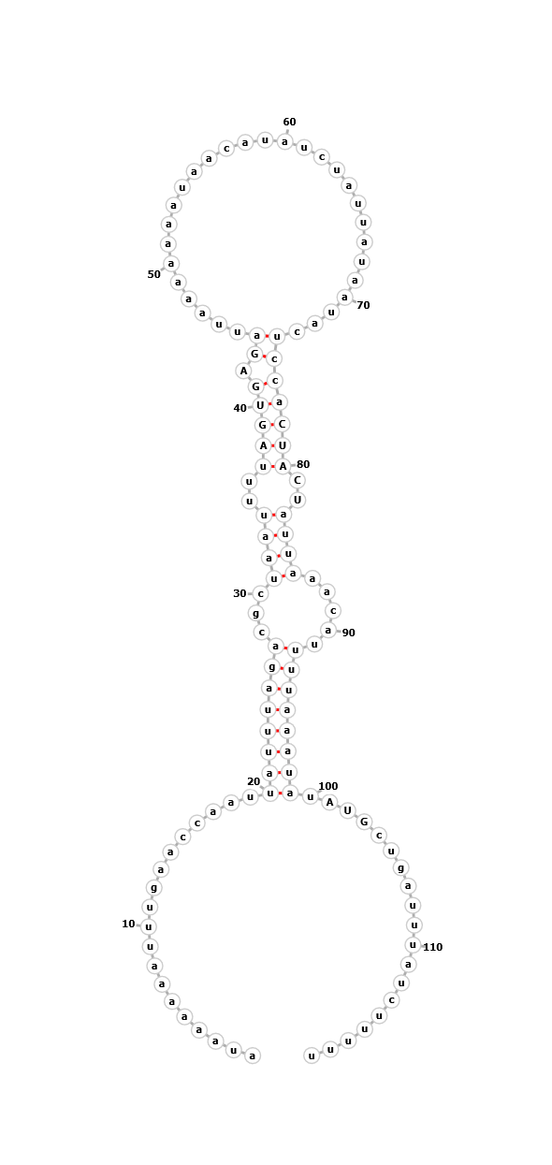
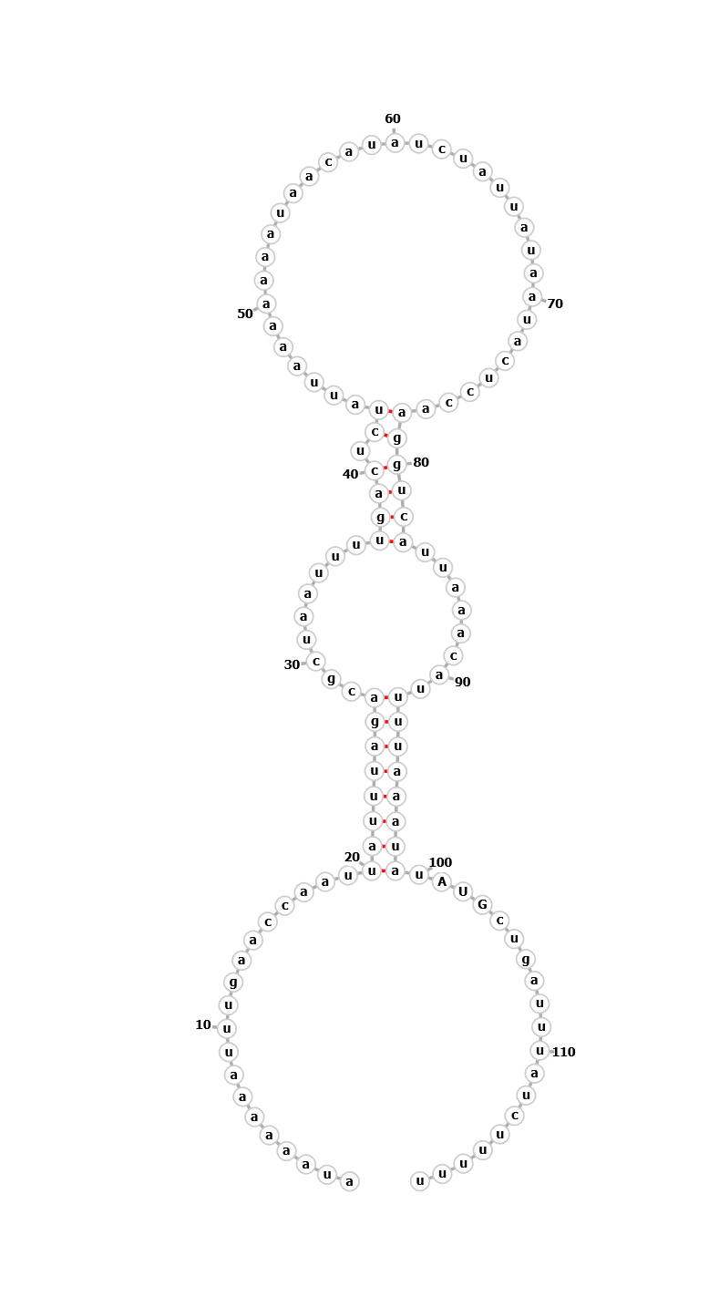
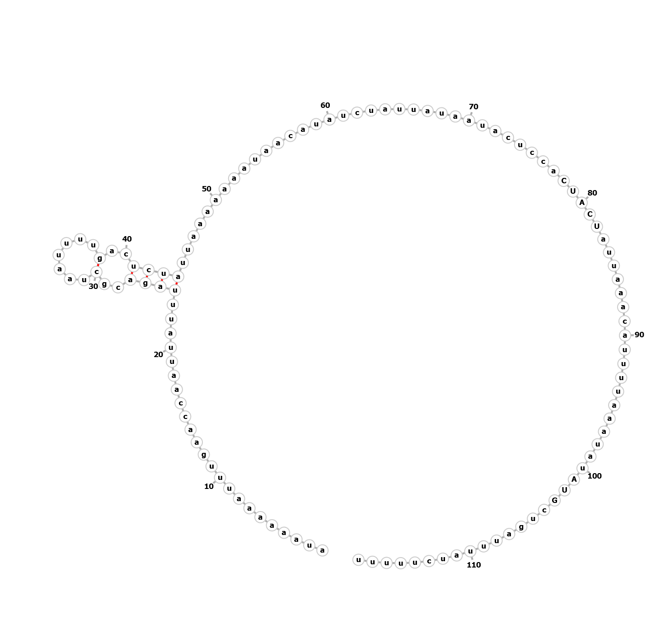
WT
mraY
mraY mutation 17
mraY mutation 18
Notes:
B – below gfp graphs

