Slide 1
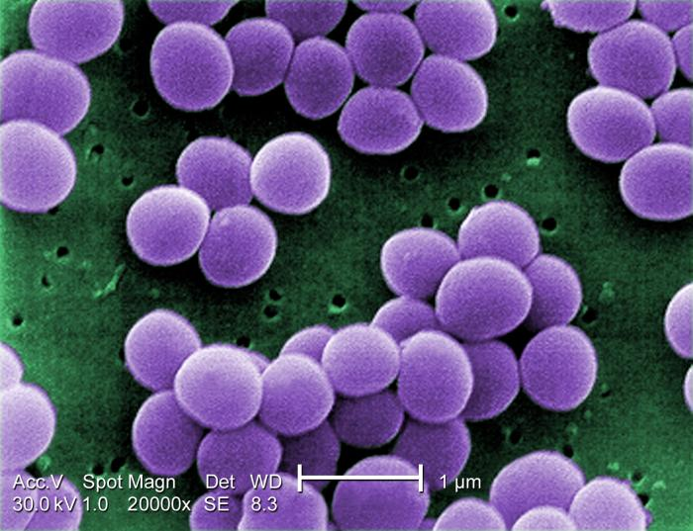
Staphylococcus aureus
Gram-positive, facultative human pathogen
High rates of infection globally
  Intensity varies
Highly adaptive resistance to antibiotics
  Penicillin
  Methicillin
  Vancomycin
  Daptomycin
CDC PHIL, Matthew J. Arduino, 2001
Notes:
-G+, facultative human pathogen. Normally lives on skin and mucosal membranes of healthy humans.
-Extremely common, estimate that 30% of population carries staph on their skin asymptomatically. When it infects, can be very mild skin boils or life-threatening bacteremia.
-one reason it is so dangerous is because of antibiotic resistance making it difficult or impossible to treat. These are just some of the antibiotics used to treat staph infections, but some staph strains have acquired resistance to every single one. For years methicillin was the main antibiotic being used, but Methicillin-resistant staph aureus, or MRSA, is now extremely common, leading vancomycin and daptomycin to become more widely used. These are the two I’m going to be focusing on for my second aim, because it turns out that clinically, mutations in rpsU are associated with resistance to vancomycin and daptomycin

Slide 2
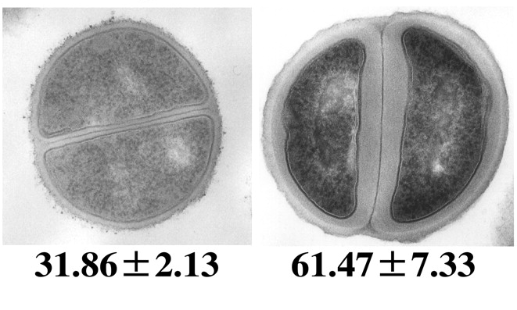
Inactivation of rpsU in S. aureus is linked to antibiotic resistance
Clinical isolates
  Frameshift insertion from 4th amino acid on; van-R (Basco 2019)
  Stop codon at 31st amino acid; van-R (Matsuo et al. 2013)
  Frameshift deletion at 53rd amino acid; van-R (Cameron et al. 2012)
  Promoter region of rpsU; dap-R (Friedman et al. 2006)
In vitro experiments
  Transposon insertion in start codon; van-R and dap-R (Blake and O'Neill 2012)
Cui et al. 2006
Notes:
There have been numerous studies on clinical strains of staph with resistance to vancomycin or daptomycin, that show mutations in rpsU, the ONLY rpsU in s. aureus, with mutations occurring in different parts of the gene as well as in the promoter region. These loss of function mutants implicate loss of rpsU in antibiotic resistance.
These clinical isolates often have numerous mutations so it’s hard to single out rpsU as being causative of the antibiotic resistance that is observed.
Fortunately, there has also been a transposon mutagenesis of staph that implicates rpsU ALONE as the transposon inserts at only one place in the genome. This study showed that knocking out rpsU was sufficient to cause both vancomycin and daptomycin resistance.
The question remains, HOW is loss of bS21 causing antibiotic resistance? Research has shown that many cells exhibiting antibiotic resistance have thickened cell walls, an example of which you can see here in vancomycin resistant bacteria. It is believed that this thickening titrates down the effective antibiotics. Even in diverse genetic backgrounds, this same mechanism results in antibiotic resistance.
This information has led us to develop a model for what may be happening with bS21 in S. aureus.

Slide 3

Model for how bS21 might control gene expression in S. aureus
RNAP
Cell wall regulator
Hypothesis: bS21 regulates expression of proteins involved in cell wall structure, thereby affecting antibiotic resistance
Notes:
SLOW DOWN
Much like the model I showed you for francisella, here we have RNA polymerase actively transcribing a gene, specifically a cell wall negative regulator. The 30S subunit that contains bS21 may interact with this mRNA, there is a strong affinity, a protein is made and we have a normal cell wall produced, which is represented by this cartoon. Antibiotics can enter this cell and eventually the cell dies.
You can imagine that there are also 30S subunits that altogether lack bS21. There may be a weaker affinity between these ribosomes and the mRNA, so translation is not initiated the protein is not produced, and this results in a thicker cell wall. In this case, antibiotics are unable to penetrate and enter the cell.
This is our hypothesis – that bS21 regulates expression of proteins involved in cell wall structure, and this in turn has an affect on antibiotic resistance.

