Slide 1
Investigating the Possibility of Specialized Ribosomes in Francisella tularensis
Hannah Trautmann
Dr. Kathryn Ramsey Lab
Notes:
Hi everyone, I did my third rotation with Dr. Ramsey and we were looking into the possibility of specialized ribosomes in Francisella tularensis, which are ribosomes that are heterogenous in composition and may have different functions. But first I’m going to tell you a little bit about the bacteria, francisella.

Slide 2
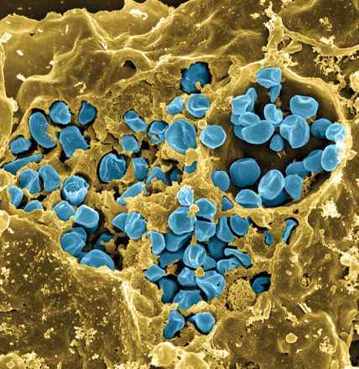
Francisella tularensis
Causes tularemia – ulceroglandular, respiratory
Many hosts and vectors
Highly infectious/ potential bioweapon
Model: F. tularensis subsp. holarctica LVS (live vaccine strain)
Notes:
Francisella is a gram -, facultative intracellular bacteria. It is pathogenic and causes a disease called tularemia, which can take a number of forms based on the route of infection. If infection is via the skin like through a mosquito or tick bite, it produces the ulceroglandular form of the disease, or if infection is by breathing in the bacteria, it causes the respiratory form, which can be fatal.
There are a large number of hosts and vectors including ticks, mosquitos, horse flies, rabbits, and a number of other rodents. It can also be water-borne, which makes understanding its epidemiology rather complex.
It is highly infectious with as few as 10 organisms able to cause the disease, and for this reason, along with the fact that it is potentially lethal, that it is considered as a potential bioweapon. This image here is colored so that the francisella are blue and are in a yellow macrophage, and you can clearly see that a ton of organisms replicate in a single host cell.
Luckily we don’t have to work with the pathogenic form because there is a live vaccine strain that we can work with in the lab.

Slide 3
Prokaryotic Ribosomes
RNAP
Notes:
My specific focus is on specialized ribosomes in francisella. As I’m sure you all know, ribosomes are the molecular machines that translate mRNA into protein. In bacteria, they function co-transcriptionally, so they are actively creating protein from mRNA, as RNA polymerase is creating that mRNA. This can occur at the same time in prokaryotes because there is no nucleus. The ribosome can also protect the mRNA in this way, so changes in translation may affect transcript abundance.

Slide 4
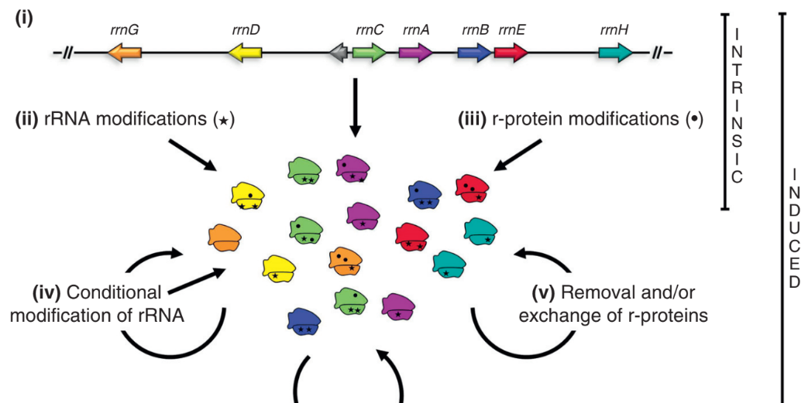
Specialized Ribosomes
Byrgazov et al. 2013
Notes:
Specialized ribosomes refer to heterogeneity in ribosomes. This may seem like a new idea to some of you, because we are generally taught that ribosomes are ribosomes are ribosomes. However there has been shown to be compositional differences among ribosomes, and this figure outlines the possible changes that may lead to heterogeneity, including modifications of the rRNA, which is represented by different colors. There are seven rRNA genes represented with sequence differences, leading to different ribosomes. There can also be post-translational modifications of ribosomal proteins, such as acetylation or methylation, or exchanges of ribosomal proteins. Of this latter group, many replacements occur because of homologous proteins. So there is evidence that there is heterogeneity in ribosomes, in a number of different models, which of course leads us to wonder if they may have distinct functions.

Slide 5
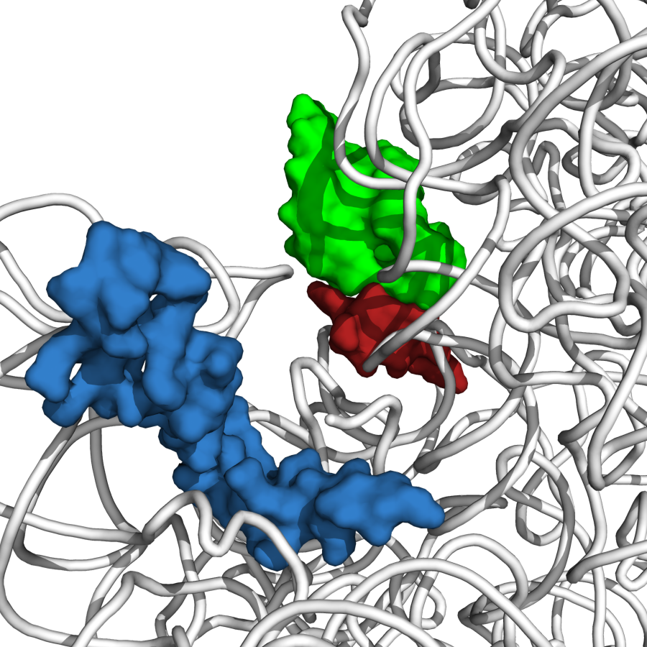
Ribosomal Protein bS21
P-site tRNA ASL
bS21
mRNA
Steven Gregory
Notes:
Courtesy of steve Gregory. In this study we are focusing on a ribosomal protein called bS21 which is shown here in its position on the ribosome. bS21 is involved in the initiation of translation, and to learn more about it, null mutants have been made in a number of different bacterial species. In bacillus subtilis, this results in defects in motility and biofilm formation, and in listeria monocytogenes, null mutants have increased acid stress resistance and changes in transcription of stress resistance genes. Additionally, in a bacterial species called burkholderia psudomallei, bs21’s gene, which is called rpsU, was identified as a virulence gene, and actually in Francisella one of the rpsU homologs was also flagged as a virulence gene.

Slide 6
Do ribosomes with different bS21 proteins translate different mRNAs?
rpsU1
rpsU2
rpsU3
cspC
yqeY
dnaG
rpoD
Standard growth
MglA-activated
Notes:
In the case of francisella, we see three homologs of one of the ribosomal proteins bS21 – the genes of which are named rpsU1, U2, and U3. This is important because not all bacteria contain multiple rpsU homolog. And these genes are located at different places on the genome and are involved in different operons. Under standard growth, rpsU2, the second homolog, is most abundant, so we would expect to see the most of that bS21 protein being incorporated into ribosomes. However, we believe when MgIA is activated, which is a transcription factor important for virulence, rpsU1 and 3 are also expressed. So the hypothesis is that some mRNA’s that are not translated during standard growth because rpsU2 does not recognize them are translated when the other two homologs are expressed. So this might be an important component of virulence for francisella, and could indicate another level of control over gene expression, whereas we normally think of it at the transcriptional level, it could actually be at the level of translation initiation. So this is a huge question, definitely too much to answer in just a 4 week rotation.

Slide 7

Experimental Questions
Are all three proteins encoded by the rpsU homologs incorporated into ribosomes?
Can we use ChIP to determine if ribosomes with different bS21 homologs translate different genes?
Notes:
But this did lead to some smaller questions that we can maybe answer. First, we know rpsu1 and rpsu3 exist and are sometimes transcribed, but are they actually being incorporated into ribosomes, or are they simply going off somewhere else in the cell? And next, we wanted to see if we could develop a tool to try to answer the bigger question we just presented - to determine if ribosomes with different bS21 homologs translate different genes, and we wanted to try to use ChIP to address that.

Slide 8
Necessary steps to investigate ribosome composition
Isolate Ribosomes
Protocol from Gregory Lab
Analyze by Mass Spec
Notes:
As I mentioned, our first question was to determine whether the homologs were actually being incorporated into ribosomes. To address this question, we had to isolate some ribosomes then send them out for mass spec to see which proteins are present. Neither Dr. Ramsey nor I had never isolated ribosomes before, so we had a lot of help from the Gregory lab on how to do that. In this case we used two strains of interest, the wild type francisella cells, and a strain that is missing the first rpsU homolog, so delta rpsU1.

Slide 9
Results
WT
ΔrpsU1
Ladder
50 kDa
30 kDa
20 kDa
15 kDa
10 kDa
Notes:
We then ran the ribosomes on an SDS page gel and stained with Coomassie, and you can see that we definitely purified a number of proteins. Bacterial ribosomes have about 55 proteins, but there has not been a published account of ribosome purification in Francisella before, so we really had nothing to compare this to. So we are going to send it out for mass spec to confirm that this is indeed a ribosome, and to see which homologs we find in the wild-type cells.

Slide 10

Next Steps
Send for mass spec and analyze results
Look at strains with different gene compositions
    - ΔrpsU2, 3, combinations
    - ΔMglA
    - with tagged genes
  CryoEM
Notes:
So as I just mentioned, we have to send these ribosomes out and then get those results back. Further down the line, we can develop different strains of francisella that may be missing one or two of the other homologs, or even missing mgla which we believe is activating the transcription of the first and third genes. And then we may also want to develop strains with tags on some of these genes so we can do other experiments on them. And we would also like to do cryoEM to visualize the ribosomes.

Slide 11
Experimental Questions
Are all three proteins encoded by the rpsU homologs incorporated into ribosomes?
Can we use ChIP to determine if ribosomes with different bS21 homologs translate different genes?
Notes:
Now onto the second question we were asking, which was whether we can develop a tool to analyze whether distinct ribosomes are translating different genes. The idea behind this was just a proof of principle, but we wanted to try an approach using ChIP.

Slide 12
Chromatin Immunoprecipitation (ChIP)
1. Crosslink
4. Purify DNA
Formaldehyde
POI
POI
DNA
2. Sonicate
5. Analyze by qPCR or next-generation sequencing
POI
3. Immunoprecipitate
ATGTCCATTGTATCGTATGTATCC
α-VSVG Beads
Notes:
This is just a brief overview of how chip works. You add formaldehyde to crosslink proteins to your DNA, so in this case our protein of interest is rpsU2, but many other proteins are also crosslinked in this process. Then we sonicate the cells to lyse them and shear the DNA so it’s broken into all these pieces, and these are just other proteins that are attached to fragments of DNA. Then you use beads with an antibody for your protein of interest, so our rpsU2 was tagged with VSVG so we used anti-VSVG beads, and this allows us to separate out only the DNA that is linked to our protein. Then we reverse the crosslink so that we are able to purify out the DNA, and we analyze that using qPCR or sequencing.

Slide 13
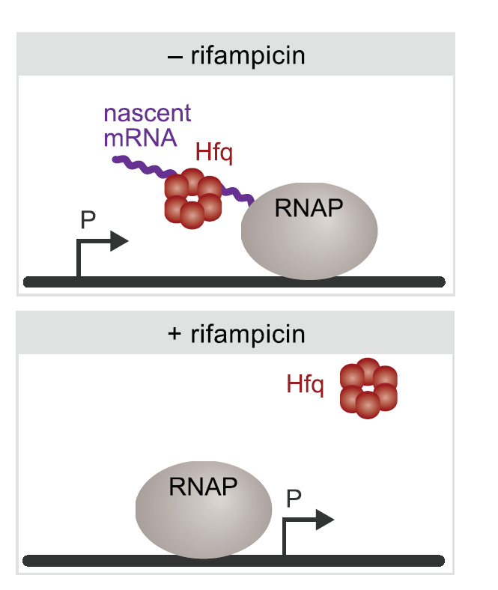
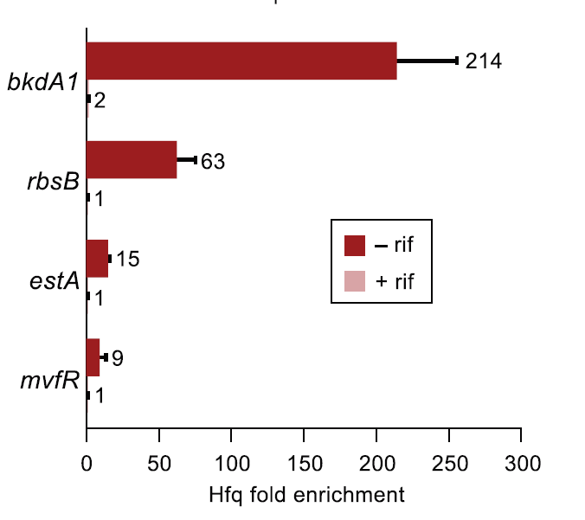
ChIPPAR
(ChIP in presence or absence of rifampicin)
Kambara, Ramsey, and Dove 2018
Notes:
The precise approach we are using is something that Dr. Ramsey assisted in developing in her previous lab to look at a chaperone protein called Hfq, and we believe can be used to identify a number of co-transcriptional activities of proteins. Under normal circumstances, Hfq is binding to mRNA as it’s being made by RNA polymerase, and is therefore close enough to the promoter region of DNA to be crosslinked there.
At a number of different genes, you see specific enrichment of Hfq at the promoter region.
Rifampicin is an antibiotic that effectively stops transcription, so when rifampicin is added to a culture, transcription does not proceed, and you would expect to see less presence of associated proteins like Hfq at the promoter region.
You can now see when compared to rifampicin treated cells, the difference in Hfq enrichment at these genes is significant.

Slide 14
Experimental Design
RNAP
RNAP
- rifampicin
+ rifampicin
Notes:
We thought we might be able to apply this same concept to study ribosomes. Because ribosomes act co-transcriptionally, without rifampicin, we expect to see nascent mRNA and the ribosome fairly close to the start of a protein-coding gene. But when we add rifampicin, we expect to not necessarily see the ribosome close to our gene of interest or active translation of a protein. For this process, we are going to use the second homolog of bS21 because it is the most abundant and likely the easiest to work with, and if we can prove this process works, we will try it on the other homologs.

Slide 15
Hypothesis for ChIP experiment with bS21-2-VSVG
RNAP
RNAP
- rifampicin
+ rifampicin
bS21
fold enrichment
-rif +rif -rif +rif
Protein coding Non-protein coding
Notes:
We want to test this at both a protein coding gene where we anticipate seeing ribosomes, and a non-protein coding region of DNA. Our expectation is that we see specific enrichment at the protein coding region only, without rifampicin. At the non-protein coding gene, or in the presence of rifampicin, we do not anticipate specific enrichment.

Slide 16
Necessary steps to develop ChIPPAR tool
Clone plasmid to overexpress bS21-2-VSVG
Amplify gene, restriction enzyme digest, ligate into plasmid backbone, transform into E. coli, miniprep, sequence, electroporate into WT Francisella cells
Chromatin Immunoprecipitation
Optimize sonication
qPCR
Design primers and validate primer efficiency
Validate ChIP
Notes:
To accomplish this I first had to clone a plasmid to overexpress the second bS21 homolog. I did successfully do this and electroporate them into WT francisella cells. For the sake of time I won’t go too much into this process.
Then we had to set up the ChIP experiment. Since ChIP has never been done in this new Ramsey lab before, I had to optimize the sonication procedure, then I validated the ChIP protocol with another short experiment. We are using qPCR to analyze relative enrichment of ChIPped DNA at different locations, so I had to validate primer efficiencies for our protein-coding and non-protein coding regions.

Slide 17
Sonication Optimization
Number of Cycles
17 20 23 26 36
Lad
3.0 kb
1.0 kb
0.5 kb
Notes:
We were borrowing the Howlett lab sonicator and hadn’t used it before, so one of the first things I had to do was optimize the sonication protocol by trying a range of different cycle numbers, and I found that 36 cycles gave us the highest yield of DNA and successful fragmentation, as you can see this smear, indicating that our DNA was broken into lots of pieces, all less than 1 kb.

Slide 18
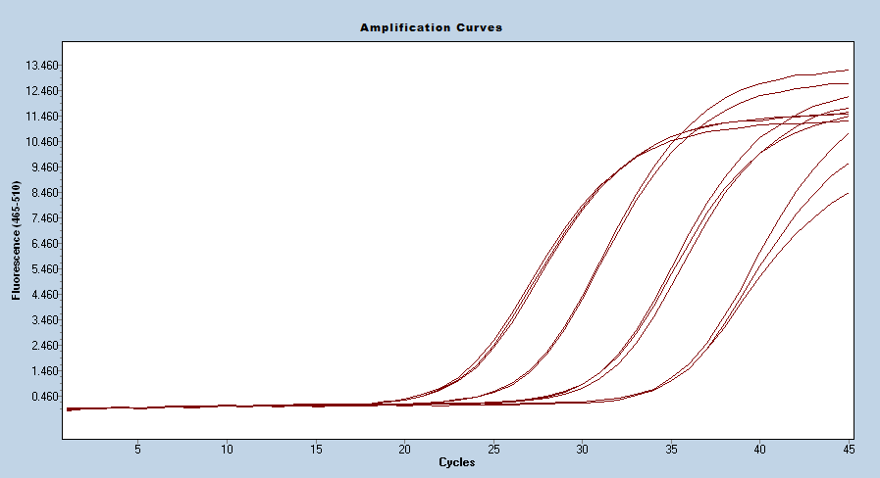
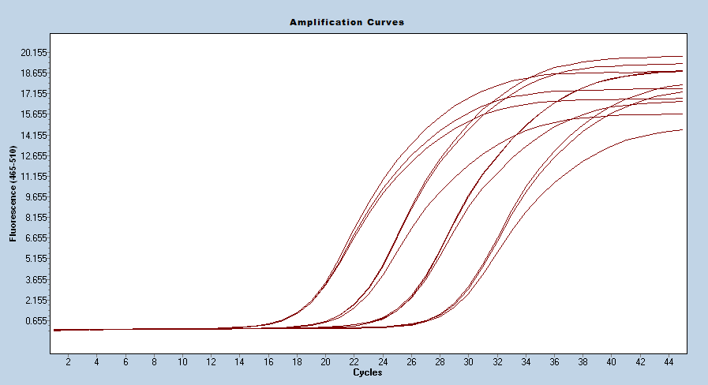
qPCR Primer Optimization
Protein Coding Gene – FTL_1364
Primer efficiency: 1.86
Non-Protein Coding Gene – 23S rRNA
Primer efficiency: 1.97
Notes:
Then we had to determine highly efficient primers to use for our qPCR experiment. So I designed a whole bunch of primers and ran them with different DNA concentrations to see how effectively they replicated the DNA. And we were hoping to find somewhere between 1.8 and 2.0 efficiency, which indicates that for every cycle, there are about 2 PCR products. And we found pretty good primers for both of our regions. Our protein coding gene is FTL_1364, it is a transcriptional regulator that is very highly transcribed and translated, and our non-protein coding control, which was 23s rRNA.

Slide 19
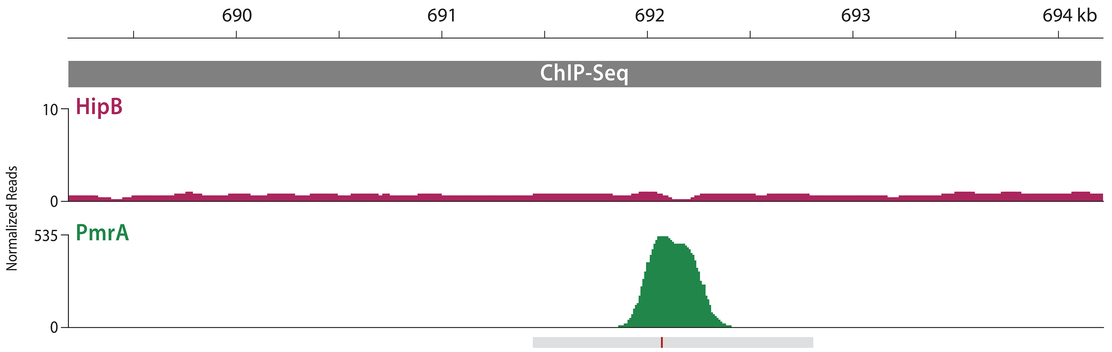
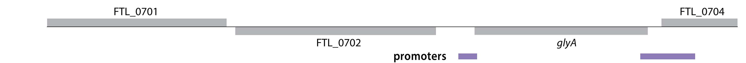
Validation of ChIP using PmrA
priM
Ramsey and Dove, 2016
Notes:
Next we wanted to validate the ChIP protocol with a different short experiment, using a protein known to associate with a particular region, using previously optimized primers. In this case, I immunoprecipitated a protein called pmra which has been shown by Ramsey and Dove to associate at the promoter of a gene called priM. And I compared that to another gene, tul4, which is known to not have specific enrichment of pmra.
So after going through the whole chip protocol with qPCR, I was able to find a 10-fold enrichment at priM compared to the control. So that’s great, it doesn’t really tell us anything we didn’t already know, but it means that I can get to ChIP to work!

Slide 20
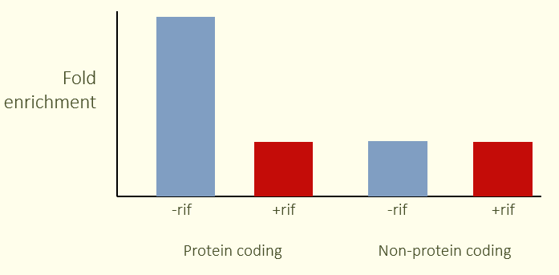
Experiment Results
Expected Results
Notes:
So now that we had our protocol optimized, we actually ran the experiment with and without rifampicin in the cells with our plasmid that is overproducing the second homolog of bS21, and I have a reminder of what we expected to see up here.
These are our results, normalized to the amount of DNA we recovered at each locus in the absence of rif comparing to with rif, and with the –rif samples set to 1. What we found is that we don’t see a difference at our protein coding gene ftl_1364. What’s notable is that we see a significant decrease of immunoprecipitated DNA at the 23s gene in the presence of rif. We just got these results so we are still trying to interpret them, because they were not what we expected. But this may reflect that the 23s region is a poor control because we may have nonspecifically immunoprecipitated lots of this gene when there are many proteins involved in transcribing the 23s gene, and the nonspecific immunoprecipitation of this gene may be less when there is no transcription of this gene.

Slide 21
Next Steps
Control with strain lacking FTL_1364 ribosomal binding site
Preliminary immunoprecipitation to include RNA polymerase
Strains with only one homolog – ribosome profiling
Notes:
Because we think the control wasn’t the best choice, the logical next step for this project would be to develop a different control. In this case, instead of comparing one gene to a totally different gene, we could develop a strain of francisella that is lacking the FTL_1364 ribosomal binding site, because we would expect to see fewer ribosomes there, and it would be comparing to a control that should have the same level of nonspecific binding.
Another idea would be to add another immunoprecipitation step ton include RNA polymerase. Right now we might be pulling down any number of ribosomes since they generally work as a polysome, but if we first precipitate using IgG beads for Tap-tagged RNA polymerase, then we use the anti-VSVG beads, we should be more accurately pulling down only ribosomal proteins that are in close association with RNA polymerase, and therefore more likely to be at the start of a gene.
And finally, we may be taking the totally wrong approach on this. ChIP is one way to try to answer this question, but a very different approach may be to develop strains with only one homolog, then do ribosome profiling and next generation sequencing to see if these distinct ribosomes are associating with different mRNA species.

Slide 22

Acknowledgements
Dr. Kathryn Ramsey
Jamie Wandzilak
John Church
Joe Paquette
Janet Atoyan at GSC
Dr. Steven Gregory & Sam, Seth, and Erin
Howlett and Camberg Labs
Notes:
I had a ton of help working on this project, in particular thank you to Dr. Ramsey, the other students in the Ramsey lab, Janet in the sequencing center. Dr. Gregory and his lab were incredibly helpful with the ribosome purification. And then Dr. Howlett and Dr. Camberg for allowing us to use the sonicator and French press.

Slide 23
Questions?
Notes:
Possible questions
No other rib proteins with homologs in francisella.
In Tb, specialized ribosomal proteins alter based on presence of zinc.
55 ribosomal proteins in e. coli
HipB – site specific DNA binding protein
Error bars – duplicate not triplicate, first time doing this.
Rifampicin binding to the B subunit of RNA polymerase, thereby deactivating it.
Holartica = less virulent, can be water-borne or respiratory
Did you check if the gene we introduced is being made into protein? NO but we want to if we have time, just run it on a gel and use the VSVG antibody

Slide 24



Ribosome Purification
Remove cell debris
Culture cells and create cell pellet
Add DNAse
Layer on sucrose cushion
X 2
Lyse cells using French Press
Pellet out ribosomes
Notes:
This is just a brief overview of the ribosome purification. You basically grow up your cells and create a pellet. Since we only want rRNA and proteins we add DNAse to chop up any DNA. Then we lyse our cells using the French Press. We remove cell debris by pelleting, then layer the supernatant on a sucrose cushion and spin that down, which is when you should be able to see your ribosome pellet at the bottom, but there are usually still some lipid membranes present, so we wash that pellet and repeat with a higher sucrose concentration. We again spin down so that resulting pellet should be our purified ribosomes. We can use this protocol with a wide variety of strains that have different rpsU genes. In this case we used two strains of interest, the wild type francisella cells, and a strain that is missing the first rpsU homolog, so delta rpsU1.

Slide 25

Cloning the Plasmid
Transform into E. coli
EcoRI
DNA overexpressing rpsU2
Plasmid backbone
Plate with kanamycin
NotI
Restriction Enzyme Digest
Culture and purify DNA
Ligation
Notes:
I’m sure most of you are familiar with cloning a plasmid, but I’ll just give a brief summary for those who don’t do it very often. We amplified our rpsU2 gene using PCR then used restriction enzymes EcoRI and NotI to cut both the PCR product and the plasmid backbone so we could ligate the two together. Then we transformed the new plasmid into E. coli. Those were then plated on kanamycin and because the plasmid backbone has an antibiotic resistance gene incorporated, only the cells that took up the plasmid should grow. We then cultured single colonies, purified the DNA, and confirmed that we had our insert using Sanger sequencing.

Slide 26
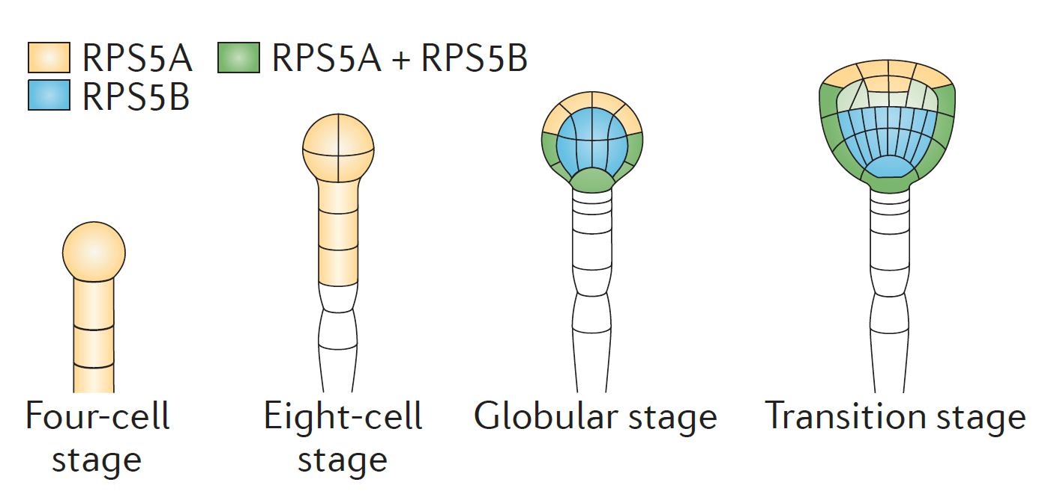
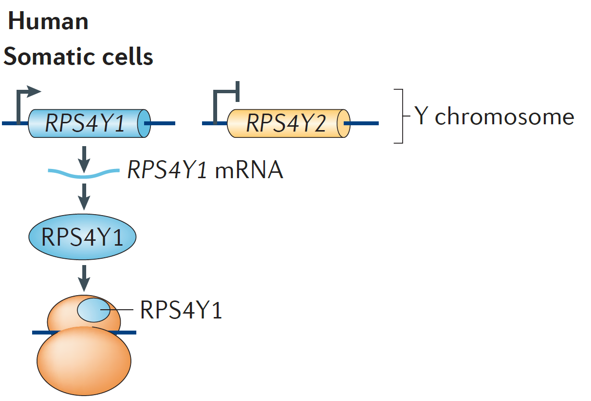
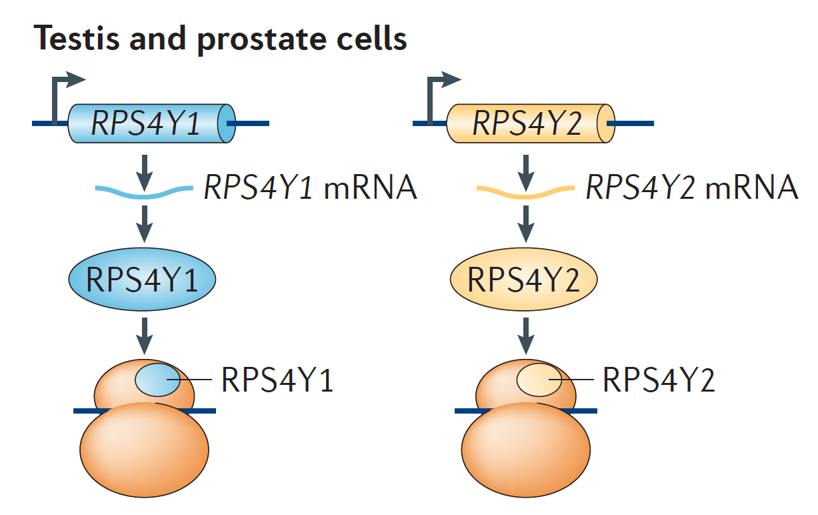
Specialized Ribosomes
Different life stages (A. thaliana)
Different tissues (H. sapiens)
Xue and Barna 2012
Notes:
The aspect of F. tularensis that I have been looking into is the possibliyt of specialized ribosomes in this species. Specialized ribosomes are basically different forms of ribosomes that may appear either because of alteration is ribosomal proteins, heterogeneity in rRNA itself, or differences in post-translational modification of ribosomal proteins. In many cases, it is because there are paralogs of certain proteins that may be expressed at different times in the life cycle as with this example here, where the early stages only have one paralog expressed but later stages have multiple proteins. In humans we also see this in different tissues, so testis and prostate cells express a paralog of RPS4Y that we don’t see expressed in somatic cells.

