Slide 1
March 18, 2019
Lab Meeting
Hannah Trautmann

Slide 2
Prokaryotic Ribosomes
RNAP
Notes:
The focus of my project in this lab is on specialized ribosomes in francisella. As I’m sure you all know, ribosomes are the molecular machines that translate mRNA into protein. They are composed of rRNA and proteins, and have two subunits the smaller 30s subunit, and the larger 50s subunit. Together these make up the whole ribosome which is called the 70S ribosome. In bacteria, they function co-transcriptionally, so they are actively creating protein from mRNA, as RNA polymerase is creating that mRNA. This can occur at the same time in prokaryotes because there is no nucleus. The ribosome can also protect the mRNA in this way, so changes in translation may affect transcript abundance.

Slide 3
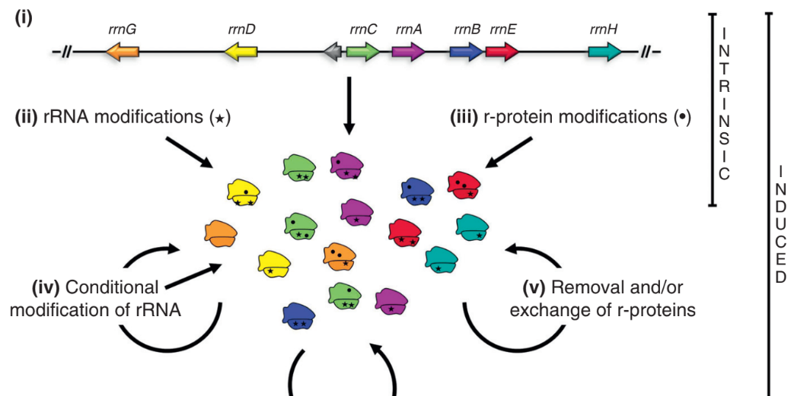
Specialized Ribosomes
Byrgazov et al. 2013
Notes:
Specialized ribosomes refer to heterogeneity in ribosomes. This may seem like a new idea to some of you, because we are generally taught that ribosomes are ribosomes are ribosomes. However there has been shown to be compositional differences among ribosomes, and this figure outlines the possible changes that may lead to heterogeneity. First is rRNA composition: there are seven rRNA genes represented with sequence differences, leading to different ribosomes, which account for the color differences. There can also be modifications to rRNA including methylation of certain nucleotides. There may be post-translational modifications of ribosomal proteins, such as acetylation or methylation, as well, and finally there’s the possibility of exchange of ribosomal proteins, perhaps because of homologous proteins. So there is evidence that there is heterogeneity in ribosomes, in a number of different models, which of course leads us to wonder if they may have distinct functions.

Slide 4
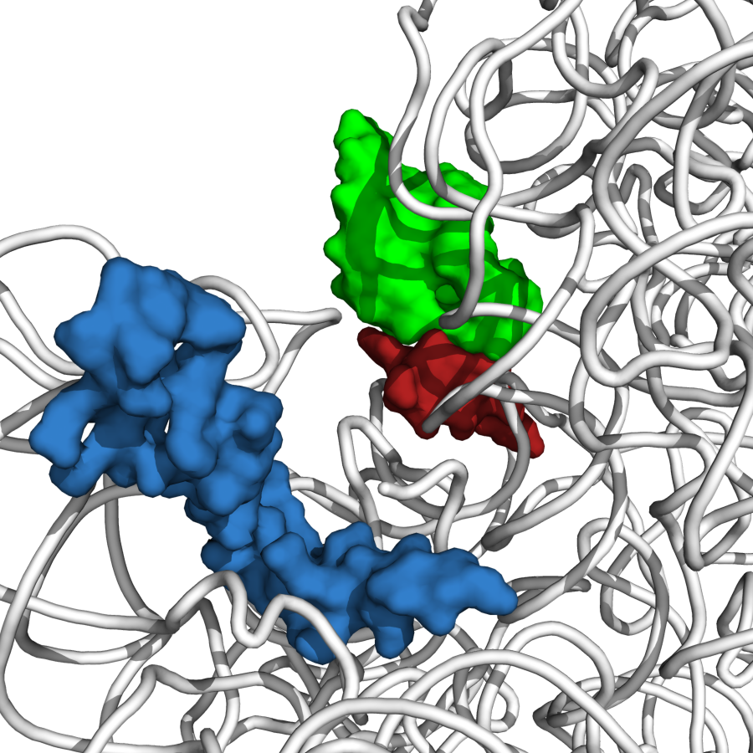
Ribosomal Protein bS21
P-site tRNA ASL
bS21
mRNA
Steven Gregory
Notes:
Courtesy of steve Gregory. In this study we are focusing on a ribosomal protein called bS21 which is shown here in its position on the ribosome. bS21 is involved in the initiation of translation, and to learn more about it, null mutants have been made in a number of different bacterial species. In bacillus subtilis, this results in defects in motility and biofilm formation, and in listeria monocytogenes, null mutants have increased acid stress resistance and changes in transcription of stress resistance genes. Additionally, in a bacterial species called burkholderia psudomallei, bs21’s gene, which is called rpsU, was identified as a virulence gene, and actually in Francisella one of the rpsU homologs was also flagged as a virulence gene.

Slide 5
Do ribosomes with different bS21 proteins translate different mRNAs?
rpsU1
rpsU2
rpsU3
cspC
yqeY
dnaG
rpoD
Standard growth
MglA-activated
Notes:
cpsC – cold shock protein
yqeY - carbon nitrogen ligase?
dnaG – primase
rpoD – RNA polymerase sigma factor
In the case of francisella, we see three homologs of one of the ribosomal proteins bS21 – the genes of which are named rpsU1, U2, and U3. This is important because not all bacteria contain multiple rpsU homologs. And these genes are located at different places on the genome and may be involved in different operons. Under standard growth, rpsU2, the second homolog, is most abundant, so we would expect to see the most of that bS21 protein being incorporated into ribosomes. However, we believe when MgIA is activated, which is a transcription factor important for virulence, rpsU1 and 3 are also expressed. So the hypothesis is that some mRNA’s that are not translated during standard growth because rpsU2 does not recognize them are translated when the other two homologs are expressed. So this might be an important component of virulence for francisella, and could indicate another level of control over gene expression, whereas we normally think of it at the transcriptional level, it could actually be at the level of translation initiation. So this is kind of the big question of my project: do ribosomes with different bS21 proteins translate different mRNAs?

Slide 6

Experimental Questions
Are all three proteins encoded by the rpsU homologs incorporated into ribosomes?
Can we develop an approach to determine if ribosomes with different bS21 homologs translate different genes?
Notes:
I’m starting with a few smaller questions that can hopefully help us answer this bigger question. First, we know rpsu1 and rpsu3 exist and are sometimes transcribed, but are they actually being incorporated into ribosomes, or are they simply going off somewhere else in the cell? And next, we wanted to see if we could develop a tool to try to answer the bigger question we just presented - to determine if ribosomes with different bS21 homologs translate different genes, and we wanted to try to use ChIP to address that.

Slide 7



Ribosome Purification
Remove cell debris
Culture cells and create cell pellet
Add DNAse
Layer on sucrose cushion
X 2
Lyse cells using French Press
Pellet out ribosomes
Notes:
To answer the first question about whether all three homologs are being incorporated into the ribosome, I did a ribosome purification. This is just a brief overview of that process. You basically grow up your cells and create a pellet. Since we only want rRNA and proteins we add DNAse to chop up any DNA. Then we lyse our cells using the French Press. We remove cell debris by pelleting, then layer the supernatant on a sucrose cushion and spin that down, which is when you should be able to see your ribosome pellet at the bottom, but there are usually still some lipid membranes present, so we wash that pellet and repeat with a higher sucrose concentration. We again spin down so that resulting pellet should be our purified ribosomes. We can use this protocol with a wide variety of strains that have different rpsU genes. In this case we used two strains of interest, the wild type francisella cells, and a strain that is missing the first rpsU homolog, so delta rpsU1.

Slide 8
Results
WT
ΔrpsU1
Ladder
50 kDa
30 kDa
20 kDa
15 kDa
10 kDa
Notes:
We then ran the ribosomes on an SDS page gel and stained with Coomassie, and you can see that we definitely purified a number of proteins. Francisella ribosomes have about 56 proteins when you count our 3 S21 proteins separately, but there has not been a published account of ribosome purification in Francisella before, so we really had nothing to compare this to.

Slide 9
Mass Spec Results
67 Proteins
52 ribosome proteins
4 ribosome-associated proteins
11 others
10 highly abundant in cell
nuoB?
Notes:
So we sent a sample of the purified ribosomes out to be analyzed by mass spec, to see how pure our samples were and to see which of the ribosomal proteins we actually identified.
There were 67 proteins identified. Out of these 56 of them were either ribosomal proteins or ribosome-associated proteins, so things like trigger factor which is a chaperone protein for nascent peptides. So why did these other 11 proteins show up? Well out of those 11, 10 of them are highly abundant in the cell, or part of complexes that are highly abundant in the cell, so are more difficult to purify out. The only one left that is not explained is a protein called nuoB which is the second subunit of NADH-quinone oxidoreductase complex. 5 peptides were identified and out of all of the 67 proteins it was tied for last in terms of relative number of spectra identified, so it was not very abundant in our ribosome sample. For this “highly abundant in cell” citeria, I had identified the top 10% of proteins identified in a whole cell sample, and nuoB fell into the bottom 50%. If any of you have any ideas as to why we may have gotten that, let me know!

Slide 10
Mass Spec Results
4 missing ribosome proteins: S1, S9, L35, L36
  Need to update reference database
bS21-2 and bS21-3 identified
Notes:
There were also 4 ribosome proteins that we did not find: S1, S9, L35, and L36. It turns out that the first two S1 and S9 were not included in the uniprot database that the mass spec people used, but they are proteins in francisella. So we could have purified them, we just need to find a better database and ask them to re-analyze our results.
The other two proteins – L35 and L36 are usually very late in assembly so are more likely to have fallen off of the ribosome or not yet have been added, which may be why we didn’t see those.
And then the major question – did we see our homologs? We found the 2nd homolog, and when widening the scope of the data, we also found the 3rd homolog. Which is very exciting!

Slide 11
Next Steps
Repeat purification with VSVG-tagged proteins
  Can they be incorporated into the ribosome?
  Western blot
Repeat with knockout strains
CryoEM
Notes:
Currently I am working on repeating the ribosome purification with VSVG tagged bS21 proteins to confirm that even with this tag they can still incorporate into the ribosome. Rather than doing mass spec to analyze this data we are going to use a western blot with an anti-vsvg antibody.
I’m also working on developing knockout strains of these homologs, so we could also do the ribosome purification with these strains once we get them going.
And finally, further down the line, we may want to try cryoEM on the ribosomes.

Slide 12
Experimental Questions
Are all three proteins encoded by the rpsU homologs incorporated into ribosomes?
Can we develop an approach to determine if ribosomes with different bS21 homologs translate different genes?
Notes:
Now onto the second question we were asking, which was whether we can develop a tool to analyze whether distinct ribosomes are translating different genes. The idea behind this was just a proof of principle, but we wanted to try an approach using ChIP.

Slide 13
Chromatin Immunoprecipitation (ChIP)
1. Crosslink
4. Purify DNA
Formaldehyde
POI
POI
DNA
2. Sonicate
5. Analyze by qPCR or next-generation sequencing
POI
3. Immunoprecipitate
ATGTCCATTGTATCGTATGTATCC
α-VSVG Beads
Notes:
This is just a brief overview of how chip works. You add formaldehyde to crosslink proteins to your DNA, so in this case our protein of interest is rpsU2, but many other proteins are also crosslinked in this process. Then we sonicate the cells to lyse them and shear the DNA so it’s broken into all these pieces, and these are just other proteins that are attached to fragments of DNA. Then you use beads with an antibody for your protein of interest, so our rpsU2 was tagged with VSVG so we used anti-VSVG beads, and this allows us to separate out only the DNA that is linked to our protein. Then we reverse the crosslink so that we are able to purify out the DNA, and we analyze that using qPCR or sequencing.

Slide 14
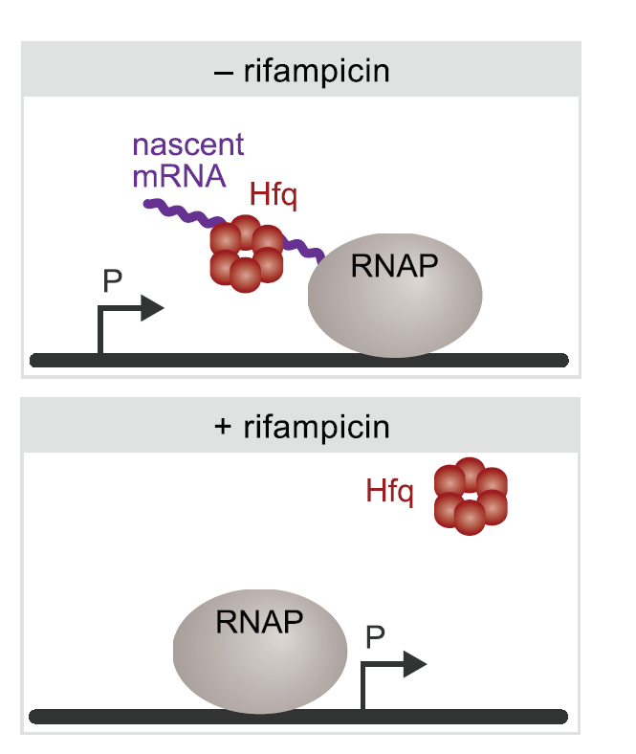
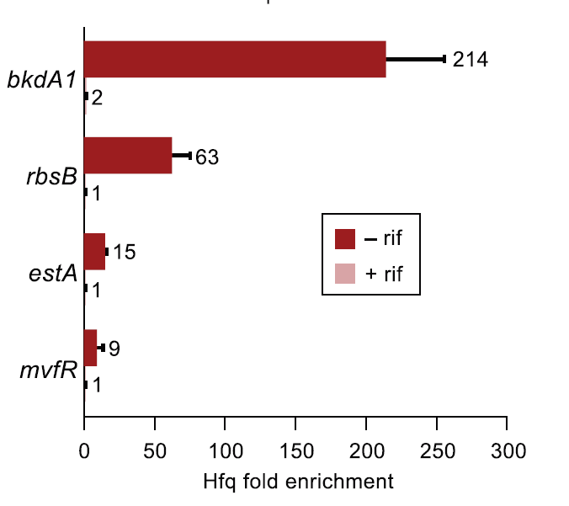
ChIPPAR
(ChIP in presence or absence of rifampicin)
Kambara, Ramsey, and Dove 2018
Notes:
The precise approach we are using is something that Dr. Ramsey assisted in developing in her previous lab to look at a chaperone protein called Hfq, and we believe can be used to identify a number of co-transcriptional activities of proteins. Under normal circumstances, Hfq is binding to mRNA as it’s being made by RNA polymerase, and is therefore close enough to the promoter region of DNA to be crosslinked there.
At a number of different genes, you see specific enrichment of Hfq at the promoter region.
Rifampicin is an antibiotic that effectively stops transcription, so when rifampicin is added to a culture, transcription does not proceed, and you would expect to see less presence of associated proteins like Hfq at the promoter region.
You can now see when compared to rifampicin treated cells, the difference in Hfq enrichment at these genes is significant.

Slide 15
Experimental Design
RNAP
RNAP
- rifampicin
+ rifampicin
Notes:
We thought we might be able to apply this same concept to study ribosomes. Because ribosomes act co-transcriptionally, without rifampicin, we expect to see nascent mRNA and the ribosome fairly close to the start of a protein-coding gene. But when we add rifampicin, we expect to not necessarily see the ribosome close to our gene of interest or active translation of a protein. For this process, we are going to use the second homolog of bS21 because it is the most abundant and likely the easiest to work with, and if we can prove this process works, we will try it on the other homologs.

Slide 16
Experimental Design
RNAP
RNAP
Protein coding
Non-protein coding
Notes:
Similarly, while we expect association of ribosomes with the promoter region of a protein coding gene, at a gene that is transcribed but not translated, we do not expect to see the ribosome associating.

Slide 17
Hypothesis for ChIP experiment with bS21
bS21
fold enrichment
-rif +rif -rif +rif
Protein coding Non-protein coding
Notes:
So this forms the basis of our ChiPPAR experiment. Our expectation is that we see specific enrichment at the protein coding region only, without rifampicin. At the non-protein coding gene, or in the presence of rifampicin, we do not anticipate specific enrichment.

Slide 18
Experiment Results
Notes:
These are our results when doing this experiment with the second homolog bs21-s, normalized to the amount of DNA we recovered at each locus in the absence of rif comparing to with rif, and with the –rif samples set to 1. What we found is that we don’t see a difference at our protein coding gene ftl_1364. What’s notable is that we see a significant decrease of immunoprecipitated DNA at the 23s gene in the presence of rif. But this may reflect that the 23s region is a poor control because we may have nonspecifically immunoprecipitated lots of this gene when there are many proteins involved in transcribing the 23s gene, and the nonspecific immunoprecipitation of this gene may be less when there is no transcription of this gene.

Slide 19
Next Steps
New control – modified ribosomal binding site
Additional immunopurification with B’-TAP
Ribosome profiling

Slide 20
Next Steps
RNAP
RNAP
WT
Modified ribosomal binding site
Notes:
Our idea to improve this poor control is actually to use the same gene – a protein coding gene called GroEL – but create a mutant that has a modified ribosomal binding site. This way we can have a direct comparison of the ribosome enrichment with similar amounts of nonspecific binding.

Slide 21
Next Steps
V
V
RNAP
α-VSVG Beads
α-VSVG Beads
Notes:
Another idea would be to add another immunoprecipitation step ton include RNA polymerase. Right now we might be pulling down any number of ribosomes since they generally work as a polysome, but if we first precipitate using IgG beads for Tap-tagged RNA polymerase, then we use the anti-VSVG beads, we should be more accurately pulling down only ribosomal proteins that are in close association with RNA polymerase, and therefore more likely to be at the start of a gene.
And finally, we may be taking the totally wrong approach on this. ChIP is one way to try to answer this question, but a very different approach may be to develop strains with only one homolog, then do ribosome profiling and next generation sequencing to see if these distinct ribosomes are associating with different mRNA species.

Slide 22
Next Steps
V
V
RNAP
TAP
α-VSVG Beads
IgG Beads
Notes:
Another idea would be to add another immunoprecipitation step ton include RNA polymerase. Right now we might be pulling down any number of ribosomes since they generally work as a polysome, but if we first precipitate using IgG beads for Tap-tagged RNA polymerase, then we use the anti-VSVG beads, we should be more accurately pulling down only ribosomal proteins that are in close association with RNA polymerase, and therefore more likely to be at the start of a gene.
And finally, we may be taking the totally wrong approach on this. ChIP is one way to try to answer this question, but a very different approach may be to develop strains with only one homolog, then do ribosome profiling and next generation sequencing to see if these distinct ribosomes are associating with different mRNA species.

Slide 23
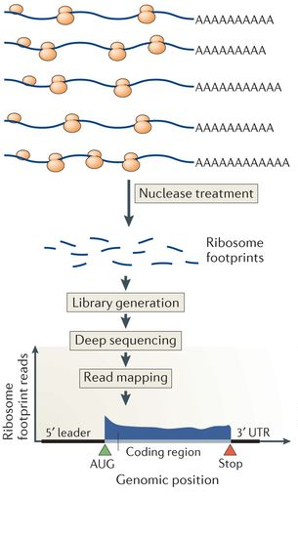
Next Steps – Ribosome profiling
Brar and Weissman, 2015

Slide 24
Questions?
Notes:
Possible questions
No other rib proteins with homologs in francisella.
In Tb, specialized ribosomal proteins alter based on presence of zinc.
55 ribosomal proteins in e. coli
HipB – site specific DNA binding protein
Error bars – duplicate not triplicate, first time doing this.
Rifampicin binding to the B subunit of RNA polymerase, thereby deactivating it.
Holartica = less virulent, can be water-borne or respiratory
Did you check if the gene we introduced is being made into protein? NO but we want to if we have time, just run it on a gel and use the VSVG antibody

Slide 25
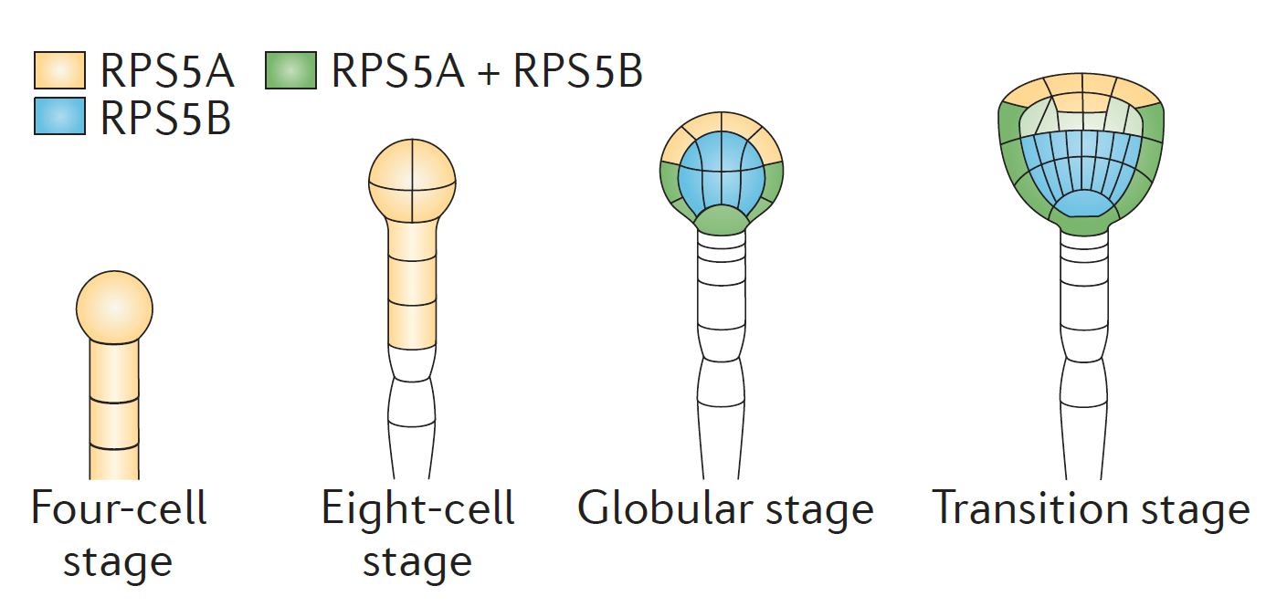
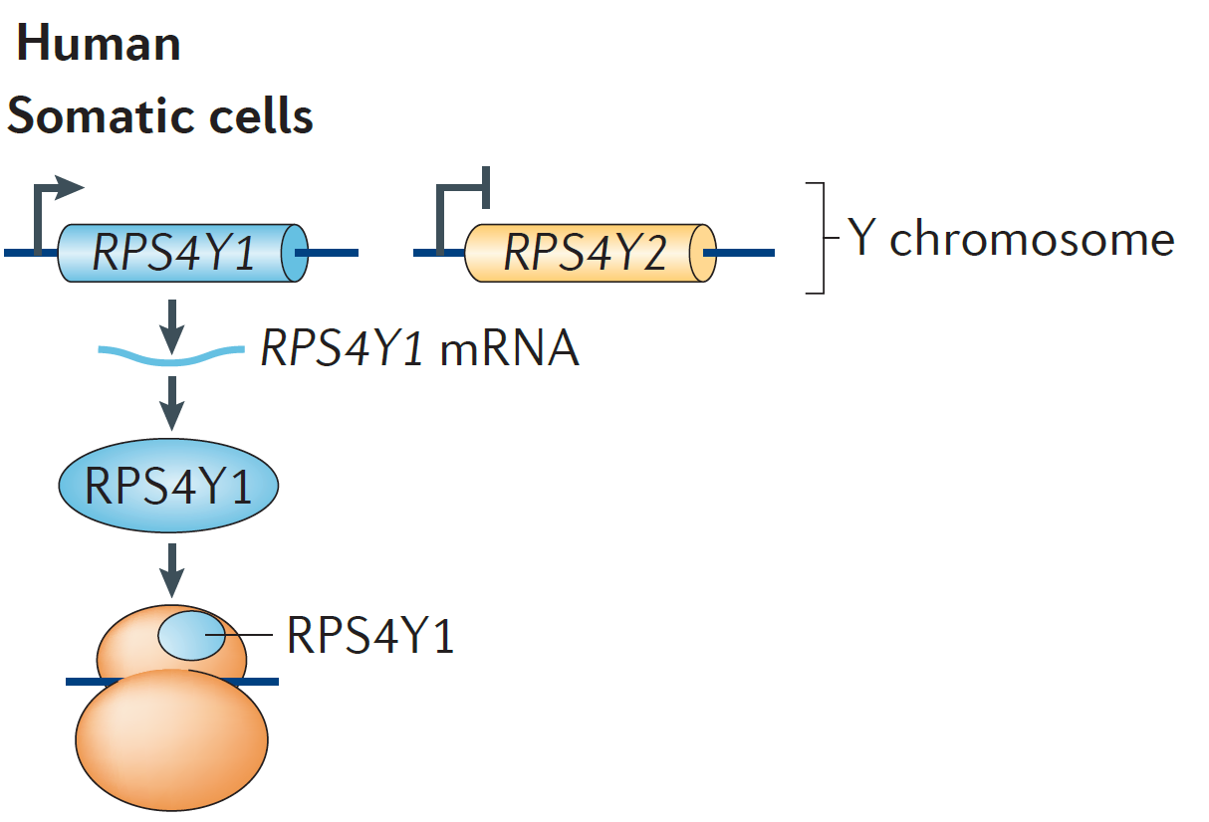
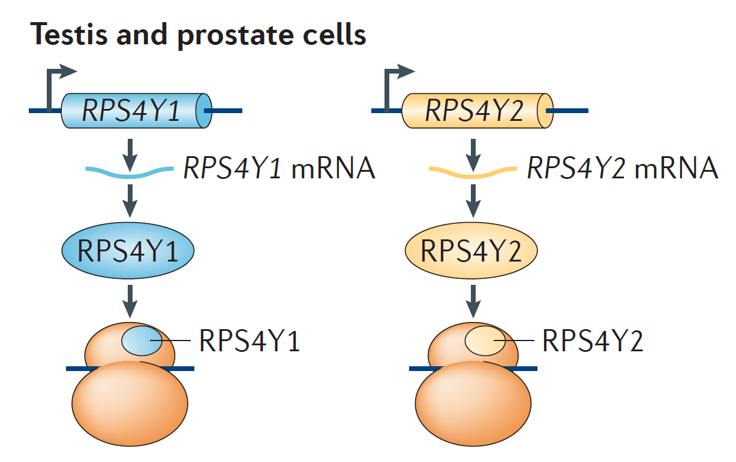
Specialized Ribosomes
Different life stages (A. thaliana)
Different tissues (H. sapiens)
Xue and Barna 2012
Notes:
The aspect of F. tularensis that I have been looking into is the possibliyt of specialized ribosomes in this species. Specialized ribosomes are basically different forms of ribosomes that may appear either because of alteration is ribosomal proteins, heterogeneity in rRNA itself, or differences in post-translational modification of ribosomal proteins. In many cases, it is because there are paralogs of certain proteins that may be expressed at different times in the life cycle as with this example here, where the early stages only have one paralog expressed but later stages have multiple proteins. In humans we also see this in different tissues, so testis and prostate cells express a paralog of RPS4Y that we don’t see expressed in somatic cells.

