Slide 1
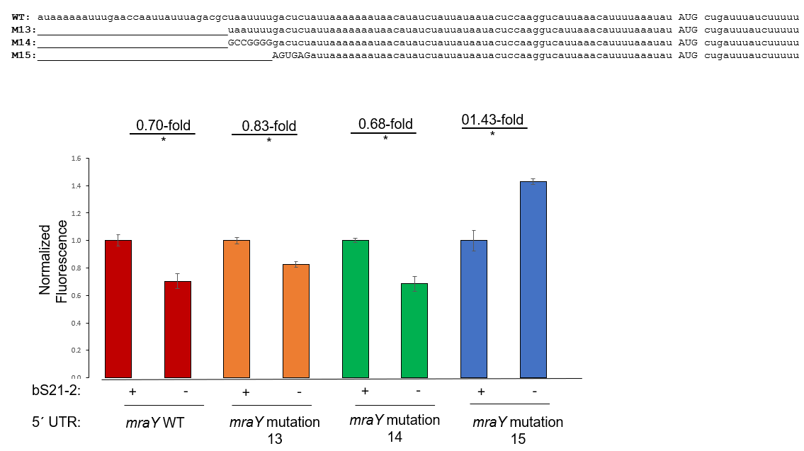
* : p<0.05
Question: Are the mutation 13 + 14 results replicable? Does modification of gacucu lead to changes in protein production?
Controls: wild-type mraY UTR
Results: Yes
Future directions: making full length UTRs with modified complements of AGUGAG

