Slide 1
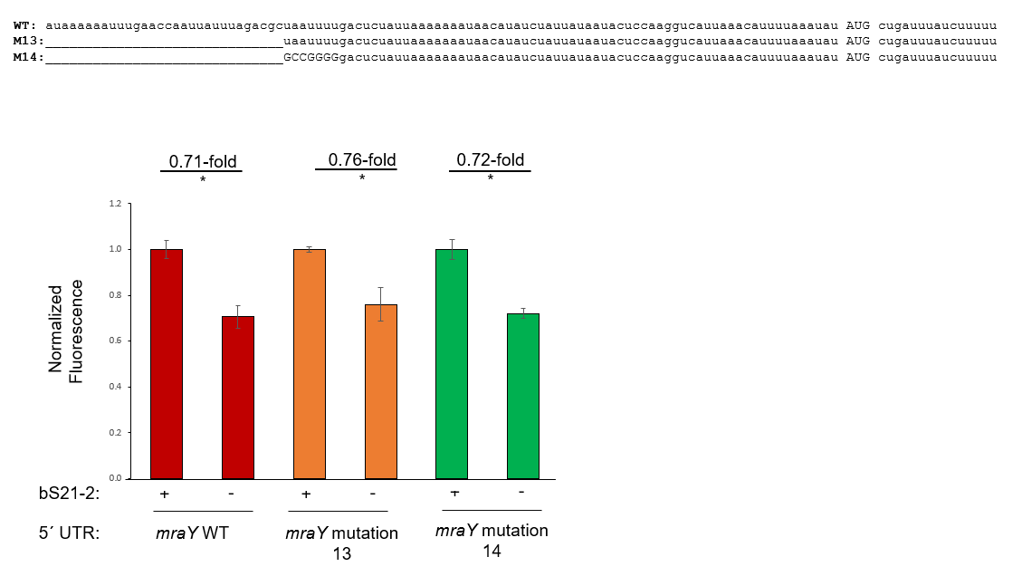
* : p<0.05
Question: Do nts 26-30 or 31-37 contribute to the regulation of the mraY UTR?
Controls: wild-type mraY UTR
Results: No apparently not. This means that the slight change from mut 14 to mut 9 is due to 3 nucleotides 38-40.
Future directions: Modify entire region 38-43 (mut15)

Slide 2
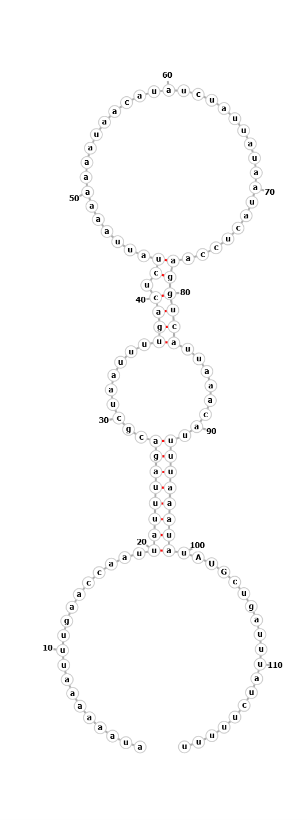

Next steps

Slide 3

Next steps

Slide 4


Next steps
M17:
auaaaaaauuugaaccaauuauuuagacgcuaauuuugacucuauuaaaaaaauaacauaucuauuauaauacuccaCUACUauuaaacauuuuaaauau AUG cugauuuaucuuuuu
M18:
auaaaaaauuugaaccaauuauuuagacgcuaauuuuAGUGAGauuaaaaaaauaacauaucuauuauaauacuccaCUACUauuaaacauuuuaaauau AUG cugauuuaucuuuuu

