Slide 1
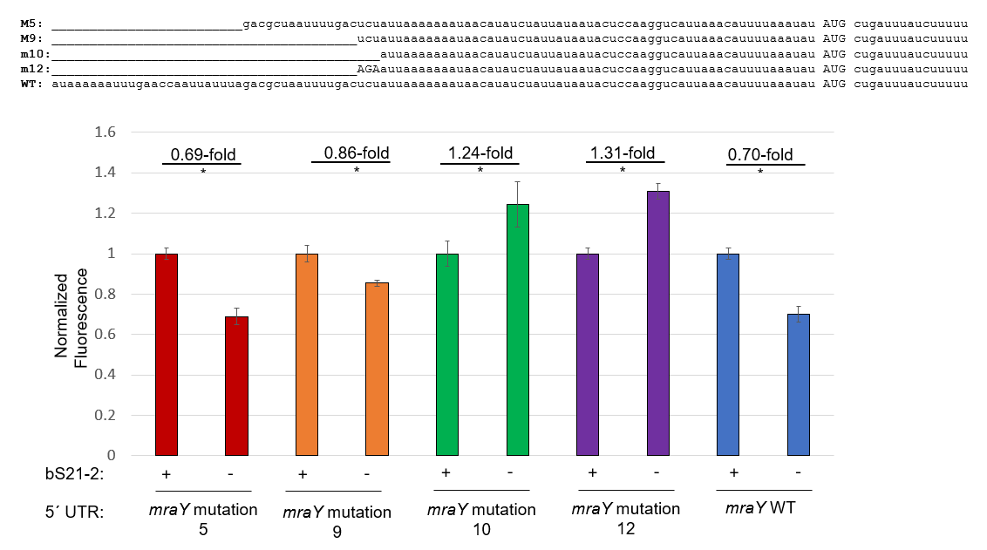
* : p<0.05
Question: Which region changes regulation of the mraY UTR?
Controls: wild-type mraY UTR
Results: Significant change in regulation occurs when altering ucu at nt 41-43, but some change in regulation may be occurring in nt 30-41.
Future directions: …

Slide 2
Regulated?
Yes
Yes
Partially
?
?
mraY WT:
auaaaaaauuugaaccaauuauuuagacgcuaauuuugacucuauuaaaaaaauaacauaucuauuauaauacuccaaggucauuaaacauuuuaaauau AUG cugauuuaucuuuuu
mraY mutation 5:
_________________________gacgcuaauuuugacucuauuaaaaaaauaacauaucuauuauaauacuccaaggucauuaaacauuuuaaauau AUG cugauuuaucuuuuu
mraY mutation 9:
________________________________________ucuauuaaaaaaauaacauaucuauuauaauacuccaaggucauuaaacauuuuaaauau AUG cugauuuaucuuuuu
mraY mutation 13:
______________________________uaauuuugacucuauuaaaaaaauaacauaucuauuauaauacuccaaggucauuaaacauuuuaaauau AUG cugauuuaucuuuuu
mraY mutation 14: ______________________________GCCGGGGgacucuauuaaaaaaauaacauaucuauuauaauacuccaaggucauuaaacauuuuaaauau AUG cugauuuaucuuuuu

Slide 3
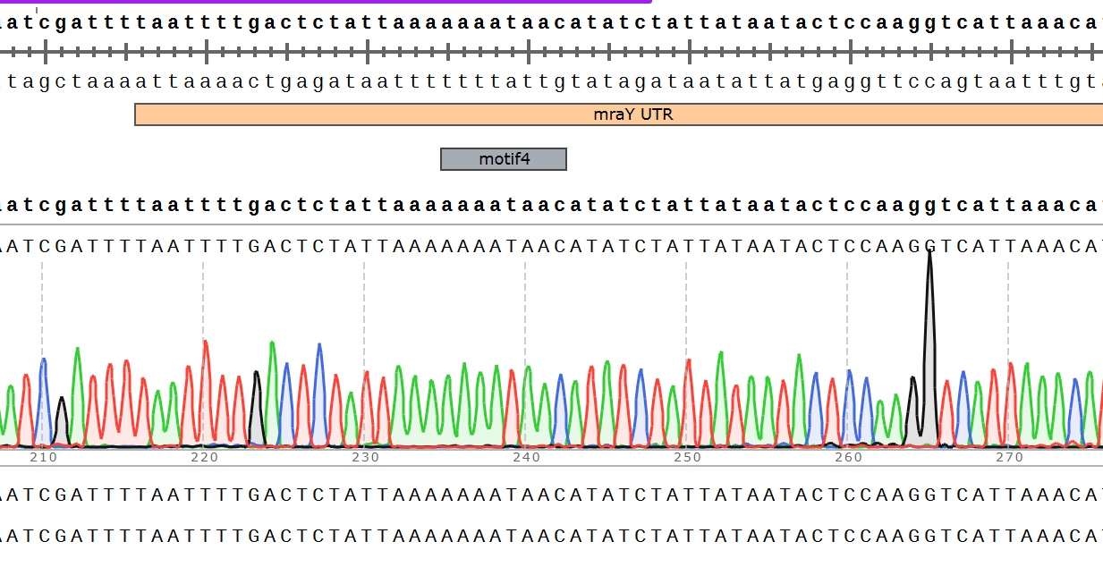
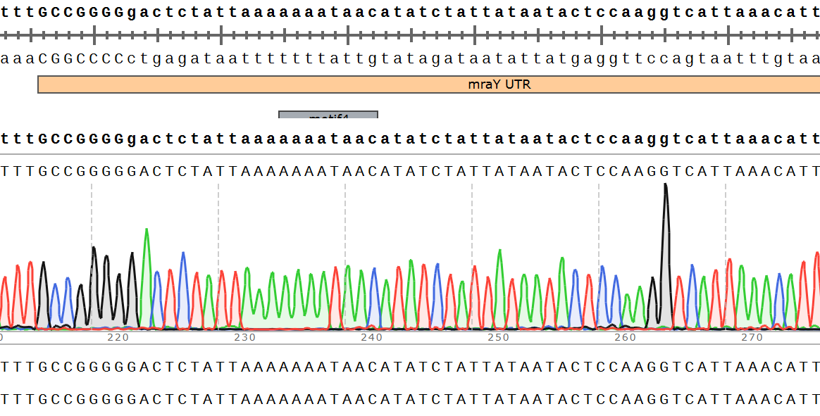
Mutation 13:
Mutation 14:

Slide 4
