Slide 1

Background
RNA
DNA
Multi-copy plasmid
Ptul4
5 ´ UTR+ first 6 codons of gene of interest
gfp
5´UTR+ first 6 codons of gene of interest
gfp
Background Strain
Expected Output
LVS
1
ΔbS21-2
0.5
Notes:
So now that we had picked some genes to look at, we developed reporter strains where we fuse this 5’UTR of this gene, along with the first few codons, to a reporter – either lacZ or GFP. We switched to GFP because it was easier to clone and the assay was more straight forward.
We can put this construct into our wild-type and mutant strains, and if bS21 is regulating the UTR, the ribosomes may translate with different efficiencies and we would see differences in B-galactosidase activity or green fluorescence.
We go in with some expectations based on the proteomics data I showed you on the previous slide, that there might be less of the proteins produced in the mutant strain than in wild-type.

Slide 2
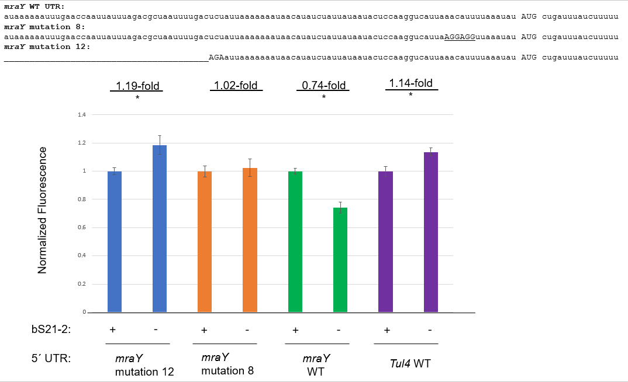
Question: Does an ideal Shine Dalgarno and a mutated 3 nt region remove regulation?
Results: Yes

Slide 3
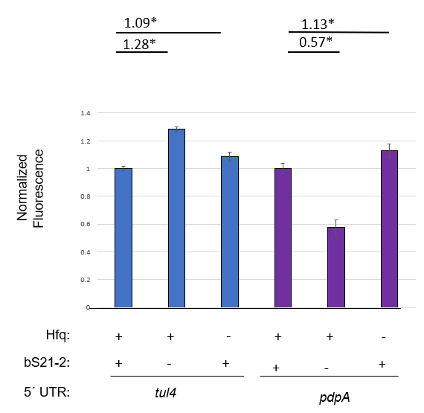
Question: Does loss of the regulator Hfq lead to a similar decrease in translation that we see with loss of bS21-2?
Results: No

