Slide 1
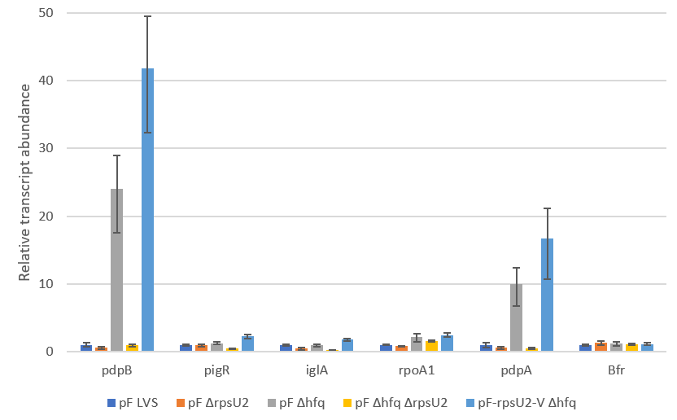
Question: Is pdpB and pdpA transcript abundance impacted by loss of Hfq?
Results: Yes, there is more pdpB and pdpA transcript in the hfq mutant, including with the addition of large amounts of bS21-2. Likely suggests a separate pathway by which bS21-2 and Hfq impact these two genes. Note that iglA is not impacted by Hfq.
Future directions: Repeat

Slide 2
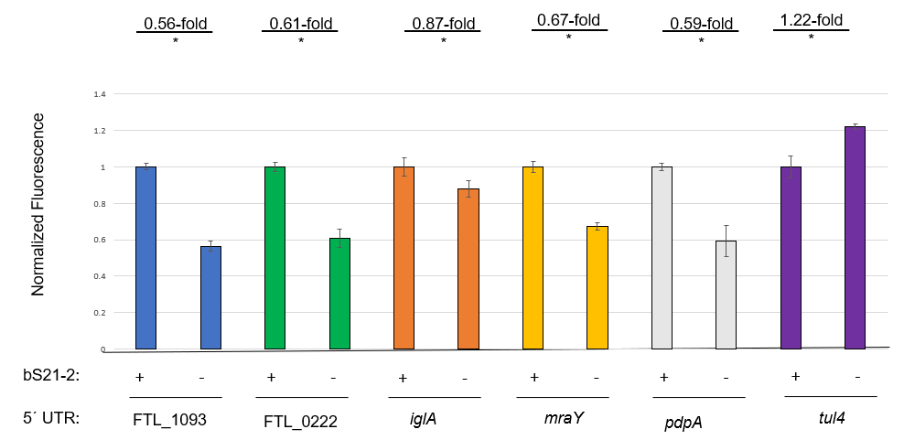
Question: Are all genes down-regulated per the GFP assay repeatable?
Results: Yes, although iglA is less significantly different than previously.
Future directions: Repeat iglA only – maybe combine this data with the new iglA data?

