Slide 1
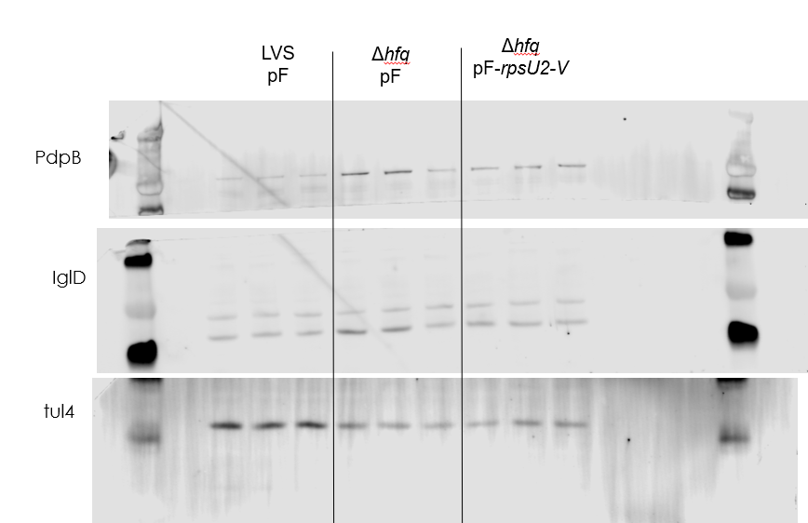
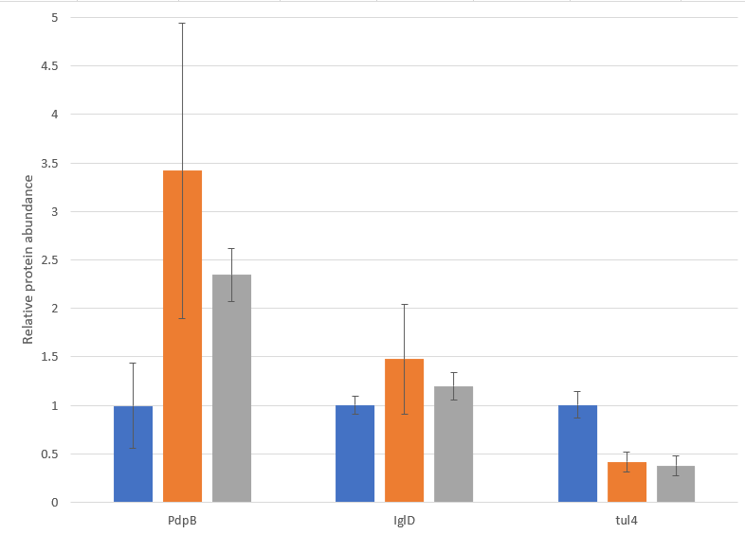
Question: Does more bS21-2 lead to more PdpB in the hfq mutant?
Results: No, there is less PdpB produced in the hfq mutant with the addition of large amounts of bS21-2 (note the variability). Also, there is much less tul4 produced in the hfq mutant, so this might not be a good control going forward.
Future directions: RNA-seq on hfq mutant. Is bS21-2 production impacted?

Slide 2




