Slide 1
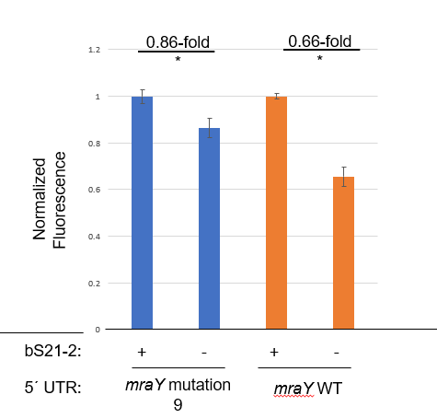
mraY mutation9:
________________________________________ucuauuaaaaaaauaacauaucuauuauaauacuccaaggucauuaaacauuuuaaauau AUG cugauuuaucuuuuu
mraY WT UTR:
auaaaaaauuugaaccaauuauuuagacgcuaauuuugacucuauuaaaaaaauaacauaucuauuauaauacuccaaggucauuaaacauuuuaaauau AUG cugauuuaucuuuuu
Question: Does a 40 nucleotide truncation lead to loss of impacts by bS21-2?
Results: No, but the fold-change is smaller than in wild-type.
Fluorescence from mutation 9 is about half that of WT, whereas fluorescence with a 56 nt-deletion is more than wild-type. Likely due to loss of secondary structure with 40 nt deletion.
Future directions: Make a 43 nucleotide truncation. This will restore secondary structure but lose more of the 5’ end and may answer question of sequence vs. structure.

Slide 2
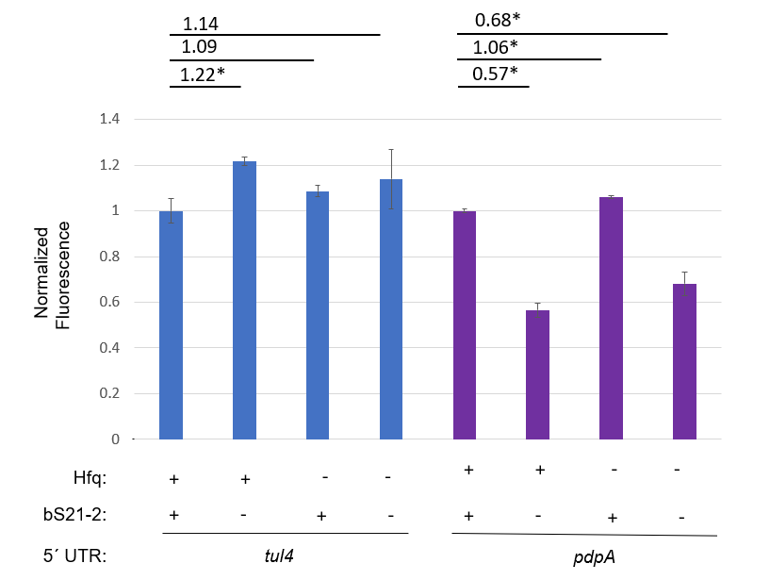
Question: Does Hfq impact production from tul4 or pdpA UTRs?
Results: Not really. This means that the Western findings of PdpB is specific to PdpB, or not related to the UTR.

