Slide 1
mraY mutation9:
________________________________________ucuauuaaaaaaauaacauaucuauuauaauacuccaaggucauuaaacauuuuaaauau AUG cugauuuaucuuuuu
mraY WT UTR:
auaaaaaauuugaaccaauuauuuagacgcuaauuuugacucuauuaaaaaaauaacauaucuauuauaauacuccaaggucauuaaacauuuuaaauau AUG cugauuuaucuuuuu
hfq short UTR:
gaaguuuaauuguuaaacuugauaaaauaauaacuauaacaaaauaauuaaaaggaagugagaua aug ucaagaauaucaucu
1.88-fold
*
0.91-fold
0.90-fold
*
Normalized Fluorescence
bS21-2:
+ -
+ -
+ -
5´ UTR:
hfq short
mraY mutation 9
mraY WT

Slide 2
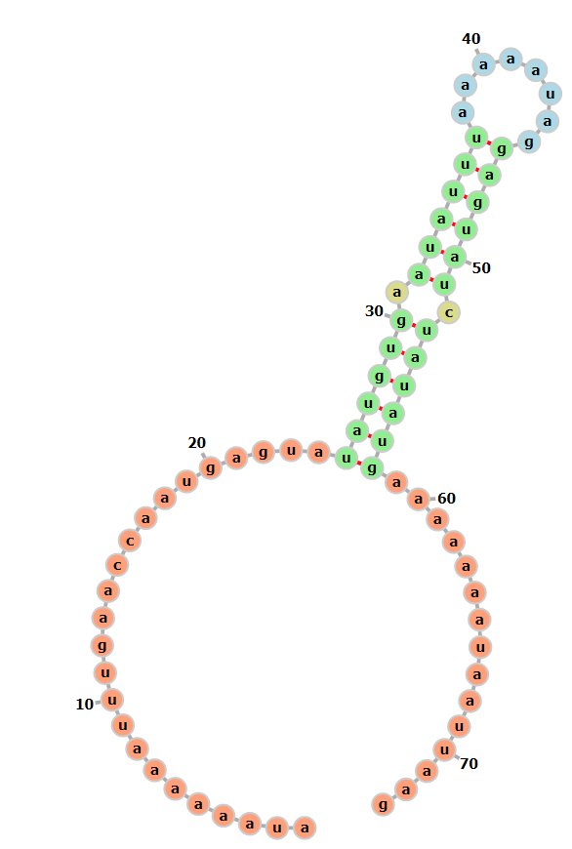
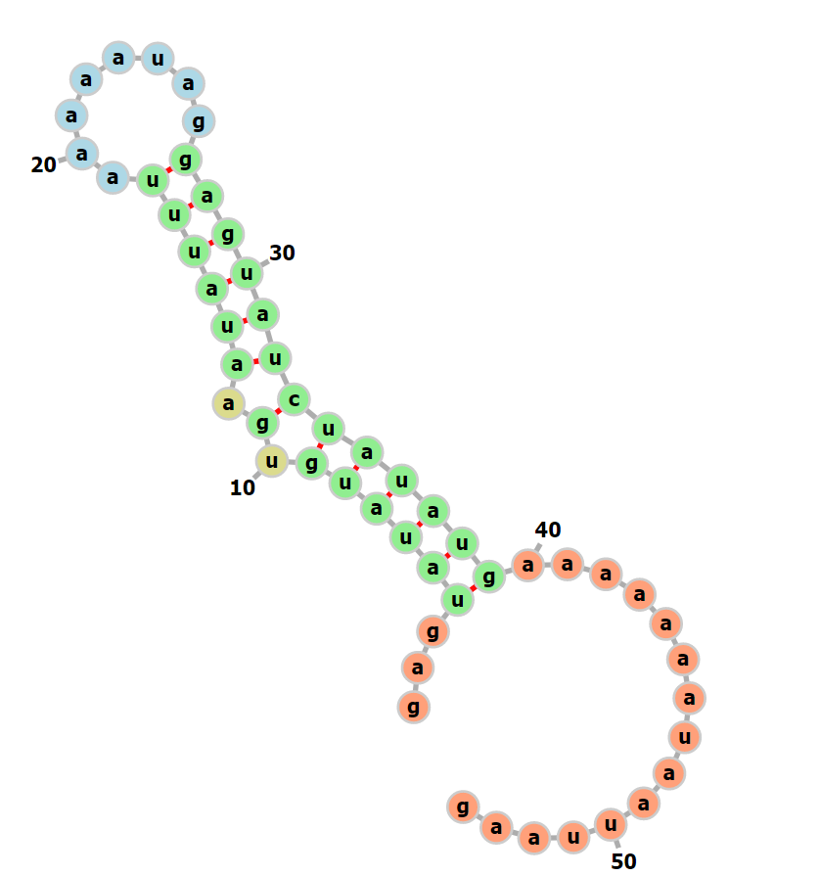
Question: Is the mraY 5’tail sufficient to cause regulation by bS21-2 in an otherwise unaffected UTR?
Sample | 20 ul plate | 100 ul plate | Remaining plate
Ligation for pKR174 | - | 8 | 97
BB ligation | - | 0 | 1
+ control | 55 | ~480 | -
- control | 0 | 0 | -
WT tul4 UTR structure
No decrease in ΔrpsU2
Added 5’tail tul4 UTR structure
5’ AUAAAAAAUUUGAACCAAUgaguauaugugaauauuuaaaaauaggaguaucuauaugaaaaaaauaauuaag - GFP

Slide 3


