Slide 1
Hypothesis 1: Hfq and bS21-2 independently impact T6SS abundance bS21-2 T6SS Hfq | Hypothesis 2: bS21-2 impacts T6SS abundance through impacts on Hfq bS21-2 Hfq T6SS | Expected PdpB abundance
WT
ΔrpsU2
Δhfq
Δhfq ΔrpsU2
bS21-2: efficient translation of T6SS
Hfq: sequesters T6SS
bS21-2: no impact on translation of T6SS
Hfq: sequesters T6SS
1.0
Hfq
Hfq
No bS21-2: less efficient translation of T6SS (-)
More Hfq: sequesters more T6SS (-)
No bS21-2: no impact on translation of T6SS
More Hfq: sequesters more T6SS (-)
0.3
Hfq
Hfq
bS21-2: efficient translation of T6SS
No Hfq: no sequestration (+)
bS21-2: no impact on translation of T6SS
No Hfq: no sequestration (+)
2.0
No bS21-2: less efficient translation of T6SS (-)
No Hfq: no sequestration (+)
No bS21-2: No impact on translation of T6SS
No Hfq: no sequestration (+)
H1: <2
H2: 2.0

Slide 2
Hypothesis 1: Hfq and bS21-2 independently impact T6SS abundance bS21-2 T6SS Hfq | Hypothesis 2: bS21-2 impacts T6SS abundance through impacts on Hfq bS21-2 Hfq T6SS | Expected PdpB abundance
WT
ΔrpsU2
Δhfq
Δhfq ΔrpsU2
bS21-2: efficient translation of T6SS
Hfq: sequesters T6SS
bS21-2: no impact on translation of T6SS
Hfq: sequesters T6SS
1.0
Hfq
Hfq
No bS21-2: less efficient translation of T6SS (-)
More Hfq: sequesters more T6SS (-)
No bS21-2: no impact on translation of T6SS
More Hfq: sequesters more T6SS (-)
0.3
Hfq
Hfq
bS21-2: efficient translation of T6SS
No Hfq: no sequestration (+)
bS21-2: no impact on translation of T6SS
No Hfq: no sequestration (+)
2.0
No bS21-2: less efficient translation of T6SS (-)
No Hfq: no sequestration (+)
No bS21-2: No impact on translation of T6SS
No Hfq: no sequestration (+)
H1: <2
H2: 2.0

Slide 3
Hypothesis 1: Hfq and bS21-2 independently impact T6SS abundance bS21-2 T6SS Hfq | Hypothesis 2: bS21-2 impacts T6SS abundance through impacts on Hfq bS21-2 Hfq T6SS | Expected PdpB abundance
WT
ΔrpsU2
Δhfq
Δhfq ΔrpsU2
bS21-2: efficient translation of T6SS
Hfq: sequesters T6SS
bS21-2: no impact on translation of T6SS
Hfq: sequesters T6SS
1.0
Hfq
Hfq
No bS21-2: less efficient translation of T6SS (-)
More Hfq: sequesters more T6SS (-)
No bS21-2: no impact on translation of T6SS
More Hfq: sequesters more T6SS (-)
0.3
Hfq
Hfq
bS21-2: efficient translation of T6SS
No Hfq: no sequestration (+)
bS21-2: no impact on translation of T6SS
No Hfq: no sequestration (+)
2.0
No bS21-2: less efficient translation of T6SS (-)
No Hfq: no sequestration (+)
No bS21-2: No impact on translation of T6SS
No Hfq: no sequestration (+)
H1: <2
H2: 2.0

Slide 4
Hypothesis 1: Hfq and bS21-2 independently impact T6SS abundance bS21-2 T6SS Hfq | Hypothesis 2: bS21-2 impacts T6SS abundance through impacts on Hfq bS21-2 Hfq T6SS | Expected PdpB abundance
WT
ΔrpsU2
Δhfq
Δhfq ΔrpsU2
bS21-2: efficient translation of T6SS
Hfq: sequesters T6SS
bS21-2: no impact on translation of T6SS
Hfq: sequesters T6SS
1.0
Hfq
Hfq
No bS21-2: less efficient translation of T6SS (-)
More Hfq: sequesters more T6SS (-)
No bS21-2: no impact on translation of T6SS
More Hfq: sequesters more T6SS (-)
0.3
Hfq
Hfq
bS21-2: efficient translation of T6SS
No Hfq: no sequestration (+)
bS21-2: no impact on translation of T6SS
No Hfq: no sequestration (+)
2.0
No bS21-2: less efficient translation of T6SS (-)
No Hfq: no sequestration (+)
No bS21-2: No impact on translation of T6SS
No Hfq: no sequestration (+)
H1: <2
H2: 2.0

Slide 5
Hypothesis 1: Hfq and bS21-2 independently impact T6SS abundance bS21-2 T6SS Hfq | Hypothesis 2: bS21-2 impacts T6SS abundance through impacts on Hfq bS21-2 Hfq T6SS | Expected PdpB abundance
WT
ΔrpsU2
Δhfq
Δhfq ΔrpsU2
bS21-2: efficient translation of T6SS
Hfq: sequesters T6SS
bS21-2: no impact on translation of T6SS
Hfq: sequesters T6SS
1.0
Hfq
Hfq
No bS21-2: less efficient translation of T6SS (-)
More Hfq: sequesters more T6SS (-)
No bS21-2: no impact on translation of T6SS
More Hfq: sequesters more T6SS (-)
0.3
Hfq
Hfq
bS21-2: efficient translation of T6SS
No Hfq: no sequestration (+)
bS21-2: no impact on translation of T6SS
No Hfq: no sequestration (+)
2.0
No bS21-2: less efficient translation of T6SS (-)
No Hfq: no sequestration (+)
No bS21-2: No impact on translation of T6SS
No Hfq: no sequestration (+)
H1: <2
H2: 2.0

Slide 6
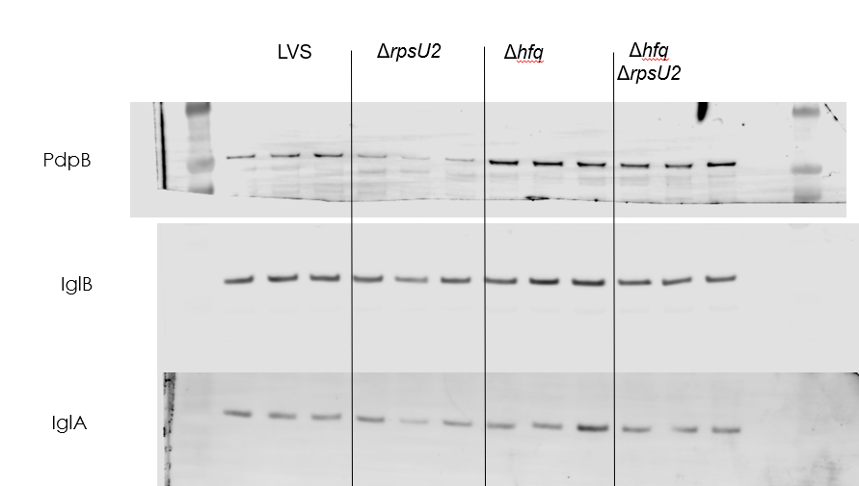
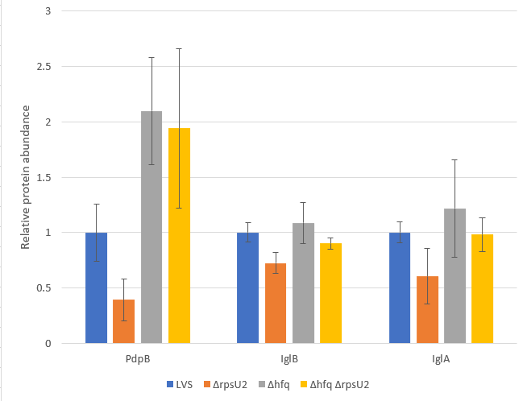
Question: Does Δhfq ΔrpsU2 produce FPI proteins similar to Δhfq?
Conclusions: Hfq does not seem to impact IglB or IglA, which suggests Hypothesis 1 is more likely. There is slightly less PdpB produced in Δhfq compared to ΔrpsU2 but not significant.
Next steps: Try testing these four strains with pdpA UTR – GFP plasmid. Also try putting large amount of bS21-2 in Δhfq mutant to see if PdpB goes up even more.

Slide 7
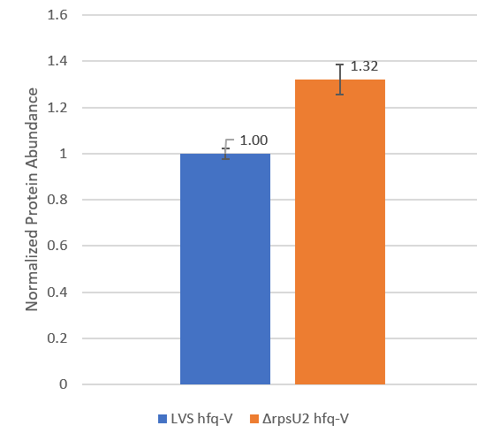
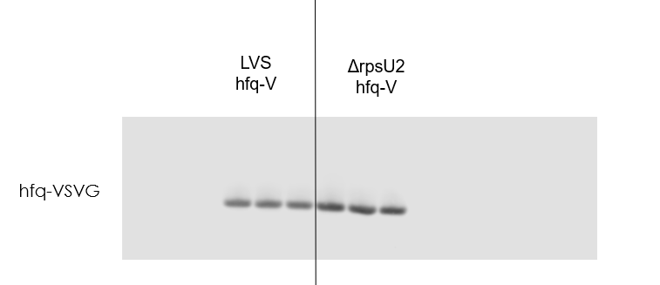
Question: Is there more Hfq in ΔrpsU2 than in wild-type?
Conclusions: Not a huge difference but statistically significant; Repeats last experiment

