Slide 1
Question: Do ideal SDs in other UTRs (besides pdpA) lead to loss of regulation by bS21-2? Does 5’ end of hfq UTR impact regulation?
mraY mutation8: auaaaaaauuugaaccaauuauuuagacgcuaauuuugacucuauuaaaaaaauaacauaucuauuauaauacuccaaggucauuaAGGAGGuuaaauau AUG cugauuuaucuuuuu
mraY WT UTR: auaaaaaauuugaaccaauuauuuagacgcuaauuuugacucuauuaaaaaaauaacauaucuauuauaauacuccaaggucauuaaacauuuuaaauau AUG cugauuuaucuuuuu
pdpC UTR: tgaaatatcaattgaaaataataaaaaaaatcagatatacctaagttattttaatttatgaaaaatccgaatcactatctgataaattaaggaggcacat AUG aacgacaaatatgaa
hfq mutation 1: _______uagauauaaaucuugcuagaauauacgcgaaguuuaauuguuaaacuugauaaaauaauaacuauaacaaaauaauuaaaaggaagugagaua aug ucaagaauaucaucu
hfq WT UTR: uugcugauagauauaaaucuugcuagaauauacgcgaaguuuaauuguuaaacuugauaaaauaauaacuauaacaaaauaauuaaaaggaagugagaua aug ucaagaauaucaucu
1.07-fold
1.47-fold
*
1.75-fold
*
1.49-fold
0.72-fold
Normalized Fluorescence
Conclusions: Ideal SD removes down-regulation; non-ideal SD is necessary, but not sufficient, to cause regulation
bS21-2:
+ -
+ -
+ -
+ -
+ -
5´ UTR:
mraY mutation 8
pdpC WT
hfq mutation 1
hfq WT
mraY WT

Slide 2
Question: When do Δhfq and Δhfq ΔrpsU2 reach mid-log phase?
Conclusions: Around 5 hours, or OD 2.2-2.5
Next steps: Western blot to assess FPI protein abundance

Slide 3
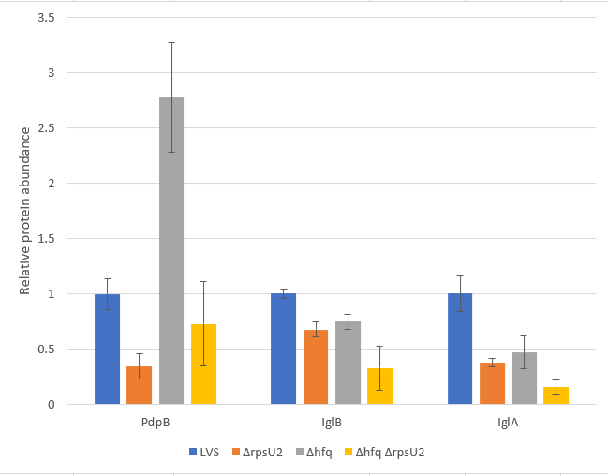
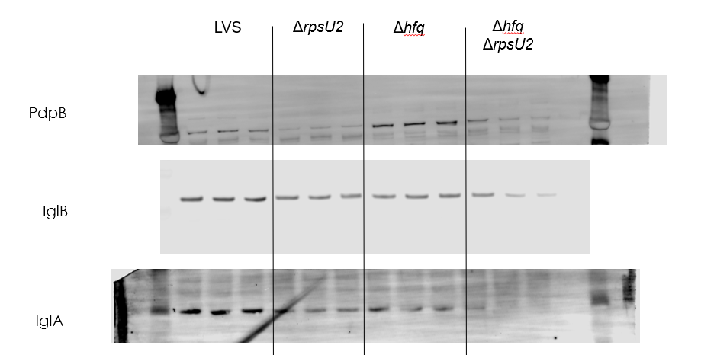
Question: Does Δhfq ΔrpsU2 produce FPI proteins similar to wild-type levels??
Conclusions: Sort of…for PdpB it seems to but for all the others there is less produced. Δhfq results do not replicate what we found last time.
Next steps: Repeat

Slide 4
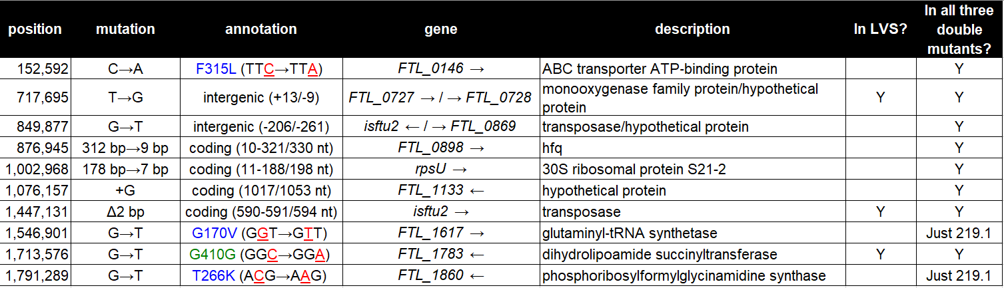
Question: Are there mutations in the Δhfq ΔrpsU2 strains I made?
Conclusions: Yes, but impacts of these mutations are not known
Next steps: Replicate previous experiments with KRLVS219.2 or 219.3

Slide 5
Question: Are there changes in abundance of any RNAses in cells lacking bS21-2?
Locus Number | Gene name | Protein name | Protein function | Log2 fold-change LVS vs. ΔrpsU2 | Adjusted p-value
FTL_1182 | rnhB | ribonuclease HII | Breaks down RNA primers during DNA synthesis | 0.97698709 | 2.40E-05
FTL_0554 | rnc | ribonuclease III | Process 16S rRNA, some mRNA, tRNA; Known function cleaving mRNA-sRNA duplexes | 1.34780364 | 5.26E-05
FTL_0556 | rnr | ribonuclease R | Maturation of tmRNAs + rRNAs; degradation of rRNA | 0.65613578 | 1.33E-05
Conclusions: Increase in abundance of hfq may be associated with increased abundance of RNAses, perhaps suggesting a mechanism for post-transcriptional regulation when bS21-2 is missing.
Next steps: Consider genes with differences in transcript AND protein abundance. Also, if pursuing this Hfq model, perhaps we want to directly look at binding by cross-linking and IP-ing.

