Slide 1
Question: Can we make a double deletion of ΔrpsU2 Δhfq?
Controls: Water, LVS gDNA, pKR11
Expectations: 1277 bps with rpsU2, 1088 bps without rpsU2
-
pKR11
LVS gDNA
9A
10A
10B
12A
12B
9B
1500 bp
Conclusions: Yes!
Next steps: Confirm no suppressor mutations by whole genome sequencing

Slide 2
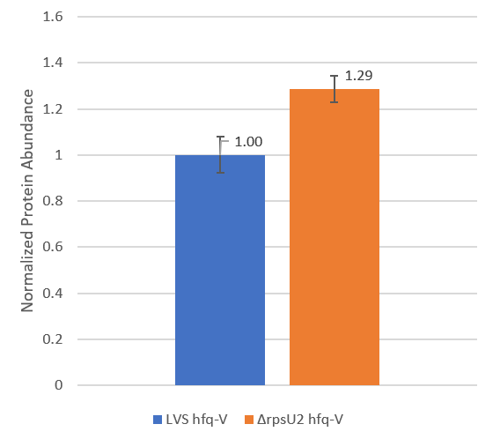
Question: Is there more Hfq in ΔrpsU2 than in wild-type?
LVS
hfq-V
ΔrpsU2
hfq-V
hfq-VSVG
Conclusions: Not a huge difference but statistically significant
Next steps: Check double mutant for changes in FPI protein abundance

Slide 3

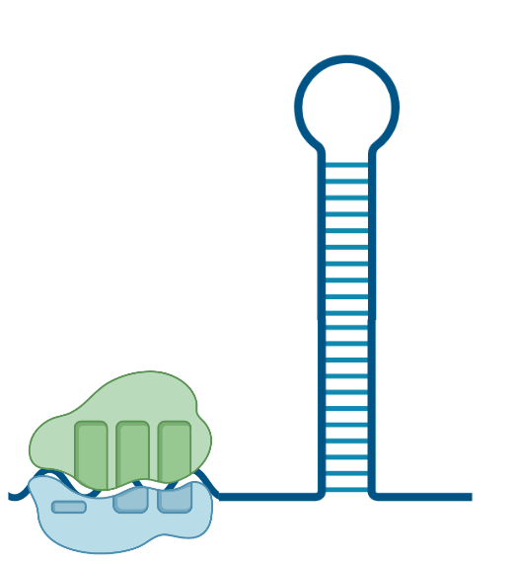

Question: Could the changes we see in translation in ΔrpsU2 be related to standby sites?

Slide 4


Question: Could the changes we see in translation in ΔrpsU2 be related to standby sites?
For this model to work, 5’ UTRs that are impacted by bS21-2 must have:
  A stem-loop structure
  An unstructured 5’ tail
Notes:
This unwinding can be done by RNA-binding proteins, small RNAs,

Slide 5
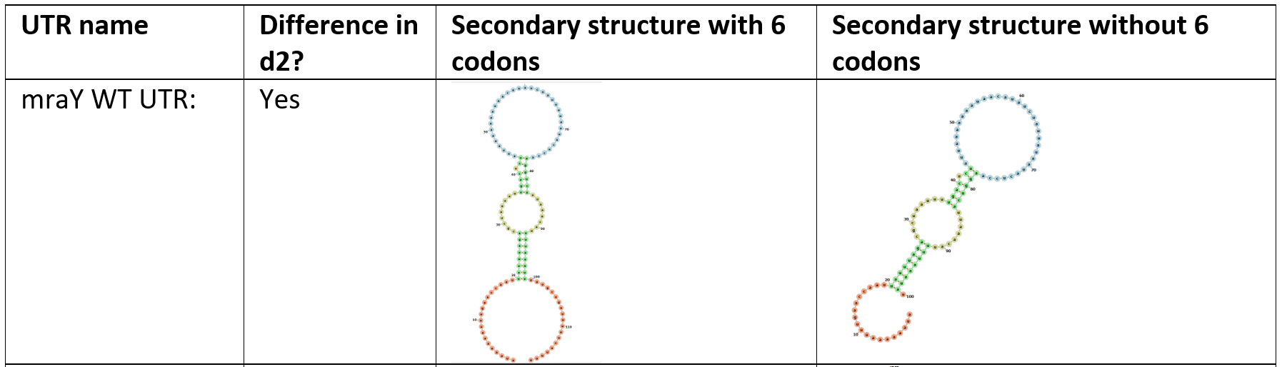
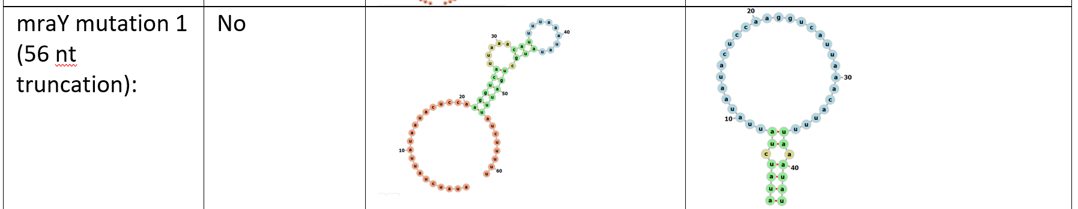
Question: Could the changes we see in translation in ΔrpsU2 be related to standby sites?

Slide 6
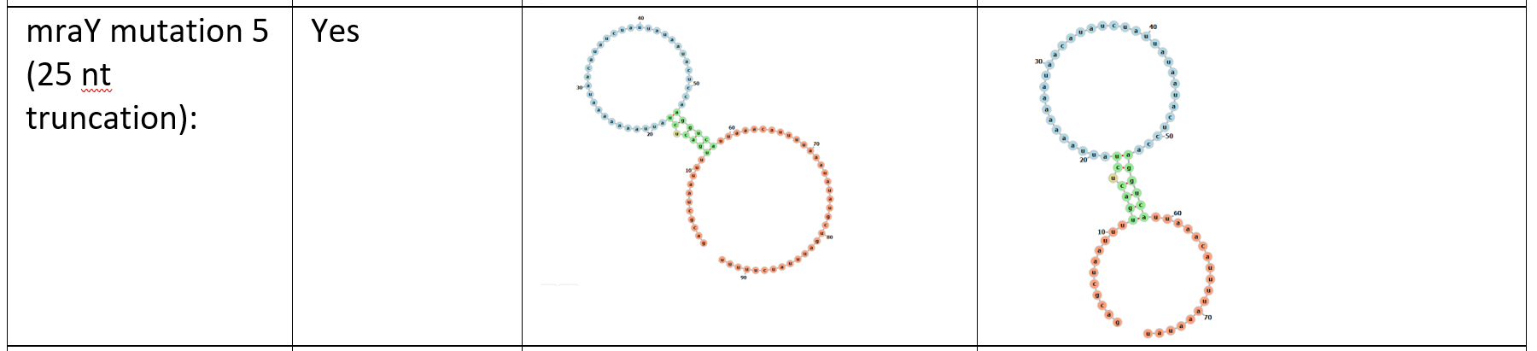
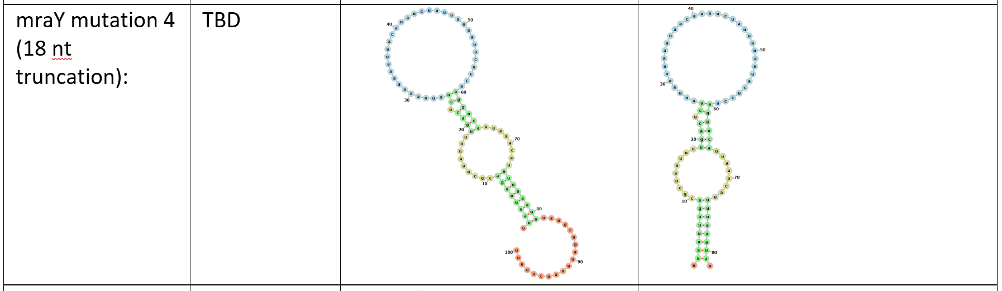
Question: Could the changes we see in translation in ΔrpsU2 be related to standby sites?

Slide 7
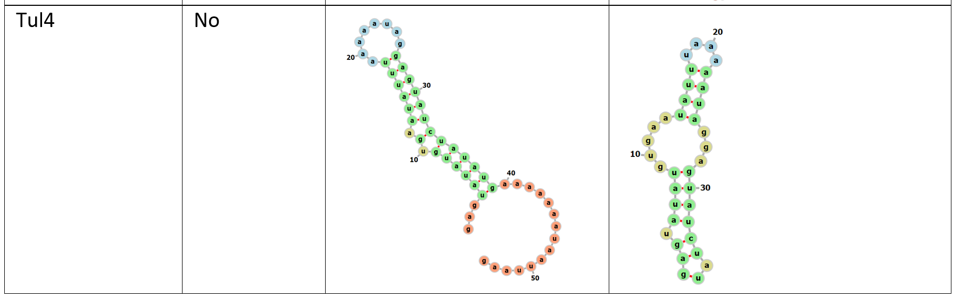
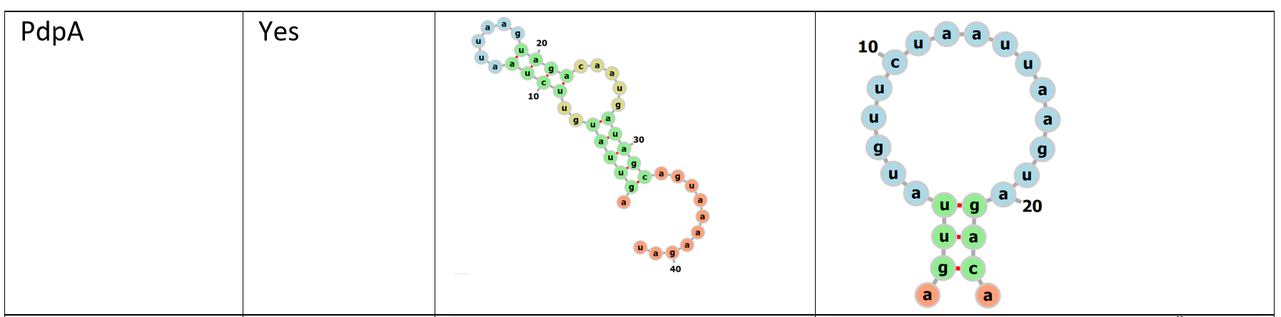
Question: Could the changes we see in translation in ΔrpsU2 be related to standby sites?

