Slide 1
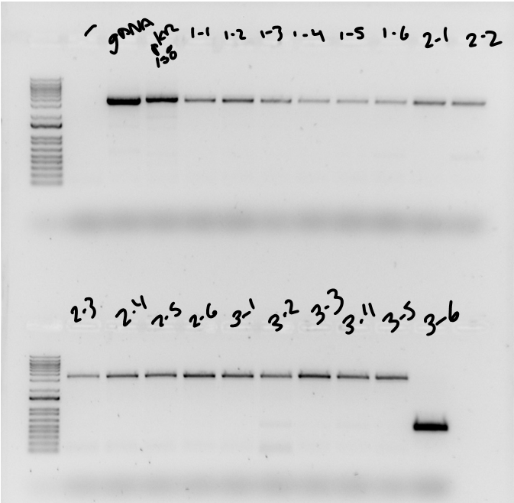
Question: Can I add a VSV-G tag to hfq in ΔrpsU2?
Controls: Water, gDNA, pKR159
Primers: one on the genome, one on the plasmid; expected size for integration ~500 bp
Conclusions: Only EP3-6 looks correct
Next steps:
Isolate gDNA + sequence
Test in a Western blot
500 bp
500 bp

Slide 2
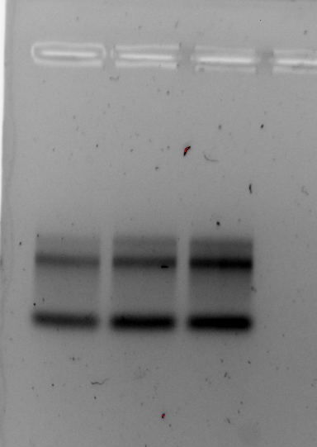
Question: Is RNAsnap an effective protocol for isolating total RNA from F. tularensis?
Sample ID | Nucleic Acid (ng/uL) | 260/280 | 260/230 | Total mass (ug)
lvs1 | 873.7 | 2.06 | 1.65 | 69.896
lvs2 | 645.3 | 2.02 | 1.67 | 51.624
lvs3 | 897 | 2.06 | 1.67 | 71.76
LVS 1
LVS 2
LVS 3
Conclusions: Looks okay, fainter 23S band than expected
Next steps: Repeat with biological replicates

Slide 3
iglA UTR:
aagguguugugaaaaaaaggacaauaag aug gcaaaaaauaaaauc
FTL_0222 UTR:
aaaaaauaaaaauuuguaauuuagucagaccauuuaaguagaauuuugaguaaucauaauguagauuuaaauuacacagaauauuaaauuuuuuaaucca aug ucagcucaagucuca FTL_0881 UTR:
aaaauuuuuacuggauaaaaaaguuucaugcagauguuuuuauuuacuauuuagauuuuaacaaacauaaaacaaauaauaguaaauuaaggagaaaaaa aug aaaaagauaauuaca
tul4 UTR:
gaguauaugugaauauuuaaaaauaggaguaucuau aug aaaaaaauaauuaag
Blue : motif4
Yellow: motif5
0.71-fold
*
0.44-fold
*
0.96-fold
1.01-fold
Conclusions: Differences in translation efficiency are not directly related to presence of motif4 or 5.
The assumed UTR lengths may not be accurate.
Next steps: Truncations of mraY reporter
Normalized Fluorescence
bS21-2:
+ -
+ -
+ -
+ -
5´ UTR:
iglA
FTL_0222
FTL_0881
tul4

