Slide 1
Question: Can we get sufficient ribosomes using TAP purification to send to cryoEM collaborators?
Control: LVS pF (no TAP tagged proteins)
Standard curve:
Calculated concentration (ug/mL)
bS21-2-TAP
256.74359
111.230769
LVS pF
Conclusions: We need at least 500 ug/mL of ribosomes for cryoEM, so we should start with 4x as many cells (i.e. 2 L) OR concentrate this sample using concentrating columns
Next steps: Confirm ribosome composition by mass spec
Notes:
Run 5 ul on a gel without digesting with E. coli miniprepped sample.
Order tet-resistant gene primers to confirm presence of plasmid in RN4220
Grow to 0.8 after back-diluting to 0.5; chill cuvettes; try electroporating same day; don’t change media just yet

Slide 2
Question: Does altering the UTR of mraY or FTL_0144 impact translation? Making new plasmids
Controls: Backbone only ligation, transform with water and pure plasmid
Transformation with XL-1Blue cells:
Transformation with DH5α cells:
Ligation number | 20 ul | 100 ul | Remaining
1 mraY-mut1 | - | 0 | 0
2 mraY- mut2 | - | 0 | 2
3 mraY- mut3 | - | 0 | 0
4 hfq-V | - | 4 | 110
5 FTL_0144-short | - | 0 | 0
6 (BB control) | - | 0 | 0
7 (BB control) | - | 0 | 0
8 (BB control) | - | 0 | 4
+ control transformation (pF) | 420 | - | -
- control transformation | 0 | - | -
Ligation number | 20 ul | 100 ul | Remaining
1 | - | 1 | 4
3 | - | 0 | 12
5 | - | 0 | 127
6 (BB control) | - | 0 | 1
7 (BB control) | - | 0 | 2
+ control transformation (pF) | TMTC | - | -
- control transformation | 0 | - | -
Conclusions: Plasmids 2 and 4 are confirmed; Plasmids 1, 3, and 5 are promising
Next steps: Miniprep plasmids 1, 3, and 5 then sequence

Slide 3
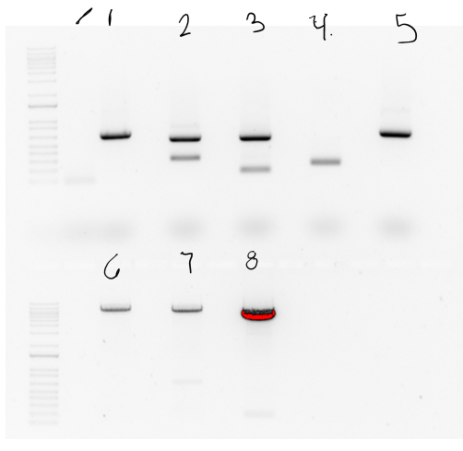
Tube | DNA | Enzyme(s) | DNA Volume (uL) | Water Volume (uL) | Band Size
1 | PCR purf 1 | MfeI/PacI | 15 | 0 | 645
2 | PCR purf 2 | NotI/PacI | 15 | 0 | 140
3 | PCR purf 3 | NotI/PacI | 15 | 0 | 140
4 | PCR purf 4 | KpnI/NotI | 15 | 0 | 205
5 | PCR purf 5 | MfeI/PacI | 15 | 0 | 634
6 | pKR145 | NotI/PacI | 10 | 5 | 7600
7 | pKR145 | MfeI/PacI | 10 | 5 | 7100
8 | pKR124 | KpnI/NotI | 10 | 5 | 5100

