Slide 1
Question: Can we get sufficient DNA for electroporating into S. aureus by miniprepping four clonal replicates?
Miniprepping just 1x5 mL culture:
Miniprepping 4x5 mL culture:
Sample ID | Nucleic Acid | Unit
sa 148-1 | 71.2 | ng/µl
sa 148-2 | 98.8 | ng/µl
Sample ID | Nucleic Acid | Unit
sa 148-3 | 265.8 | ng/µl
sa 148-4 | 367.6 | ng/µl
Conclusions: Yes – can get up to 1.8 ug per electroporation
Next steps: Electroporate into HG003

Slide 2
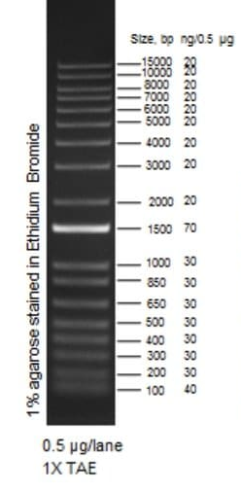
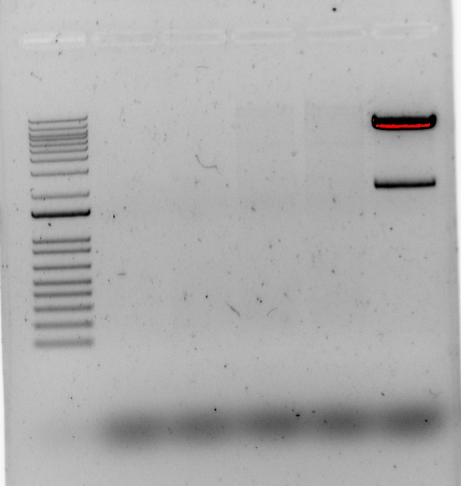
Question: Am I really miniprepping pKR148 from S. aureus RN4220?
Control: pKR148 miniprepped from E. coli
Minprepped from S. aureus
Minprepped from E. coli
1
2
3
4
Enzymes: BamHI, KpnI
Expected sizes: ~2000 and ~7000 bps
Conclusions: No
Next steps: Modify electroporation conditions for S. aureus RN4220
-2 mm cuvettes (contested), chill cuvettes, use B2 media, make EC cells fresh, grow EC cells longer
Notes:
Run 5 ul on a gel without digesting with E. coli miniprepped sample.
Order tet-resistant gene primers to confirm presence of plasmid in RN4220
Grow to 0.8 after back-diluting to 0.5; chill cuvettes; try electroporating same day; don’t change media just yet

Slide 3
tul4

Slide 4
1.16-fold
*
1.72-fold
*
0.58-fold
*
0.63-fold
*
0.96-fold
Normalized Fluorescence
Wild-type
ΔbS21-2
Wild-type
ΔbS21-2
Wild-type
ΔbS21-2
Wild-type
ΔbS21-2
Wild-type
ΔbS21-2
tul4 UTR
hfq UTR
FTL_0144 UTR
mraY UTR
FTL_0215 UTR
Notes:
To assess this, we tried taking the tul4SD and mutating incremental pieces to become more like the idealSD, to see if this impacted regulation. We started with just the last nucleotide in the SD, from a U to a G, and then with the 3 nucleotides after it.
We found that there was no significant difference between our wild-type and mutant if we changed that last nt in the SD to make it perfect, but there was still regulation when we mutated the following three nucleotides.
So we found out that if there are perfect SD sequences, we don’t see control of translation by bS21-2. We still don’t know what part of the UTRs are regulated by bS21-2 because not all unregulated genes have perfect SDs so it’s not just the SD.
Ex. Tul4 doesn’t have a perfect SD and it’s not regulated.

