Slide 1
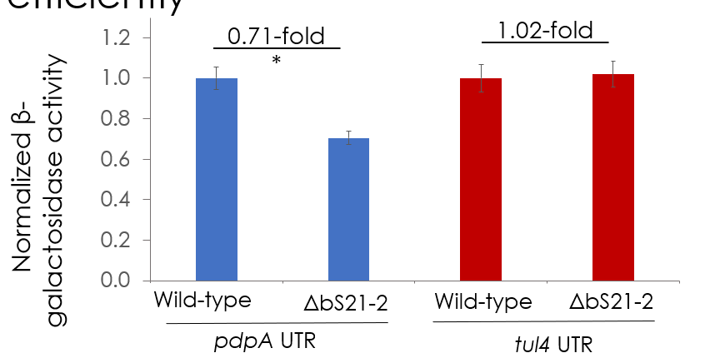
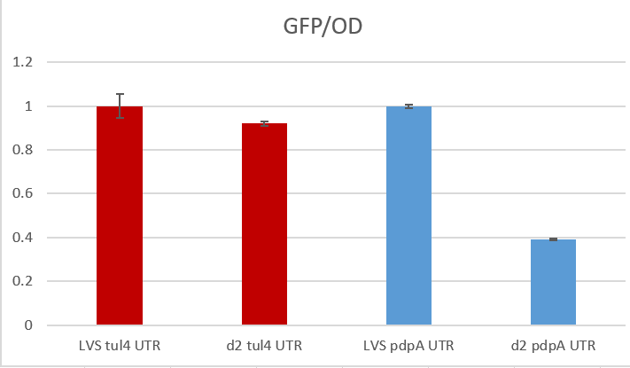
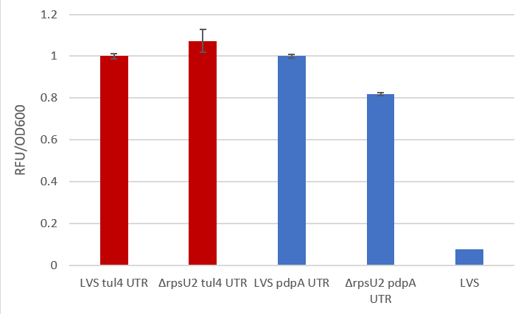
Question: Do we see similar results using the GFP UTR reporter as we do with the lacZ UTR reporter?
Controls: tul4 UTR; media/buffer only; LVS only
B-gal assay
GFP from plates
GFP from cultures
0.82
0.39
Conclusions: Doesn’t seem to be more sensitive than the B-gal assay assay on a consistent basis
Next steps: Test other UTRs of differentially expressed genes

Slide 2
Question: Do other UTRs lead to differences in GFP expression in cells lacking bS21-2?
Controls: Negative control (water); positive control (pKFT)
Reaction | 20 ul | 100 ul | Remaining
Ligation 1 (pKR149) | - | 7 | 48
Ligation 2 (pKR150) | - | 4 | 28
Ligation 3 (pKR151) | - | 2 | 27
Ligation 4 (pKR152) | - | 0 | 24
Ligation 5 (BB) | - | 0 | 1
+ control | 0 | - | -
- control | 0 | - | -
Conclusions: Looks promising!
Next steps: Confirm by sequencing; electroporate into LVS and ΔrpsU2

