Slide 1
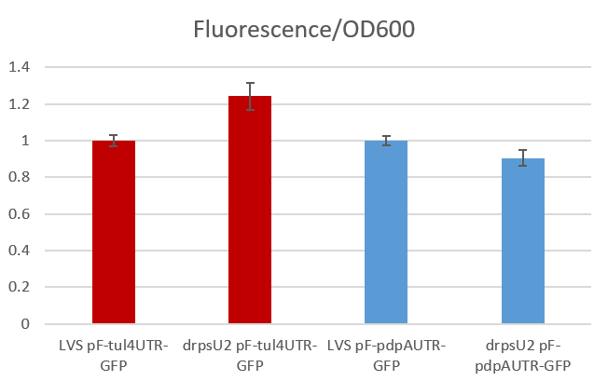
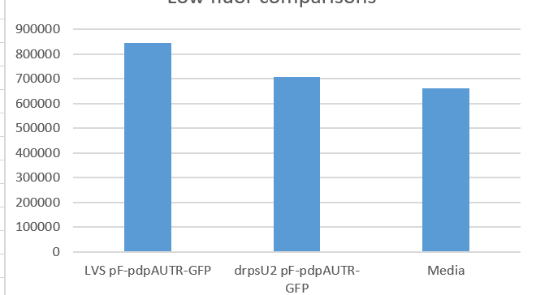
Question: Do we see similar results using the GFP UTR reporter as we do with the lacZ UTR reporter?
Controls: tul4 UTR; media/buffer only
Attempt 1: in MHB
Conclusions: Small dynamic range between pdpA reporters; may be because of MHB absorbance
Next steps: Try resuspending in PBS instead of MHB

Slide 2
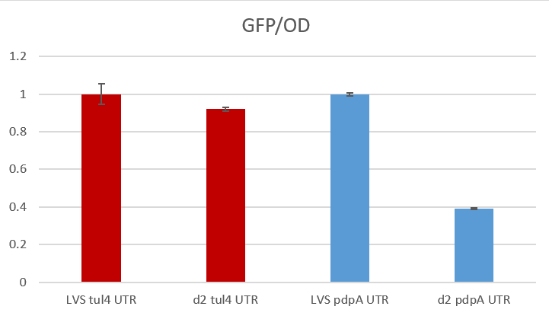
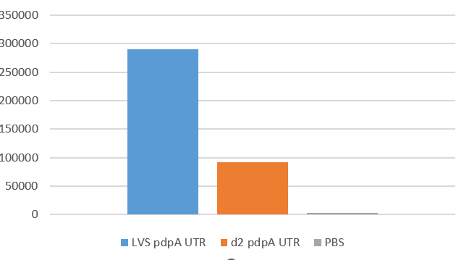
Question: Do we see similar results using the GFP UTR reporter as we do with the lacZ UTR reporter?
Controls: tul4 UTR; media/buffer only
Attempt 2: in PBS
Conclusions: Better! We see little absorbance of PBS and significant differences between pdpA reporters
Next steps: Repeat in triplicate; include LVS as control

Slide 3
Question: Can we delete rpsU in S. aureus using new plasmid? Build new plasmid using different temperature-sensitive backbone
Controls: Negative control (water); positive control (pKFT)
Reaction | 20 ul plate | 100 ul plate | Remaining plate
Ligation 1 (pKR148) | - | Too many to count | Too many to count
Ligation 2 (BB only) | - | 89 | ~750
pKFT (+ con) | Too many to count | - | -
- control | 0 | - | -
Conclusions: Looks promising!
Next steps: Propagate in restriction-deficient S. aureus
Sequence only after propogation?

