Slide 1
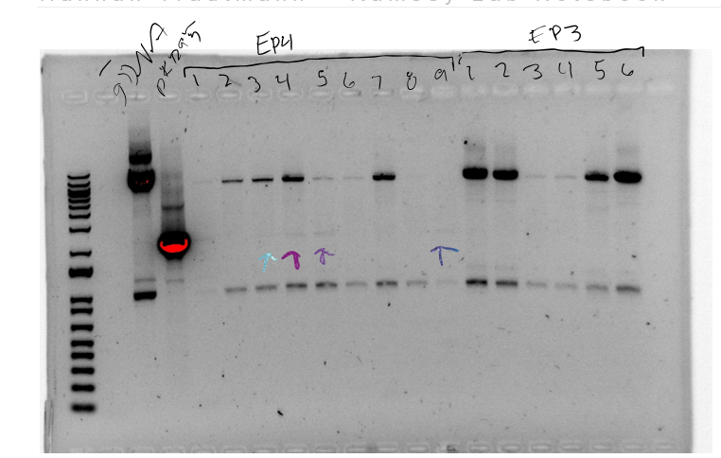
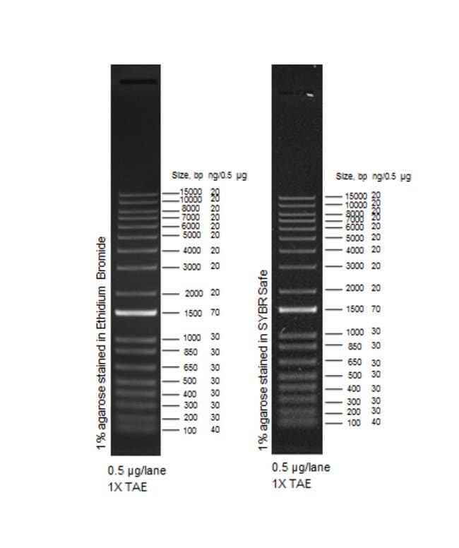
Question: Is pKR95 in the electroporated S. aureus cells?
Controls: Water, S. aureus gDNA, pKR95
Conclusions: Yes, in some
Lane | Sample | Expected size (bps)
1 | - | 0
2 | S. aureus gDNA | 0
3 | pKR95 1:10 | 2200
4-16 | Electroporation colonies | 0 if plasmid is not in the cells, 2200 if plasmid is

Slide 2
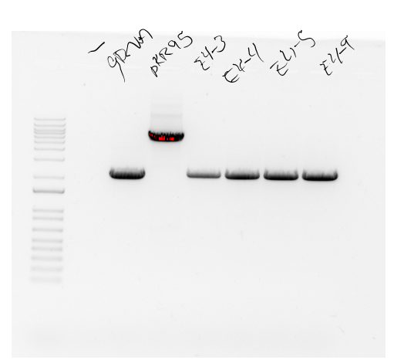
Question: Is pKR95 integrated into the genome of the electroporated S. aureus cells?
Controls: Water, S. aureus gDNA, pKR95
Conclusions: No. Need to streak to single colony at 37C and re-test, looking at the side of integration
Reaction numbers | Sample | Expected size (bps)
1 | - | 0
2 | S aureus gDNA | 2159
3 | pKR95 1:10 | Plasmid backbone
4-7 | EPs | 2159 if wild-type rpsU is present; >10 kb if whole plasmid integrated (no band)

Slide 3
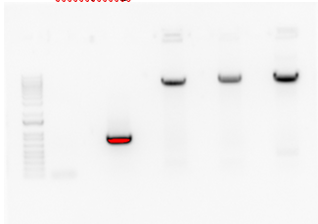
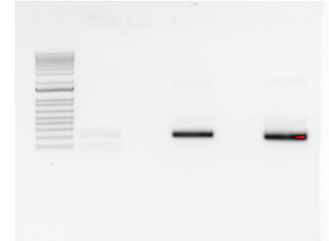
Question: Can we make a multi-copy plasmid (pF backbone) that expresses GFP with different UTRs?
Controls: No DNA (- control), pF (+ control)
Conclusions: Not promising but will confirm with diagnostic digest
- GFP tul4 UTR pdpA UTR pF
Tube | Sample | Enzyme(s) | Size Band to keep (bps)
1 | GFP (from PCR of gBlock) | NotI/BamHI | 730
2 | tul4 UTR (PCR of pKR89) | NotI/KpnI | 207
3 | pdpA UTR (PCR of pKR74) | NotI/KpnI | 195
4 | pF (backbone) | KpnI/BamHI | 6900
- tul4 UTR pdpA UTR
Reaction | 20 ul plate | 100 ul plate | Remaining plate
Ligation 1 (pKR145 tul4 UTR) | - | 0 | 1
Ligation 2 (pKR146 pdpA UTR) | - | 0 | 2
Ligation 3 (backbone only) | - | 1 | 0
+ control | 34 | - | -
- control | 0 | - | -

Slide 4
