Slide 1
Question: Does the pF2 promoter in front of rpsU3 lead to complementation of T6SS proteins with normal growth?
Controls: LVS with empty vector, ΔrpsU2 pF-rpsU2-V
Conclusions: Growth is like wild-type

Slide 2
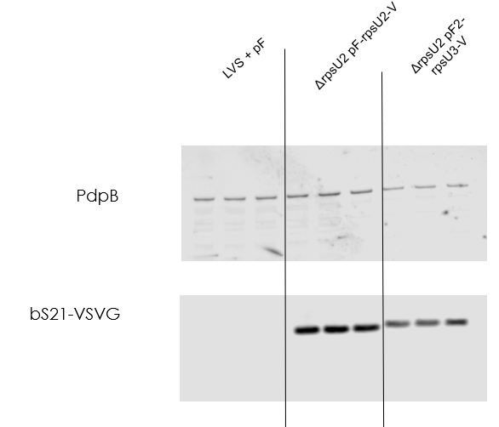
Question: Does the pF2 promoter in front of rpsU3 lead to complementation of T6SS proteins with normal growth?
Controls: LVS with empty vector, ΔrpsU2 pF-rpsU2-V
Conclusions: T6SS protein abundance is not completely restored
Possible post-translational modification of bS21-3?

Slide 3
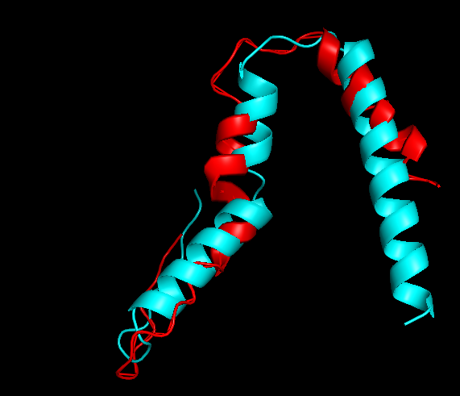
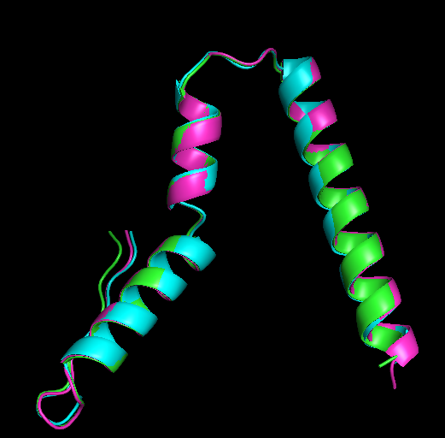
Question: Does known structure of bS21 from E. coli align with predicted structures of bS21-1, 2, and 3 from F. tularensis?
Conclusions: All bS21s from F. tularensis seem to be identical
Similar to E. coli with differences in C terminal helix and indicated region, around amino acid 28
bS21 from E. coli red
bS21-1 blue
bS21-2 purple
bS21-3 green
N-terminal
C-terminal
N-terminal
C-terminal
Notes:
E coli is 5-6 amino acids longer, with extra in C terminus based on multiple sequence alignment
Around amino acid 28 in e coli it is VLA, in F tul it is IKQ or IVS
-make an image with whole E coli ribosome with francisella to look for clashes/neighboring interactions that might impact structure

