Slide 1
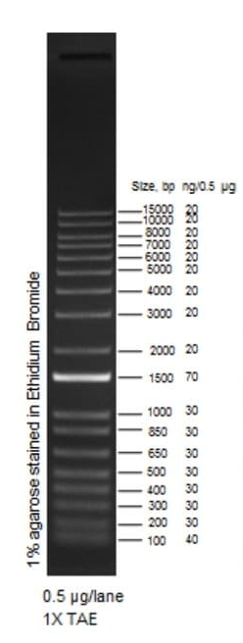
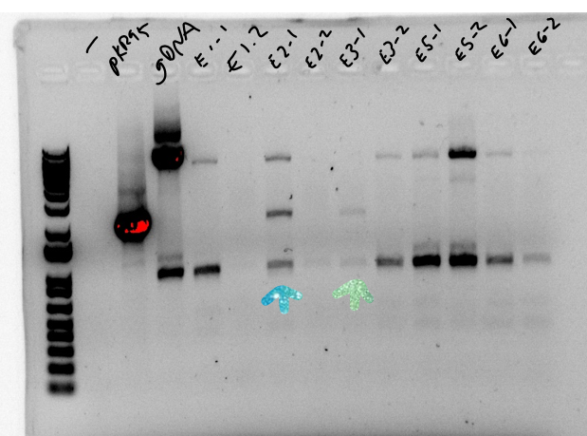
Question: Can we get pKR95 into S. aureus SA113?
Controls: Water, SA gDNA, pure plasmid
Conclusions: Yes, pKR95 is getting into cells under certain electroporation conditions
Reaction numbers | Sample | Expected size (bps)
1 | - | 0
2 | pKR95 1:10 | 2200
3 | S aureus gDNA | 0
4 | E1-1 | 0 if plasmid is not in the cells, 2200 if plasmid is
5 | E1-2
6 | E2-1
7 | E2-2
8 | E3-1
9 | E3-2
10 | E5-1
11 | E5-2
12 | E6-1
13 | E6-2

Slide 2
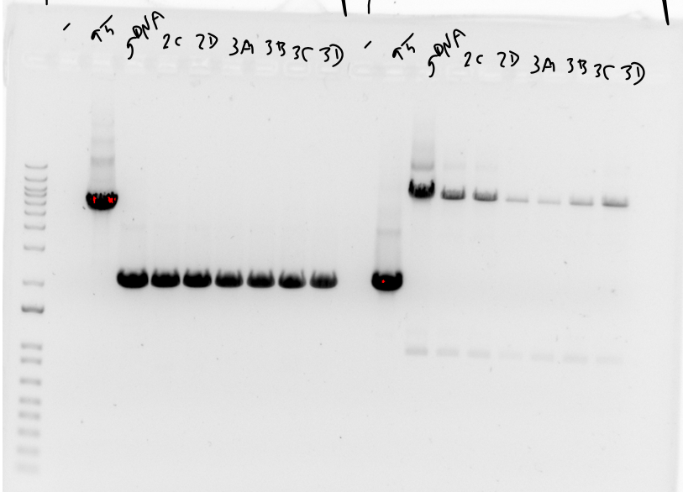
Primer set 1: Is plasmid integrating?
Question: Is pKR95 integrating into the genome of S. aureus?
Controls: Water, SA gDNA, pure plasmid
Conclusions: None of the tested samples had pKR95 integrated nor replicating
Reaction numbers | Sample | Expected size (bps)
1 | - | 0
2 | pKR95 1:10 | Plasmid backbone
3 | S aureus gDNA | 2159
4-9 | EPs | 2159 if rpsU is present; 1982 if rpsU is deleted; >10 kb if whole plasmid integrated (no band)
Primer set 1:
Primer set 2:
Primer set 2: Is plasmid present?
Reaction numbers | Sample | Expected size (bps)
1 | - | 0
2 | pKR95 1:10 | 2200
3 | S aureus gDNA | 0
4-9 | EPs | 0 if plasmid is not in the cells, 2200 if plasmid is
Next steps: Repeat electroporations for two conditions with plasmid detected; eliminate X-gal from plates and screen only with colony PCR

Slide 3
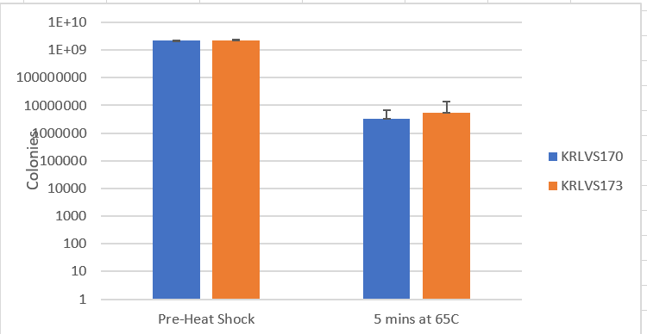
Question: Does overexpression of rpsU3 lead to defective sigma32 activity?
Controls: 0 minutes (pre-heat shock)
Individual counts after heat shock
Sample | CFU/mL
170-1 | 230000
170-2 | 2500000
170-3 | 5000000
173-1 | 14000000
173-2 | 150000
173-3 | 1100000
Conclusions: No significant difference in sigma-32 activity between wild-type (KRLVS170) and overexpression of rpsU3 (KRLVS173). Still variability among samples after heat shock.

