Slide 1
Investigation into gene regulation by bS21-2 in F. tularensis
Hannah Trautmann
CMB Seminar
April 1, 2022
Notes:
Hi everyone. I’m Hannah, and I will be presenting on my research into a small ribosomal protein, bs21 and its role regulating genes

Slide 2
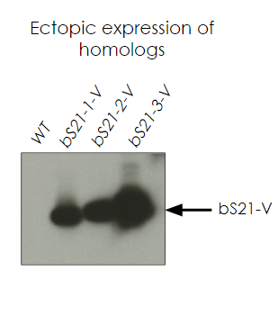
F. tularensis has heterogeneous populations of ribosomes
bS21-1
cspC
bS21-2
yqeY
dnaG
rpoD
bS21-3
Notes:
Even though francisella has a very small genome, it encodes three copies of the rpsU genes, which encode bS21. This is especially noteworthy because most bacteria have 0 or 1 of this gene.
We originally hypothesized, and have since shown, that these three proteins are produced and incorporated into ribosomes. I purified ribosomes from wild-type cells as well as cells ectopically expressing each of the bS21 proteins with a VSVG tag. We then ran these on a gel and immunoblotted. This, along with some mass spec data we have of purified ribosomes, indicates that F. tularensis can incorporate each paralog into ribosomes, so Francisella is producing heterogeneous ribosomes.
Now that we have seen that structurally heterogeneous ribosomes exist, the question is why Francisella may have these and if they affect translation? We have developed a model for our hypothesis about this, which I will show you now.

Slide 3
Cells lacking bS21-2 have changes in protein, not transcript, abundance
∆bS21-2 vs WT
Significant abundance change:
Protein (161)
Transcript (60)
Transcript and protein (concordant; 23)
Transcript and protein (discordant; 1)
Consistent with bS21 regulating gene expression at level of translation
Notes:
When we delete one of the bS21 genes, we see genome-wide changes in protein abundance. On the y-axis here is log2-fold-change differences in protein abundance from mass spec on whole cell lysates, comparing the bS21-2 mutant to wild-type. Now an obvious explanation for this would be changes in transcript abundance, but when we did RNA-seq on the mutant vs. wild-type strain, we see some changes in transcript abundance but they do not directly correlate with those in protein abundance. In fact there are 161 proteins that are different at the protein level but NOT at the transcript level.
Of particular note in this set, are a number of Francisella pathogenicity island genes that are primarily down-regulated in the mutant line at the protein level but not at the transcript level.

Slide 4
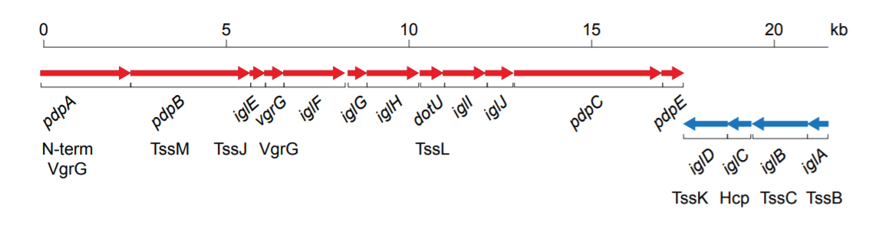
Francisella Pathogenicity Island (FPI)
12/16 different at protein level (11 down, 1 up)
Notes:
The FPI is a set of 16 genes that encodes the Type VI secretion system in Francisella. Now a lot of research has shown that these genes are regulated at the level of transcription, but we don’t know of any published research that investigates regulation post-transcriptionally.
Of these 16 genes, 11 are down-regulated in delta bS21-2 at the protein level based on the mass spec data, and 1 is up-regulated.
WE don’t see coordinated Fpi transcript changes across the island.
Now this genome-wide proteomics stuff is kind of new to us, so we wanted to verify these findings using immunoblotting, and luckily there are antibodies for a number of these FPI genes….

Slide 5
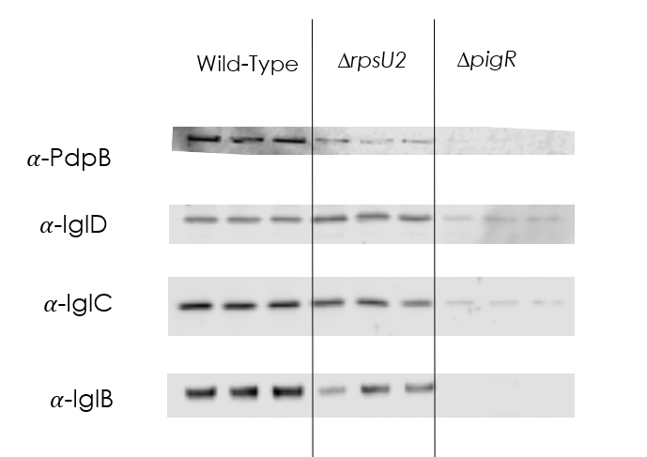
Lack of bS21-2 changes FPI protein abundance
ΔbS21-2
*
*
*
*
ΔbS21-2
ΔrpsU2
* : p< 0.01
Notes:
Here we have antibodies for four of the FPI proteins and we have our wild-type francisella in triplicate.
We were able to quantify these Westerns, normalizing to total protein, as you can see on this graph.
When we look at drpsU2, we see a significant decrease in abundance of some, most notably PdpB, which we have seen consistently to be about 3- to 5-fold less than in wild-type cells. Interestingly we do see that some proteins are unaffected by loss of rpsU2 and one protein, iglD, is actually MORE expressed.
Okay so we have confirmed that we see differences in the protein level, but if you think back to that first central dogma slide I showed you, this could be because of transcription or translation. So we next looked at whether these genes were different at the transcript level.

Slide 6
The role of bS21 in translation
16S rRNA
PDB entry: 4V50
Notes:
Here we have images of the 30S subunit of the E. coli ribosome. On the right we have a view of only the 16s rRNA with bS21 which is colored in red. On the left is a closer view, and to orient yourself in yellow is the p-site tRNA and an mRNA in blue, so you can imagine a longer mRNA would be exiting here, very close to the position of bS21. Early research into the functions of ribosomal proteins identified that bS21 is involved in translation initiation, perhaps moderating the interaction between the ribosome and the mRNA molecule.
**remind them that this is where the 5’UTR interacts during initiation
Now this positioning led us to hypothesize that bS21 is interacting, directly or indirectly, with the 5’ UTR of mRNA molecules. In order to assess this, we’ve come up with reporter strains where we fuse a 5’UTR that we believe is differentially regulated in our wild-type vs. mutant cells, to a reporter – lacZ. For this

Slide 7

Reporter strains
aguuauguucuaauuaaguagaca AUG auagcaguaaaagau
Untranslated Region
Untranslated Region
LacZ
Notes:
In order to assess this, we’ve come up with reporter strains where we fuse a 5’UTR that we believe is differentially regulated in our to a reporter – lacZ. Our hypothesis is that if we put this construct in wild-type cells and our delta bS21-2 cells, we will see differences in B galactosidase production.
For this experiment, we decided to use the 5’UTR from PdpA, because we know the transcription start site and we see differential regulation in the mass-spec data.

Slide 8
Cells without bS21-2 translate from the pdpA 5´UTR less efficiently
1.42-fold
*
0.97-fold
Normalized β-galactosidase activity
Wild-type
ΔbS21-2
Wild-type
ΔbS21-2
pdpA UTR
tul4 UTR
pdpA: aguuauguucuaauuaaguagaca AUG auagcaguaaaagau
tul4: gaguauaugugaauauuuaaaaauaggaguaucuau AUG augaaaaaaauaauuaag
Notes:
What we see here is a normalized activity of B-galactosidase in our pdpA UTR in both strains, and we see a significant difference that’s about 1.42-fold in this experiment. We wanted to confirm that this wasn’t a generalized effect on translation of every protein, so we have a control. We did the same thing with the UTR of another gene, tul4. We know that the protein encoded by tul4 is not different in the bS21-2 mutant cells, and we don’t see a significant change in the B-gal activity.
I do want to point out that these are all normalized values so there are significant differences in the amount of B-gal produced between different UTR constructs, but our question is whether there is a difference in the delta strain relative to wild-type.
What’s cool about this data, it shows that this 5’UTR is sufficient to cause changes in protein abundance in cells lacking bS21-2. Alright so we see a difference attributable to the pdpA UTR, but we are still wondering what PART of the UTR makes the difference. To assess this, we tried making a bunch of mutations in the pdpA UTR that would break this regulation and lead to a graph more similar to what we see on the right.

Slide 9
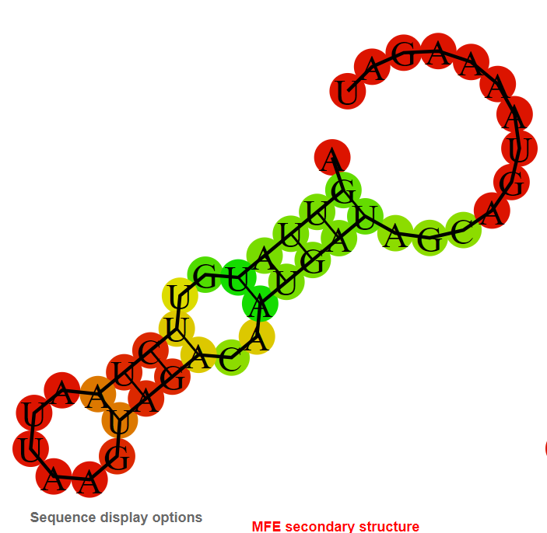
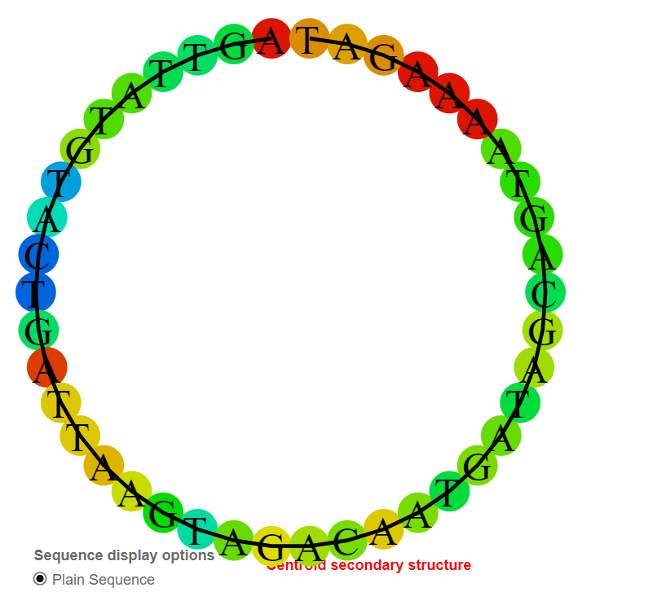
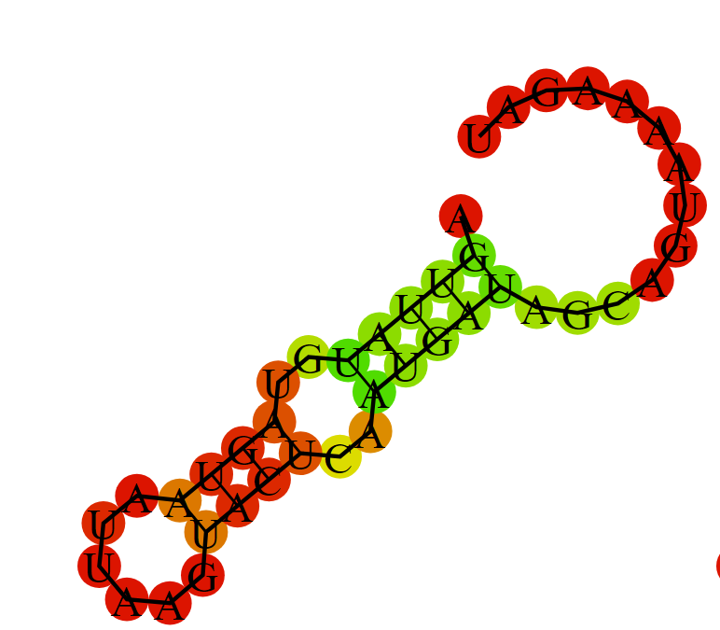
Will disrupting the secondary structure impact the regulation of the pdpA UTR?
WT pdpA UTR
Mutation 1
Mutation 1 restored
1.41-fold
*
1.59-fold
*
1.49-fold
*
Normalized β-galactosidase activity
Wild-type
ΔbS21-2
Wild-type
ΔbS21-2
Wild-type
ΔbS21-2
Notes:
Once possibility that could be causing this regulation that we see in the pdpA UTR but not in other UTRs is the secondary structure of the mRNA. The PdpA 5’UTR and first few codons are predicted to form a really pretty stem-loop like you can see here, so we tried disrupting this stem loop with different mutations which RNAfold predicted would lead to this structure instead, and then we tried making complementary mutations to restore the stem-loop. What I found when I did the b-gal assay is actually we still see 1.5 to 2-fold more protein expression in wild-type compared to our mutant, and we tried a different set of mutations that I’m not showing here with the same results, so we don’t think the secondary structure plays a significant role in this regulation we see here.
Another important aspect of control of translation is the physical interaction between the UTR and the ribosome, and the most well-characterized is between the shine Dalgarno and anti-shine Dalgarno.

Slide 10
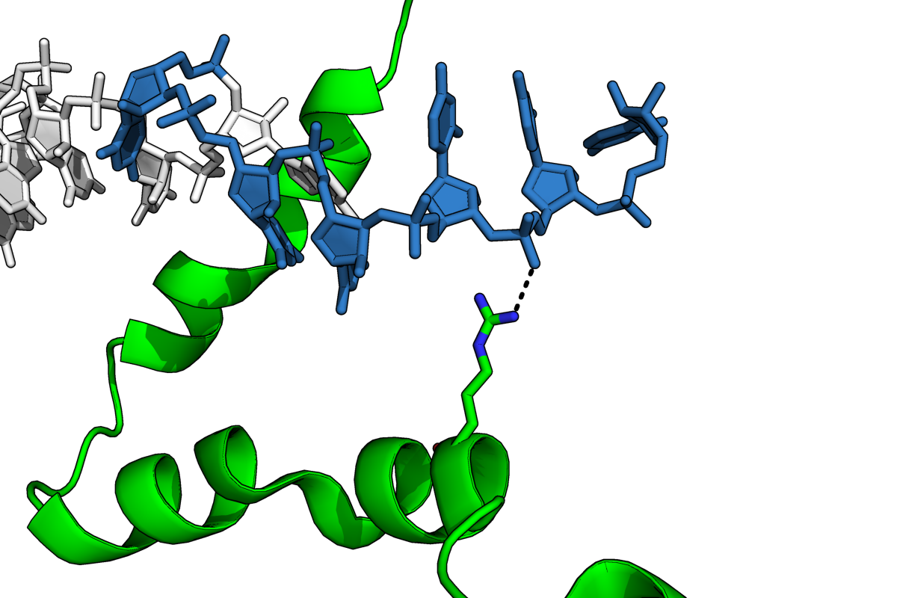
Possible interaction between bS21 and Anti-Shine-Dalgarno (ASD)
C1535
C1538
16S rRNA
C1539
3’
U1540
ASD sequence (1535-1540)
5’-CCUCCU-3’
Ideal Shine-Dalgarno(SD) sequence
5’-AGGAGG-3’
U1536
U1537
R17
bS21
pdb entry 6o7k.cif
Kaledhonkar et al. (2019) Nature 570:400
Image courtesy of Dr. Gregory
Notes:
The next thing we want to look at is the Shine-Dalgarno, and we are particularly interested in this because Dr. Gregory found a possible interaction between bS21 in the E coli ribosome with the anti-shine Dalgarno on the 16S rRNA, so potentially the presence of bS21 may be playing an indirect role regulating the interaction between the 16S and mRNA, the critical step of translation initiation.
I want to remind you all here that an ideal Shine Dalgarno on the mRNA strand is a reverse complement of the anti-shine Dalgarno on the 16S rRNA. For E. coli and Francisella it is the same – AGGAGG – and is generally located about 6 nucleotides upstream of the start codon.

Slide 11
The SD sequence impacts regulation by bS21-2
1.68-fold
*
1.43-fold
*
0.83-fold
*
Normalized β-galactosidase activity
Wild-type
ΔbS21-2
Wild-type
ΔbS21-2
Wild-type
ΔbS21-2
WT pdpA UTR
Bad SD
Moved SD
WT pdpA: aguuauguucuaauuaaguagaca aug auagcaguaaaagau
Bad SD: aguuauguucuCCuuCCAuCAaca aug auagcaguaaaagau
Moved SD: aguuaugAAGGAGGUCCAUCAaca aug auagcaguaaaagau
Notes:
So I predicted the Shind ealgarno in the pdpA UTR based on the closest sequence to AGGagg, and have it underlined here. I then made a few alterations to see how it impacted the B-gal activity. First I made a really BAD shine Dalgarno, changing it to all Cs and Us, and found that there is still a difference in B-gal activity.
I then tried moving the SD upstream because the WT one is closer to the start codon that would be expected, and we did actually see the regulation changed. But upon making this mutation we had also made an ideal SD, so we wanted to tease apart if it was the ideal SD of the positioning that led to this alteration.
I next made a construct with an ideal SD in the ideal location AND one using the tul4 SD because as I showed you previously, there is no regulation in the tul4SD.
We also know the SD in the tul4 UTR is pretty close to ideal, so we wondered if that was sufficient that there is no longer regulation by bS21-2.
What I found was that the tul4SD, which isn’t a perfect SD, we still see regulation., but the ideal SD doesn’t. And this was exciting because these constructs are so similar, there are only 4 nucleotides different. So now I tried to really hone in on these 4 nucleotides to see if we could narrow down even further.
e apart if it was the ideal SD of the positioning that led to this alteration.

Slide 12
Altering the Shine-Dalgarno
1.38-fold
*
1.48-fold
*
0.99-fold
*
Normalized β-galactosidase activity
Wild-type
ΔbS21-2
Wild-type
ΔbS21-2
Wild-type
ΔbS21-2
WT pdpA UTR
tul4SD
Ideal SD
WT pdpA: aguuauguucuaauuaaguagaca aug auagcaguaaaagau
tul4 SD: aguuauguucuaAGGAGUAUCaca aug auagcaguaaaagau
Ideal SD: aguuauguucuaAGGAGGUCAaca aug auagcaguaaaagau
Notes:
I next made a construct with an ideal SD in the ideal location AND one using the tul4 SD because as I showed you previously, there is no regulation in the tul4SD.
We also know the SD in the tul4 UTR is pretty close to ideal, so we wondered if that was sufficient that there is no longer regulation by bS21-2.
What I found was that the tul4SD, which isn’t a perfect SD, we still see regulation., but the ideal SD doesn’t. And this was exciting because these constructs are so similar, there are only 4 nucleotides different. So now I tried to really hone in on these 4 nucleotides to see if we could narrow down even further.

Slide 13
bS21-2 doesn’t control UTRs with perfect SD sequences
0.90-fold
*
1.10-fold
*
1.17-fold
*
1.38-fold
*
1.48-fold
*
Normalized β-galactosidase activity
Wild-type
ΔbS21-2
Wild-type
ΔbS21-2
Wild-type
ΔbS21-2
Wild-type
ΔbS21-2
Wild-type
ΔbS21-2
WT pdpA UTR
tul4SD
Ideal SD
tul4SDmod1
tul4SDmod2
WT pdpA: aguuauguucuaauuaaguagaca aug auagcaguaaaagau
tul4 SD: aguuauguucuaAGGAGUAUCaca aug auagcaguaaaagau
Ideal SD: aguuauguucuaAGGAGGUCAaca aug auagcaguaaaagau
tul4SDmod1: aguuauguucuaAGGAGGAUCaca aug auagcaguaaaagau
tul4SDmod2: aguuauguucuaAGGAGUUCAaca aug auagcaguaaaagau
Notes:
To assess this, we tried taking the tul4SD and mutating incremental pieces to become more like the idealSD, to see if this impacted regulation. We started with just the last nucleotide in the SD, from a U to a G, and then with the 3 nucleotides after it. Interestingly, what we found is that neither was restored to the what we see with idealSD, but they were somewhat closer. This might mean that the impact of these four nucleotides is additive, but it merits further investigation.

Slide 14
Future directions
Next pdpA mutants more detail
Mutate a non-regulated UTR
Discuss FPI UTRs?
Mutating bS21 proteins – specific amino acids
Notes:
Once we know what component breaks the regulation in this UTR, we can try to ADD regulation to a different UTR that is the same in wild-type and our mutant to see if this small change is both necessary and sufficient.
We also are working with some collaborators to get a cryoEM structure of the francisella ribosome because all we have to work with right now are structures from E coli, but it’s proving to be somewhat difficult so I think it would be really interesting to see if we can use chemical probing like the Gregory lab is using to see where Francisella’s bS21 is interacting with 16S.
And then Dan’s project that I’m advising him on is to see if this regulation by bS21 is occurring in other orgnasims, specifically staphylococcus aureus, so we are working on making that deletion now.

Slide 15
Conclusions and model for how bS21 might control gene expression in F. tularensis
2
1
RNAP
Your favorite gene
Model: Each bS21 homolog interacts (directly or indirectly) with 5’UTRs of distinct genes, leading to preferential translation which results in differences in protein abundance
Notes:
As I said the bS21 proteins are important in initiation of translation. So perhaps we have RNA polymerase actively transcribing a gene. The 30S subunit that contains paralog 1 may interact with the leader sequence of this mRNA – but perhaps there isn’t strong affinity, so translation doesn’t initiate.
Then a 30S with a different bS21 comes in. There could be a stronger affinity, so the 30S interacts with the mRNA long enough for the 50S subunit to come in, translation is initiated, and we see the protein being expressed.
This is a simple model, but it shows our hypothesis: that each bS21 paralog possibly has a greater affinity for distinct mRNA species, leading to preferential translation which results in differences in protein abundance.
Now that I’ve told you why we are interested in this, I’ll show you some of our preliminary data.
We started by individually deleting each of the rpsU genes and looking to see a phenotype.

Slide 16

Questions?
Notes:
What couples transcription and translation? NusG
-important that at exit channel because initiation occurs at exit channel when 16s rRNA recognizes shine delgarno on mRNA
-bS21 interacts with bs18, uS11, and 16s rRNA
-In bacillus subtilis, this results in defects in motility and biofilm formation, and in listeria monocytogenes, null mutants have increased acid stress resistance and changes in transcription of stress resistance genes.
-Percent identities:
1 and 3 – 72%
1 and 2 57%
1 and ecoli – 52%
2 and 3 – 50%
2 and e coli – 60%
-E.Coli bS21 is in same operon rpoC and primase, so most similar to #2. Others are more similar to #3, like listeria and bacillus
- paralogs = gene duplication, orthologs = from different species. Likely rpsU are paralogs because we built a tree and they all clustered very close together and were only surrounded by other francisella proteins
-yqeY = hypothetical protein, uncharacterized
GT in Vivo Generation Time in Vitro
LVS + pF 156.3858 131.5391
∆rpsU2 + pF 233.5667 169.1624
∆rpsU2 + pF-rpsU2 119.5633 147.0962
*Faster in Vivo for WT and complement, slower in vivo for drpsU2*
Complement is fasted in vivo, drpsU2 is slowest

Slide 17
Next mutants to make…
WT pdpA: aguuauguucuaauuaaguagaca aug auagcaguaaaagau
tul4 SD: aguuauguucuaAGGAGUAUCaca aug auagcaguaaaagau
Ideal SD: aguuauguucuaAGGAGGUCAaca aug auagcaguaaaagau
Tul4SDmod1:aguuauguucuaAGGAGGAUCaca aug auagcaguaaaagau
Tul4SDmod2:aguuauguucuaAGGAGUUCAaca aug auagcaguaaaagau
Tul4SDmod3:aguuauguucuaAGGAGUUUCaca aug auagcaguaaaagau
WTBetter: aguuauguucuaauuaGgAGgaca aug auagcaguaaaagau
Underlined = Shine-Dalgarno
Capitalized = modified from wt
Highlighted = modified from tul4 SD
Notes:
The next mutant we want to make is just changing the one nucleotide after the ShineDalgarno because we noticed that in the first two constructs that show regulation it is an A in the idealSD it is a U, so we will try only mutating just that one. And then finally, all of these constructs have the SD in a position slightly upstream of where the wild type one is, so we are going to try to make another “ideal” SD, AGGAGG, but NOT move it upstream, as you can see here.

Slide 18
Amino acid alignment of bS21 homologs with S. aureus
bS21-1 MLSIRVDEHKPFDISLRNFKRACEKAGIKQELRDRQHYVKPTEKRKIAKRQAVKRARISQ 60
bS21-3 MPRIIVDPKKPFDISLRNFKRACEKAGIKQELRDRQHYVKPTQKRKIAKKAAISKAKKEA 60
S.aureus MSKTVVRKNESLEDALRRFKRSVSKSGTIQEVRKREFYEKPSVKRKKKSEAARKRKFK-- 58
bS21-2 MPSVRIKEREPFDVALRRFKRSCEKAGIVSELRRREYFEKPTWARKRKKTAAVKRAHKSN 60
E.coli MPVIKVRENEPFDVALRRFKRSCEKAGVLAEVRRREFYEKPTTERKRAKASAVKRHAKKL 60
* : .: :: :**.***: .*:* *:* *:.: **: ** . * .:
bS21-1 -----RRAFI- 65
bS21-3 -----RRSYSY 66
S.aureus ----------- 58
bS21-2 IIVKR------ 65
E.coli ARENARRTRLY 71
* = identical amino acid
: = very similar amino acid
. = somewhat similar amino acid
Notes:
Percent identities:

Slide 19
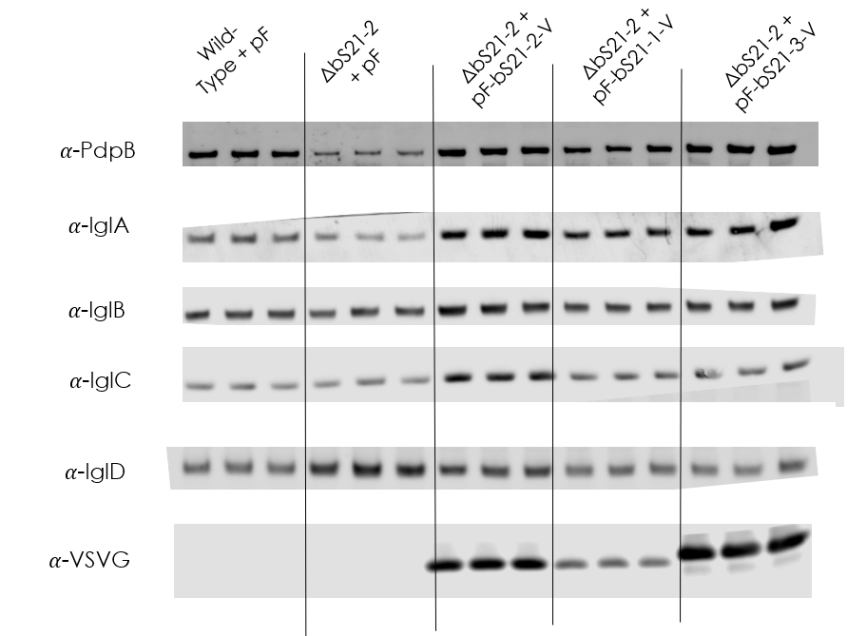
Lack of bS21-2 changes FPI protein abundance
Notes:
***Update with more up-to-date Western data if possible. Hannah- include boxes or arrows showing the ones that are significant.
So here we have antibodies for 5 of the FPI proteins and VSVG which is a tag we have on bS21 in complement strains. Looking first at Wild-type vs. our mutant, we see a significant decrease in PdpB, IglA, and IglC, and an increase in IglD. This is consistent with the mass spec data.
We also looked to see if these changes could be complemented with bS21-2 but also with overexpression of the other two bS21 homologs, and indeed we see restoration to wild-type level or beyond wild-type level with all of these complements. I do want to point out here that even though these overexpression plasmids have the same promoter, there are differences in expression of the bS21 proteins themselves.
Now in the interest of time I won’t show you this but we did confirm the RNA-seq for these genes via qPCR and found there are not significant differences in transcript abundance. Additionally, we see changes in virulence associated with loss of bS21-2, so we really want to understand the mechanism of how this happens. Before I jump into those experiments, I want to backtrack a little…

Slide 20
Percent identity matrix of bS21 homologs with S. aureus
 | bS21-1 | bS21-3 | S. aureus | bS21-2 | E. coli
bS21-1 | 100.00 | 72.31 | 37.93 | 56.67 | 52.31
bS21-3 |  | 100.00 | 37.93 | 50.00 | 50.00
S. aureus |  |  | 100.00 | 46.55 | 53.45
bS21-2 |  |  |  | 100.00 | 60.00
E. coli |  |  |  |  | 100.00
Notes:
Percent identities:

Slide 21
Loss of rpsU2 leads to alterations in MIC for some ribosome-targeting antibiotics
 | WT | ∆rpsU1 ∆rpsU3 | ∆rpsU1 ∆rpsU2 | ∆rpsU2 ∆rpsU3
Kanamycin | 6.3 | 6.3 | 6.25 | 6.25
Hygromycin | 84.4 | 84.4 | 42.19 | 42.19
Tetracycline | 4.0 | 4.0 | 2.0 | 2.0
Streptomycin | 6.3 | 6.3 | 6.3 | 6.3
All values in μg/mL

Slide 22
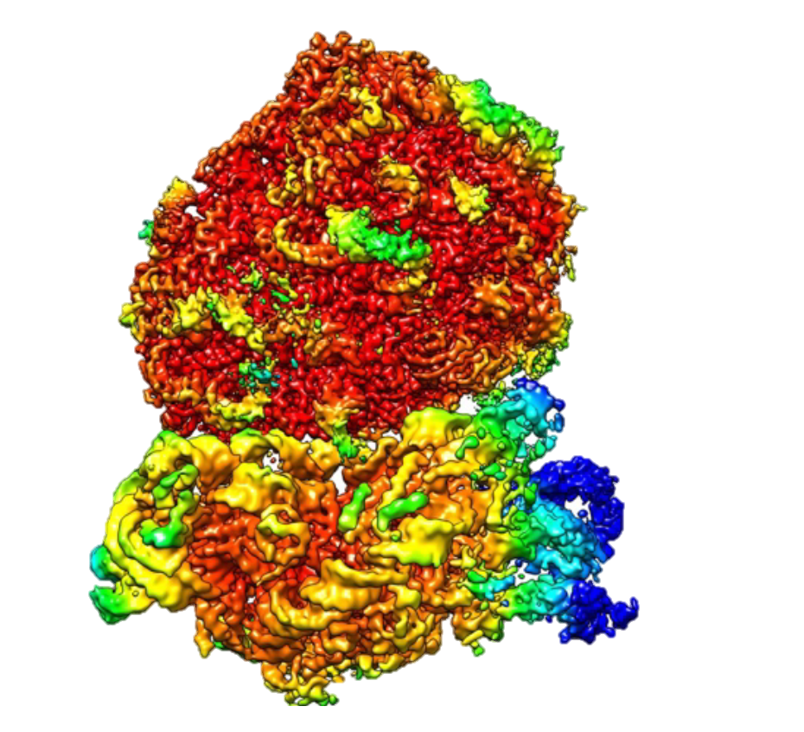


F. tularensis ribosome

Slide 23
CryoEM strategy – reconstitute subunits

Slide 24
Partial phylogenetic tree of rpsU genes
Burkholderia pseudomallei S13 bS21-1
Burkholderia pseudomallei S13 bS21-3
Burkholderia pseudomallei S13 bS21-2
F. tularensis subsp. holarctica LVS bS21-1
F. tularensis subsp. tularensis Schu4 bS21-1
F. tularensis subsp. novicida U112 bS21-1
F. tularensis subsp. holarctica LVS bS21-3
F. tularensis subsp. tularensis Schu4 bS21-3
F. tularensis subsp. novicida U112 bS21-3
F. tularensis subsp. holarctica LVS bS21-2
F. tularensis subsp. tularensis Schu4 bS21-2
F. tularensis subsp. novicida U112 bS21-2
Escherichia coli K12 bS21
Notes:
S. Aureus bS21 is VERY far away from this, definitely farther away than E. coli.

